Slide 1
Information Retrieval
Chapter 5 – tolerant retrieval - evaluation
Quoc Dinh TRUONG, PhD
Modified from Christopher D. Manning, Prabhakar Raghavan and Hinrich Schütze slides

Slide 2
Wild-card queries: *
Sec. 3.2
mon*: find all docs containing any word beginning “mon”.
Easy with binary tree lexicon: retrieve all words in range: mon ≤ w < moo
*mon: find words ending in “mon”
Maintain an additional B-tree for terms backwards.
Can retrieve all words in range: nom ≤ w < non.

Slide 3
Query processing
Sec. 3.2
At this point, we have an enumeration of all terms in the dictionary that match the wild-card query.
We still have to look up the postings for each enumerated term.
E.g., consider the query:
se*ate AND fil*er
This may result in the execution of many Boolean AND queries.

Slide 4
B-trees handle *’s at the end of a query term
Sec. 3.2
How can we handle *’s in the middle of query term (co*tion)?
We could look up co* AND *tion in a B-tree and intersect the two term sets
Expensive
The solution: transform wild-card queries so that the *’s occur at the end, this gives rise to the Permuterm Index.

Slide 5
Permuterm index
Sec. 3.2.1
For term hello, index under:
hello$, ello$h, llo$he, lo$hel, o$hell
where $ is a special symbol to mark the end of a term.
Queries
X lookup on X$ X* lookup on $X*
*X lookup on X$* *X* lookup on X*
X*Y lookup on Y$X*
Query = hel*o
X=hel, Y=o
Lookup o$hel*

Slide 6
Bigram (k-gram) indexes
Sec. 3.2.2
Enumerate all k-grams (sequence of k chars) occurring in any term
e.g., from text “April is the cruelest month” we get the 2-grams (bigrams)
$ is a special word boundary symbol
Maintain a second inverted index from bigrams to dictionary terms that match each bigram.
$a,ap,pr,ri,il,l$,$i,is,s$,$t,th,he,e$,$c,cr,ru,
ue,el,le,es,st,t$, $m,mo,on,nt,h$

Slide 7
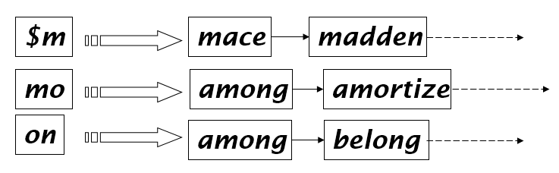
Bigram index example
Sec. 3.2.2
The k-gram index finds terms based on a query consisting of k-grams (here k=2).

Slide 8
Processing wild-cards
Sec. 3.2.2
Query mon* can now be run as
$m AND mo AND on
Gets terms that match AND version of our wildcard query.
But we’d enumerate moon. Must post-filter these terms against query.
Surviving enumerated terms are then looked up in the term-document inverted index.

Slide 9
Spell correction
Sec. 3.3
Two principal uses
Correcting document(s) being indexed
Correcting user queries to retrieve “right” answers
Two main flavors
Isolated word
Check each word on its own for misspelling
Will not catch typos resulting in correctly spelled words, e.g., from → form
Context-sensitive
Look at surrounding words, e.g., I flew form Heathrow to Narita.

Slide 10
Document correction
Sec. 3.3
Especially needed for OCR’ed documents
Correction algorithms are tuned for this: “rn” / ”m”
Can use domain-specific knowledge
E.g., OCR can confuse O and D more often than it would confuse O and I (adjacent on the QWERTY keyboard, so more likely interchanged in typing).
But also: web pages and even printed material has typos
Goal: the dictionary contains fewer misspellings

Slide 11
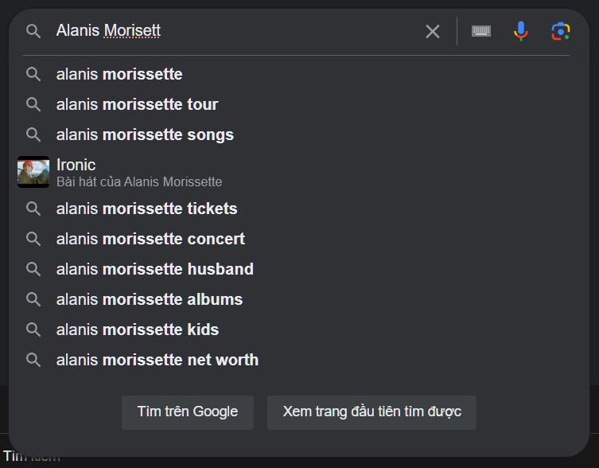
Query mis-spellings
Sec. 3.3
Our principal focus here
E.g., the query Alanis Morisett
We can either
Retrieve documents indexed by the correct spelling, OR
Return several suggested alternative queries with the correct spelling
Did you mean … ?

Slide 12
Isolated word correction
Sec. 3.3.2
Fundamental premise – there is a lexicon from which the correct spellings come.
Two basic choices for this
A standard lexicon such as
Webster’s English Dictionary; An “industry-specific” lexicon – hand-maintained
The lexicon of the indexed corpus
E.g., all words on the web; All names, acronyms etc.
(Including the mis-spellings)

Slide 13
Isolated word correction
Sec. 3.3.2
Given a lexicon and a character sequence Q, return the words in the lexicon closest to Q.
What’s “closest”?
We’ll study several alternatives
Edit distance (Levenshtein distance)
Weighted edit distance
n-gram overlap

Slide 14
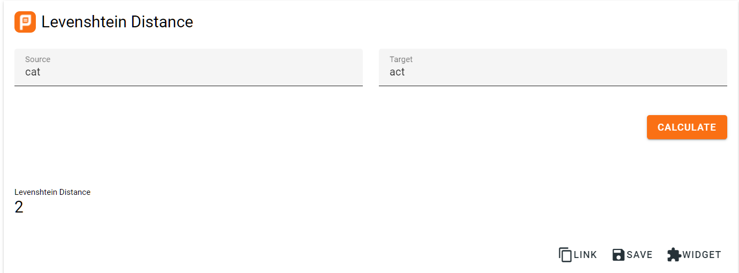
Edit distance
Sec. 3.3.3
Given two strings S₁ and S₂, the minimum number of operations to convert one to the other.
Operations are typically character-level
Insert, Delete, Replace, (Transposition)
E.g., the edit distance from dof to dog is 1
From cat to act is 2 (Just 1 with transpose.)
from cat to dog is 3.
Generally found by dynamic programming.
See https://planetcalc.com/1721/ for a nice example.

Slide 15
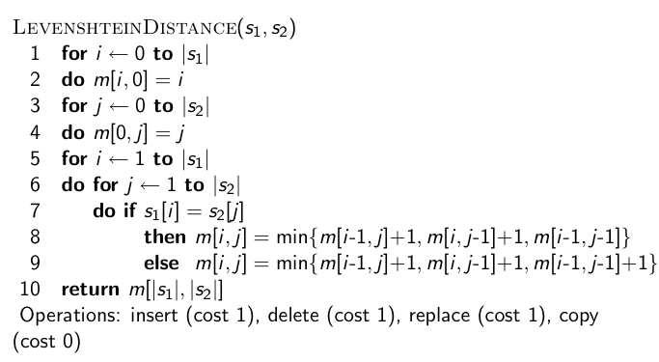
Dynamic programming algorithm for edit distance

Slide 16
Weighted edit distance
Sec. 3.3.3
As above, but the weight of an operation depends on the character(s) involved
Meant to capture OCR or keyboard errors, e.g. m more likely to be mis-typed as n than as q
Therefore, replacing m by n is a smaller edit distance than by q
Requires weight matrix as input
Modify dynamic programming to handle weights

Slide 17
Edit distance to all dictionary terms?
Sec. 3.3.4
Given a (mis-spelled) query – do we compute its edit distance to every dictionary term?
Expensive and slow
Alternative?
How do we cut the set of candidate dictionary terms?
One possibility is to use n-gram overlap for this.
This can also be used by itself for spelling correction.

Slide 18
n-gram overlap
Sec. 3.3.4
Enumerate all the n-grams in the query string as well as in the lexicon.
Use the n-gram index to retrieve all lexicon terms matching any of the query n-grams.
Threshold by number of matching n-grams
Variants – weight by keyboard layout, etc.

Slide 19
Example with trigrams
Sec. 3.3.4
Suppose the text is november
Trigrams are nov, ove, vem, emb, mbe, ber.
The query is december
Trigrams are dec, ece, cem, emb, mbe, ber.
So 3 trigrams overlap (of 6 in each term)
How can we turn this into a normalized measure of overlap?

Slide 20
One option – Jaccard coefficient
Sec. 3.3.4
A commonly-used measure of overlap
Always assigns a number between 0 and 1
Now threshold to decide if you have a match
E.g., if J.C. > 0.8, declare a match

Slide 21
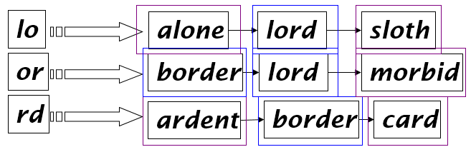
Matching trigrams
Sec. 3.3.4
Consider the query lord – we wish to identify words matching 2 of its 3 bigrams (lo, or, rd)

Slide 22
Context-sensitive spell correction
Sec. 3.3.5
Text: I flew from Heathrow to Narita.
Consider the phrase query “flew form Heathrow”
We’d like to respond
Did you mean “flew from Heathrow”?
because no docs matched the query phrase.

Slide 23
Context-sensitive correction
Sec. 3.3.5
Need surrounding context to catch this.
First idea: retrieve dictionary terms close (in weighted edit distance) to each query term.
Now try all possible resulting phrases with one word “fixed” at a time
flew from heathrow
fled form heathrow
flea form heathrow
Hit-based spelling correction: Suggest the alternative that has lots of hits.

Slide 24
General issues in spell correction
Sec. 3.3.5
We enumerate multiple alternatives for “Did you mean?”
Need to figure out which to present to the user
Use heuristics
The alternative hitting most docs
Query log analysis + tweaking
Spell-correction is computationally expensive
Run only on queries that matched few docs

Slide 25
Measures for a search engine
Sec. 8.6
How fast does it index
Number of documents/hour (Average document size)
How fast does it search
Latency as a function of index size
Expressiveness of query language
Ability to express complex information needs
UI
Is it free?

Slide 26
Measures for a search engine
Sec. 8.6
All of the preceding criteria are measurable: we can quantify speed/size.
The key measure: user happiness
What is this?
Speed of response/size of index are factors
But blindingly fast, useless answers won’t make a user happy
Need a way of quantifying user happiness.

Slide 27
Measuring user happiness
Sec. 8.6.2
Issue: who is the user we are trying to make happy?
Web engine:
User finds what they want and return to the engine
User completes their task – search as a means, not end
eCommerce site: user finds what they want and buy
Is it the end-user, or the eCommerce site, whose happiness we measure?
Measure time to purchase, or fraction of searchers who become buyers?

Slide 28
Happiness: elusive to measure
Sec. 8.1
Most common proxy: relevance of search results
But how do you measure relevance?
Relevance measurement requires 3 elements:
A benchmark document collection
A benchmark suite of queries
A usually binary assessment of either Relevant or Nonrelevant for each query and each document.

Slide 29
Evaluating an IR system
Sec. 8.1
Note: the information need is translated into a query
Relevance is assessed relative to the information need not the query
E.g., Information need: I'm looking for information on whether drinking red wine is more effective at reducing your risk of heart attacks than white wine.
Query: wine red white heart attack effective
We evaluate whether the doc addresses the information need, not whether it has these words.

Slide 30
Standard relevance benchmarks
Sec. 8.2
TREC - National Institute of Standards and Technology (NIST) has run a large IR test bed for many years.
Reuters and other benchmark doc collections used.
“Retrieval tasks” specified
sometimes as queries
Human experts mark, for each query and for each doc, Relevant or Nonrelevant.

Slide 31
Unranked retrieval evaluation: Precision and Recall
Sec. 8.3
Precision: fraction of retrieved docs that are relevant = P(relevant|retrieved)
Recall: fraction of relevant docs that are retrieved = P(retrieved|relevant)
Precision P = tp/(tp + fp)
Recall R = tp/(tp + fn)
 | Relevant | Nonrelevant
Retrieved | tp | fp
Not Retrieved | fn | tn

Slide 32
Should we instead use the accuracy measure for evaluation?
Sec. 8.3
Given a query, an engine classifies each doc as “Relevant” or “Nonrelevant”
The accuracy of an engine: the fraction of these classifications that are correct
Accuracy = (tp + tn) / (tp + fp + fn + tn)
Accuracy is a commonly used evaluation measure in machine learning classification work
Why is this not a very useful evaluation measure in IR?

Slide 33
Precision/Recall
Sec. 8.3
We can get high recall (but low precision) by retrieving all docs for all queries!
Recall is a non-decreasing function of the number of docs retrieved.
In a good system, precision decreases as either the number of docs retrieved or recall increases.
This is not a theorem, but a result with strong empirical confirmation

Slide 34
Difficulties in using precision/recall
Sec. 8.3
Should average over large document collection/query ensembles.
Need human relevance assessments.
People aren’t reliable assessors
Assessments have to be binary.
Heavily skewed by collection/authorship
Results may not translate from one domain to another

Slide 35
A combined measure: F
Sec. 8.3
Combined measure that assesses precision/recall tradeoff is F measure (weighted harmonic mean):
People usually use balanced F₁ measure
i.e., with β = 1 or α = ½

Slide 36
Evaluating ranked results
Sec. 8.4
Evaluation of ranked results:
The system can return any number of results.
By taking various numbers of the top returned documents (levels of recall), the evaluator can produce a precision-recall curve.

Slide 37
A precision-recall curve
Sec. 8.4

Slide 38
Averaging over queries
Sec. 8.4
A precision-recall graph for one query isn’t a very sensible thing to look at.
We need to average performance over a whole bunch of queries.
But there’s a technical issue:
Precision-recall calculations place some points on the graph.
How do you determine a value (interpolate) between the points?

Slide 39
Evaluation
Sec. 8.4
Precision at fixed retrieval level
Precision-at-k: Precision of top k results
Perhaps appropriate for most of web search: all people want are good matches on the first one or two results pages
11-point interpolated average precision
The standard measure in the early TREC competitions: you take the precision at 11 levels of recall varying from 0 to 1 by tenths of the documents, using interpolation (the value for 0 is always interpolated!), and average them

Slide 40
Typical (good) 11 point precisions
Sec. 8.4
SabIR/Cornell 8A1 11pt precision from TREC 8 (1999)

Slide 41

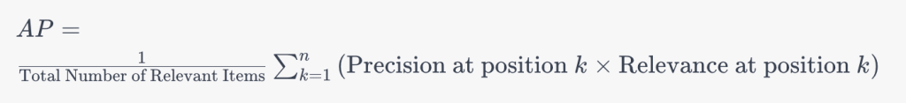
Yet more evaluation measures…
Sec. 8.4
Mean average precision (mAP)
Average of the precision value obtained for the top k documents, each time a relevant doc is retrieved.
R-precision
Precision of top Rel docs returned, perfect system could score 1.0.

Slide 42
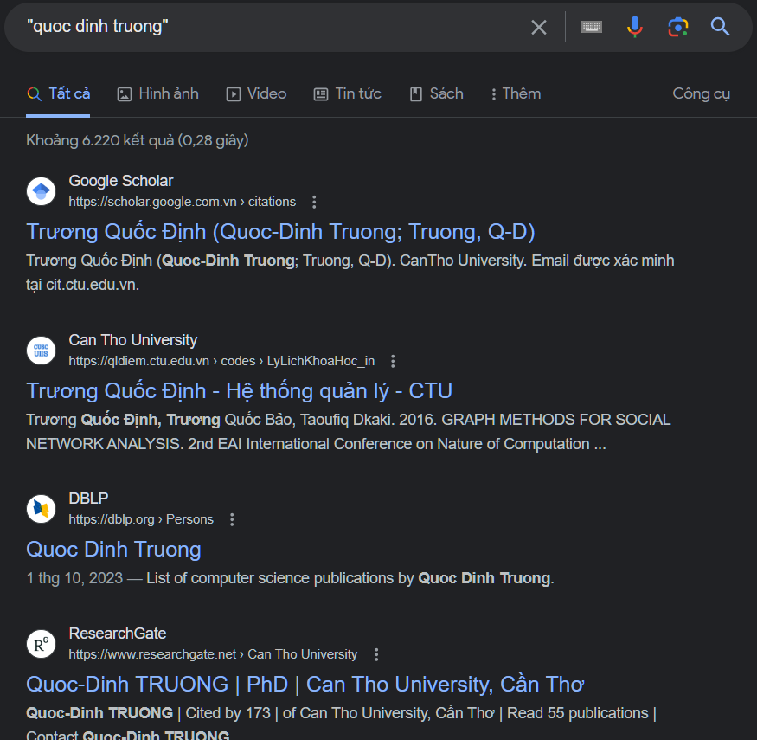
Result Presentation
Sec. 8.7
Having ranked the documents matching a query, we wish to present a results list.
Most commonly, a list of the document titles plus a short summary, aka “10 blue links”.

Slide 43
Summaries
Sec. 8.7
The title is often automatically extracted from document metadata. What about the summaries?
This description is crucial, User can identify good/relevant hits based on description.
Two basic kinds: Static vs Dynamic
A static summary of a document is always the same, regardless of the query that hit the doc
A dynamic summary is a query-dependent attempt to explain why the document was retrieved for the query at hand.

Slide 44
Static summaries
Sec. 8.7
In typical systems, the static summary is a subset of the document.
Simplest heuristic: the first 50 (or so – this can be varied) words of the document
More sophisticated: extract from each document a set of “key” sentences.
Most sophisticated: NLP used to synthesize a summary
Seldom used in IR; cf. text summarization work.

Slide 45


Dynamic summaries
Sec. 8.7
Present one or more “windows” within the document that contain several of the query terms.
“KWIC” snippets: Keyword in Context presentation

Slide 46
Techniques for dynamic summaries
Sec. 8.7
Find small windows in doc that contain query terms
Requires fast window lookup in a document cache
Score each window wrt query
Use various features such as window width, position in document, etc.
Challenges in evaluation: judging summaries
Easier to do pairwise comparisons rather than binary relevance assessments

