Slide 1

VIETNAM INTERNATIONAL UNIVERSITY – HO CHI MINH CITY
INTERNATIONAL UNIVERSITY
WEB APPLICATION DEVELOPMENT PROJECT
E-Commerce Project
Members of Group:
Lê Thành Đại Dương_ITITUN14002
Vương Khắc Duy_ITITUN14010
Ninh Thế Lâm_ ITITUN14007
GitHub Link: https://github.com/tieuduong241096/2017S2-WEB_LAB-

Slide 2
Out Line
Features and description
Database design for these features
Class diagram for these features
Sequence diagram for these features

Slide 3
Features and description
Product Recommendation
Purchase history
Search product

Slide 4
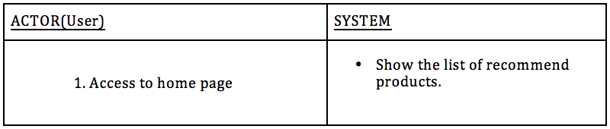
Product Recommendation

Slide 5
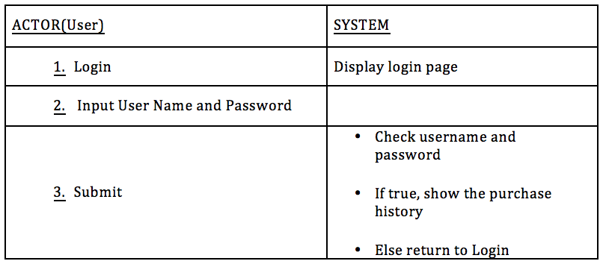
b. Purchase History

Slide 6
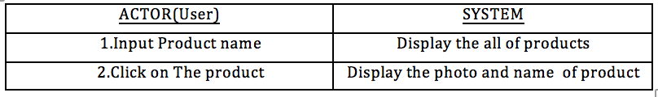
c. Search Product

Slide 7
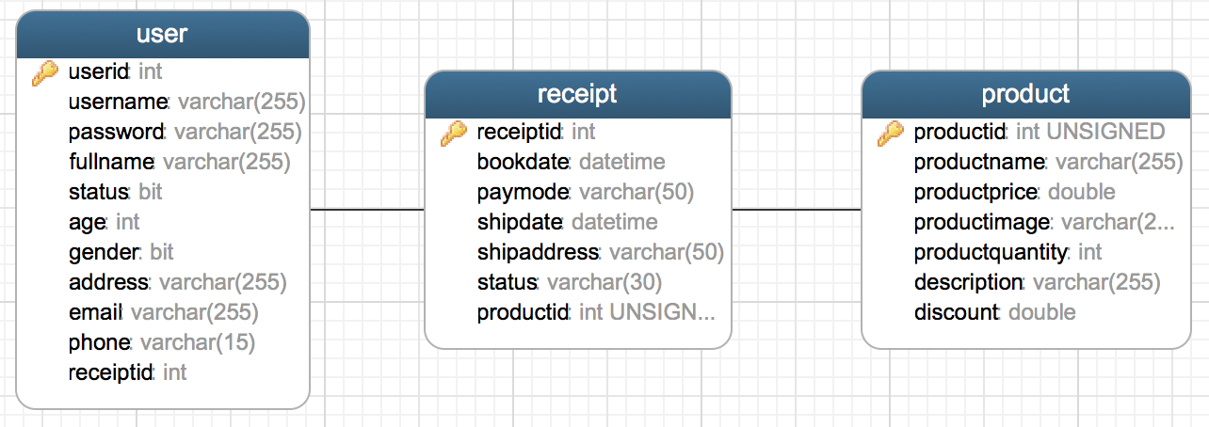
B. Database Design

Slide 8
C. Class Diagram
Purchase History
Search & Recommend Product
Receipt Detail Product
bookDate: Timestamp payMode: String shipAddress: String quantity: Integer price: Double size: Double productID: Product
getBookDate(): Timestamp setBookDate( bookDate: Timestamp ): void getPayMode(): String setPayMode( payMode: String ): void getShipAddress(): String setShipAddress( shipAddress: String ): void getQuantity(): Integer setQuantity( quantity: Integer ): void getPrice( ) : Double setPrice( price: Double ) : void getSize(): Double setSize( size: Double) : void getProductName(): String setProductName( productName: String ): void
Product
ProductID: Integer productName: String productPrice: Double productImage: String productQuantity: Integer description: String discount: Double count: Integer
etProductID(): Integer setProductID(productID : Integer): void getProductName(): String setProductName( productName: String): void getProductPrice(): Double setProductPrice( productPrice: Double ): void getProductImage(): String setProductImage( productImage: String): void getProductQuangtity(): Integer setProductQuantity( productQuantity: Integer): void getDescription(): String setDescrption( description: String): void getDiscount(): Double setDiscount( discount: Double): void getCount(): Integer setCount( countNumber: Integer): void

Slide 9
D. Sequence Diagram

Slide 10
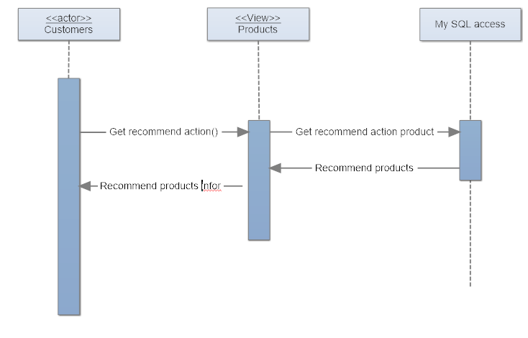
Recommend product

Slide 11
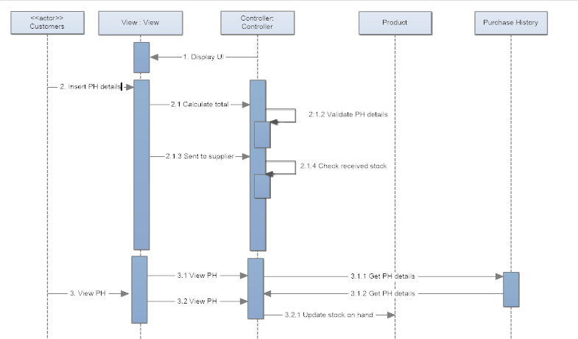
b. Purchase History

Slide 12
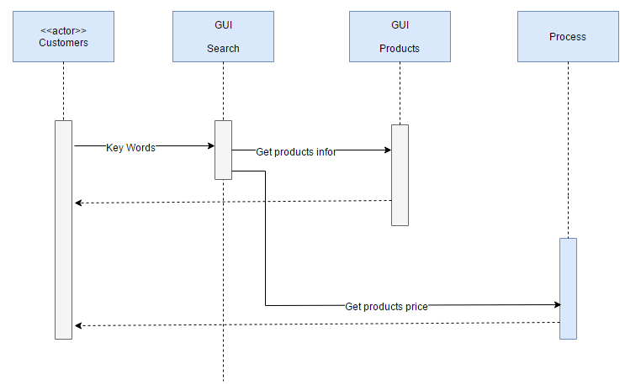
c. Search Product

Slide 13
DEMO Search Function

Slide 14


