Slide 1

VIETNAM INTERNATIONAL UNIVERSITY – HO CHI MINH CITY
INTERNATIONAL UNIVERSITY
WEB APPLICATION DEVELOPMENT PROJECT
SHOES SHOPPING ONLINE
Members of Group:
Lê Thành Đại Dương_ITITUN14002
Vương Khắc Duy_ITITUN14010
Ninh Thế Lâm_ ITITUN14007
GitHub Link: https://github.com/tieuduong241096/2017S2-WEB_LAB-

Slide 2
Out Line
Features and description
Database design for these features
Class diagram for these features
Sequence diagram for these features

Slide 3
a) Features and description
Recommend product
Purchase history
Research product

Slide 4
b) Database design for features

Slide 5
c) Class Diagram

Slide 6
d) Sequence diagram for these features

Slide 7
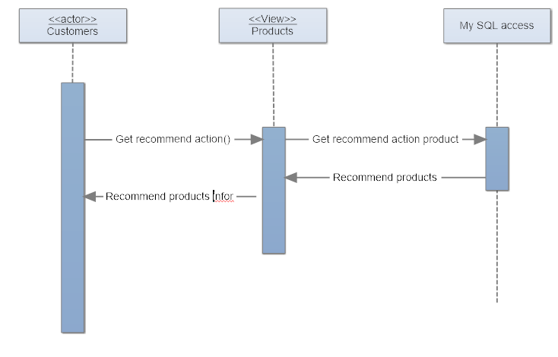
Recommend product

Slide 8
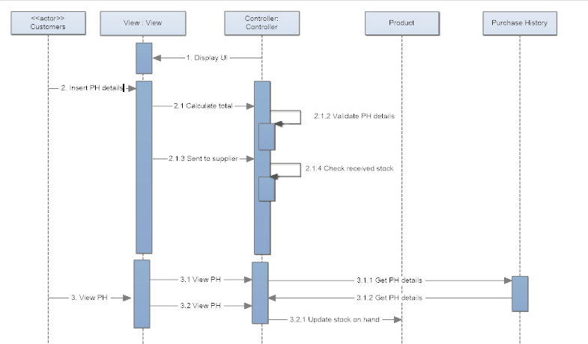
II. Purchase History

Slide 9
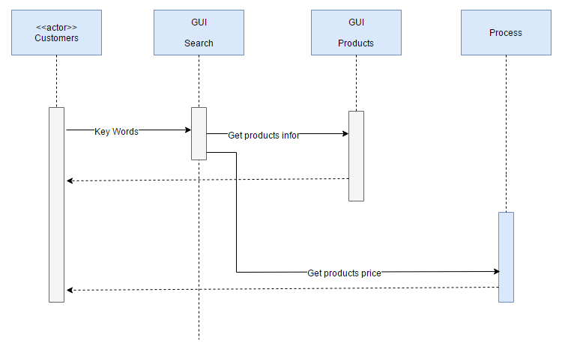
III. Search product

Slide 10


