Slide 1

VIETNAM INTERNATIONAL UNIVERSITY – HO CHI MINH CITY
INTERNATIONAL UNIVERSITY
WEB APPLICATION DEVELOPMENT PROJECT
SHOES SHOPPING ONLINE
Members of Group:
Lê Thành Đại Dương_ITITUN14002
Vương Khắc Duy_ITITUN14010
Ninh Thế Lâm_ ITITUN14007
GitHub Link: https://github.com/tieuduong241096/2017S2-WEB_LAB-

Slide 2
Out Line
Features and description
Database design for these features
Class diagram for these features
Sequence diagram for these features

Slide 3
a) Features and description
Recommend product
Purchase history
Research product

Slide 4
b) Database design for features

Slide 5
Recommerce

Slide 6
PURCHASE HISTORY
Field name | Type (size) | Identity | NULL | PK | FK | References | Description
ReceiptDetailID | int | yes | no | PK |  |  | Receipt Detail identity number
Quantity | int |  | no |  |  |  | User’s prefered quantity
price | double |  | no |  |  |  | Total Price (productPrice * quantity)
ReceiptID | int |  | no |  | FK | Receipt(ReceiptID | one receipt has many receipt detail
ProductID | int |  | no |  | FK | Product(ProductID) | One receipt detail has many product
size | double |  | no |  |  |  | User’s prefered shoe size
date | Dd//mm/yy |  | no |  |  |  | Booking date

Slide 7
Research products

Slide 8
c) Class Diagram

Slide 9
Product
ProductID: Integer productName: String productPrice: Double productImage: String productQuantity: Integer description: String discount: Double count: Integer
etProductID(): Integer setProductID(productID : Integer): void getProductName(): String setProductName( productName: String): void getProductPrice(): Double setProductPrice( productPrice: Double ): void getProductImage(): String setProductImage( productImage: String): void getProductQuangtity(): Integer setProductQuantity( productQuantity: Integer): void getDescription(): String setDescrption( description: String): void getDiscount(): Double setDiscount( discount: Double): void getCount(): Integer setCount( countNumber: Integer): void
Recommend products

Slide 10
Product
ProductID: Integer productName: String productPrice: Double productImage: String productQuantity: Integer description: String discount: Double count: Integer
getProductID(): Integer setProductID(productID : Integer): void getProductName(): String setProductName( productName: String): void getProductPrice(): Double setProductPrice( productPrice: Double ): void getProductImage(): String setProductImage( productImage: String): void getProductQuangtity(): Integer setProductQuantity( productQuantity: Integer): void getDescription(): String setDescrption( description: String): void getDiscount(): Double setDiscount( discount: Double): void getCount(): Integer setCount( countNumber: Integer ): void
Search Product

Slide 11
Receipt Detail Product
bookDate: Timestamp payMode: String shipAddress: String quantity: Integer price: Double size: Double productName: String
getBookDate(): Timestamp setBookDate( bookDate: Timestamp ): void getPayMode(): String setPayMode( payMode: String ): void getShipAddress(): String setShipAddress( shipAddress: String ): void getQuantity(): Integer setQuantity( quantity: Integer ): void getPrice( ) : Double setPrice( price: Double ) : void getSize(): Double setSize( size: Double) : void getProductName(): String setProductName( productName: String ): void
Purchase History

Slide 12
d) Sequence diagram for these features

Slide 13
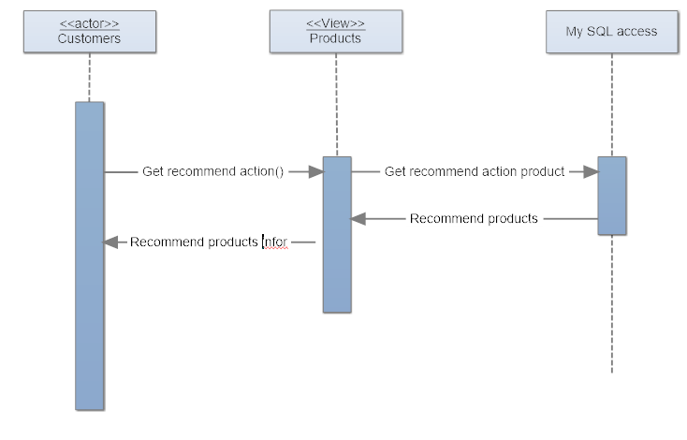
Recommend product

Slide 14
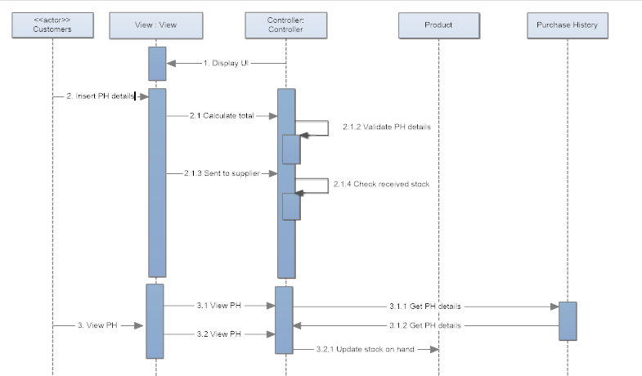
II. Purchase History

Slide 15
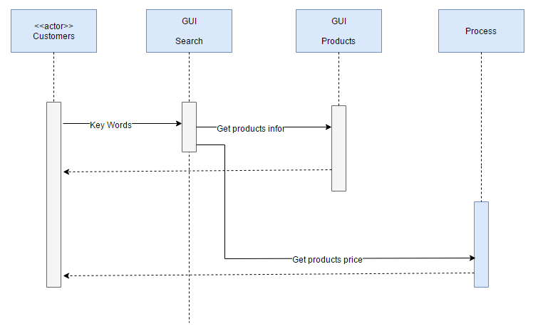
III. Search product

Slide 16


