Slide 1

Chapter 18
How to deploy a web site
on a web server
Notes:
Session: Ghi số thứ tự session trong môn học
Session Name: ghi tên của session sẽ dạy

Slide 2
Objectives
How to get a web host and domain name
How to transfer files to and from the web
Four more skills for deploying a web site
Notes:
Mô tả nội dung mà học viên phải đạt được khi kết thúc môn học này

Slide 3
How to get a web host and domain name

Slide 4
How to find a web host
A web host, or web hosting services, provides space on a server computer that’s connected to the Internet
File Transfer Protocol (FTP) allow you to transfer the file for your web site to and from your web host
An Internet Service Provider (ISP) often include free web hosting as part of its monthly fees
Notes:
Mô tả nội dung chi tiết từng chuyên đề

Slide 5
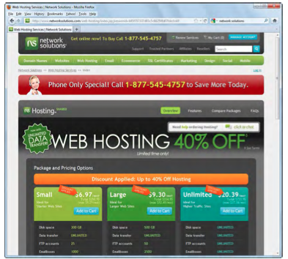
A web host
Notes:
Mô tả nội dung chi tiết từng chuyên đề

Slide 6
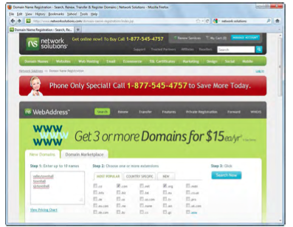
How to get a domain name
A domain name is a user-friendly name that’s used to locate a resource that’s connected to the internet.
A search for a domain name

Slide 7
How to transfer files to and from the web

Slide 8
How to install FileZilla Client
Filezilla is a free FTP client application that runs on the Window, Mac, and Linux operating systems
FileZilla supports basic FTP as well as FTP over SSL/TLS (FTPS) and SSH File Transfer Protocol (SFTP)
How to install File Client
An FTP program

Slide 9
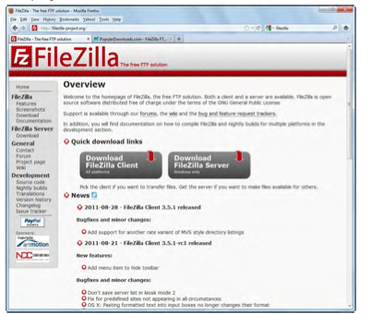
FileZilla software

Slide 10
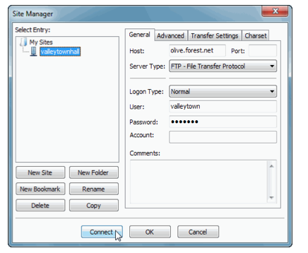
How to connect to a web site on a remote web server
FileZilla Site Manager dialog box

Slide 11
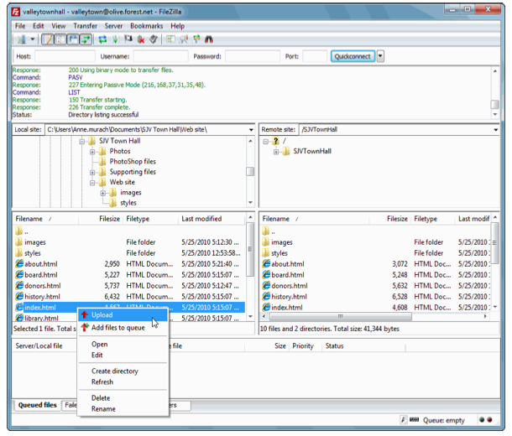
How to upload and download files
FileZilla when it is connected to a web host

Slide 12
Four more skills for deploying a web site

Slide 13
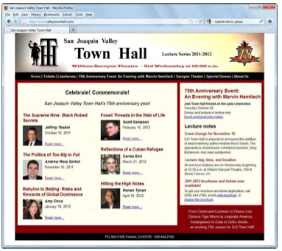
How to test a web site that has been upload to the web server
A web site on the internet

Slide 14
How to test a web site that has been upload to the web server
Test a web page that you’re just added to your site
Start your browser, go to the home page, and navigate to the new page.
Review content for the page, and make sure it’s all there and it is all work.
Test all the link on the page.
Retest the page in all of the other browser

Slide 15
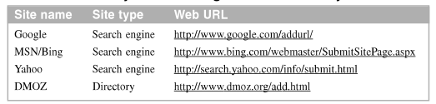
How to get your web site into search engines and directories
The URLs for the major search engines and directory

Slide 16
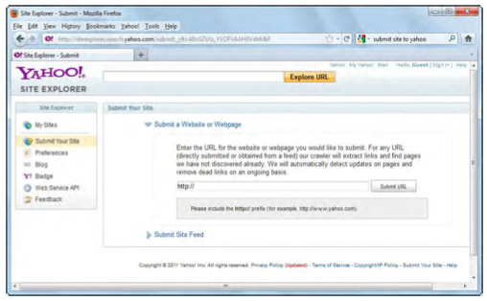
The Yahoo! Page for submitting your site

Slide 17
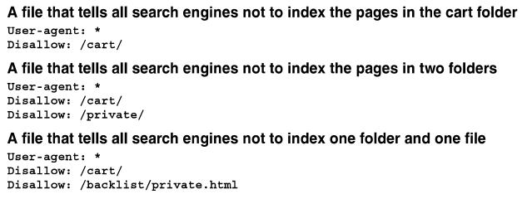
How to control which pages are indexed and visited
Three robots.txt files

Slide 18
How to control which pages are indexed and visited
A meta tag that tells a robot not to index a page or follow its links
A meta tag that redirects the user from a deleted page to a current page
How to control which page are indexed
How to control which pages are visited from the search results

Slide 19
How to maintain a healthy website
After deployed website, test and ready to be accessed by anyone on the Internet. You need to monitor to maintain a healthy website.
Google webmaster tool is a good tool help you monitor healthy your website.

Slide 20
Summary
To deploy (or publish) a web site, use web host or web hosting services
Use FTP to transfer the files
An IP address uniquely identifies a web site
Find domain name
Upload and download file from your web server
Get your web site into a search engine
You need to maintain a healthy website
Notes:
Tóm tắt lại nội dung đã học

