Slide 1

Chapter 14
How to work with closures,
callbacks, and recursion
Notes:
Session: Ghi số thứ tự session trong môn học
Session Name: ghi tên của session sẽ dạy

Slide 2
Objectives
Introduction to closures
How to use closures
The Slide Show application
How to use callbacks
How to use recursion
The Task Manager application
Notes:
Mô tả nội dung mà học viên phải đạt được khi kết thúc môn học này

Slide 3
How to use closures
Notes:
Session: Ghi số thứ tự session trong môn học
Session Name: ghi tên của session sẽ dạy

Slide 4
How the scope chain works
The scope chain in JavaScript refers to what is in scope, or what can be seen and used by other objects.
The scope chain starts with global scope and move down.
Object that are created within other objects have access to their own scope, and the scope of the object that contains them.

Slide 5
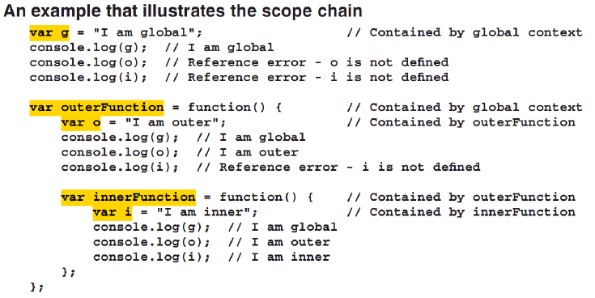
Scope chain example

Slide 6
Introduction to closures
Closure is a function which is created in another function(parent function). It can access the object in parent function even the parent function has finished executing and is out of scope.
Clouse are a powerful feature of JavaScript language and they are common used in many framework.

Slide 7
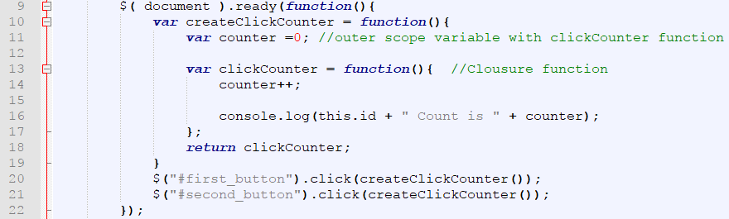
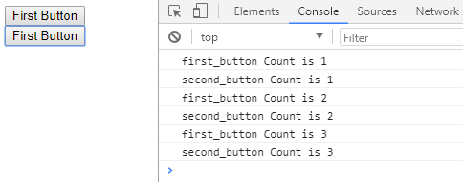
How closures work
An example that illustrates a closure
Result in console when you click on buttons

Slide 8
How closures work (cont.)
When we click a button, look at return statement in line 18, it call clickCounter function. In this time the createClickCounter was finish but clickCounter function still can access counter variable in this function.
Look at the result in console, it can separate the counter variable private for each event handler. It is advanced of closure.

Slide 9
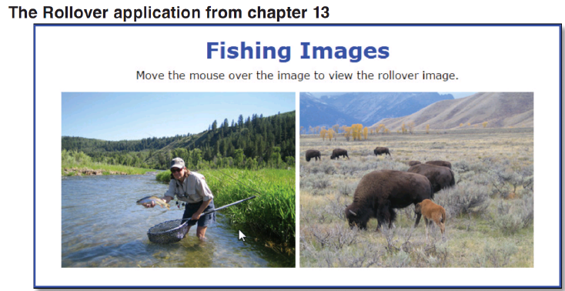
Closures in the Rollover application

Slide 10
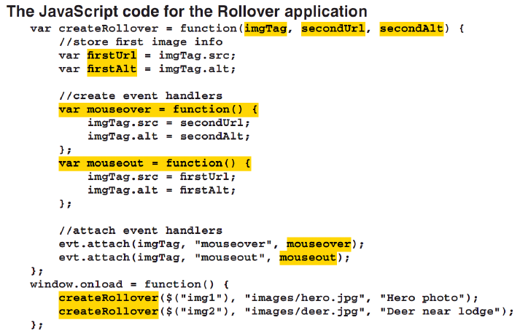
Closures in the Rollover application

Slide 11
How to use closures
Notes:
Session: Ghi số thứ tự session trong môn học
Session Name: ghi tên của session sẽ dạy

Slide 12
How to use closures to create private state
All the properties and methods of JavaScript objects are publically available. That means that an object’s critical properties and methods can be overwritten.
To protect an object’s properties and methods, you can use closures to create private state.

Slide 13
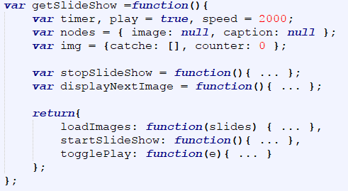

How to use closures to create private state
A function that creates a closure with private state
Code that create and uses the slideshow object

Slide 14
How to work with the this keyword in closures
Although an inner function has access to the variables in the outer function that contains it, each function has its own this keyword.
If an inner function needs access to the outer function’s this keyword, the outer function can pass it use the bind() method of the inner function.
Sometimes, an inner function needs access to both the outer function this keyword and it’s own this keyword. The outer function can store the value of this in a variable.

Slide 15
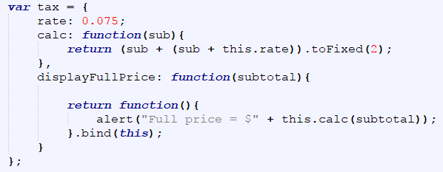
How to work with the this keyword in closures (cont.)
How to use the bind() method to set the value of an inner function this keyword
Attach the inner function as an event handler for a button

Slide 16
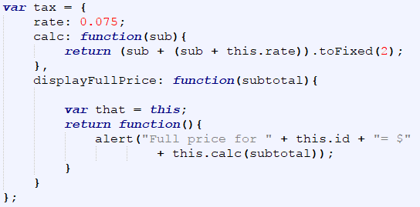
How to work with the this keyword in closures (cont.)
How to use a variable to store the value of an outer function this keyword
Attach the inner function as an event handler for a button

Slide 17
The Slide Show application
Notes:
Session: Ghi số thứ tự session trong môn học
Session Name: ghi tên của session sẽ dạy

Slide 18

The Slide Show application
The User Interface

Slide 19
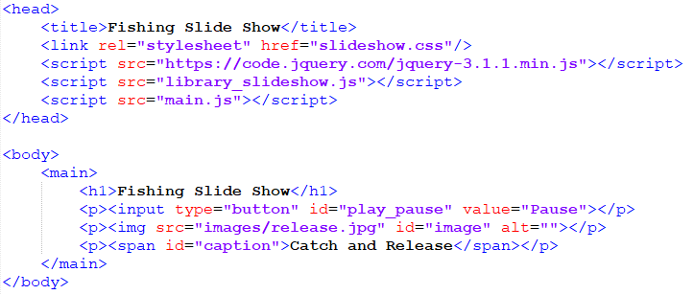
The Slide Show application
The HTML code

Slide 20
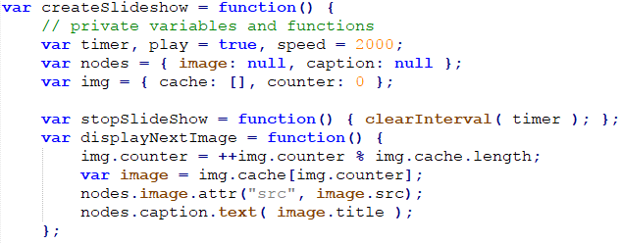
The Slide Show application
The JavaScript code – library_slideshow.js file

Slide 21
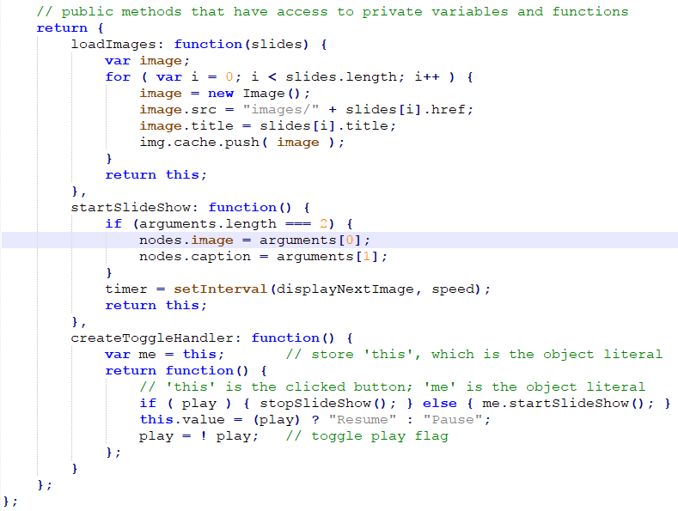
The Slide Show application
The JavaScript code – library_slideshow.js file

Slide 22
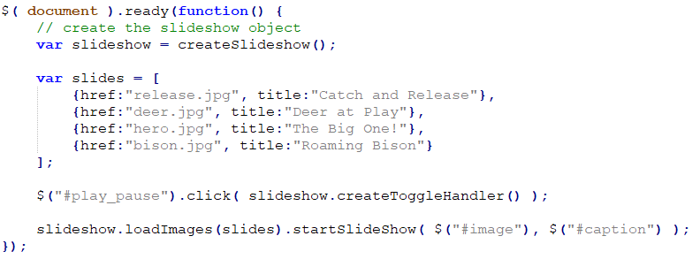
The Slide Show application
The JavaScript code – main.js file

Slide 23
How to use callbacks
Notes:
Session: Ghi số thứ tự session trong môn học
Session Name: ghi tên của session sẽ dạy

Slide 24
Introduction to callbacks functions
In JavaScript, functions are objects. That means they can be returned by other functions and passed as argument to other function.
A function that is passed to other function is a callback function.
When a function is passed as an argument, only its definition is passed. The function itself will be called later, by the function that be receives it. This is similar to assigning a function as an event handler.

Slide 25
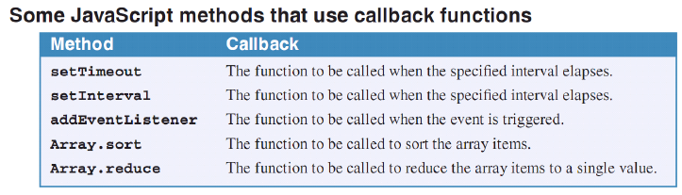
Introduction to callbacks functions (cont.)

Slide 26
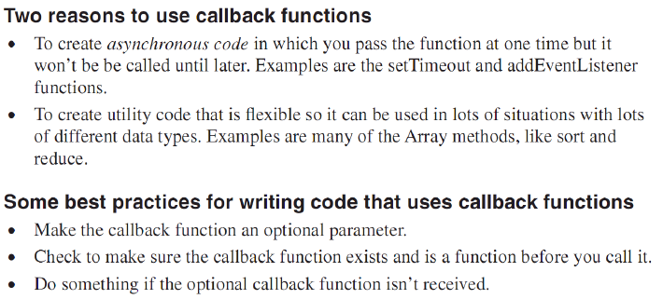
Introduction to callbacks functions (cont.)

Slide 27
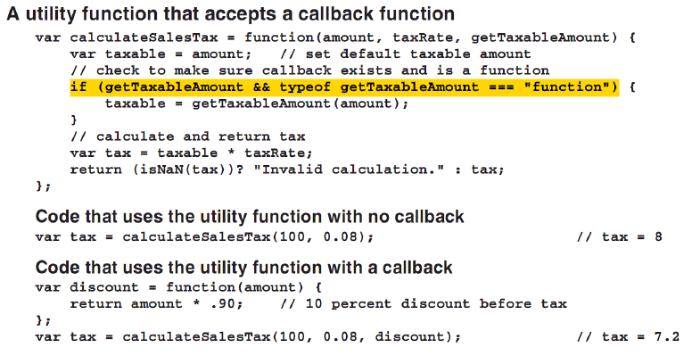
How to create and use callback functions

Slide 28
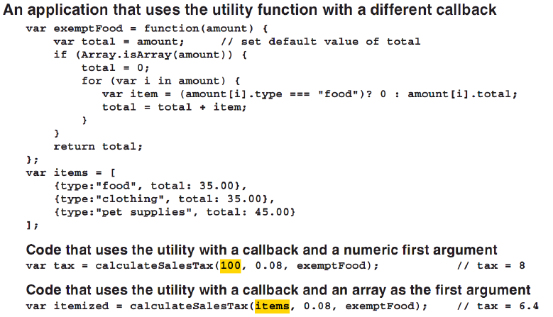
How to create and use callback functions (cont.)

Slide 29
How to work with the this keyword in callback functions
If the callback function use this keyword, you can use the call, apply or bind method to set it value.
This can help you create and use callback function with optional functionality, like logging or displaying data.
The function that receives an invokes the callback function can use the call or apply method to set the value of the callback this keyword.

Slide 30
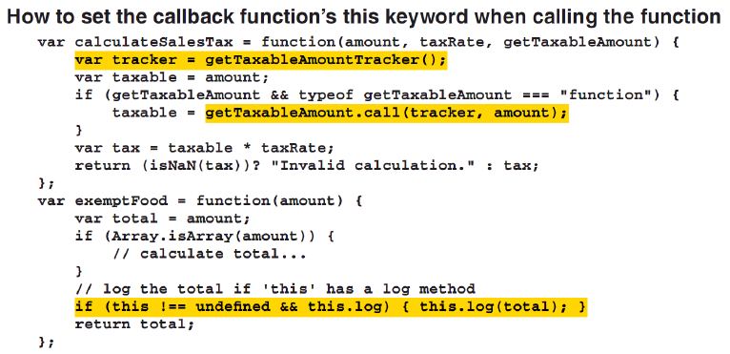
How to work with the this keyword in callback functions (cont.)

Slide 31
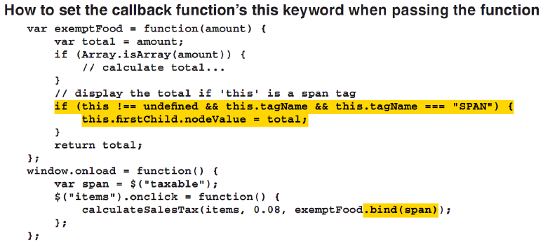
How to work with the this keyword in callback functions (cont.)

Slide 32
How to use recursion
Notes:
Session: Ghi số thứ tự session trong môn học
Session Name: ghi tên của session sẽ dạy

Slide 33
Introduction to recursion
Recursion is a form of iteration in which a function repeatedly call itself.
Recursion is often used with hierarchical data, like DOM, and extremely large arrays.
You can also use recursion if you think it make your code is easier to understand.

Slide 34
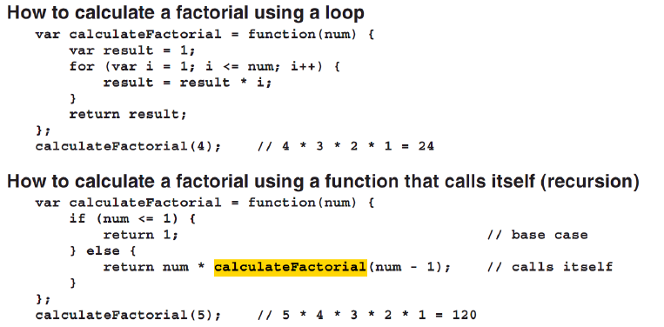
How recursion works

Slide 35
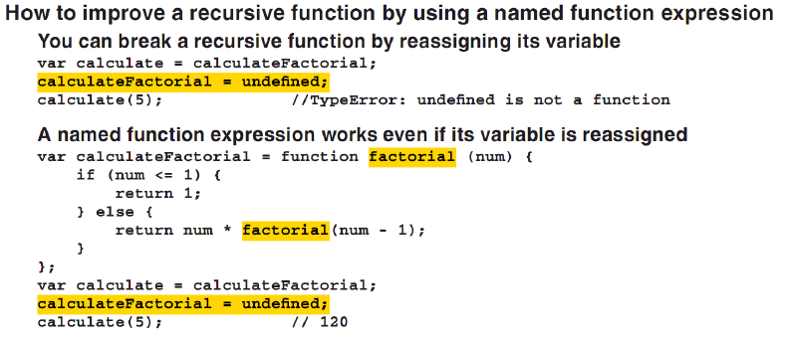
How recursion works(cont.)

Slide 36
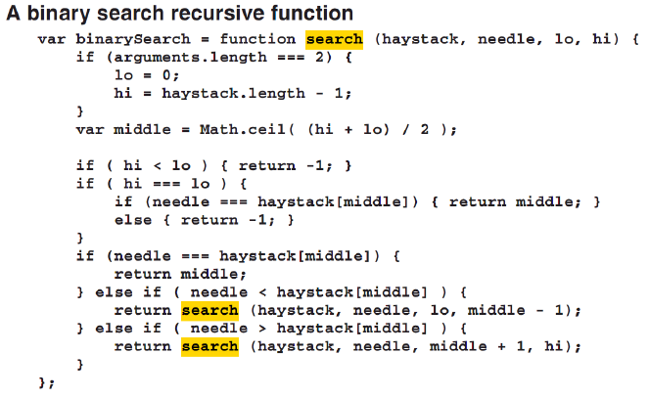
How to code and use a binary search recursive function

Slide 37
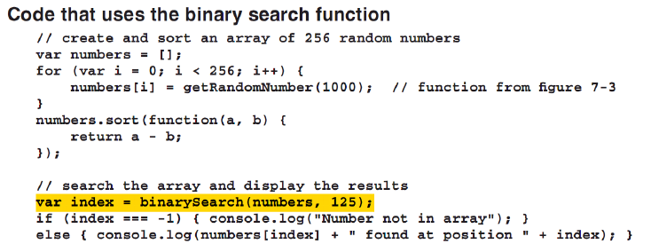
How to code and use a binary search recursive function(cont.)

Slide 38
The Task Manager application
Notes:
Session: Ghi số thứ tự session trong môn học
Session Name: ghi tên của session sẽ dạy

Slide 39
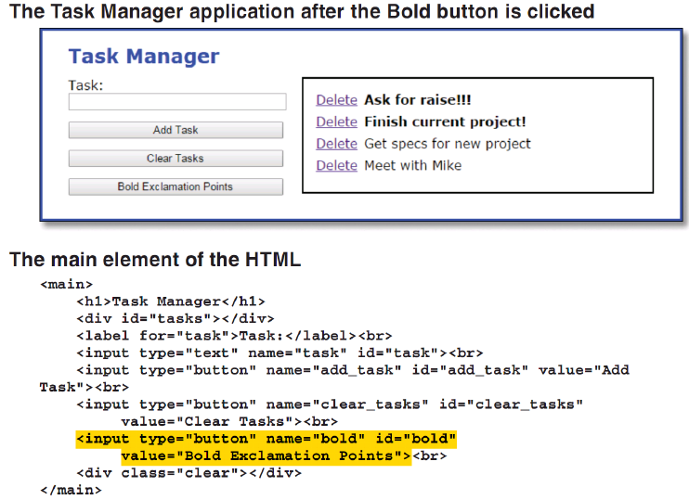
The Task Manager application

Slide 40
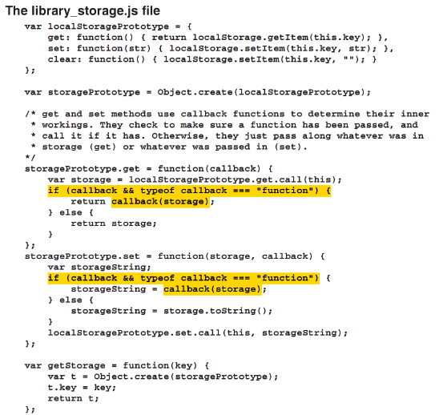

Slide 41
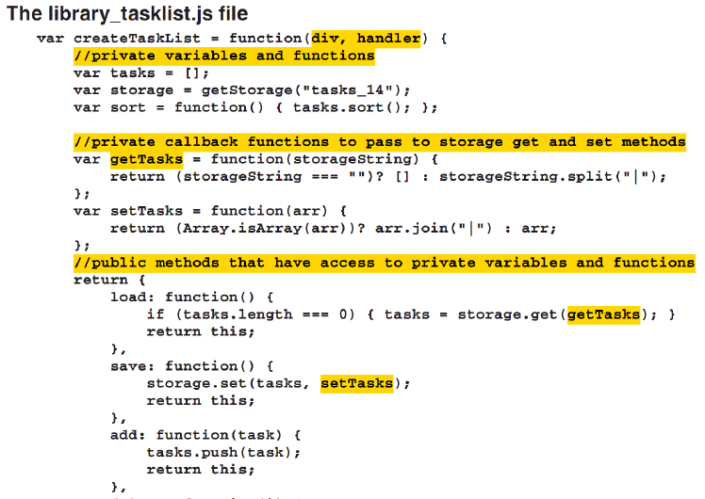

Slide 42
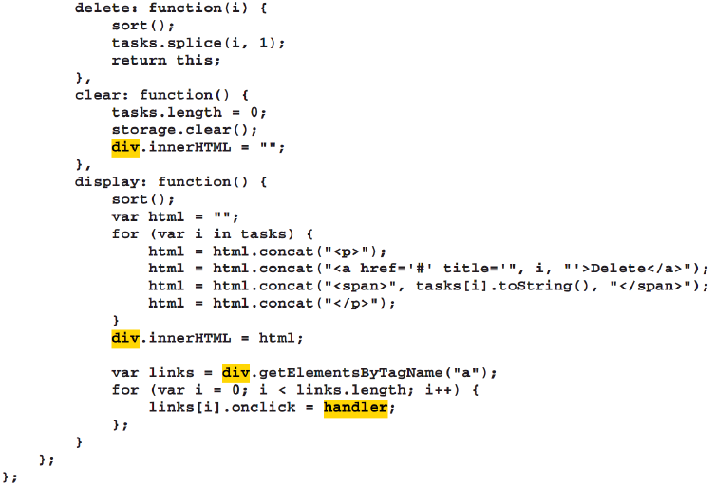

Slide 43
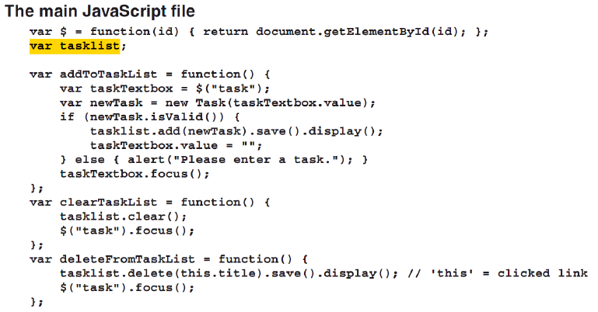
The Task Manager application

Slide 44
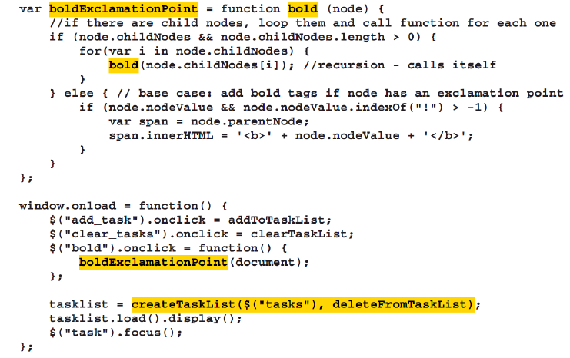

Slide 45
Summary
Closure is a function which is created in another function (parent function). It can access the object in parent function even the parent function has finished executing and is out of scope.
In JavaScript, functions are objects. That means they can be returned by other functions and passed as argument to other function. A function that is passed to other function is a callback function.
Recursion is a form of iteration in which a function repeatedly call itself.
Notes:
Tóm tắt lại nội dung đã học

Slide 46
The End.

