Slide 1
React Forms

Slide 2
Objectives
Controlled Components
The textarea Tag
The select Tag
The file input Tag
Handling Multiple Inputs
Controlled Input Null Value

Slide 3
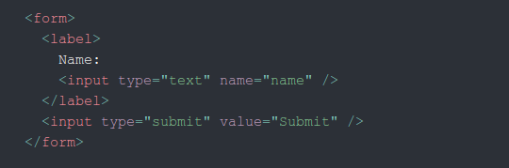
Introduction
HTML form elements work a little bit differently from other DOM elements in React, because form elements naturally keep some internal state. For example, this form in plain HTML accepts a single name

Slide 4
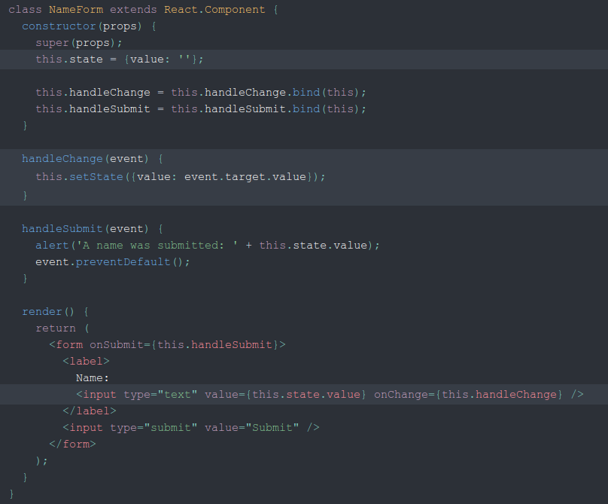
Controlled Components
In HTML, form elements such as <input>, <textarea>, and <select> typically maintain their own state and update it based on user input. In React, mutable state is typically kept in the state property of components, and only updated with setState().

Slide 5



The textarea Tag
In HTML, a <textarea> element defines its text by its children:
In React, a <textarea> uses a value attribute instead. This way, a form using a <textarea> can be written very similarly to a form that uses a single-line input:

Slide 6
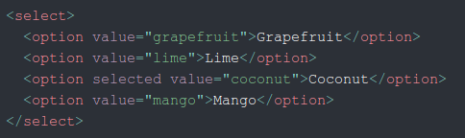

The select Tag
In HTML, <select> creates a drop-down list. For example, this HTML creates a drop-down list of flavors
React, instead of using this selected attribute, uses a value attribute on the root select tag. This is more convenient in a controlled component because you only need to update it in one place

Slide 7
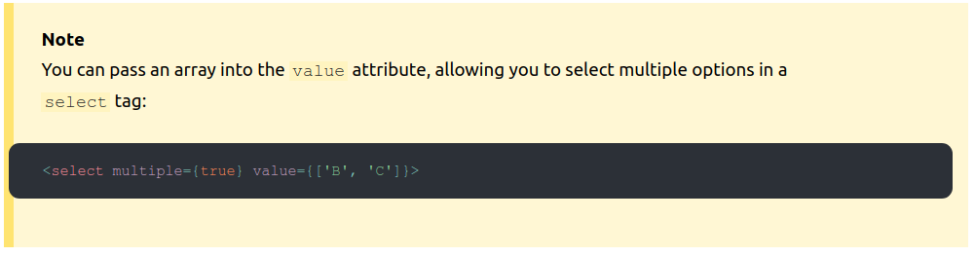
The select Tag
Overall, this makes it so that <input type="text">, <textarea>, and <select> all work very similarly - they all accept a value attribute that you can use to implement a controlled component.

Slide 8
The file input Tag
In HTML, an <input type="file"> lets the user choose one or more files from their device storage to be uploaded to a server or manipulated by JavaScript via the File API.
Because its value is read-only, it is an uncontrolled component in React. It is discussed together with other uncontrolled components later in the documentation.

Slide 9

Handling Multiple Inputs
When you need to handle multiple controlled input elements, you can add a name attribute to each element and let the handler function choose what to do based on the value of event.target.name
Note how we used the ES6 computed property name syntax to update the state key corresponding to the given input name:

Slide 10
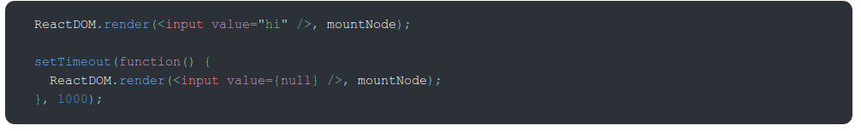
Controlled Input Null Value
Specifying the value prop on a controlled component prevents the user from changing the input unless you desire so. If you’ve specified a value but the input is still editable, you may have accidentally set value to undefined or null.
The following code demonstrates this. (The input is locked at first but becomes editable after a short delay.)

Slide 11
Other
Alternatives to Controlled Components
It can sometimes be tedious to use controlled components, because you need to write an event handler for every way your data can change and pipe all of the input state through a React component. This can become particularly annoying when you are converting a pre-existing codebase to React, or integrating a React application with a non-React library. In these situations, you might want to check out uncontrolled components, an alternative technique for implementing input forms.
Fully-Fledged Solutions
If you’re looking for a complete solution including validation, keeping track of the visited fields, and handling form submission, Formik is one of the popular choices. However, it is built on the same principles of controlled components and managing state — so don’t neglect to learn them.

