Slide 1
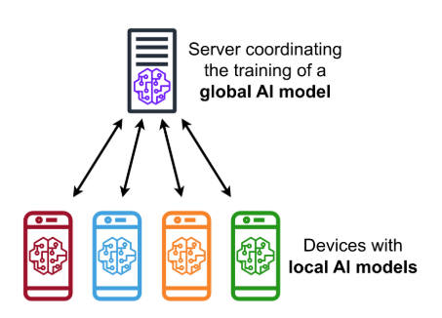
Straggler-Tolerant Federated Learning via
Systematic Erasure Coding
Erasure Coding for Fault-Tolerant Federated Learning
Md Khairul Azman · Mahfujur Rahman · Dr. Tanzima Islam
Department of Computer Science,
Texas State University
Notes:
[~1 min] Welcome. Today I present our work on making Federated Learning resilient to slow clients — stragglers — using erasure coding. No Straggler Left Behind: every client's data contributes, no matter how slow they are.

Slide 2
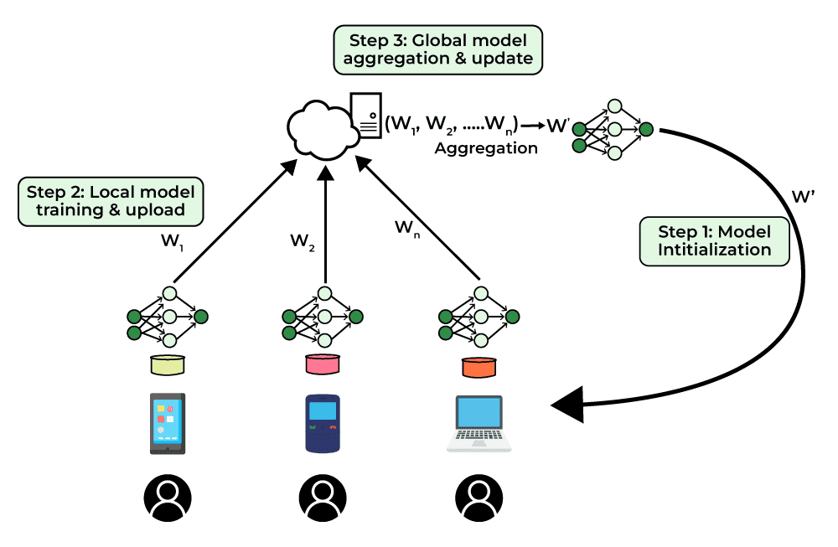
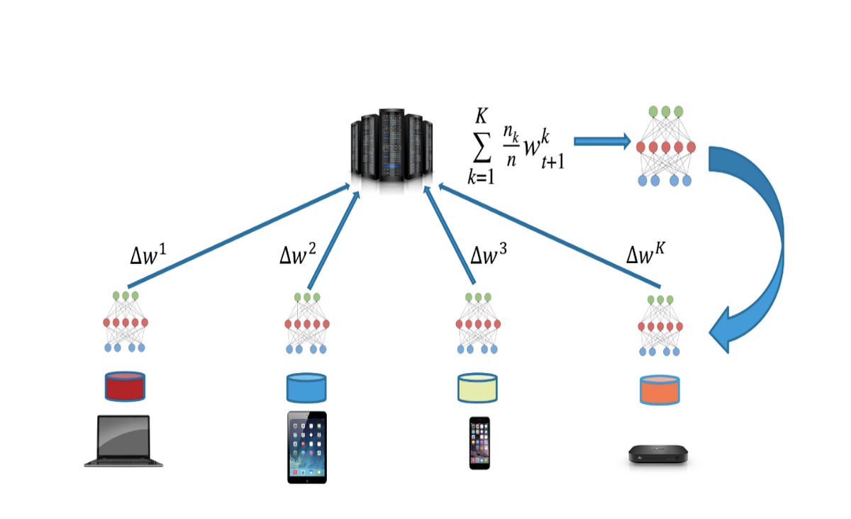
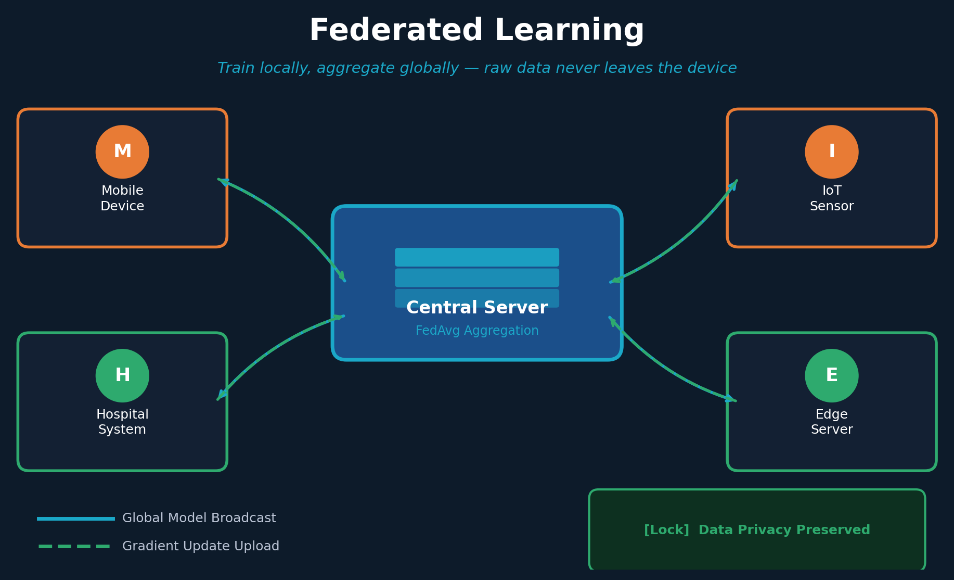
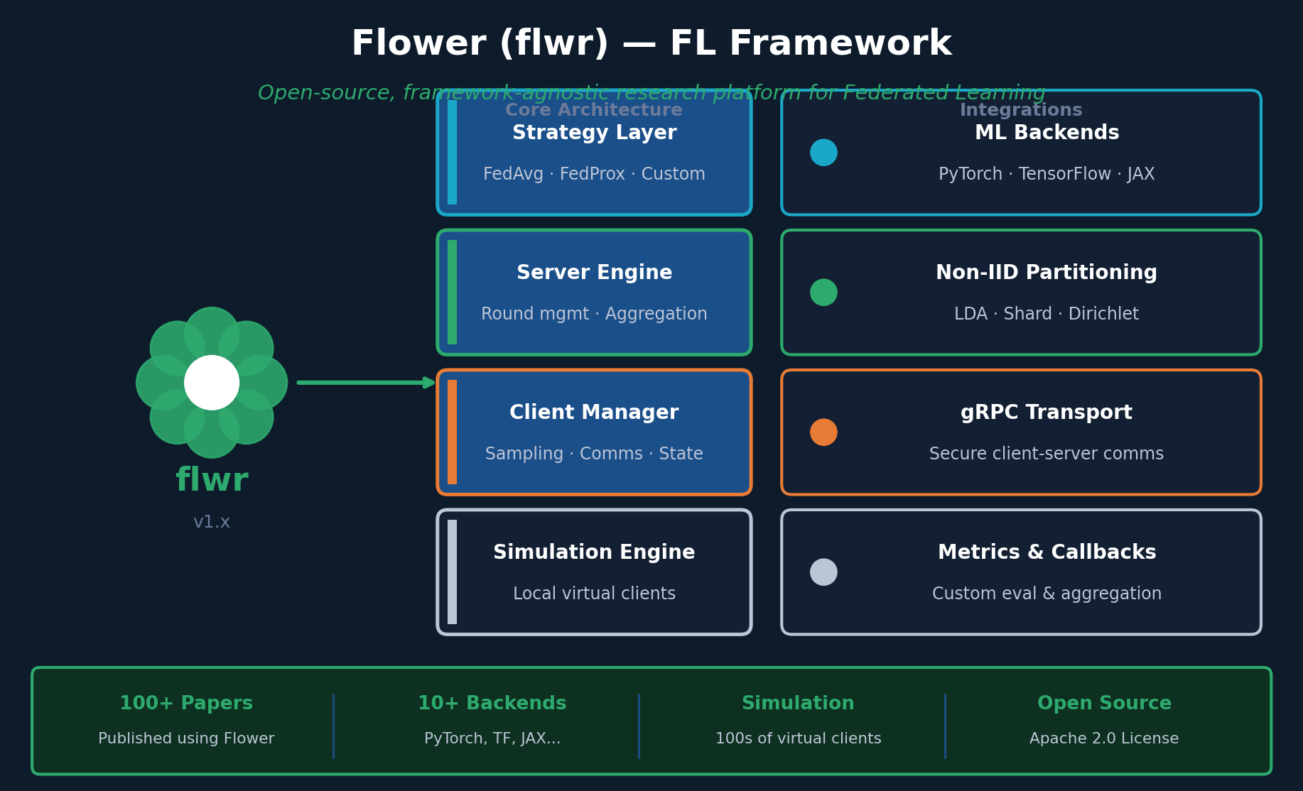
Background: What Are We Building On? (Two Key Technologies)
Federated Learning (FL)
Flower (flwr) Framework
N clients train locally on private data. A central server aggregates updates via FedAvg — raw data never moves off-device.
Open-source FL platform used in this project. Simulates 100+ virtual clients with non-IID data, custom strategies, and metrics tracking.

Slide 3
The Straggler Problem in Federated Learning
The Straggler Problem in Federated Learning
What is a Straggler?
FedAvg Round Timeline
In synchronous Federated Learning (FedAvg), the server must wait for all participating clients before advancing to the next round.
Client 0 (Straggler)
~4.5s
Client 1 (Straggler)
⚙ Hardware heterogeneity (slow CPUs/GPUs)
~3.8s
🌐 Network congestion & packet loss
Client 2–9 (Fast)
0.3s
📱 Mobile device resource contention
Deadline blocked by slowest!
Round time ∝ worst-case client delay

Slide 4
Existing Solutions Fall Short
Full Sync (Baseline)
✓ 100% data coverage
✗ Waits for slowest — unbounded delay
Speed vs. coverage tradeoff
Partial (k=5)
✓ Faster rounds
✗ Same clients excluded every round → persistent non-IID bias
Speed vs. coverage tradeoff
Deadline-based (8s)
✓ Bounded round time
✗ Wastes entire rounds when stragglers miss cutoff
Speed vs. coverage tradeoff
Async (1.5s window)
✓ Very short wait
✗ Window too tight → collected ZERO updates in our setup
Speed vs. coverage tradeoff
Erasure Coded ★ Ours
✓ Full coverage + tolerates S stragglers
→ Parity clients cover missing data — no accuracy tradeoff
Our approach: no tradeoff — parity clients guarantee full data coverage every round
Notes:
[~2 min] Four common strategies all make a tradeoff between speed and data coverage. Our erasure coded approach is the only one that avoids this tradeoff entirely.

Slide 5
Theoretical Foundation: Erasure Coding for FL
Gradient Coding (Tandon et al., ICML '17)
Client Roles (N=10, K=7, S=3)
Treat stragglers as erasures in an error-correcting code framework. Encode gradient vectors so any K-of-N responses reconstruct the full batch gradient.
Clients 0–2
Straggler-Prone
Primary partition only
Systematic (10, 7) Code → tolerates S = 3 stragglers
Clients 3–6
Parity client update:
Systematic
β_j = (|D_j| / |D_j|+|D_φ(j)|) · β_primary
+ (|D_φ(j)| / |D_j|+|D_φ(j)|) · β_backup
Primary partition only
Clients 7–9
Fault tolerance guarantee:
Parity
∪ₖ∈R(t) partitions(k) = {D₀, …, D_N-1} for any |F| ≤ S
Primary + backup partition
(trains 2 partitions per round)

Slide 6
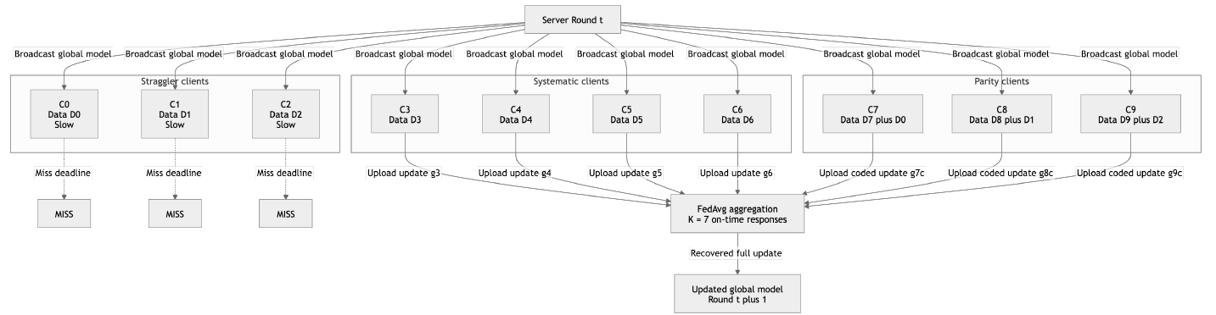
System Architecture
Straggler clients
Systematic clients
Parity clients
Miss deadline → MISS
Upload normal updates
Upload coded updates (2 partitions)
Notes:
[~2 min] This is the actual framework diagram from the paper. Three client groups visible: straggler clients on the left miss their deadline and send MISS. Systematic clients in the middle send normal updates. Parity clients on the right send coded updates covering two partitions. FedAvg aggregation at the server uses only the 7 on-time responses — and still reconstructs the full global update.

Slide 7
Parity Client Update — The Math
Each parity client j trains TWO models and sends ONE weighted average:
βⱼ = [|Dⱼ| / (|Dⱼ|+|Dφ(j)|)] · βⱼᵖʳⁱᵐᵃʳʸ + [|Dφ(j)| / (|Dⱼ|+|Dφ(j)|)] · βⱼᵇᵃᶜᵏᵘᵖ
φ(j) = index of the straggler that parity client j backs up
Same Communication Cost
No Server Changes Needed
Zero Inter-Client Coordination
Parity client sends ONE model update — identical bandwidth to any standard client
Standard FedAvg aggregation. Parity clients get larger weight wⱼ = |Dⱼ|+|Dφ(j)|
Each parity client trains independently. No messages between clients required
Notes:
[~2.5 min] The math is clean. Parity client j trains two models from the same global initialization — one on its primary data, one on the backup straggler's data. It takes a weighted average proportional to dataset sizes. Three key properties: same communication cost, no server changes, no inter-client coordination.

Slide 8
Experimental Setup
Framework
Flower (Beutel et al., 2022) — Python simulation engine, single machine
Dataset
FashionMNIST — Non-IID partition: 2 class shards per client (sorted split)
Model
Two-layer CNN — SGD, lr=0.01, momentum=0.9, 1 local epoch per round
Scale
10-node (primary) and 100-node (scaling) — 5 communication rounds each
Straggler delay
Clients 0–2 (10-node) / 0–9 (100-node): Uniform(2s, 5s) per round
Fast clients
Remaining clients: Uniform(0s, 0.6s) — complete well before deadline
Five strategies compared:
Baseline (wait all)
Partial k=5
Deadline 8s
Async 1.5s
Erasure Coded ★
Notes:
[~2 min] Flower framework, FashionMNIST with non-IID shard partition — each client gets 2 of 10 class shards. Two-layer CNN with SGD. Two scales. Straggler delays injected with time.sleep.

Slide 9
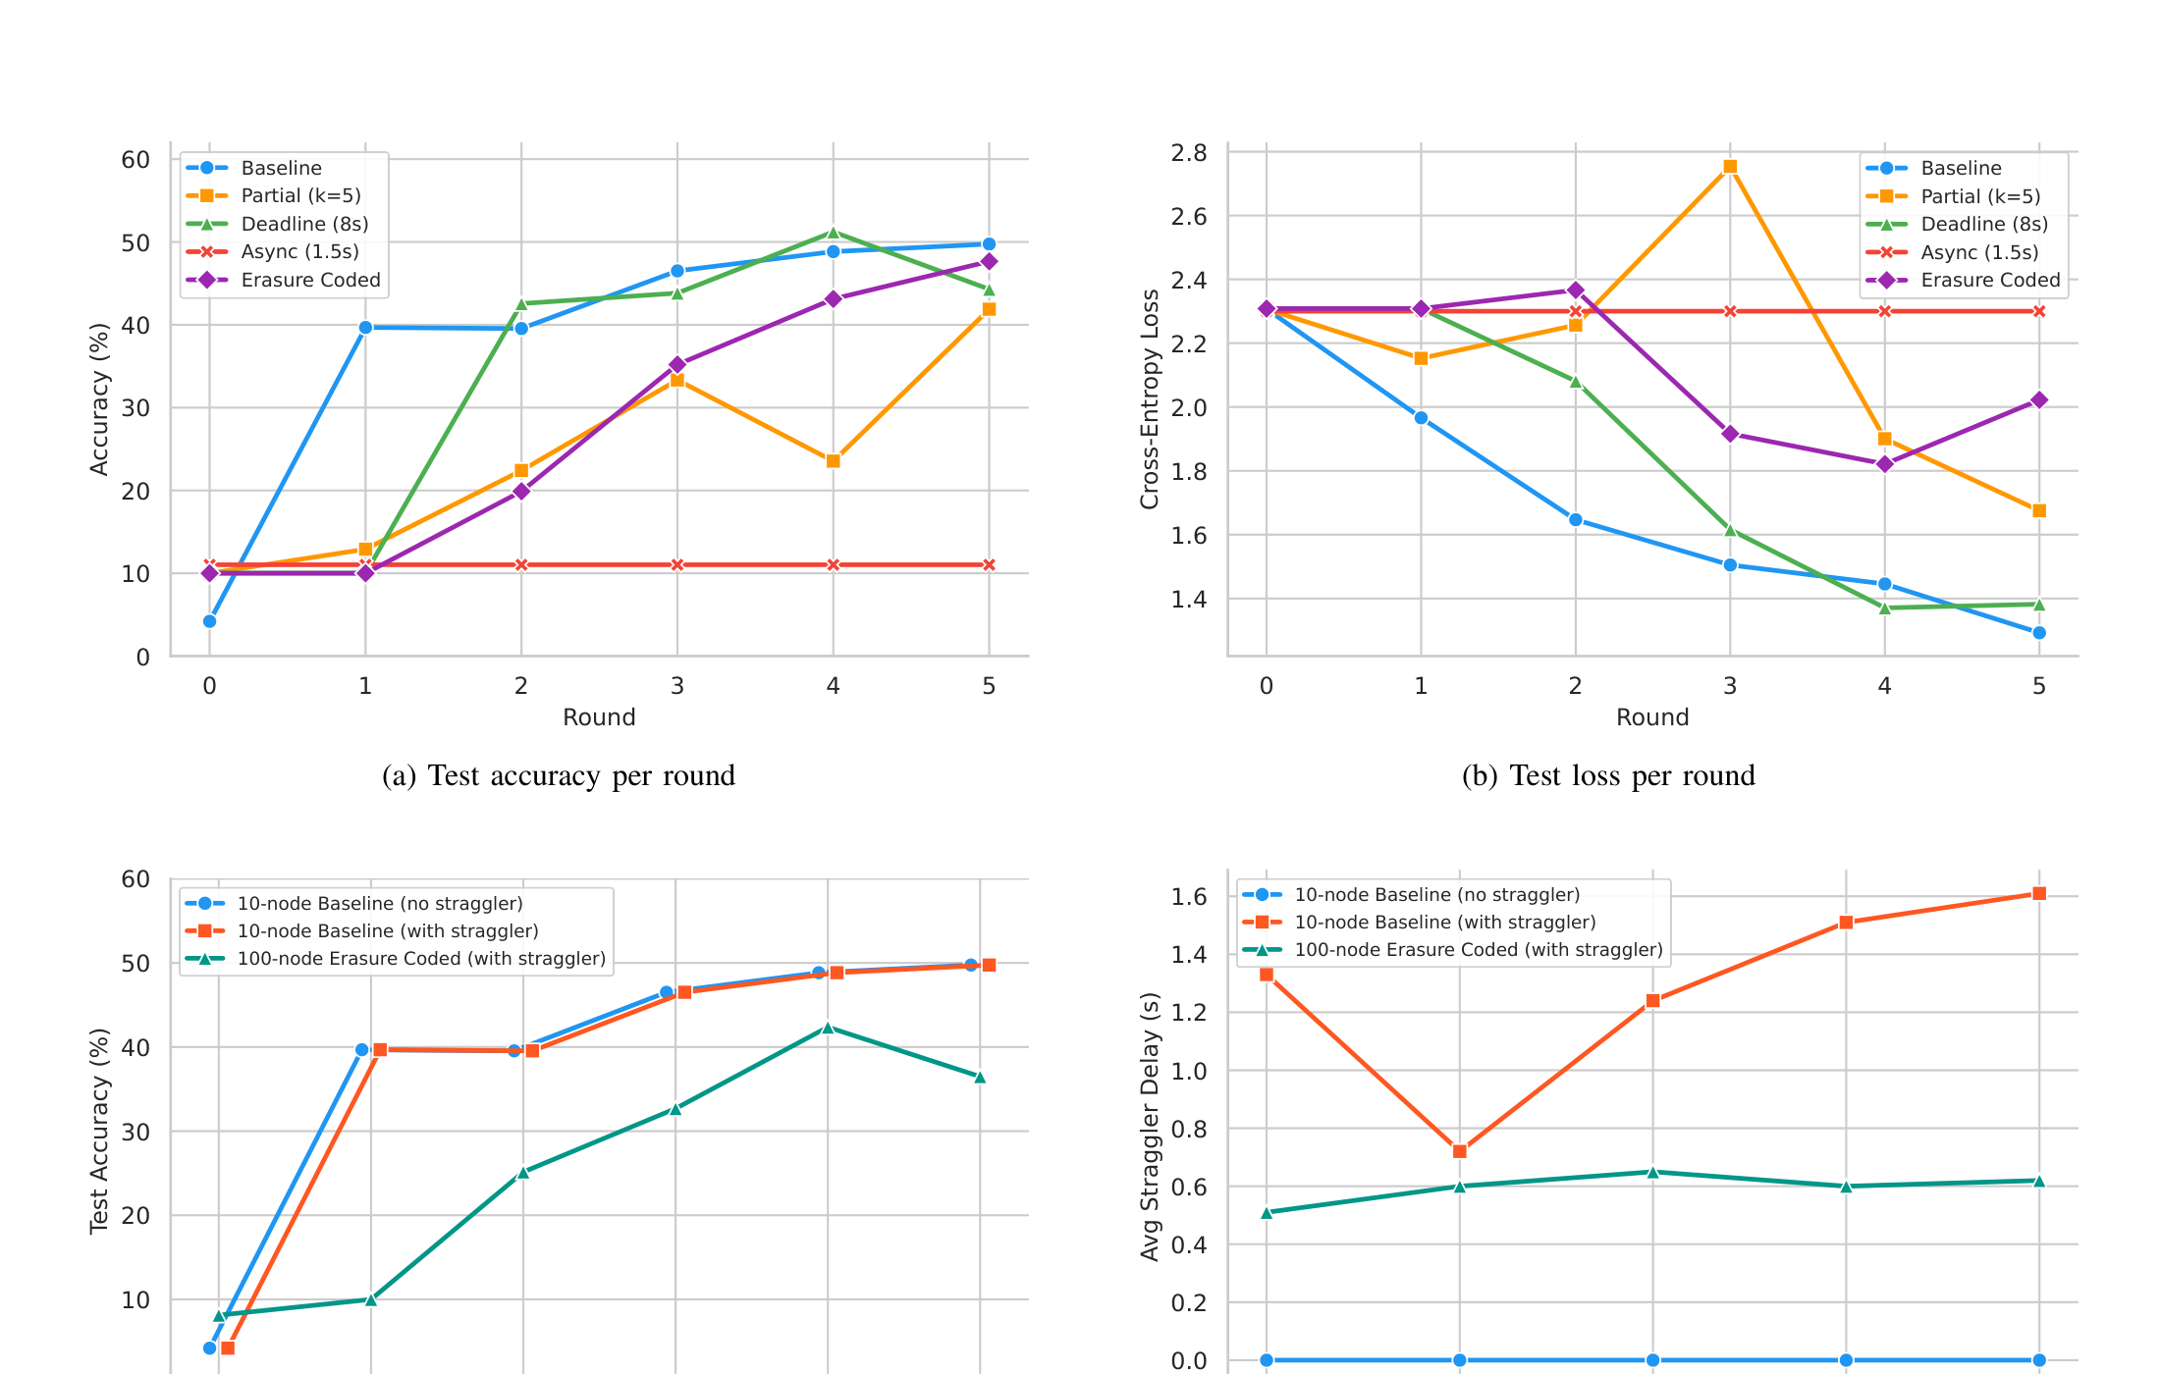
Results: Accuracy & Convergence
Key Numbers
47.7%
Erasure Coded
vs 49.8% baseline
2.1pp
Accuracy gap
Within 2 percentage points of theoretical ceiling
41.9%
Partial k=5
Persistent non-IID bias
11.0%
Async 1.5s
Complete failure — 0 updates collected
Notes:
[~2.5 min] Looking at convergence. Top row: all 5 strategies over 5 rounds. Bottom row: 10-node vs 100-node comparison. Our erasure coded approach tracks the baseline closely — 47.7% vs 49.8%, within 2.1 percentage points. Partial participation shows clear non-IID drift. Async never gets off the ground.

Slide 10
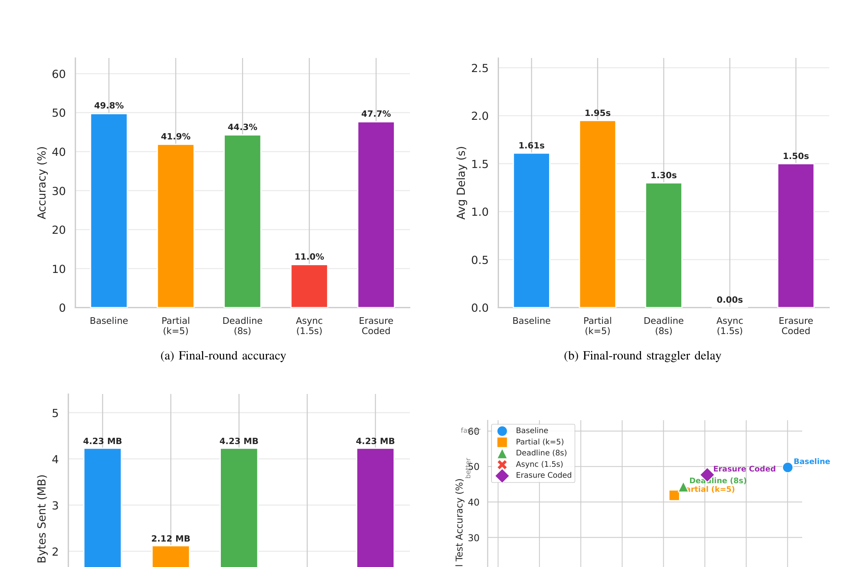
Results: Final-Round Strategy Comparison
★ Erasure Coded: 47.7% accuracy · 1.50s delay · 4.23 MB communication — same bandwidth as baseline with full fault tolerance
Notes:
[~2 min] The four-panel figure from the paper. Top-left: accuracy — our approach second only to baseline. Top-right: straggler delay — comparable to baseline. Bottom-left: communication cost — identical to baseline at 4.23 MB. Bottom-right: accuracy vs training time scatter — erasure coded lands in the sweet spot.

Slide 11
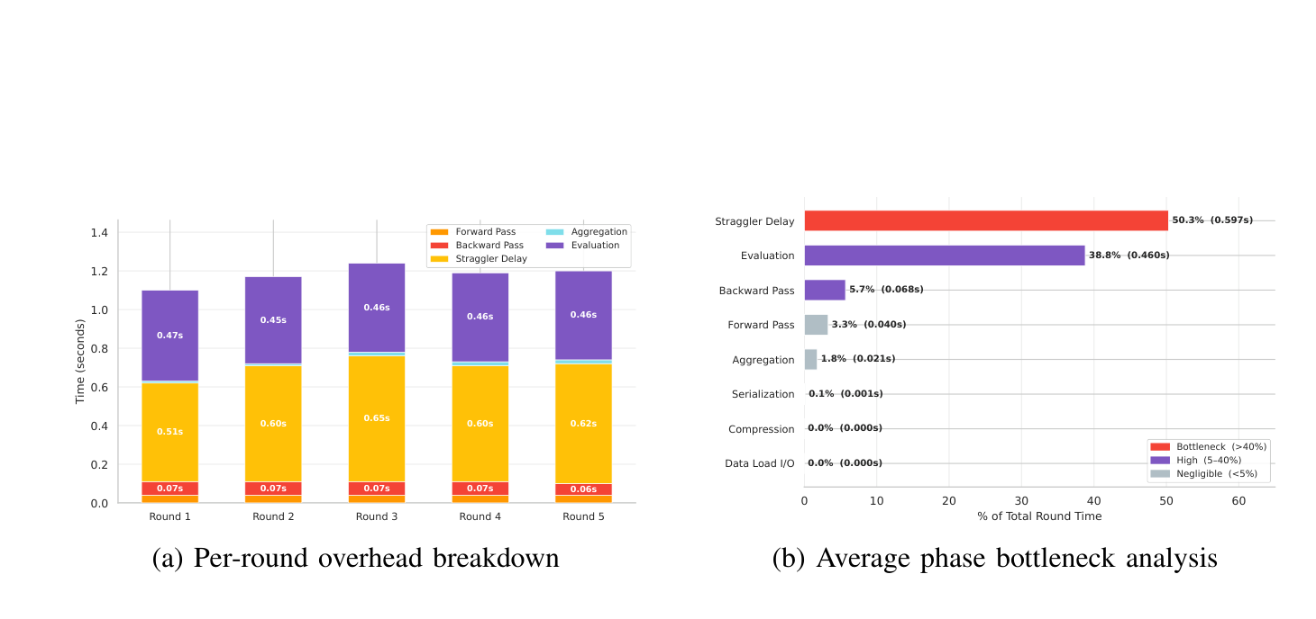
Results: Per-Phase Overhead Analysis
Phase Breakdown
Straggler Delay
50.3%
0.597s
Evaluation
38.8%
0.460s
Backward Pass
5.7%
0.068s
Forward Pass
3.3%
0.040s
Aggregation
1.8%
0.021s
Serialization
0.1%
0.001s
Data I/O + Comp.
0.0%
0.000s
Bottleneck: Straggler Delay (50.3%)
Quick Win: Evaluation (38.8%)
Unavoidable with synchronous FL — the fundamental cost of waiting for slow clients.
Running test inference every round is unnecessary in production. Evaluate every 5–10 rounds instead.
Notes:
[~2 min] Overhead breakdown. Two things dominate: straggler delay at 50.3% — unavoidable with synchronous FL — and centralized evaluation at 38.8%, which is entirely optional overhead we added for measurement. The actual ML compute — forward pass, backward pass — is just 9% combined.

Slide 12
Quantitative Summary
47.7%
2.1 pp
4.23 MB
Erasure Coded
Final Accuracy
Below Baseline
(49.8%)
Communication
(same as Baseline)
Strategy | Accuracy | Delay | Comm. | Data Loss?
Baseline | 49.8% ✓ | 1.61s | 4.23 MB | None (waits forever)
Partial (k=5) | 41.9% | 1.95s | 2.12 MB | Yes — 50% excluded
Deadline 8s | 44.3% | 1.30s | 4.23 MB | Yes — round 1 wasted
Async 1.5s | 11.0% ✗ | 0.00s | 0 MB | 100% — zero updates
Erasure Coded ★ | 47.7% ✓ | 1.50s | 4.23 MB | None ✓
Notes:
[~2 min] Summary table. Erasure coded is the only strategy that achieves: near-baseline accuracy, moderate delay, baseline communication cost, and zero data loss. It strictly dominates partial, deadline, and async on coverage. It trades a tiny 2.1pp accuracy versus baseline — in exchange for tolerating 3 simultaneous stragglers.

Slide 13
Limitations — Honest Assessment
Simulated Delays Only
All client delays injected via time.sleep() — not real network latency or hardware variability. Real deployment may behave differently.
Fixed Straggler Set
The scheme protects only clients 0–9 (known in advance). Any client can become a straggler in practice — dynamic reassignment needed.
100-Node Accuracy Gap
36.5% vs 49.8% baseline. Greater non-IID heterogeneity + more clients + only 5 rounds. More training rounds would close this gap.
Sequential Simulation Bias
Flower runs clients sequentially in one process. CPU measured at 0.0% — does not reflect true parallel load on real hardware.
Notes:
[~2 min] Four honest limitations. Simulated delays don't capture real-world unpredictability. Fixed straggler set is a strong assumption. 100-node accuracy gap needs more rounds. CPU measurement is a simulation artifact.

Slide 14
Future Work
1. Real Hardware Deployment
4. Reduce Evaluation Overhead
HPC cluster or cloud — real network latency, true parallel execution
Evaluate every 5–10 rounds instead of every round → 38.8% overhead eliminated
2. Dynamic Straggler Assignment
5. Differential Privacy
Protect arbitrary, changing straggler sets — not a fixed set known in advance
Combine erasure coding with DP-SGD to address straggler tolerance AND data privacy
3. Convergence at Scale
6. Quantization on Parity Updates
More rounds + LR tuning at 100 nodes + FedProx/SCAFFOLD for non-IID stabilization
Apply QSGD/gradient compression to reduce 42.35 MB/round at 100-node scale
Notes:
[~2 min] Six future directions. Most important: real hardware deployment and dynamic straggler assignment — these would make the system production-ready. Differential privacy integration is a natural pairing that would complete the FL security story.

Slide 15
Key Takeaways
1
Erasure coding eliminates the accuracy–speed tradeoff
Parity clients guarantee full data coverage even when stragglers miss deadlines — no accuracy penalty
2
Zero extra communication cost
Parity clients transmit ONE averaged update — same bandwidth as any standard FedAvg client
3
Drop-in compatible — no server changes
Standard FedAvg aggregation with adjusted weights. Plugs into any existing FL system
4
Straggler delay dominates (50.3%) — compute is negligible
Forward + backward pass = only 9%. The bottleneck is waiting, not computing
5
10-node: 47.7% vs 49.8% baseline — within 2.1pp of optimal
Near-optimal accuracy while tolerating up to 3 simultaneous stragglers with zero data loss
Notes:
[~2 min] Five takeaways. The fundamental result: erasure coding removes the accuracy-speed tradeoff. No extra bandwidth. No server changes. Bottleneck is waiting not computing. And near-optimal accuracy.

Slide 16
Thank You
Questions & Discussion
No Straggler Left Behind:
Erasure Coding for Fault-Tolerant Federated Learning
Md Khairul Azman · Mahfujur Rahman · Tanzima Islam
Department of Computer Science · Texas State University
Notes:
[~1 min] Thank you. Happy to take questions. The key result: erasure coding is a practical, drop-in solution for straggler tolerance — no accuracy tradeoff, no extra communication, no server changes.

