Slide 1



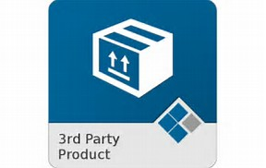

LINKINGVISION
LINKING VISION CLOUD
Linkvis Protocol
Linkvis Protocol
LINKING APP
RTSP/RTMP/HLS/HTML5-MSE
3rdparty Cameras

