Slide 1
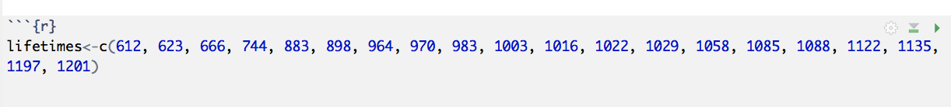
Sample Data for Consideration
The following data represent the lifetimes (in hours) of 20 different incandescent lamps. The data was gathered as part of a routine quality control sample of lamps created at a large electronics manufacturer. They are ordered from smallest to largest for convenience:
612, 623, 666, 744, 883, 898, 964, 970, 983, 1003,
1016, 1022, 1029, 1058, 1085, 1088, 1122, 1135, 1197, 1201
Create a vector of data “lifetimes” in R so we can do some coding with it.
Notes:
Be thinking about – what would create a “good” quality control sample?

Slide 2
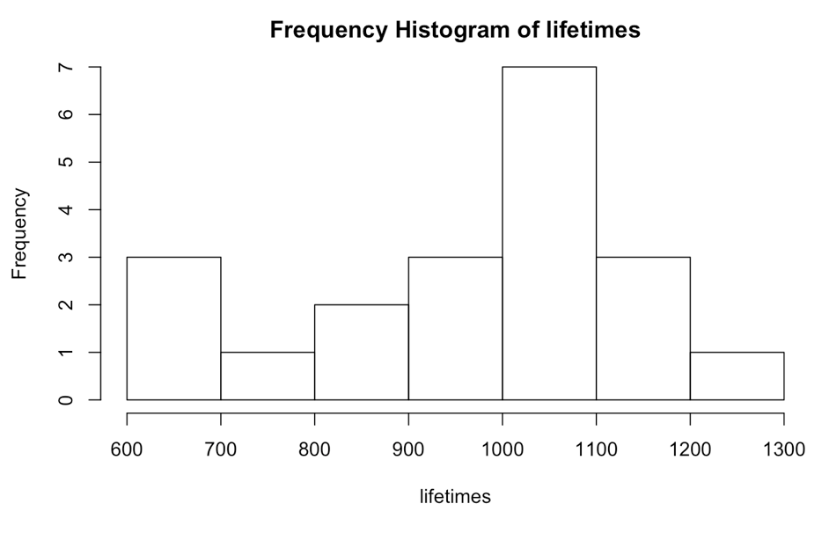
Descriptive Statistics (graphically) cont…
To make a histogram (by hand is optional),
1. Make a frequency table
*choose ~ 5-15 equal-length intervals covering [min, max] (number of bins matters)
*count # points in each interval
(default in R is to put values that fall on boundary in lower bin)
2. Above each interval, draw bar whose height
indicates its: (A) frequency (count)
From this graph, we can see there were
3 lamps that had lifetimes between 600 and 700 (612, 623, 666)
and only 1 between 700 and 800 (744)
(Check R or other program conventions for including/excluding end points)
R help for histogram: ?hist The number of bins matter! (see class R code)
Notes:
Y axis- frequency and the x axis is bins/intervals of lifetimes
I’ve included different number of bins in the notes codes – play around with what is hidden/revealed

Slide 3
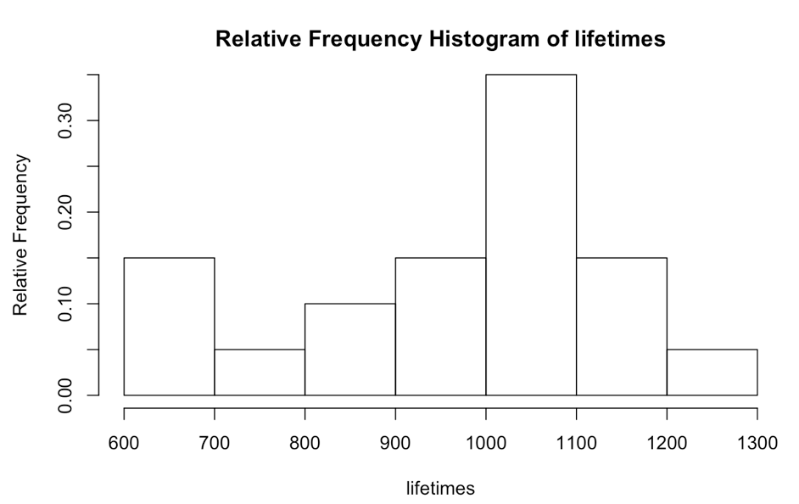
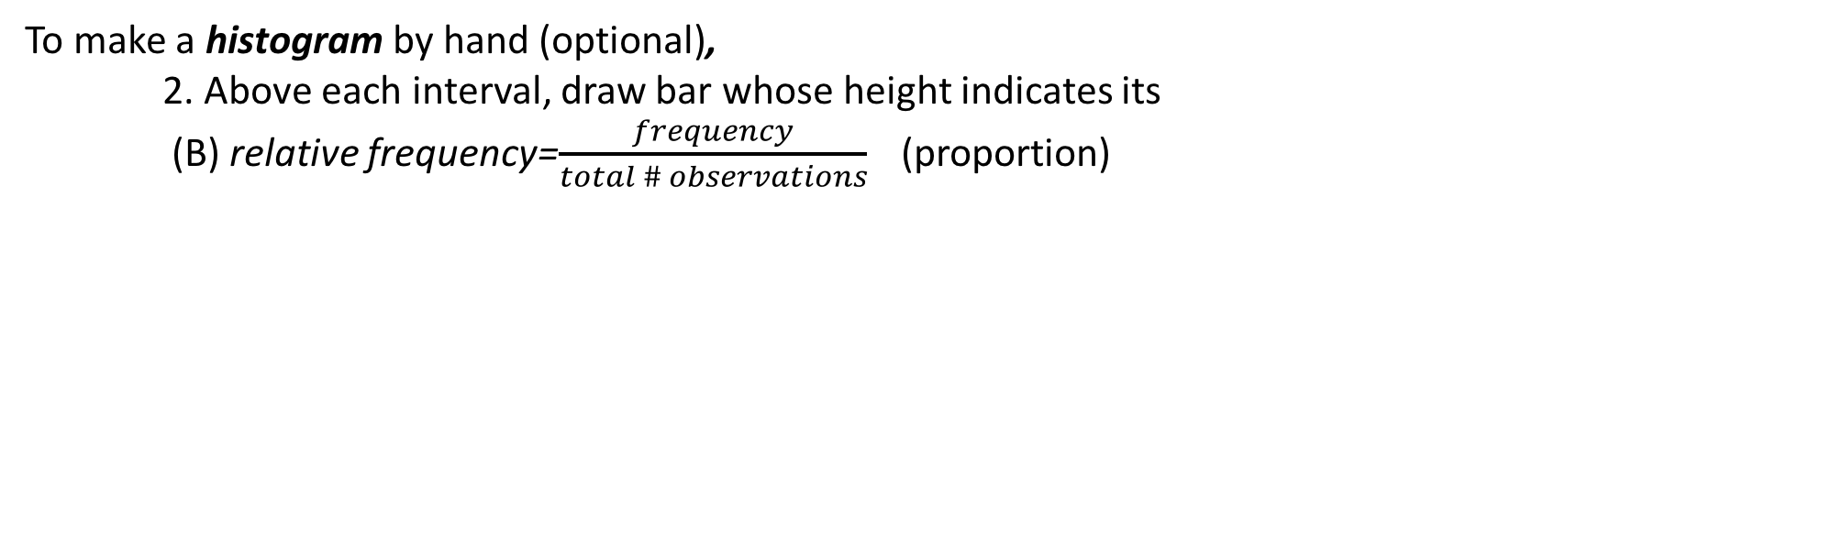
Descriptive Statistics (graphically) cont…
To make a histogram by hand (optional),
2. Above each interval, draw bar whose height indicates its
(B) relative frequency=$\frac{frequency}{total \# observations}$ (proportion)
From this graph, we can see that 15% (3/20) of the lamps had lifetimes between 600 and 700
(612, 623, 666)
and only 5% (1/20) between 700 and 800 (744)
*Relative Frequency Histograms are more helpful than frequency when comparing multiple sets of data. Why?
Notes:
Numeric data – interested in lifetime values.
Notice for this sized data set (20) values, the plots are not too busy. But these are not useful for larger data sets.
If those multiple sets of data have a different number of values, then comparing frequency within bins is les straightforward than comparing relative frequency.

Slide 4
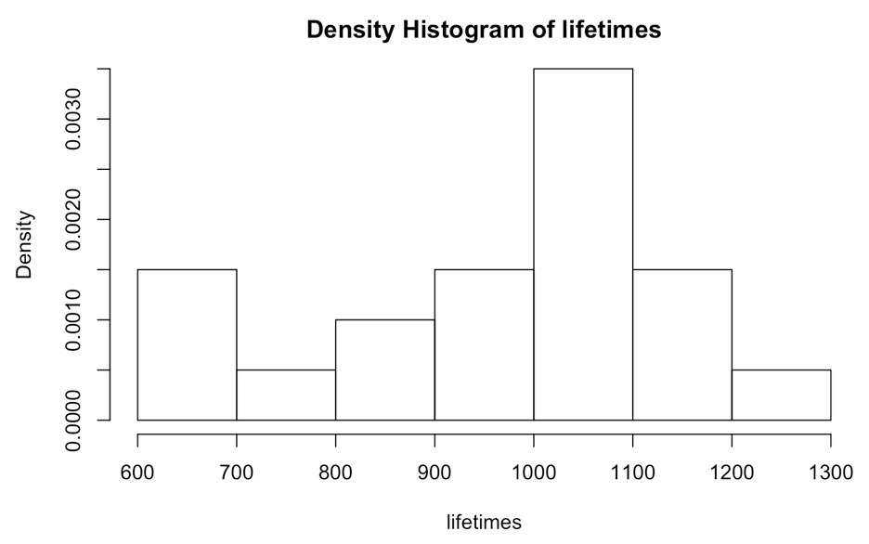
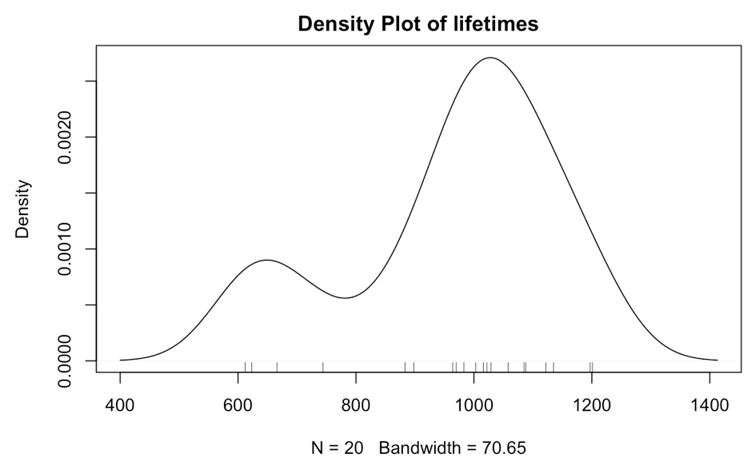

Descriptive Statistics (graphically) cont…
To make a histogram by hand (optional),
2. Above each interval, draw bar whose height indicates its
(C) density=$\frac{relative frequency}{width of bins}$ (so that total area=1). Density*Width=Relative Frequency
*or a density plot “smooths” out the bars
Notes:
Added Rug command shows where actual data values fall – the density plot is most accurate when we have a lot of data values.

Slide 5
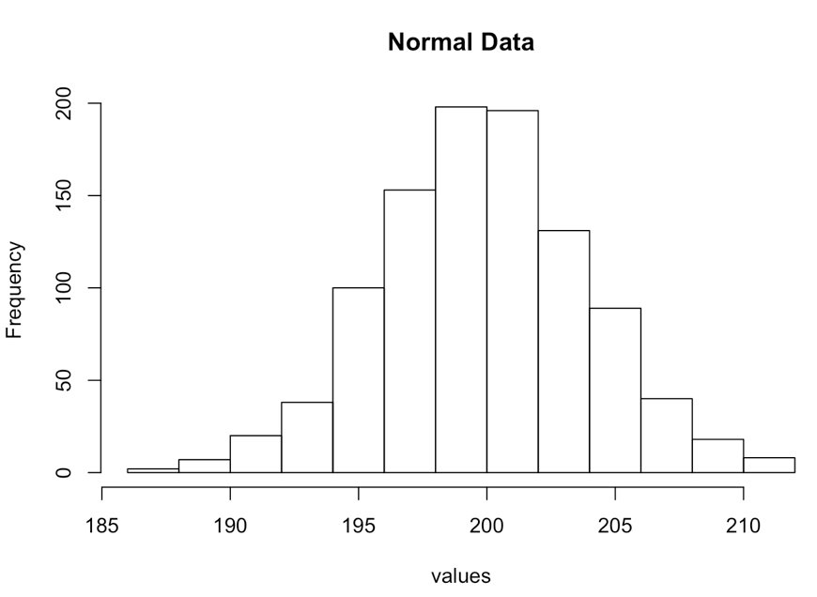
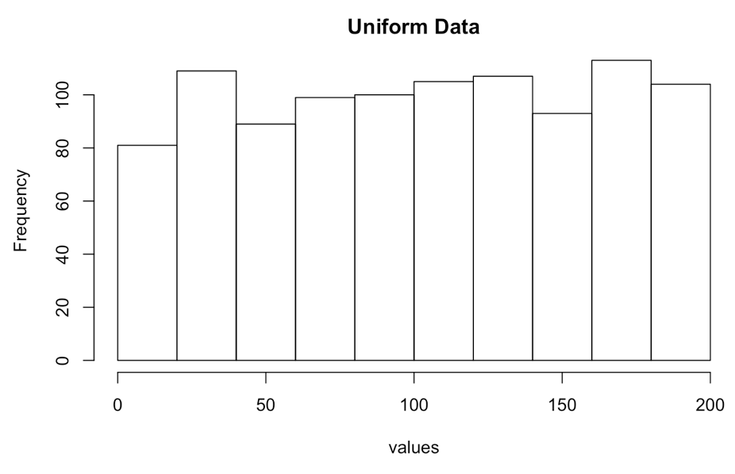
Descriptive Statistics (graphically) cont…
Graphing numeric data allows us to see the shape of the data
*most easily seen in stem and leaf or histogram
Symmetric, unimodal (normal) distribution
e.g.
*repeated measures
*length of 2X4’s in stockyard, etc
Uniform distribution
e.g.
*face that lands up when tossing die
*serial number on a randomly selected
product, etc
Notes:
Histogram with 1 major peak is called unimodal,
When every interval has essentially the same number of observations, the histogram is called a uniform histogram.
Symmetric if the upper and lower half of the data have approximately the same shape

Slide 6
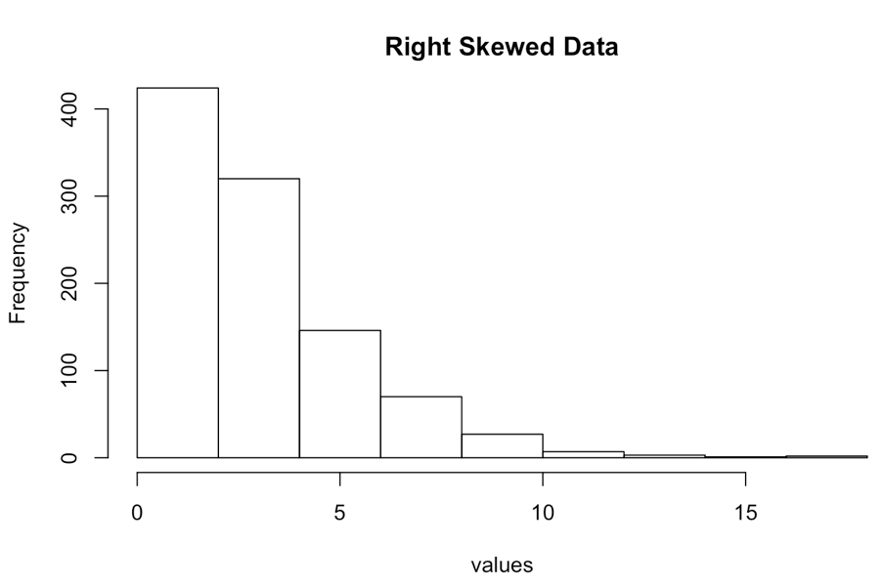
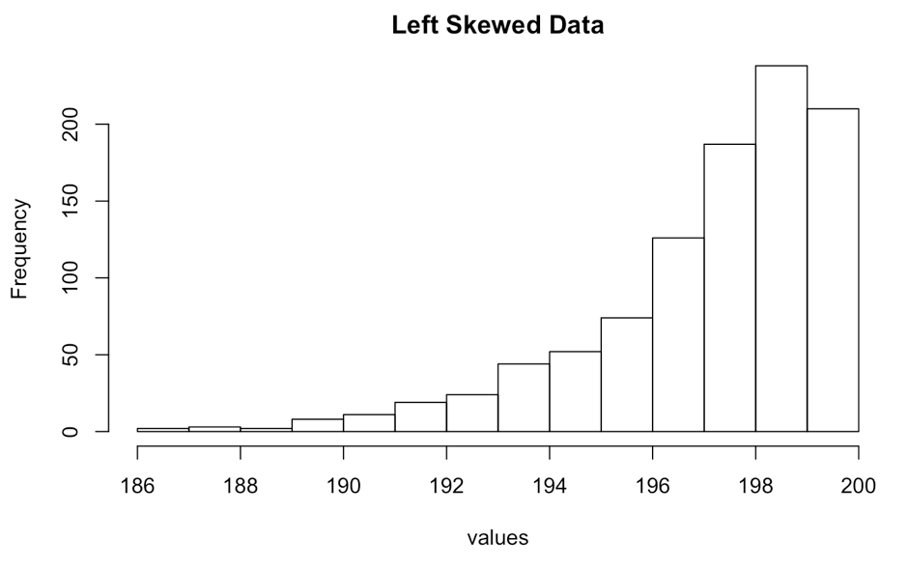
Descriptive Statistics (graphically) cont…
Graphing numeric data allows us to see the shape of the data
Right-Skewed Distribution
e.g.
*number of items purchased by each customer
*Score on hard test
Left-Skewed Distribution
e.g.
*age at death or retirement in developed countries
*score on easy test
Notes:
Skewed to the right: right side of the histogram, larger half of the observations extends a greater distance than the lower
Skewed to the left: left side of the histogram, lower half of the observations extends a greater distance than the upper

Slide 7
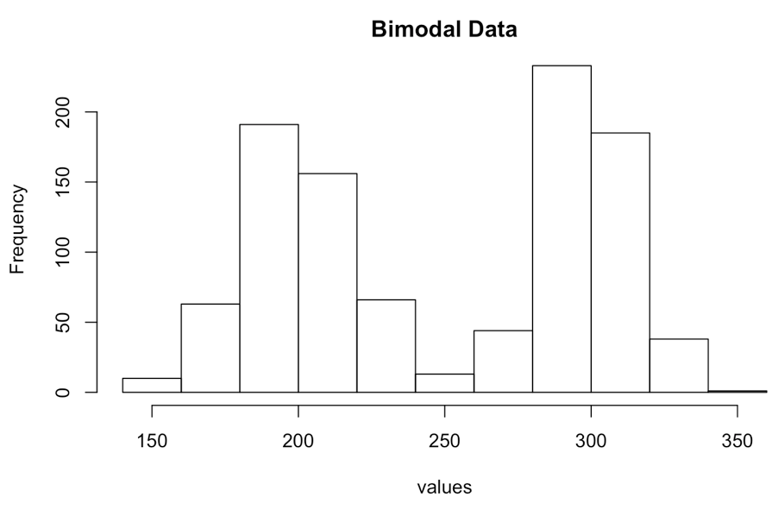
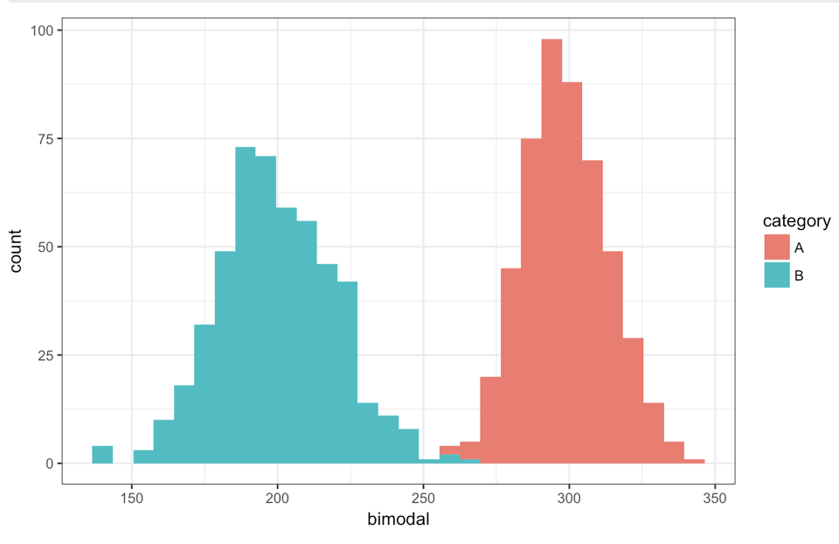
Descriptive Statistics (graphically) cont…
Graphing numeric data allows us to see the shape of the data
e.g.
*Starting salary of lawyers
*Book prices (paper vs hard cover) or textbooks vs non?
*number of hours after opening that a customer comes into a restaurant
Notes:
when histogram has two major peaks its called bimodal.
As the distribution of starting lawyer salaries makes clear, very few new law school graduates earn anything close to the mean. Instead, many graduates will earn much more than the mean salary, and many more will earn much less.”
https://abovethelaw.com/2010/07/nalp-gives-more-information-on-expected-lawyer-salary/

Slide 8
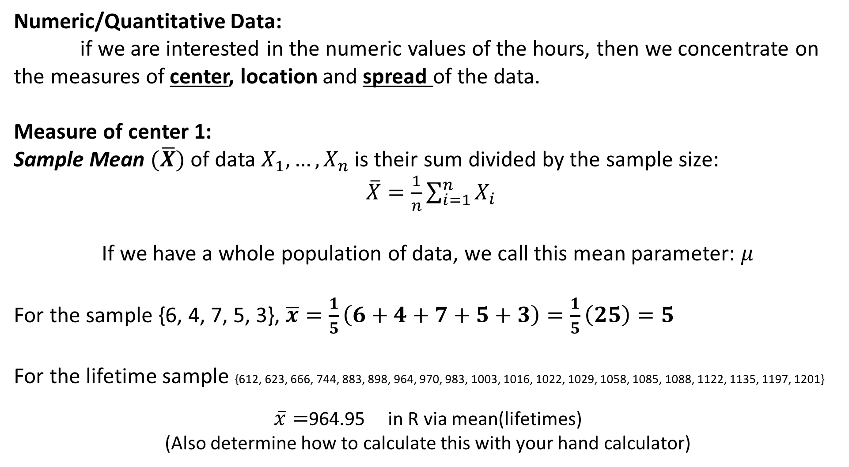
Descriptive Statistics (Numerically)
Numeric/Quantitative Data:
if we are interested in the numeric values of the hours, then we concentrate on the measures of center, location and spread of the data.
Measure of center 1:
Sample Mean $(\overline{X})$ of data $X_{1},…, X_{n}$ is their sum divided by the sample size:
$\overline{X}=\frac{1}{n}\sum_{i=1}^{n}{X_{i}}$
If we have a whole population of data, we call this mean parameter: $μ$
For the sample {6, 4, 7, 5, 3}, $\overline{x}=\frac{1}{5}\left(6+4+7+5+3\right)=\frac{1}{5}\left(25\right)=5$
For the lifetime sample {612, 623, 666, 744, 883, 898, 964, 970, 983, 1003, 1016, 1022, 1029, 1058, 1085, 1088, 1122, 1135, 1197, 1201}
$\overline{x}=$964.95 in R via mean(lifetimes)
(Also determine how to calculate this with your hand calculator)
Notes:
/

Slide 9
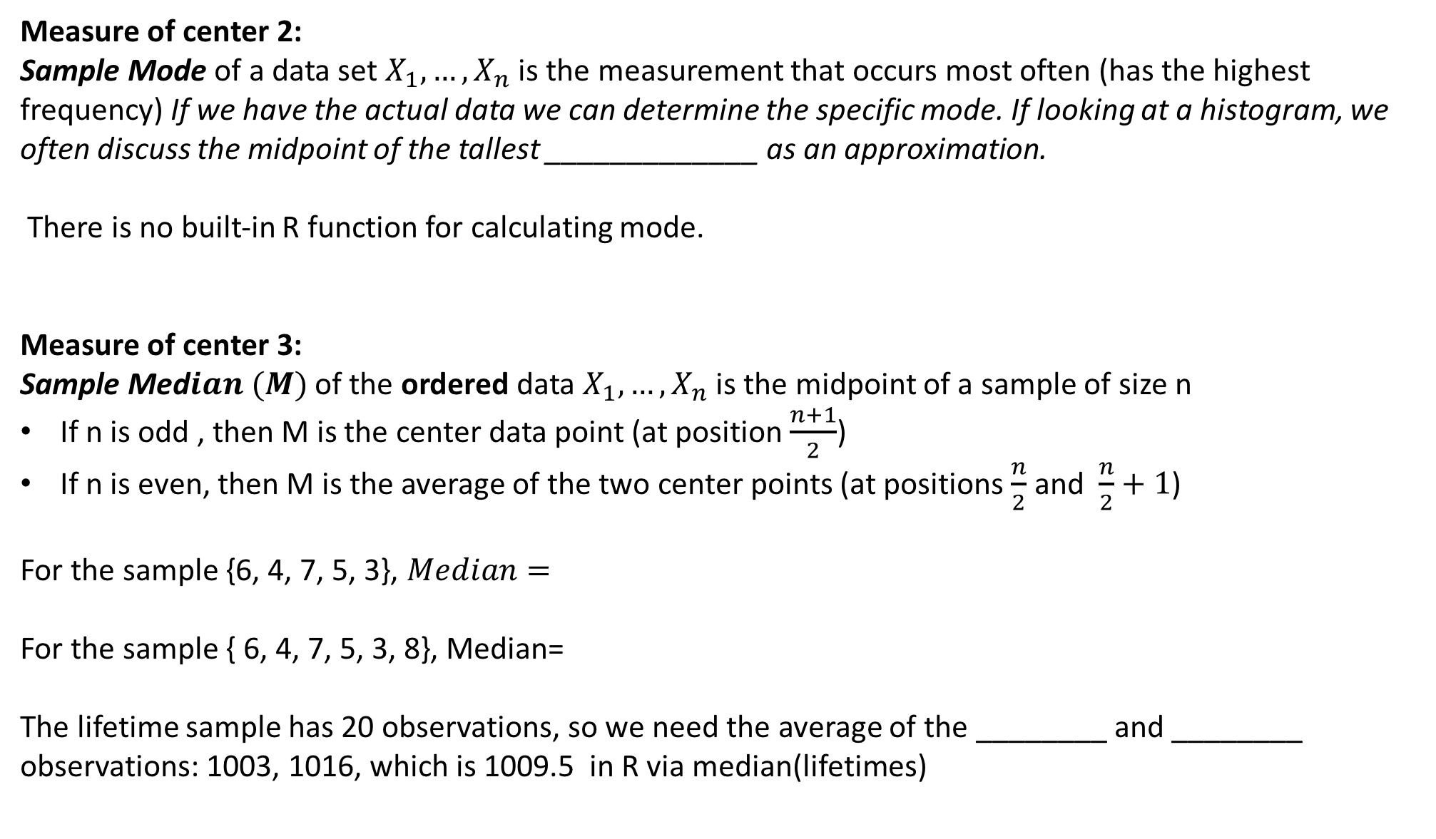
Descriptive Statistics (Numerically) cont.
Measure of center 2:
Sample Mode of a data set $X_{1},…, X_{n}$ is the measurement that occurs most often (has the highest frequency) If we have the actual data we can determine the specific mode. If looking at a histogram, we often discuss the midpoint of the tallest _____________ as an approximation.
There is no built-in R function for calculating mode.
Measure of center 3:
Sample Med$ian (M)$ of the ordered data $X_{1},…, X_{n}$ is the midpoint of a sample of size n
If n is odd , then M is the center data point (at position $\frac{n+1}{2}$)
If n is even, then M is the average of the two center points (at positions $\frac{n}{2}$ and $\frac{n}{2}+1$)
For the sample {6, 4, 7, 5, 3}, $Median=$
For the sample { 6, 4, 7, 5, 3, 8}, Median=
The lifetime sample has 20 observations, so we need the average of the ________ and ________ observations: 1003, 1016, which is 1009.5 in R via median(lifetimes)

Slide 10
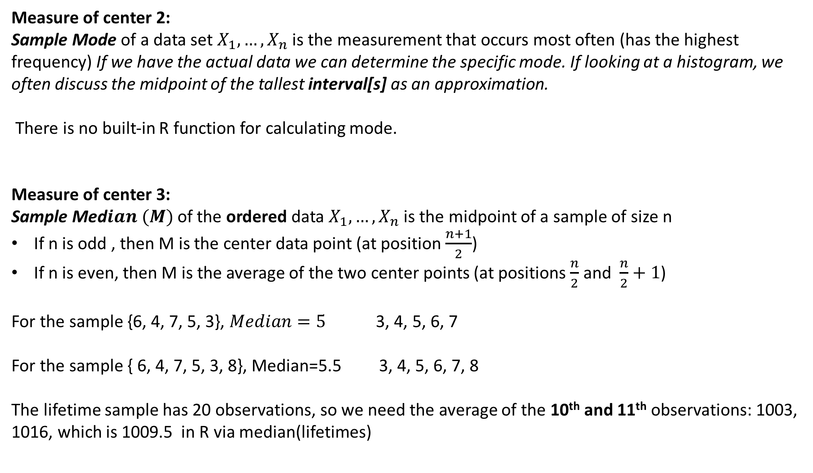
Descriptive Statistics (Numerically) cont.
Measure of center 2:
Sample Mode of a data set $X_{1},…, X_{n}$ is the measurement that occurs most often (has the highest frequency) If we have the actual data we can determine the specific mode. If looking at a histogram, we often discuss the midpoint of the tallest interval[s] as an approximation.
There is no built-in R function for calculating mode.
Measure of center 3:
Sample Med$ian (M)$ of the ordered data $X_{1},…, X_{n}$ is the midpoint of a sample of size n
If n is odd , then M is the center data point (at position $\frac{n+1}{2}$)
If n is even, then M is the average of the two center points (at positions $\frac{n}{2}$ and $\frac{n}{2}+1$)
For the sample {6, 4, 7, 5, 3}, $Median=5$ 3, 4, 5, 6, 7
For the sample { 6, 4, 7, 5, 3, 8}, Median=5.5 3, 4, 5, 6, 7, 8
The lifetime sample has 20 observations, so we need the average of the 10th and 11th observations: 1003, 1016, which is 1009.5 in R via median(lifetimes)
Notes:
Mode discussion pg 78-79 of O&L

Slide 11
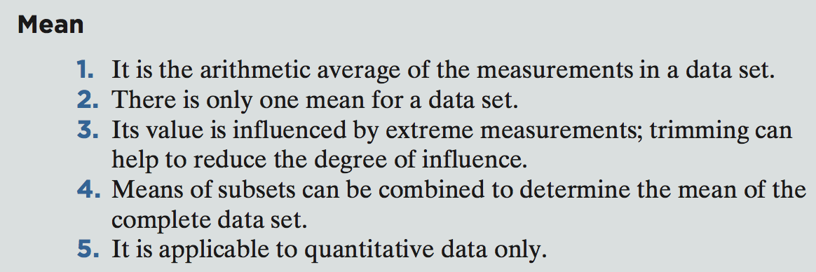
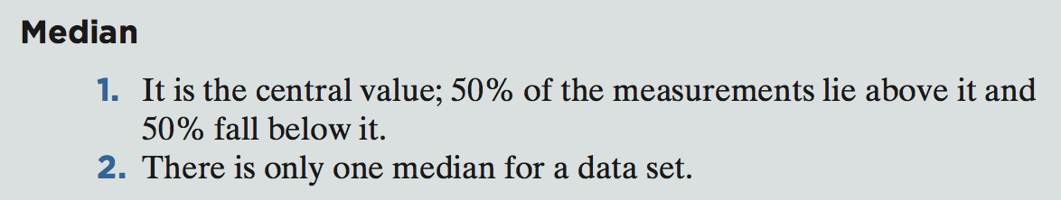
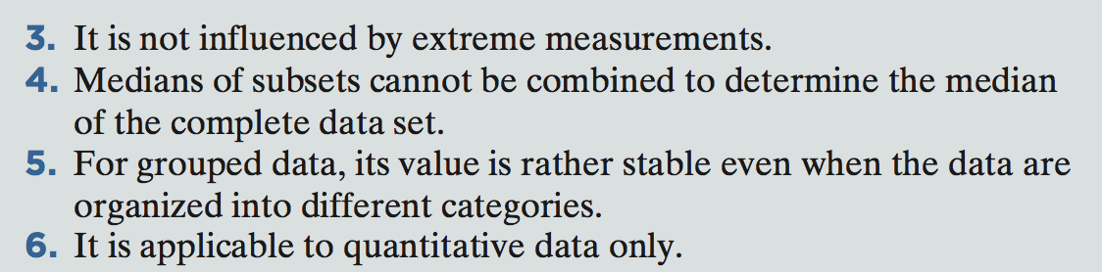
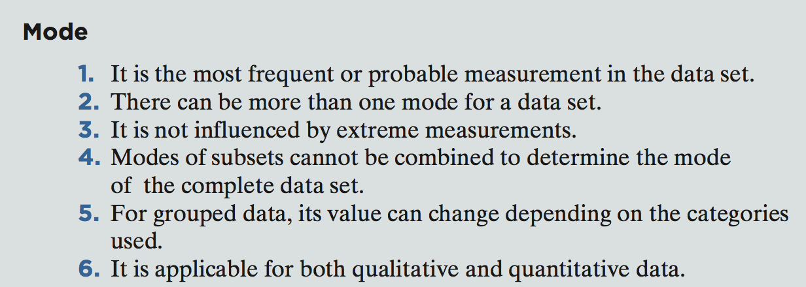
1. Why might you want to use the median instead of the mean as measure of center when the data has outliers / extreme values or is skewed?
2. In bimodal data, the mean and median are not real helpful for the full data set …why?
Major Characteristics of Each Measure of Central Tendency (O&L pg 85)

Slide 12
1. Why might you want to use the median instead of the mean as measure of center when the data has outliers - extreme values or is skewed?
The mean is highly affected by extreme values- one large value can drastically change the mean
2. In bimodal data, the mean and median are not real helpful for the full data set …why?
There are no actual values around the mean and median
Major Characteristics of Each Measure of Central Tendency (O&L pg 85)

Slide 13
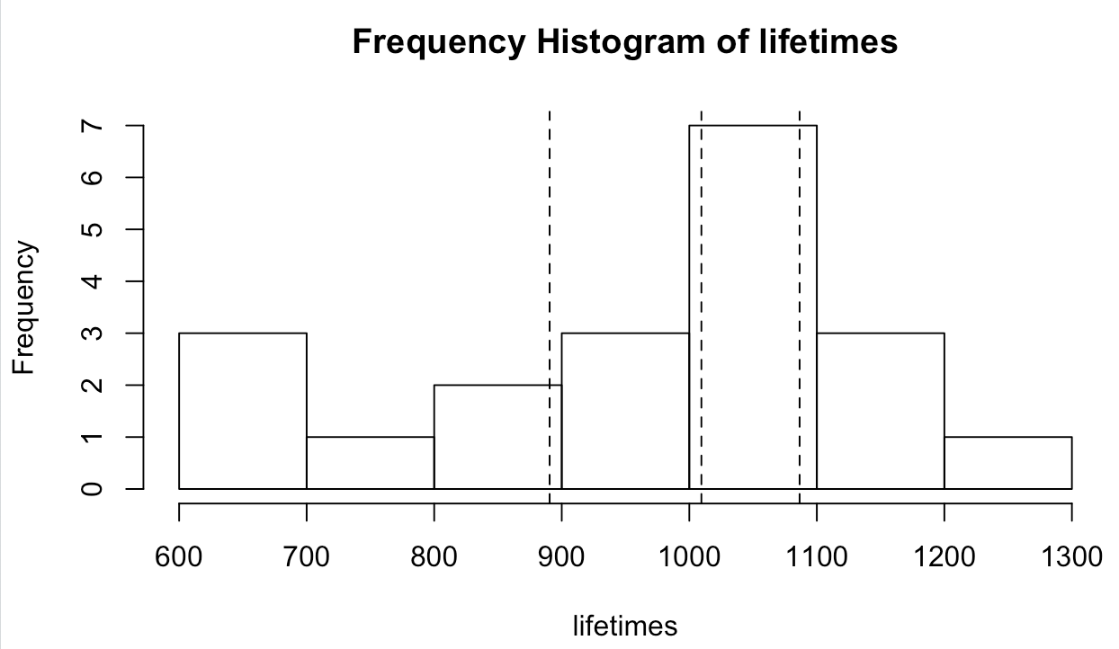
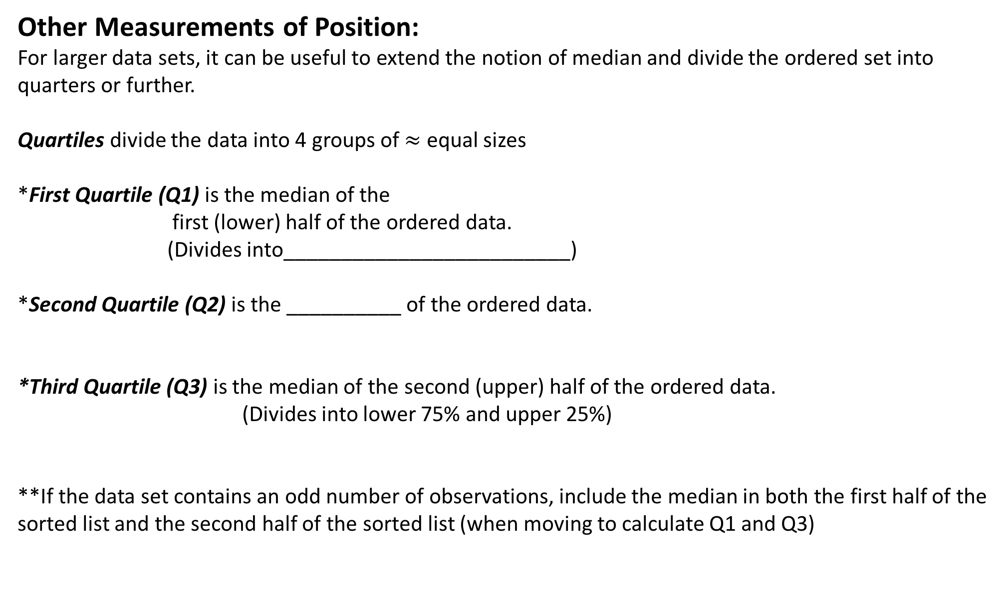
Descriptive Statistics (Numerically) cont.
Other Measurements of Position:
For larger data sets, it can be useful to extend the notion of median and divide the ordered set into quarters or further.
Quartiles divide the data into 4 groups of $≈$ equal sizes
*First Quartile (Q1) is the median of the
first (lower) half of the ordered data.
(Divides into_________________________)
*Second Quartile (Q2) is the __________ of the ordered data.
*Third Quartile (Q3) is the median of the second (upper) half of the ordered data.
(Divides into lower 75% and upper 25%)
**If the data set contains an odd number of observations, include the median in both the first half of the sorted list and the second half of the sorted list (when moving to calculate Q1 and Q3)
Q1
Q2
Q3

Slide 14
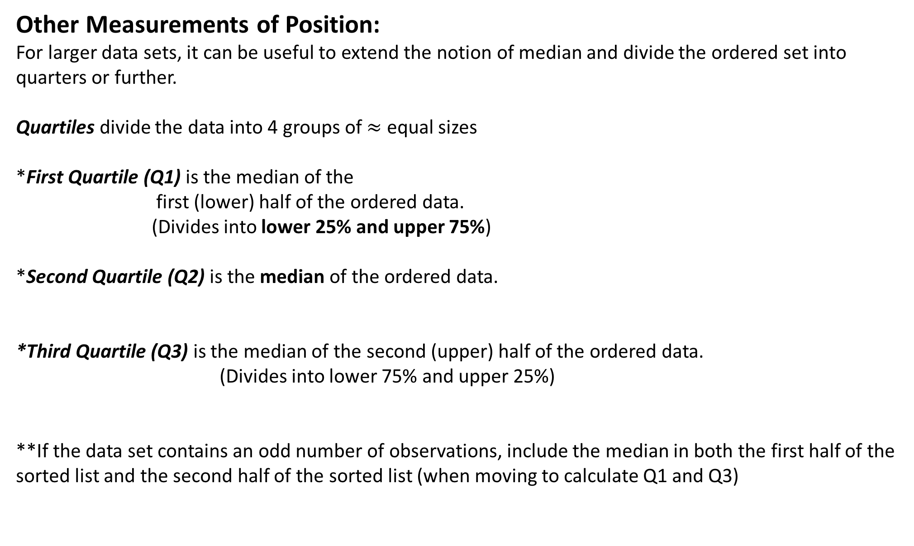
Descriptive Statistics (Numerically) cont.
Other Measurements of Position:
For larger data sets, it can be useful to extend the notion of median and divide the ordered set into quarters or further.
Quartiles divide the data into 4 groups of $≈$ equal sizes
*First Quartile (Q1) is the median of the
first (lower) half of the ordered data.
(Divides into lower 25% and upper 75%)
*Second Quartile (Q2) is the median of the ordered data.
*Third Quartile (Q3) is the median of the second (upper) half of the ordered data.
(Divides into lower 75% and upper 25%)
**If the data set contains an odd number of observations, include the median in both the first half of the sorted list and the second half of the sorted list (when moving to calculate Q1 and Q3)
Q1
Q2
Q3

Slide 15
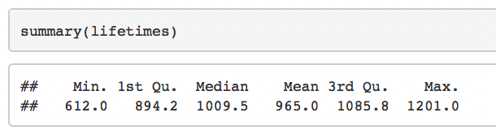
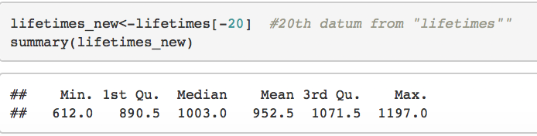
Descriptive Statistics (Numerically) cont.
Quartiles Considering the lamp lifetime data:
{612, 623, 666, 744, 883, 898, 964, 970, 983, 1003, 1016, 1022, 1029, 1058, 1085, 1088, 1122, 1135, 1197, 1201}
Summary in R gives us something else!?
*Just be clear in your hwk/exam what
Process you are using – R or by hand
Considering the lamp lifetime data (with highest value removed**):
{612, 623, 666, 744, 883, 898, 964, 970, 983, 1003, 1016, 1022, 1029, 1058, 1085, 1088, 1122, 1135, 1197}

Slide 16
Descriptive Statistics (Numerically) cont.
Quartiles Considering the lamp lifetime data:
{612, 623, 666, 744, 883, 898, 964, 970, 983, 1003, 1016, 1022, 1029, 1058, 1085, 1088, 1122, 1135, 1197, 1201}
Summary in R gives us something else!?
*Just be clear in your hwk/exam what
Process you are using – R or by hand
Considering the lamp lifetime data (with highest value removed**):
{612, 623, 666, 744, 883, 898, 964, 970, 983, 1003, 1016, 1022, 1029, 1058, 1085, 1088, 1122, 1135, 1197}
M= 1009.5
Q3= 1086.5
Q1= 890.5
Q3= 1071.5
M= 1003
Q1= 890.5
Notes:
Q1 is the median of the first 10 data values (since 20 total data values) and Q3 is the median of the last 10 data values.

Slide 17
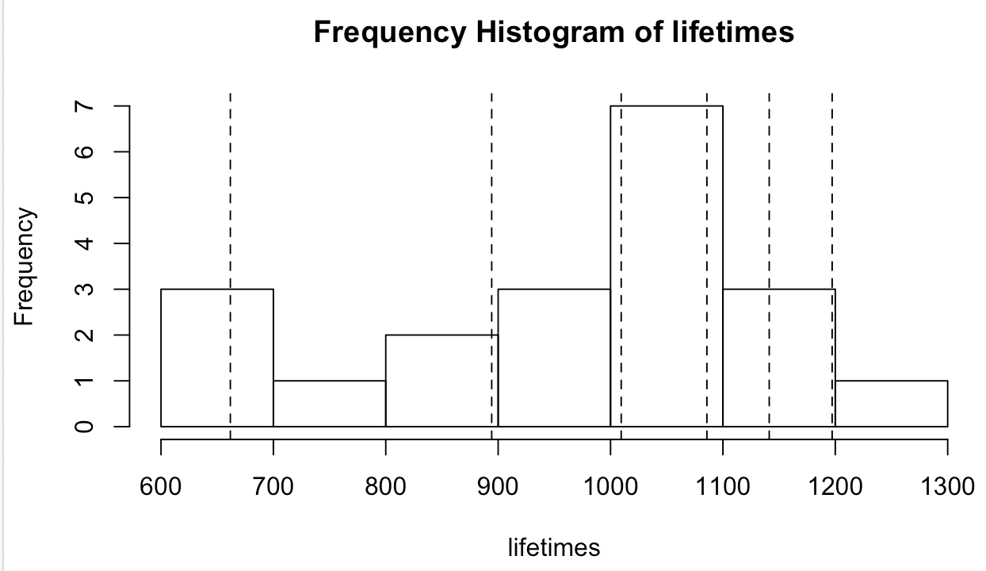
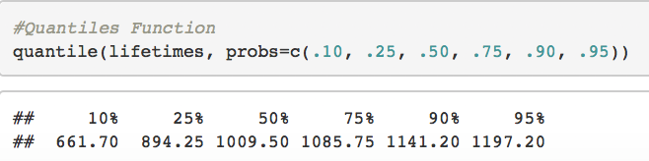
Descriptive Statistics (Numerically) cont.
Percentiles/Quantiles
More generally, we can define the percentile [quantile]
Defn: The pth percentile of a set of n measurements arranged in order of magnitude is that value that has at most p% of the measurements below it and at most (100-p)% above it. (We call it a quantile when we are interested in an arbitrary value q on [0,1] instead of p on [0%, 100%]).
The .25 quantile is Q1, the 0.5 quantile is Q2 (Median), and the 0.75 quantile is Q3
For now, will use R to find quantiles/percentiles: 0.10, Q1, Med, Q3, 0.90, 0.95. There are many acceptable ways of computing them. R has 9 (!) different ways of calculating quantiles.
*The different methods of calculating quantiles/percentiles typically give similar values for large data set.
Notes:
We’ll study these more extensively when we talk about normal distributions.

Slide 18
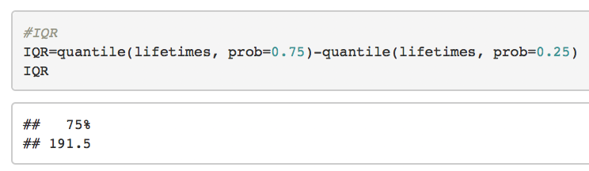
Descriptive Statistics (Numerically) cont.
Numeric/Quantitative Data:
if we are interested in the numeric values of the hours, then we concentrate on the measures of center, location and spread of the data.
Measures of SPREAD/VARIABILITY:
Range: Max Value- Min Value. range: ______________
2. Interquartile Range: IQR:____________. Difference between the third and first quartiles (range of middle __________of data) – this is the length of the box in the box plot
612, 623, 666, 744, 883, 898, 964, 970, 983, 1003, 1016, 1022, 1029, 1058, 1085, 1088, 1122, 1135, 1197, 1201
Q1= 890.5
Q3= 1086.5
IQR=

Slide 19
Descriptive Statistics (Numerically) cont.
Numeric/Quantitative Data:
if we are interested in the numeric values of the hours, then we concentrate on the measures of center, location and spread of the data.
Measures of SPREAD/VARIABILITY:
1. Range: Max Value- Min Value. range: 1201-612=589. Crude Measure.
2. Interquartile Range: IQR:Q3-Q1. Difference between the third and first quartiles (range of middle 50% of data) – this is the length of the box in the box plot
612, 623, 666, 744, 883, 898, 964, 970, 983, 1003, 1016, 1022, 1029, 1058, 1085, 1088, 1122, 1135, 1197, 1201
Q1= 890.5
Q3= 1086.5
IQR=1086.5-890.5=196
Notes:
Difference between methods in R vs by hand become less pronounced with larger data sets.

Slide 20
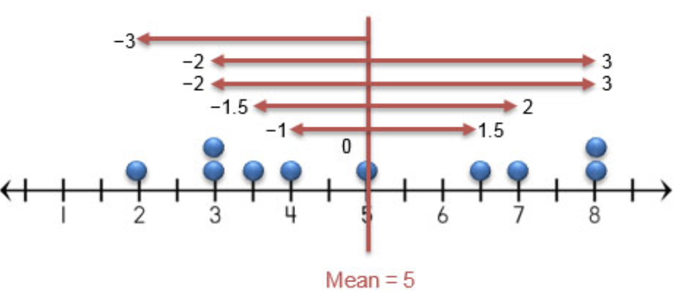
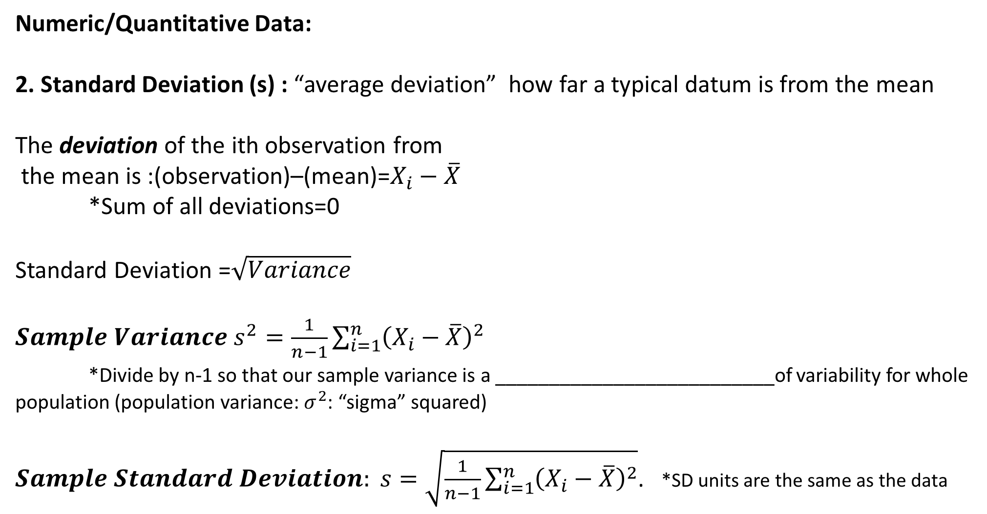
Descriptive Statistics (Numerically) cont.
Numeric/Quantitative Data:
2. Standard Deviation (s) : “average deviation” how far a typical datum is from the mean
The deviation of the ith observation from
the mean is :(observation)–(mean)=$X_{i}−\overline{X}$
*Sum of all deviations=0
Standard Deviation =$\sqrt{Variance}$
$Sample Variance s^{2}=\frac{1}{n−1}\sum_{i=1}^{n}{{\left(X_{i}−\overline{X}\right)}^{2}}$
*Divide by n-1 so that our sample variance is a __________________________of variability for whole population (population variance: $σ^{2}$: “sigma” squared)
$Sample Standard Deviation: s=\sqrt{\frac{1}{n−1}\sum_{i=1}^{n}{{\left(X_{i}−\overline{X}\right)}^{2}}}$. *SD units are the same as the data

Slide 21
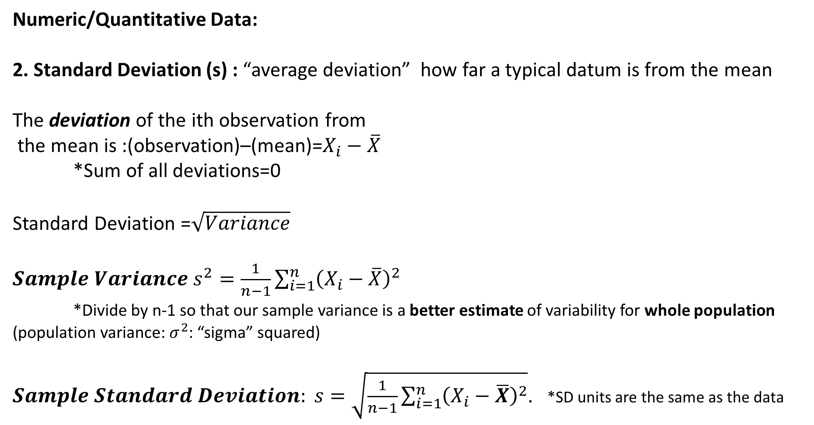
Descriptive Statistics (Numerically) cont.
Numeric/Quantitative Data:
2. Standard Deviation (s) : “average deviation” how far a typical datum is from the mean
The deviation of the ith observation from
the mean is :(observation)–(mean)=$X_{i}−\overline{X}$
*Sum of all deviations=0
Standard Deviation =$\sqrt{Variance}$
$Sample Variance s^{2}=\frac{1}{n−1}\sum_{i=1}^{n}{{\left(X_{i}−\overline{X}\right)}^{2}}$
*Divide by n-1 so that our sample variance is a better estimate of variability for whole population (population variance: $σ^{2}$: “sigma” squared)
$Sample Standard Deviation: s=\sqrt{\frac{1}{n−1}\sum_{i=1}^{n}{{\left(X_{i}−\overline{X}\right)}^{2}}}$. *SD units are the same as the data
Notes:
Walk through what the equation means
If we had all observations in our population, then x-bar would be equal to the population mean (mu) and then we could calculate our population variance sigma^2 by dividing by n.

Slide 22
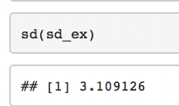
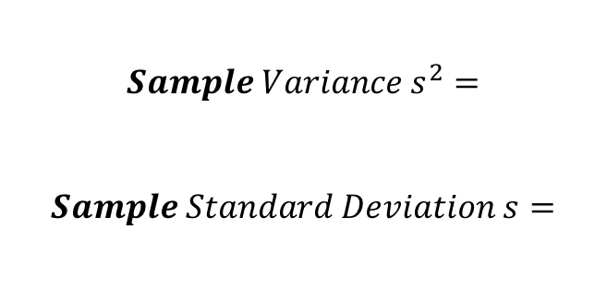
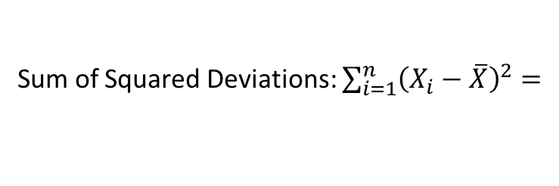
Descriptive Statistics (Numerically) cont.
Numeric/Quantitative Data:
2. Sample Standard Deviation (s) : “average deviation” how far a typical datum is from the mean
Ex: Calculate the sample standard deviation (s) of the numbers 3,5,8,10 by hand:
Data | Deviation from Mean | (Dev)^2
3 |  | (-3.5)^2=12.25
5
8 |  | (1.5)^2=2.25
10
Sum of Squared Deviations: $\sum_{i=1}^{n}{{\left(X_{i}−\overline{X}\right)}^{2}=}$
$$Sample Variance s^{2}=$$
$$Sample Standard Deviation s=$$
Check with R:

Slide 23
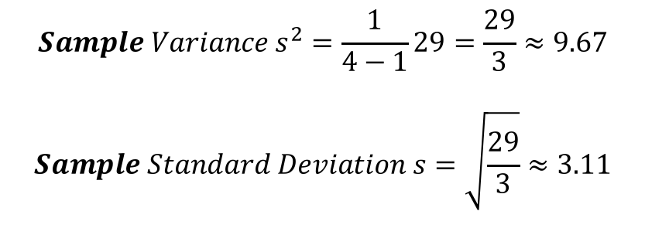
Descriptive Statistics (Numerically) cont.
Numeric/Quantitative Data:
2. Sample Standard Deviation (s) : “average deviation” how far a typical datum is from the mean
Ex: Calculate the sample standard deviation (s) of the numbers 3,5,8,10 by hand:
Data | Deviation from Mean | (Dev)^2
3 | 3-6.5=-3.5 | (-3.5)^2=12.25
5 | 5-6.5=-1.5 | (-1.5)^2=2.25
8 | 7-6.5=1.5 | (1.5)^2=2.25
10 | 10-6.5=3.5 | (3.5)^2=12.25
Sum of Squared Deviations: $\sum_{i=1}^{n}{{\left(X_{i}−\overline{X}\right)}^{2}=29}$
$$Sample Variance s^{2}=\frac{1}{4−1}29=\frac{29}{3}≈9.67$$
$$Sample Standard Deviation s=\sqrt{\frac{29}{3}}≈3.11$$
Check with R:
Notes:
Walk through what the equation means
If we had all observations in our population, then x-bar would be equal to the population mean (mu) and then we could calculate our population variance sigma^2 by dividing by n.

Slide 24
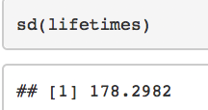
Descriptive Statistics (Numerically) cont.
Numeric/Quantitative Data:
2. Sample Standard Deviation (s)
Ex: Calculate the [sample] standard deviation for the lamp lifetime data
(Make sure you can also calculate this value with your calculator)
Mean and Standard Deviation are the most appropriate/useful measures of center and spread when:
*Data is fairly symmetric and highly concentrated around the central value. Why?
Median and IQR are the most appropriate/useful when:
*Data is highly skewed or has extreme outliers. Why?
EXAM TIP:
Learn how to calculate SAMPLE MEAN and SAMPLE STANDARD DEVIATON on your calculator
Notes:
Both mean and standard deviation are highly effected by the actual value of each datum, so they are both very reactive to extreme values.
The median and IQR may be more useful measures when data is highly skewed or has extreme outliers.

