Slide 1
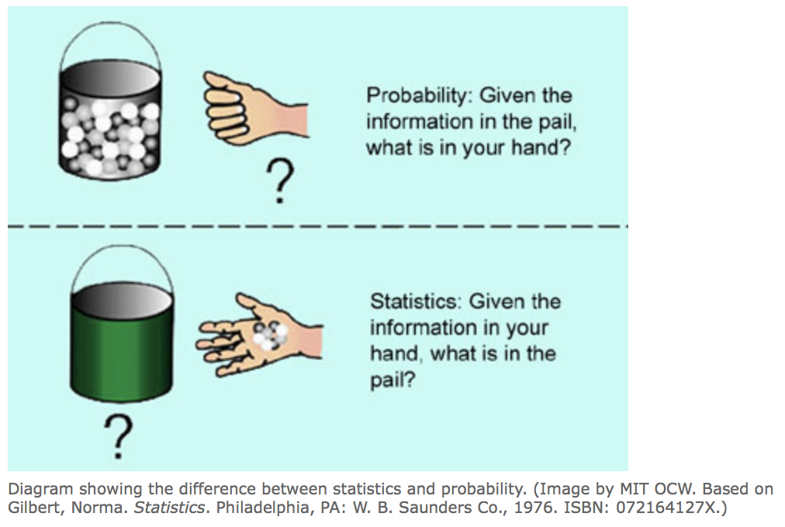
Probability vs Statistics
Population
Statistics
Sample

Slide 2
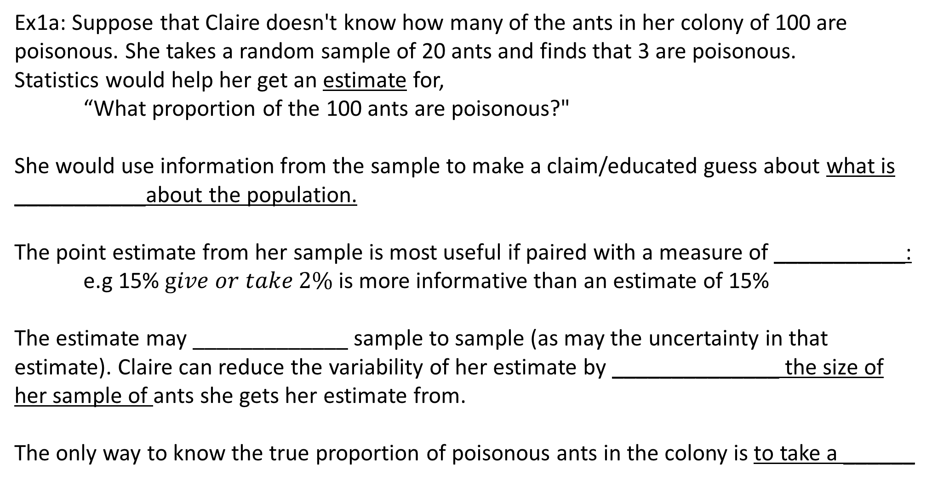
Probability vs Statistics
Ex1a: Suppose that Claire doesn't know how many of the ants in her colony of 100 are poisonous. She takes a random sample of 20 ants and finds that 3 are poisonous.
Statistics would help her get an estimate for,
“What proportion of the 100 ants are poisonous?"
She would use information from the sample to make a claim/educated guess about what is ___________about the population.
The point estimate from her sample is most useful if paired with a measure of ___________:
e.g 15% $give or take 2\%$ is more informative than an estimate of 15%
The estimate may _____________ sample to sample (as may the uncertainty in that estimate). Claire can reduce the variability of her estimate by ______________ the size of her sample of ants she gets her estimate from.
The only way to know the true proportion of poisonous ants in the colony is to take a ______

Slide 3
Probability vs Statistics
Population
Probability
Probability considers information from a population to understand how random samples from that population behave and how much _____________ in our statistic we will see sample to sample
Sample

Slide 4
Probability vs Statistics
Ex1b: Claire’s ant farm supports 100 ants. She knows 10 of the 100 ants are poisonous, but they are indistinguishable by sight.
Probability helps us answer questions like:
“If I select one ant at random, what is the chance that it is poisonous?”
“If I select a group of 10 ants at random, what is the chance that 3 or more are poisonous?”
Even though we know the percent of ants that are poisonous in the population, we can’t predict what will happen in any single random sample
*each ant will either be poisonous or not
*each sample of 10 ants could have between _____________ poisonous ants

Slide 5
Some Probability Terminology
A random process is any process that generates data in which the result has some amount of random chance involved.
e.g, Select one ant at random from the ant farm and observe whether it is poisonous.
e.g. coin flip, playing cards, sample of 3 students’ heights
e.g. randomly assign half of patients to treatment A and half to treatment B and observe weight loss
An [elementary] outcome is a distinct result of a random process.
e.g. the outcome of “poisonous” when evaluating an ant
e.g. H when flipping a coin, Queen of Hearts when choosing a card from a deck, (64, 61, 73)
e.g. observed weight loss of all patients on A and on B
A sample space S is the set of all possible ____________________ of a random process.
e.g. {poisonous, nonpoisonous}, {H,T}, {1,2,3,4,5,6}, {52 cards from a deck}, {all possible trios heights}
An event E is a collection of outcomes (_____________________of the sample space)
e.g. E1={Club}, E2={2 heights < 60 inches}, E3={mean weight loss of group A< mean weight loss of group B}
an event is said to have occurred if at least one of the outcomes in this collection occurs; not all outcomes in the collection need occur for the event to be said to occur.

Slide 6
Applying Terminology
Ex2: An engineer has a box containing 4 bolts and another box containing 4 nuts. The diameters of the bolts are 4,6,8, and 10 mm, and the diameters of the nuts are 6,10, 12, and 14 mm. One bolt and one nut are chosen.
a. How large is the sample space S?
Specify the subsets corresponding to the events A and B.
b. Let A be the event that the bolt diameter is less than 8.
c. Let B be the event that the bolt and the nut have the same diameter.

Slide 7
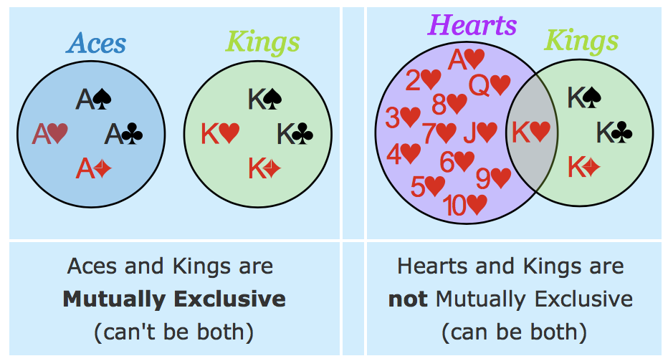
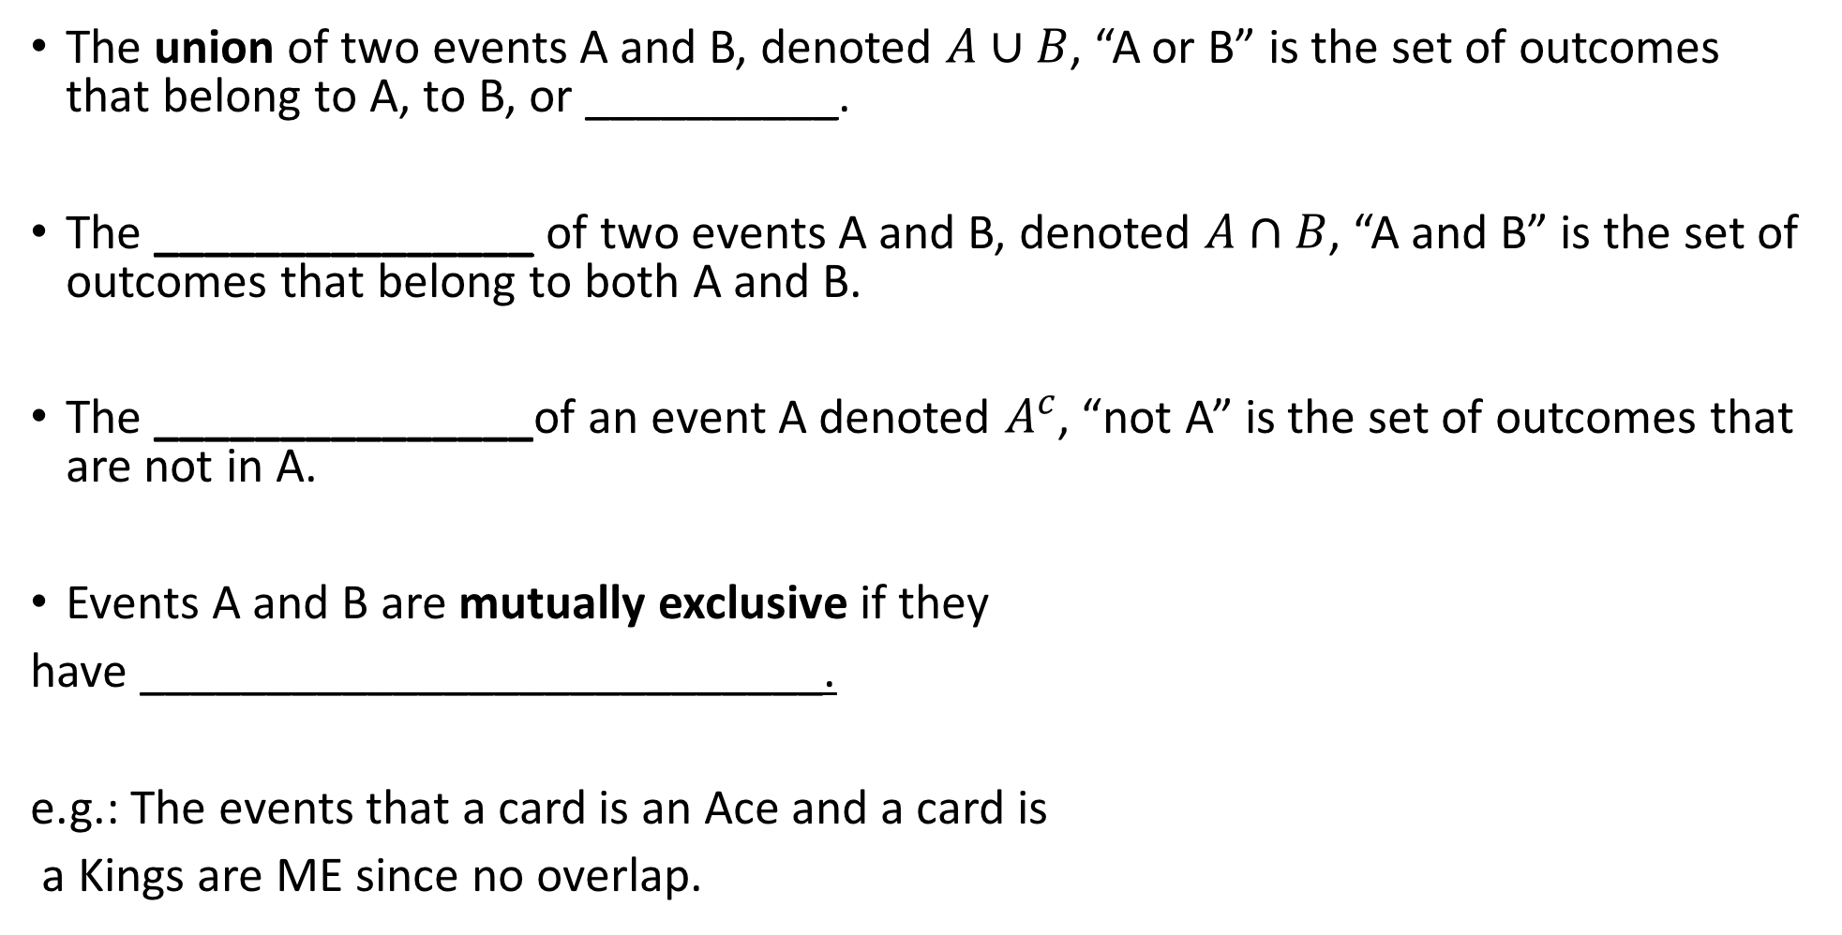
Some Terminology(optional)
The union of two events A and B, denoted $A∪B$, “A or B” is the set of outcomes that belong to A, to B, or __________.
The _______________ of two events A and B, denoted $A∩B$, “A and B” is the set of outcomes that belong to both A and B.
The _______________of an event A denoted $A^{c}$, “not A” is the set of outcomes that are not in A.
Events A and B are mutually exclusive if they
have ___________________________.
e.g.: The events that a card is an Ace and a card is
a Kings are ME since no overlap.

Slide 8
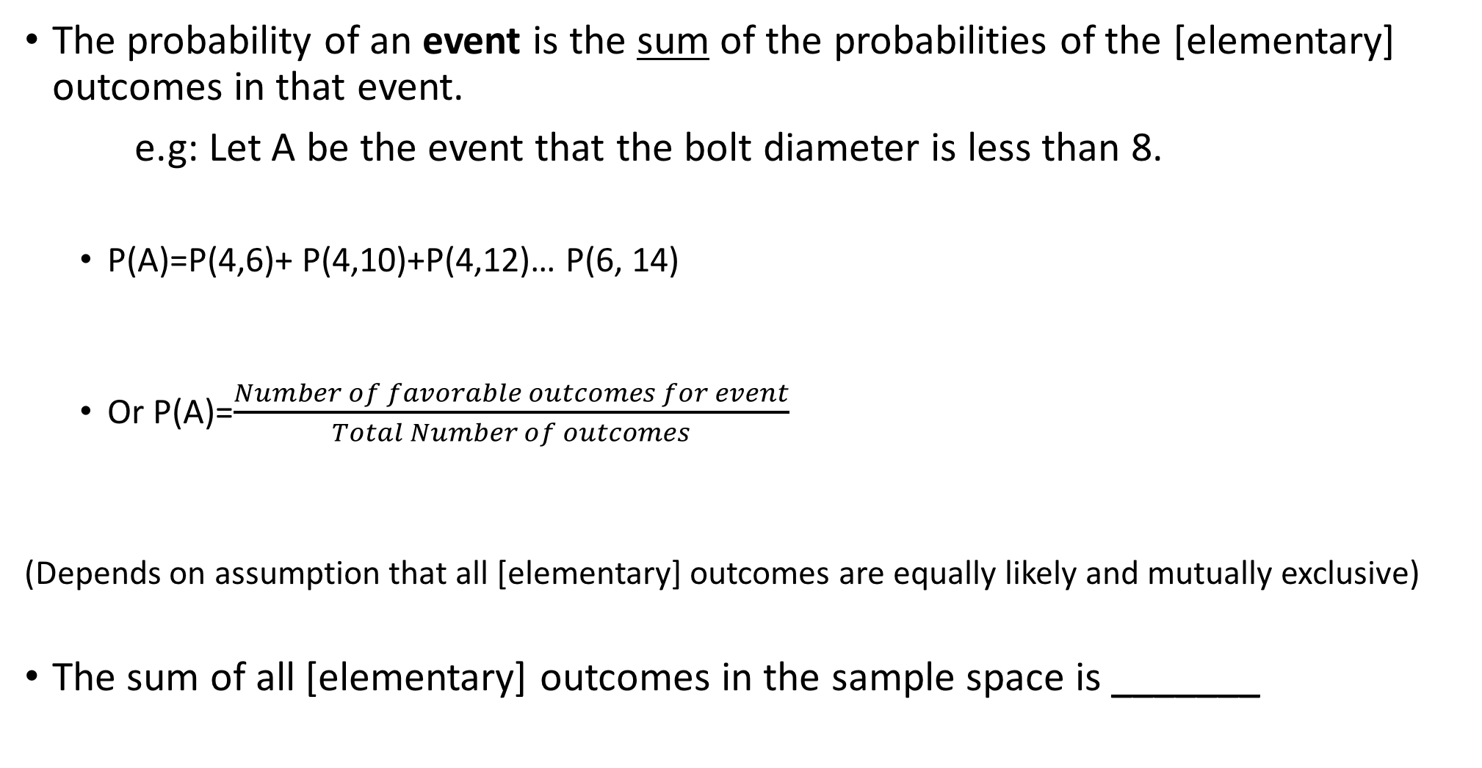
Properties of Probability (in the context of a finite sample space)
The probability of an event is the sum of the probabilities of the [elementary] outcomes in that event.
e.g: Let A be the event that the bolt diameter is less than 8.
P(A)=P(4,6)+ P(4,10)+P(4,12)… P(6, 14)
Or P(A)=$\frac{Number of favorable outcomes for event}{Total Number of outcomes}$
(Depends on assumption that all [elementary] outcomes are equally likely and mutually exclusive)
The sum of all [elementary] outcomes in the sample space is _______

Slide 9
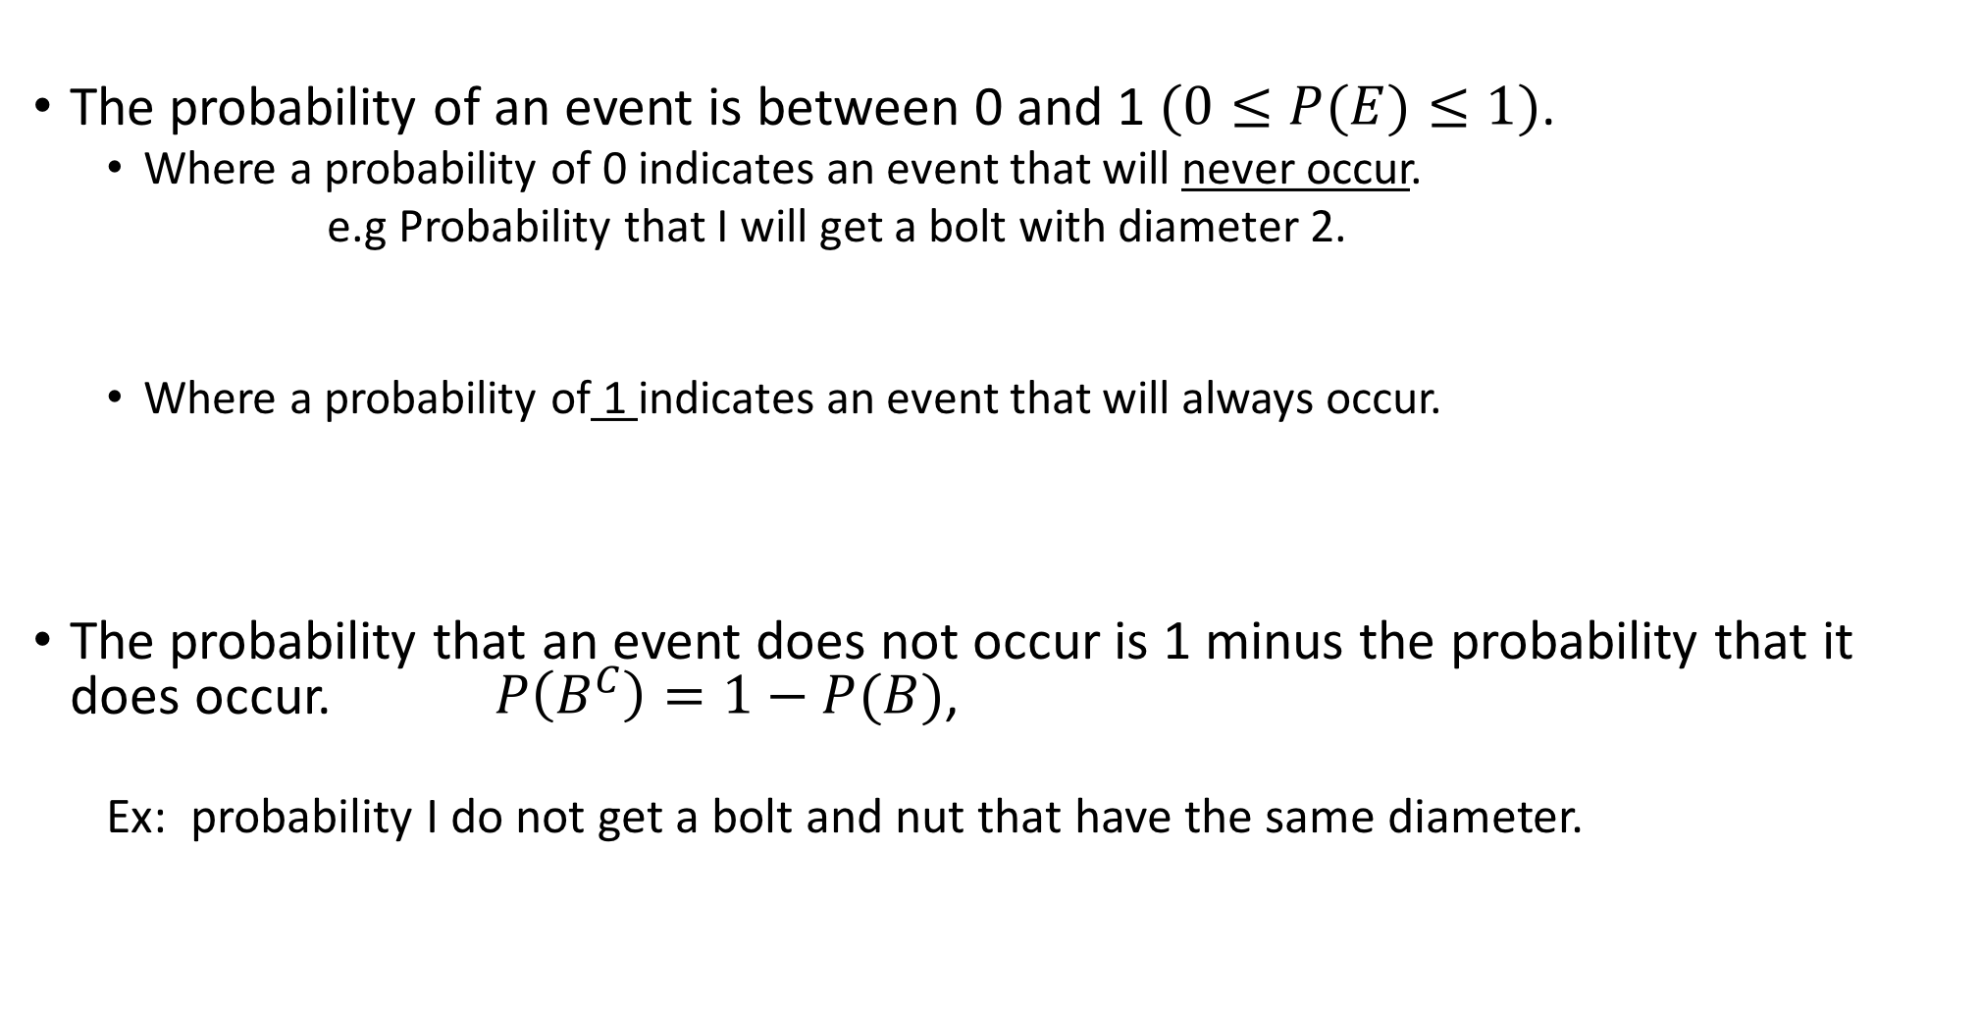
Properties of Probability (in the context of a finite sample space)
The probability of an event is between 0 and 1 $(0≤P(E)≤1)$.
Where a probability of 0 indicates an event that will never occur.
e.g Probability that I will get a bolt with diameter 2.
Where a probability of 1 indicates an event that will always occur.
The probability that an event does not occur is 1 minus the probability that it does occur. $P\left(B^{C}\right)=1−P(B)$,
Ex: probability I do not get a bolt and nut that have the same diameter.

Slide 10
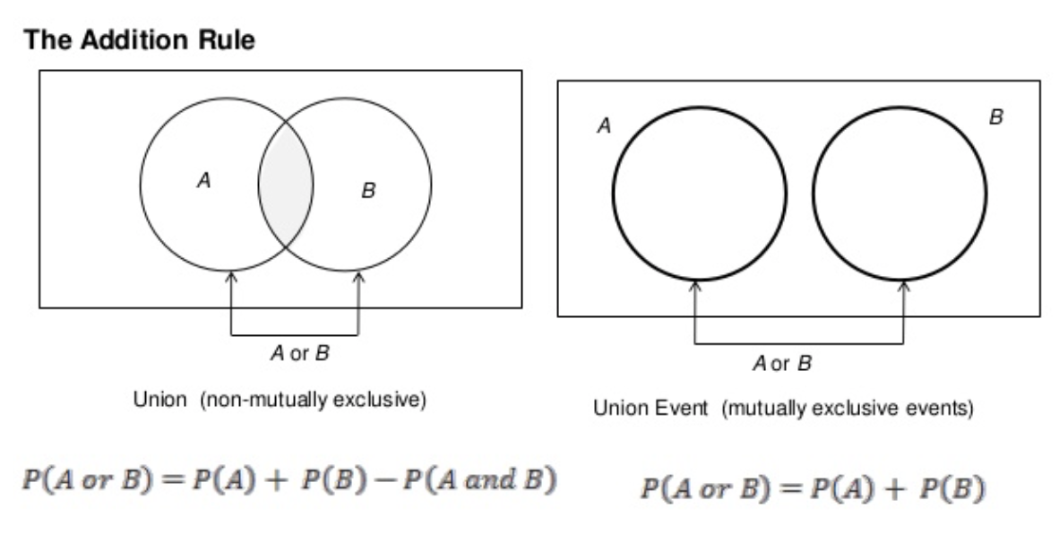
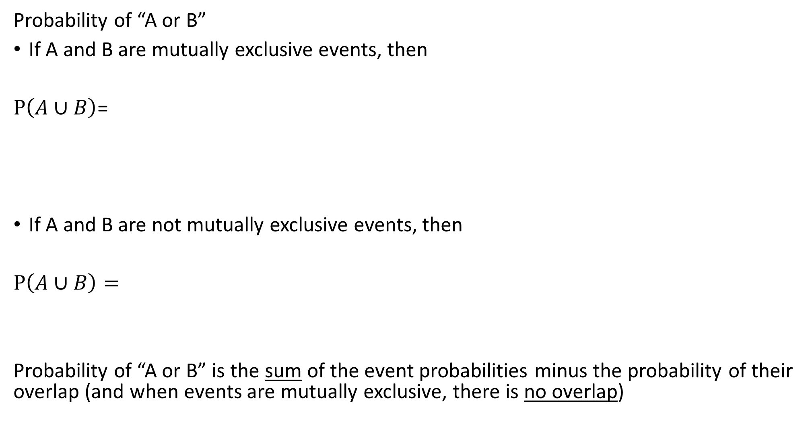
Properties of Probability (optional)
Probability of “A or B”
If A and B are mutually exclusive events, then
$P\left(A∪B\right)$=
If A and B are not mutually exclusive events, then
$P\left(A∪B\right)=$
Probability of “A or B” is the sum of the event probabilities minus the probability of their overlap (and when events are mutually exclusive, there is no overlap)

Slide 11
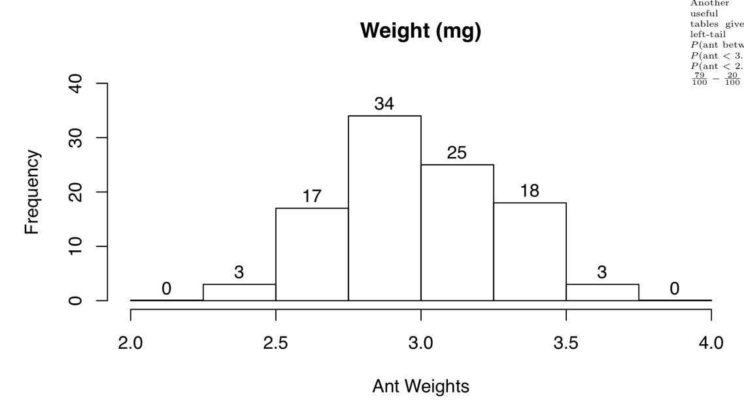
Applying Basic Probability
Ex 3: Consider the 100 ants again. Here are their weights.
(using the convention that values on borderline are included in
upper bin)
If one ant is selected at random, what is the probability…
Its weight is less than 2.75mg?
Its weight is at least 2.75 mg?
Its weight is between 2.5 and 3.5? *Check against relative frequency
with repeated sampling.
Its weight is at least 3.5 or less than 2.5 mg?

Slide 12
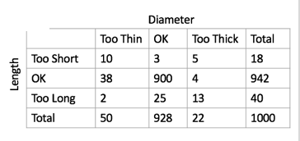
Properties of Probability- Independence
Two events are said to be independent if the occurrence of one does not change the probability of the other. Otherwise, they are dependent.
5g. If an aluminum dowel is randomly sampled from the day,
Compare the unconditional probability of the dowel being too long and the conditional probability of it being too long given it is too thin.
What does that tell us about the events “Dowel is too thin” and “Dowel is too long” ?

Slide 13
Reasonableness of Independence Assumption
In most cases, the best way to determine whether independence of events is a good assumption is through understanding the process that produces the events.
A die is rolled. Is it reasonable to believe that the outcome of the second roll is independent of the first roll?
A card is chosen. Is it reasonable to believe that the outcome of the second card chosen is independent of the first card?
A chemical reaction is run twice,
Using different equipment each time -
Using the same equipment each time –
The items in a simple random sample may be treated as independent (even though this is sampling without replacement), unless the population is finite and the sample comprises more than about 5-10% of the population (you will look at this in discussion).

Slide 14
Probability Practice
Ex 7: A system contains two components, A and B, connected in series as shown in the following diagram. The system will function only if both components function. The probability that A functions is P(A)=0.98, and the probability that B functions is P(B)=0.95. Assume that A and B function independently. Find the probability that the system functions.
Ex 8: A system contains two components, C and D, connected in parallel as shown in the following diagram. The system will function if either C or D functions. The probability that C functions is 0.90 and the probability that D functions is 0.85. Assume that C and D function independently.
Find the probability that the system functions.
A
B
C
D

Slide 15
Probability Practice
Dog | 1 | 2 | 3 | 4
Sex | M | M | F | F
Age (weeks) | 10 | 15 | 10 | 10
Ex 9: Four young lab puppies from different litters are
available for a new method of training. Two dogs will be
selected by lottery to receive the training. Assuming that each
pair of dogs are equally likely to receive the training calculate the following probabilities:
9a. P(A) where A is the event that the dogs are the same gender.
9b. P(B) where B is the event that the dogs are the same age.
9c. P(A or B)
9d. Are A and B mutually exclusive? 9e. Are A and B independent?
We can list out all of the pairs to check our answers: (12, 13, 14, 23, 24, 34)

Slide 16
Probability Practice
Ex 10: Consider Rolling 6-sided die. Find the probability for these events:
Observing an odd number with one roll of the die.
Observing a number greater than 4 on one roll of the die.
Observing a number that is even and a number that is greater than 2 on one roll of the die.
Rolling exactly 1 six in 4 rolls of the die.
Rolling at least 1 six in 4 rolls of the die.

