Slide 1
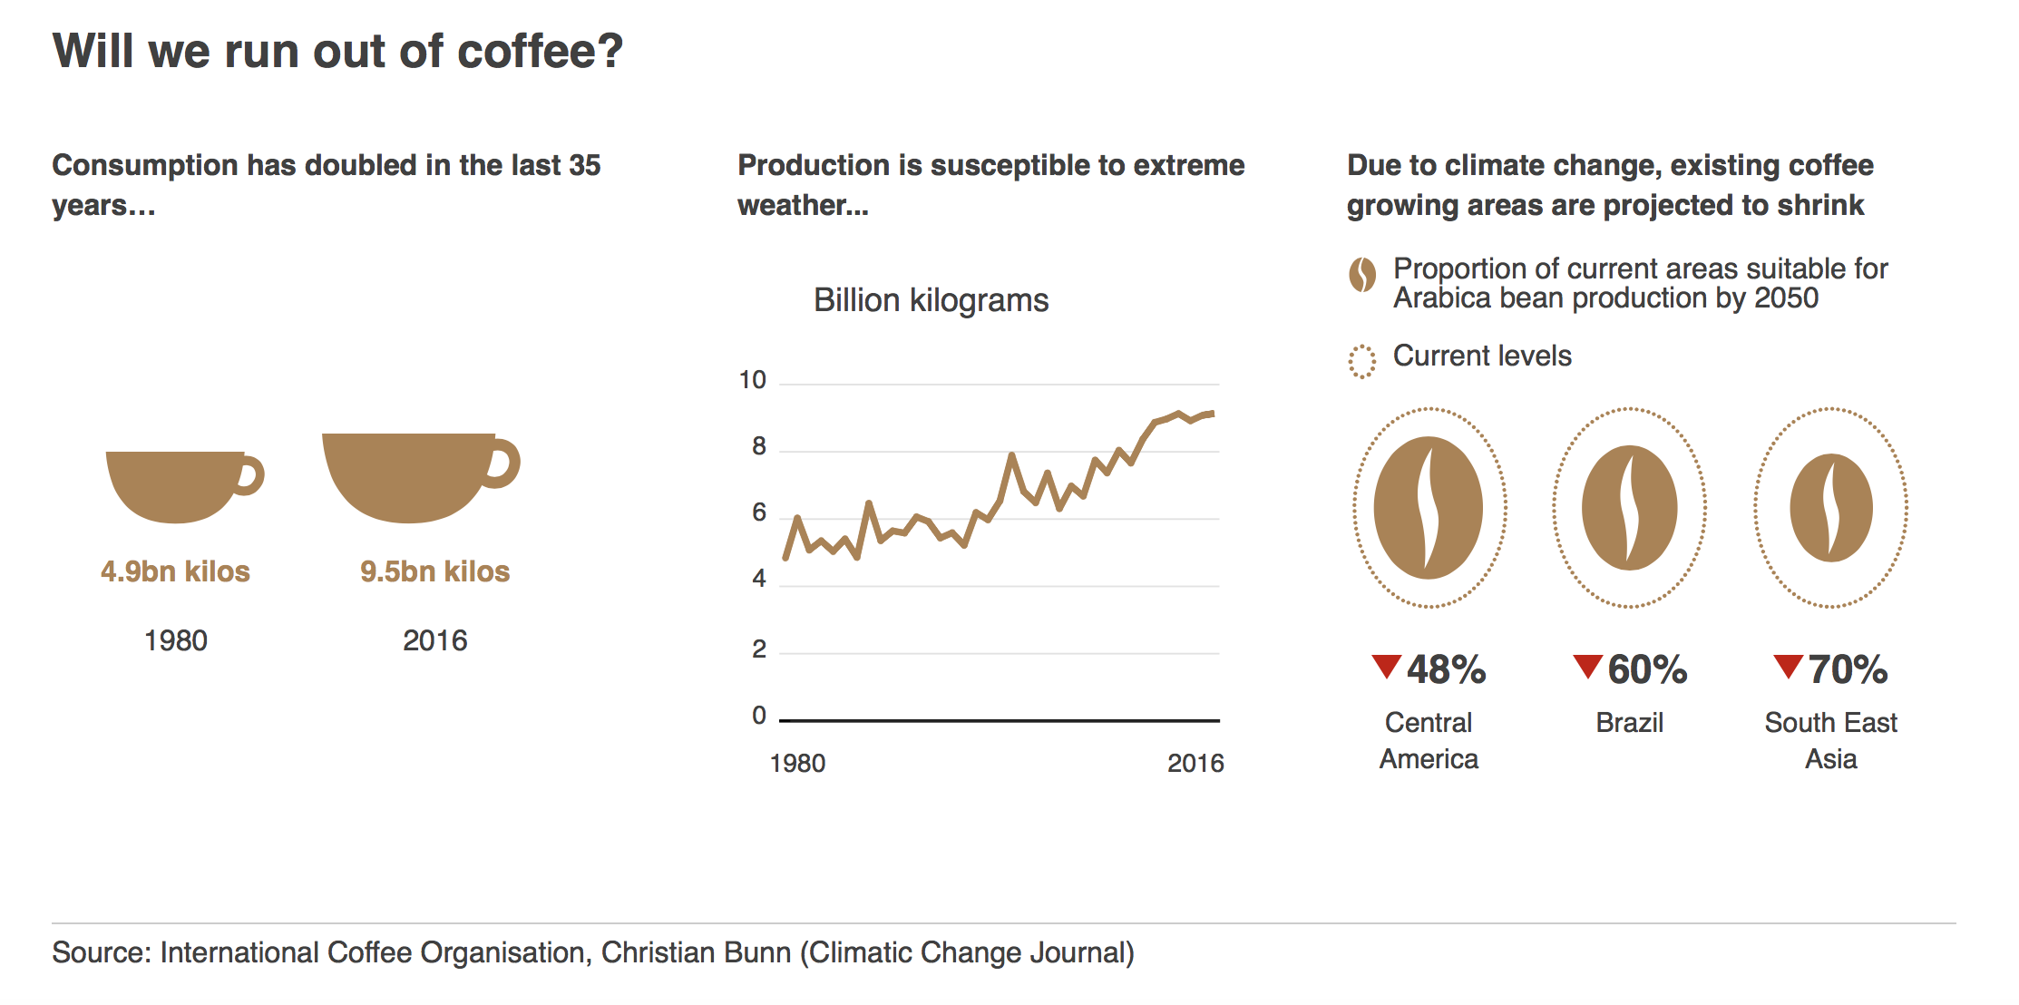
Why Study Statistics?
www.bbc.co.uk 19 June 2017
Notes:
https://www.bbc.co.uk/news/resources/idt-fa38cb91-bdc0-4229-8cae-1d5c3b447337

Slide 2
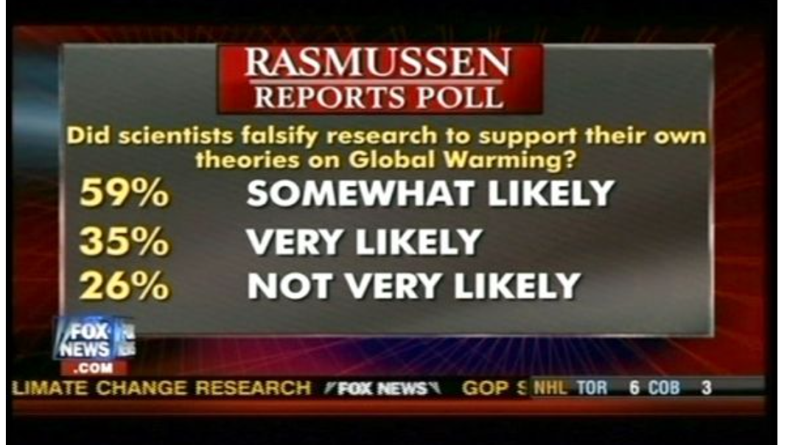
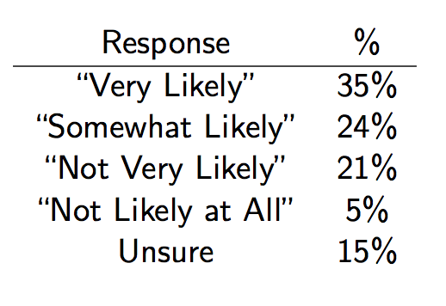
Why Study Statistics?
Fox News, America’s Newsroom, 12/8/09, via Media Matters
Via Media Matters

Slide 3
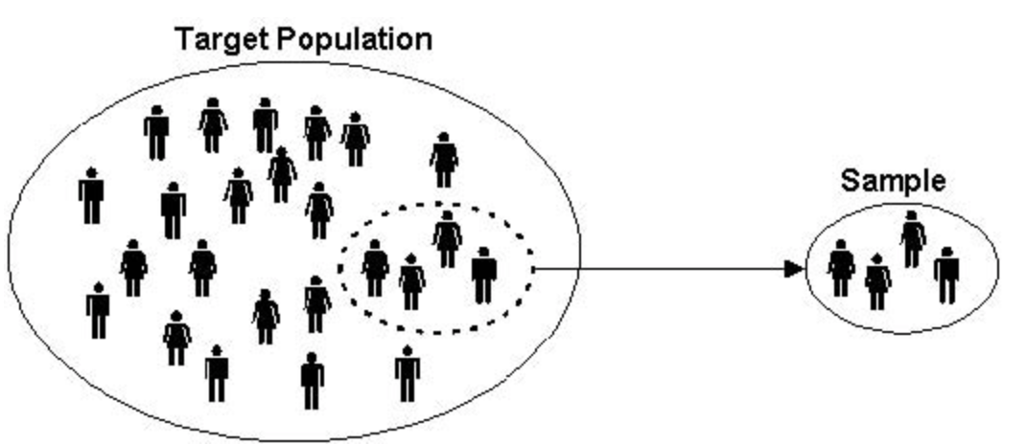
What is Statistics?
Necessary Vocabulary
A population is the entire collection of objects or outcomes about which information is sought.
A parameter is a numeric summary of a population’s characteristic[s].
A sample is a subset of a population, containing the objects or outcomes that are actually observed
A statistic is a numeric summary of the sample’s characteristic[s].
Ex: I’d like to know the percent of UW Madison
students who would cheer for Ohio State if they
made it to the Final 4.
Notes:
Population can be tangible: customers of a utility company, concrete blocks in a pile, bolts in a shipment or conceptual: all values that might possibly have been observed (ex: engineer measures the length of a rod five times, being as careful as possible to take measurement under identical conditions. The set of all values that might possibly have been observed)
collection of data on all members of the population
Parameter can be determined exactly if we can take a census, but very seldom can we get a true census. Census: When we can contact the whole population of interest

Slide 4
What is Statistics?
A. Descriptive Statistics
Graphical and Numerical summaries of observed data.
Summarizing data in “useful” ways that could reveal interesting patterns lurking within.
The type of data we’ve collected and the questions we have will drive what summaries are most useful/appropriate.
Notes:
Graphical

Slide 5
What is Statistics?
B. Inferential Statistics
Making inferences (educated guesses/probabilistic claims) about a population by studying a relatively small sample chosen from it.
A point estimate is a statistic used to estimate a parameter.
E.g. We may ask the classmates we are having lunch with if they would cheer for Ohio State in final 4, and use that percent to estimate the percent for all students
A confidence interval is a range of probabilistically plausible values for a parameter, in light of a sample.
In a hypothesis test , we write a hypothesis about a population parameter and then reject or retain it in light of the evidence from the sample data.
In a linear model, we estimate and make claims about the slope and intercept of a line relating one variable to another.
Notes:
Probably not a very good estimate, but it is something commonly done.

Slide 6
Types of Data
The types of data you are interested in drives the type of descriptive and inferential statistics you use – not always cut and dry designation - more on this later
Types of Data
Numerical
/Quantitative
How much? How many? For each element of sample
Continuous – any value in a range is possible; things that could theoretically be measured to high degree of accuracy.
e.g.: time, length, width
Categorical
/Qualitative
Are sample items placed into categories?
Discrete –only certain specific values are possible. Counting numbers are a common example.
e.g. number of children, number of pets
Nominal –Categories with no natural order.
e.g.: gender, dog breed, color
Ordinal –Categories with a natural order.
e.g: Likert Score, Grade in School
Notes:
Numerical Quantitative: when numerical quantity desgnating how much or how many is assigned to each item in a sample
Continuous: time, lengths, widths, concentrations
Discrete: number of children, number of pets
Nominal : gender, dog breed, color
Ordinal: Natural order exists: ex: likert scale strongly disagree, neutral, strongly agree

Slide 7
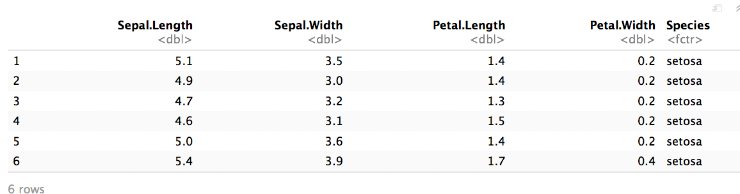
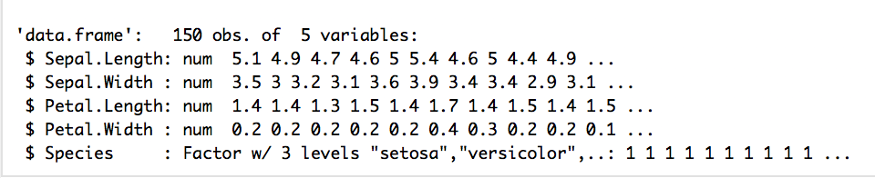
Types of Data
Often, quantitative and categorical data are collected in the same experiment or observational study.
Ex: Iris data
Variables and their Type:
Notes:
Numerical Quantitative: when numerical quantity desgnating how much or how many is assigned to each item in a sample
Continuous: time, lengths, widths, concentrations
Discrete: number of children, number of pets
Nominal : gender, dog breed, color
Ordinal: Natural order exists: ex: likert scale strongly disagree, neutral, strongly agree,

Slide 8
Course Information
GOALS
Logistics
1. Produce appropriate numeric and graphical summaries of simple data.
2. Articulate the basics of probability and statistics
3. Recognize and apply statistical methods appropriate for analysis of a data set in some situations, and know when to ask a statistician for help.
4. Relate data and analyses back to the original context in which data was collected.
5. Use R, a free statistical software package, for statistical computations and graphs.
1. Bring your computer to lecture and discussion so you can get some R practice as we go.
2. Lecture and Discussion attendance are essential for getting the practice necessary to become proficient.
3 Note taking is one form of practice
4. Read the Syllabus for logistics questions.

Slide 9
Computational Tools we will use
R (free statistical programming language) and R Studio (a free integrated development environment)
Calculators will be used for exams so should also practice using calculator on HWK. You will be reading some R output on exams, but you will not be doing any R coding during exam time.

Slide 10
For Next Time:
Read through the syllabus and put the exam dates on your calendar.
Install R and Rstudio on your computer and then bring your computer with you to discussion.

