Slide 1

COVID 19 Detection from radiograph using Computer Vision Deep Learning
PROJECT-1 (ECD-416)
Submitted By-
Sunil Kumar 17mi438
Divyanshu Bhaik 17mi446
Prayas Thakur 17mi437
Rahul Sharma 17mi426
ECE Dual Degree (BTech & MTech)
Under the Guidance of
Dr. Abhijit Bhattacharyya
Assistant Professor
Department of Electronics and Communication Engineering
National Institute of Technology Hamirpur, 177005 Himachal Pradesh

Slide 2
Index
Project Overview
Literature survey
Objective to be carried out
Dataset Management
Pipelining
Methodology Adopted
Observations

Slide 3
Project Overview
Coronavirus disease (COVID-19) is an infectious disease caused by a newly discovered coronavirus severe acute respiratory syndrome coronavirus 2 (SARS-CoV-2). Currently, the detection of coronavirus disease 2019 (COVID-19) is one of the main challenges in the world, given the rapid spread of the disease.
Basic method Reverse Transcription-Polymerase Chain Reaction (RT-PCR) test has turned out as a gold standard for identifying COVID-19 patients [4]. However, the RT-PCR test becomes infeasible in the severely affected areas during early outbreak of the pandemic. In addition, the preparation of sample and poor-quality control techniques lead to increase in false-negative rates [5].
We are working on an an artificial-intelligence technique based on computer vision Deep Learning to detect COVID-19 patients using real-world datasets. Our system examines chest X-ray images to identify such patients. Our findings indicate that such an analysis is valuable in COVID-19 diagnosis as X-rays are conveniently available quickly and at low costs

Slide 4
Literature survey
We are using Computer vision deep learning in this project. Computer vision is a field of artificial intelligence that trains computers to interpret and understand the visual world. Using digital images from cameras and videos and deep learning models, machines can accurately identify and classify objects — and then react to what they “see.”
deep learning is a machine learning technique. It teaches a computer to filter inputs through layers to learn how to predict and classify information. Observations can be in the form of images, text, or sound. The inspiration for deep learning is the way that the human brain filters information.

Slide 5
Objective to be carried out
Proper Segmentation of the X-Ray lungs images and classification of COVID-19 from other pneumonia and healthy subjects using the segmented X-Ray images.

Slide 6
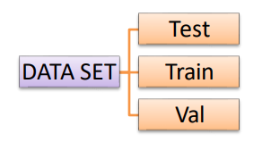
Dataset Management
Image Pre-processing Dataset
We have used four dataset for this research from given sources
https://arxiv.org/abs/2003.11597
https://github.com/ieee8023/covid-chestxray-dataset
https://www.kaggle.com/paultimothymooney/chest-xray-pneumonia
we further created folders of data set to attain higher accuracy.

Slide 7
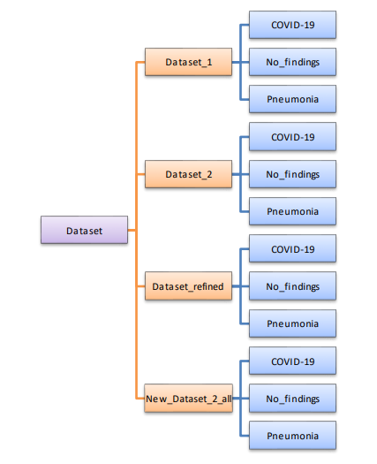
Classification Dataset

Slide 8
Dataset_1`
Dataset_1 is taken from Cohen. Which contains 1347 images.
Dataset_refined Dataset_refined
is the subset of Dataset_1 which contains 1000 best images from previous dataset.
New_Dataset_2_all
This dataset contains data from all above given sources. And as per categories it contains COVID-19 – 722 images Pneumonia – 1500 images Normal – 1500 images
Dataset_2
This dataset contains best images from above all datasets.

Slide 9
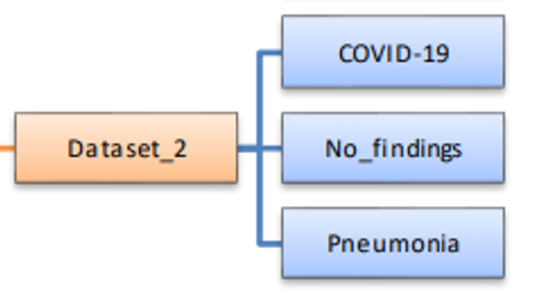
Selected Dataset after Model Performance Evaluation on each Dataset

Slide 10
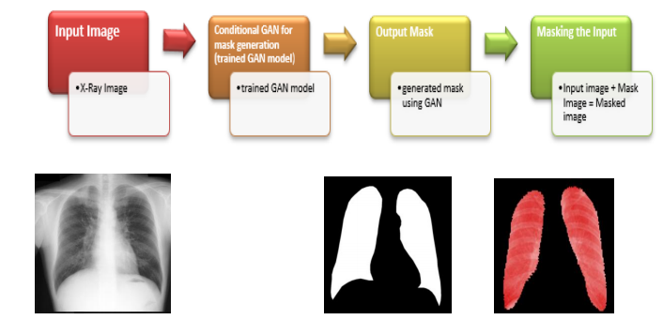
Final Pipeline of Operation-

Slide 11
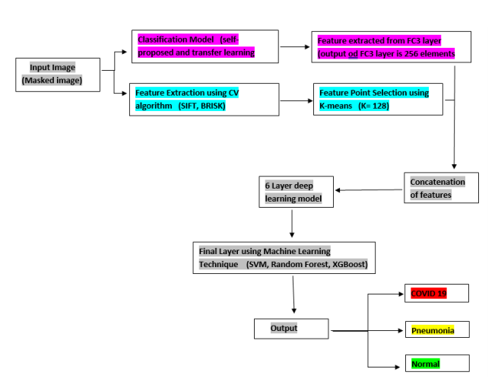

Slide 12
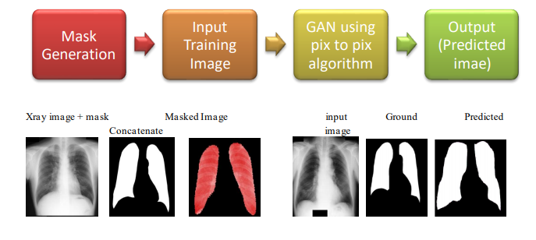
Pipeline of processing
Generation of masked images
Predicted NAND/OR Xray Masked Image

Slide 13
Classification
We have proposed a particular pipeline for classification of Xray Images of a patient into three types. Namely COVID-19, Pneumonia, Normal. For this particular pipeline we have tested best performing pretrained classification models from ImageNet available in Keras Library. Also we have tested a self-defined Simple Convolution Network for the same purpose.

Slide 14
Name of the training model used
Name of the training model used
Simple Convolution Network (self-defined)
VGG-16
VGG-19
Xception
DenseNet169
DenseNet201
InceptionResNetV2
NASANetLarge

Slide 15
DATA type of trained images
• Maximum number of images for particular class for training is 700 due to RAM restriction.
• Test Size for validation data is 0.1% of total data.
• For transfer learning models we have used include top = true and weights are downloaded from ImageNet.
• Fully connected dense layer used after flatten layer are
FC1, FC2, FC3 and Output.
Number of Perceptron 4096 1024 256 3
Activation Function relu relu relu SoftMax

Slide 16
• Optimizer - Adam Optimizer
Learning rate=0.001
• Loss Function – Categorical Cross Entropy
• Matrix of evolution during training is accuracy.
• We have used pre-processed input functions related to every transfer learning model used ion this research.
• Call Back used Model Check Point ReduceLROnPlateau
• Epoch range (100-300)
• Feature Extraction using Computer Vision Libraries Feature extraction algorithm used SIFT, BRISK Threshold value = 50 Clustering using K-means. Value of k = 128
• Combining all Processes Combining the outputs from K-means clustering and FC3 layer of trained models earlier.
Total feature = 384
Maximum input data for training = 2100 Containing maximum of 700 training data per class.
Total size = 0.1% of total data.

Slide 17
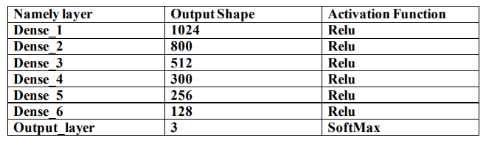
DL model contain total no. of 7 layers

Slide 18
Optimizer- Adam optimizer
Learning rate- 0.001
Loss function – Categorical cross entropy
Matrix of evolution- accuracy
Call-backs Model check point ReduceLROnPlateau
Epoch range – (100-300)
ML method use Output from Dense_6 layer = 128 are used as the input for the machine learning algorithms namely
1. SVM- Max_iter = 5000
2. XGboost- Max_iter = 5000
3. Random Forest- n_estimators = 1000

Slide 19
Observations
Table 1: fc3 output from deep CNN model accuracy with SVM, XG boost and Random Forest
S.no | Model | SVM | Xg boost | Random forest
1 | VGG-16 | 93% | 93% | 93%
2 | VGG-19 | 92% | 92% | 90%
3 | simple conv net | 92% | 91% | 92%
4 | DenseNet169 | 77% | 80% | 79%
5 | DenseNet201 | 65% | 78% | 77%
6 | Xception | 60% | 71% | 70%
7 | InceptionResnetV2 | 59% | 73% | 64%
8 | NASANetLarge | 61% | 71% | 72%

Slide 20
Table 2: CV2 feature extractor algos SHIFT and BRISK accuracy with SVM, XG boost and Random forest
Sno | Model | SVM |  | XG boost |  | Random Forest
 |  | SIFT | BRISK | SIFT | BRISK | SIFT | BRISK
1 | VGG-16 | 78% | 77% | 79% | 74% | 77% | 74%
2 | VGG-19 | 79% | 73% | 77% | 72% | 81% | 74%
3 | simple conv net | 82% | 76% | 80% | 74% | 77% | 75%
4 | DenseNet169 | 77% | 69% | 75% | 68% | 76% | 70%
5 | DenseNet201 | 73% | 66% | 75% | 68% | 76% | 65%
6 | Xception | 79% | 59% | 77% | 61% | 83% | 59%
7 | InceptionResnetV2 | 76% | 69% | 76% | 65% | 73% | 60%
8 | NASANetLarge | 83% | 60% | 77% | 60% | 83% | 63%

Slide 21
Table 3: dense6 output analysis from the DL model for integrated data from CV2 features and fc3 features
S.no | Model | SVM |  | XG boost |  | Random forest
 |  | SIFT | BRISK | SIFT | BRISK | SIFT | BRISK
1 | VGG-16 | 93% | 95% | 92% | 93% | 92% | 94%
2 | VGG-19 | 92% | 90% | 92% | 92% | 92% | 92%
3 | simple conv net | 92% | 93% | 92% | 91% | 91% | 92%
4 | DenseNet169 | 85% | 85% | 86% | 80% | 85% | 80%
5 | DenseNet201 | 85% | 81% | 85% | 83% | 84% | 80%
6 | Xception | 81% | 69% | 78% | 74% | 79% | 71%
7 | InceptionResnetV2 | 83% | 70% | 81% | 75% | 81% | 75%
8 | NASANetLarge | 81% | 59% | 81% | 60% | 80% | 61%

