Slide 1
MENON LABS FELLOWSHIP PROJECT DEMO
Team Members:-
Vaishnavi Madhekar
Divyanshu Bhaik
Ayush Kesarwani

Slide 2
OCR FOR HANDWRITTEN DIGITS
WHY USE YOLO ?
In Region-Based methods, the first objective is to find all the regions which have the objects and then pass those regions to a classifier, which gives us the locations of the required objects. So, it is a two-step process. Firstly, it finds the bounding box and afterwards, the class of it.
Single Shot detectors, however, predict both the boundary box and the class at the same time. Being a single step process, it is much faster. SSD and YOLO are Single Shot detectors.
YOLOv3 (You Only Look Once, Version 3) has accuracy on par with the contemporary object detection algorithms while being faster than the other algorithms by a wide margin. So, we have employed the YOLOv3 architecture to carry out our task.
Handwritten digit recognizer models are usually trained on a fixed set of classes, so the model would locate and classify only those classes in the image. Also, the location of the object is generally in the form of a bounding rectangle. So, this involves both localization of the object in the image and classifying that object.

Slide 3
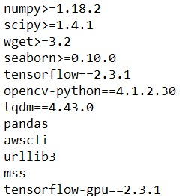
OCR FOR HANDWRITTEN DIGITS
Installation
Installing the requirements and downloading pretrained weights
Quick training for custom MNIST dataset
MNIST folder contains MNIST images, create training data:
python mnist/make_data.py
requirements.txt

Slide 4
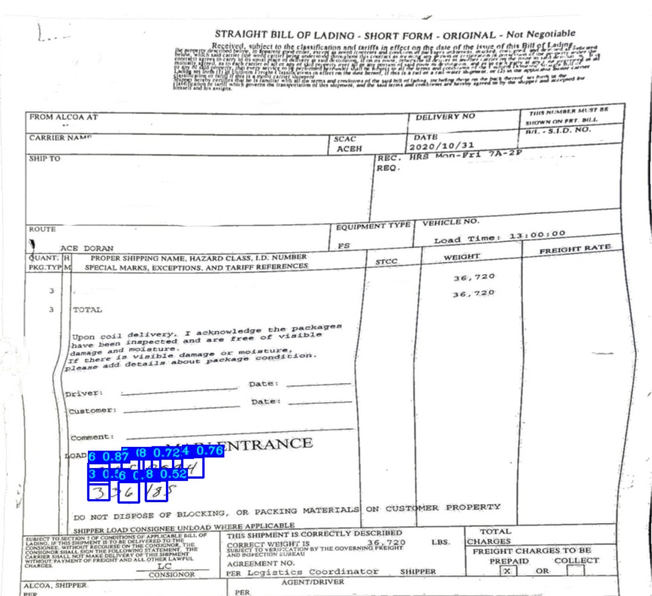
DEMO

Slide 5

OCR for Handwritten Digits
Making Dataset
The YOLO Algorithm
Training the Model
Implementation and Further Algorithm

Slide 6
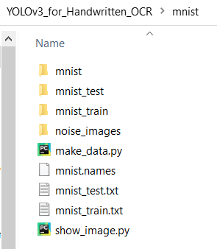
Making the Dataset
Related Programs and Files in mnist folder.
Run make data.py
Images folders obtained → mnist_test, mnist_train
Labels obtained → mnist_test,txt mnist_train.txt

Slide 7
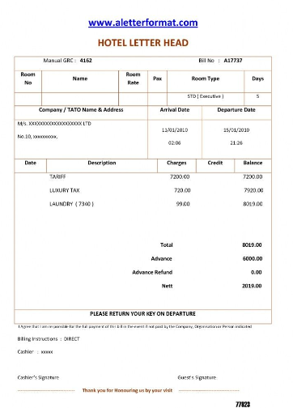

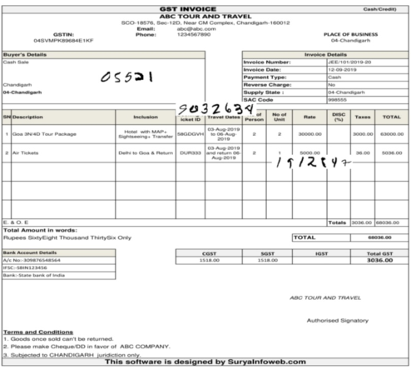
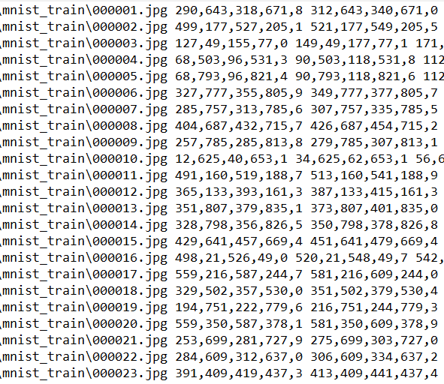
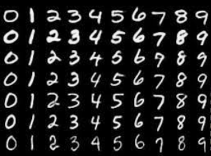
Related to mnist folder
noise_images
mnist
Obtained Results
show_images.py

Slide 8
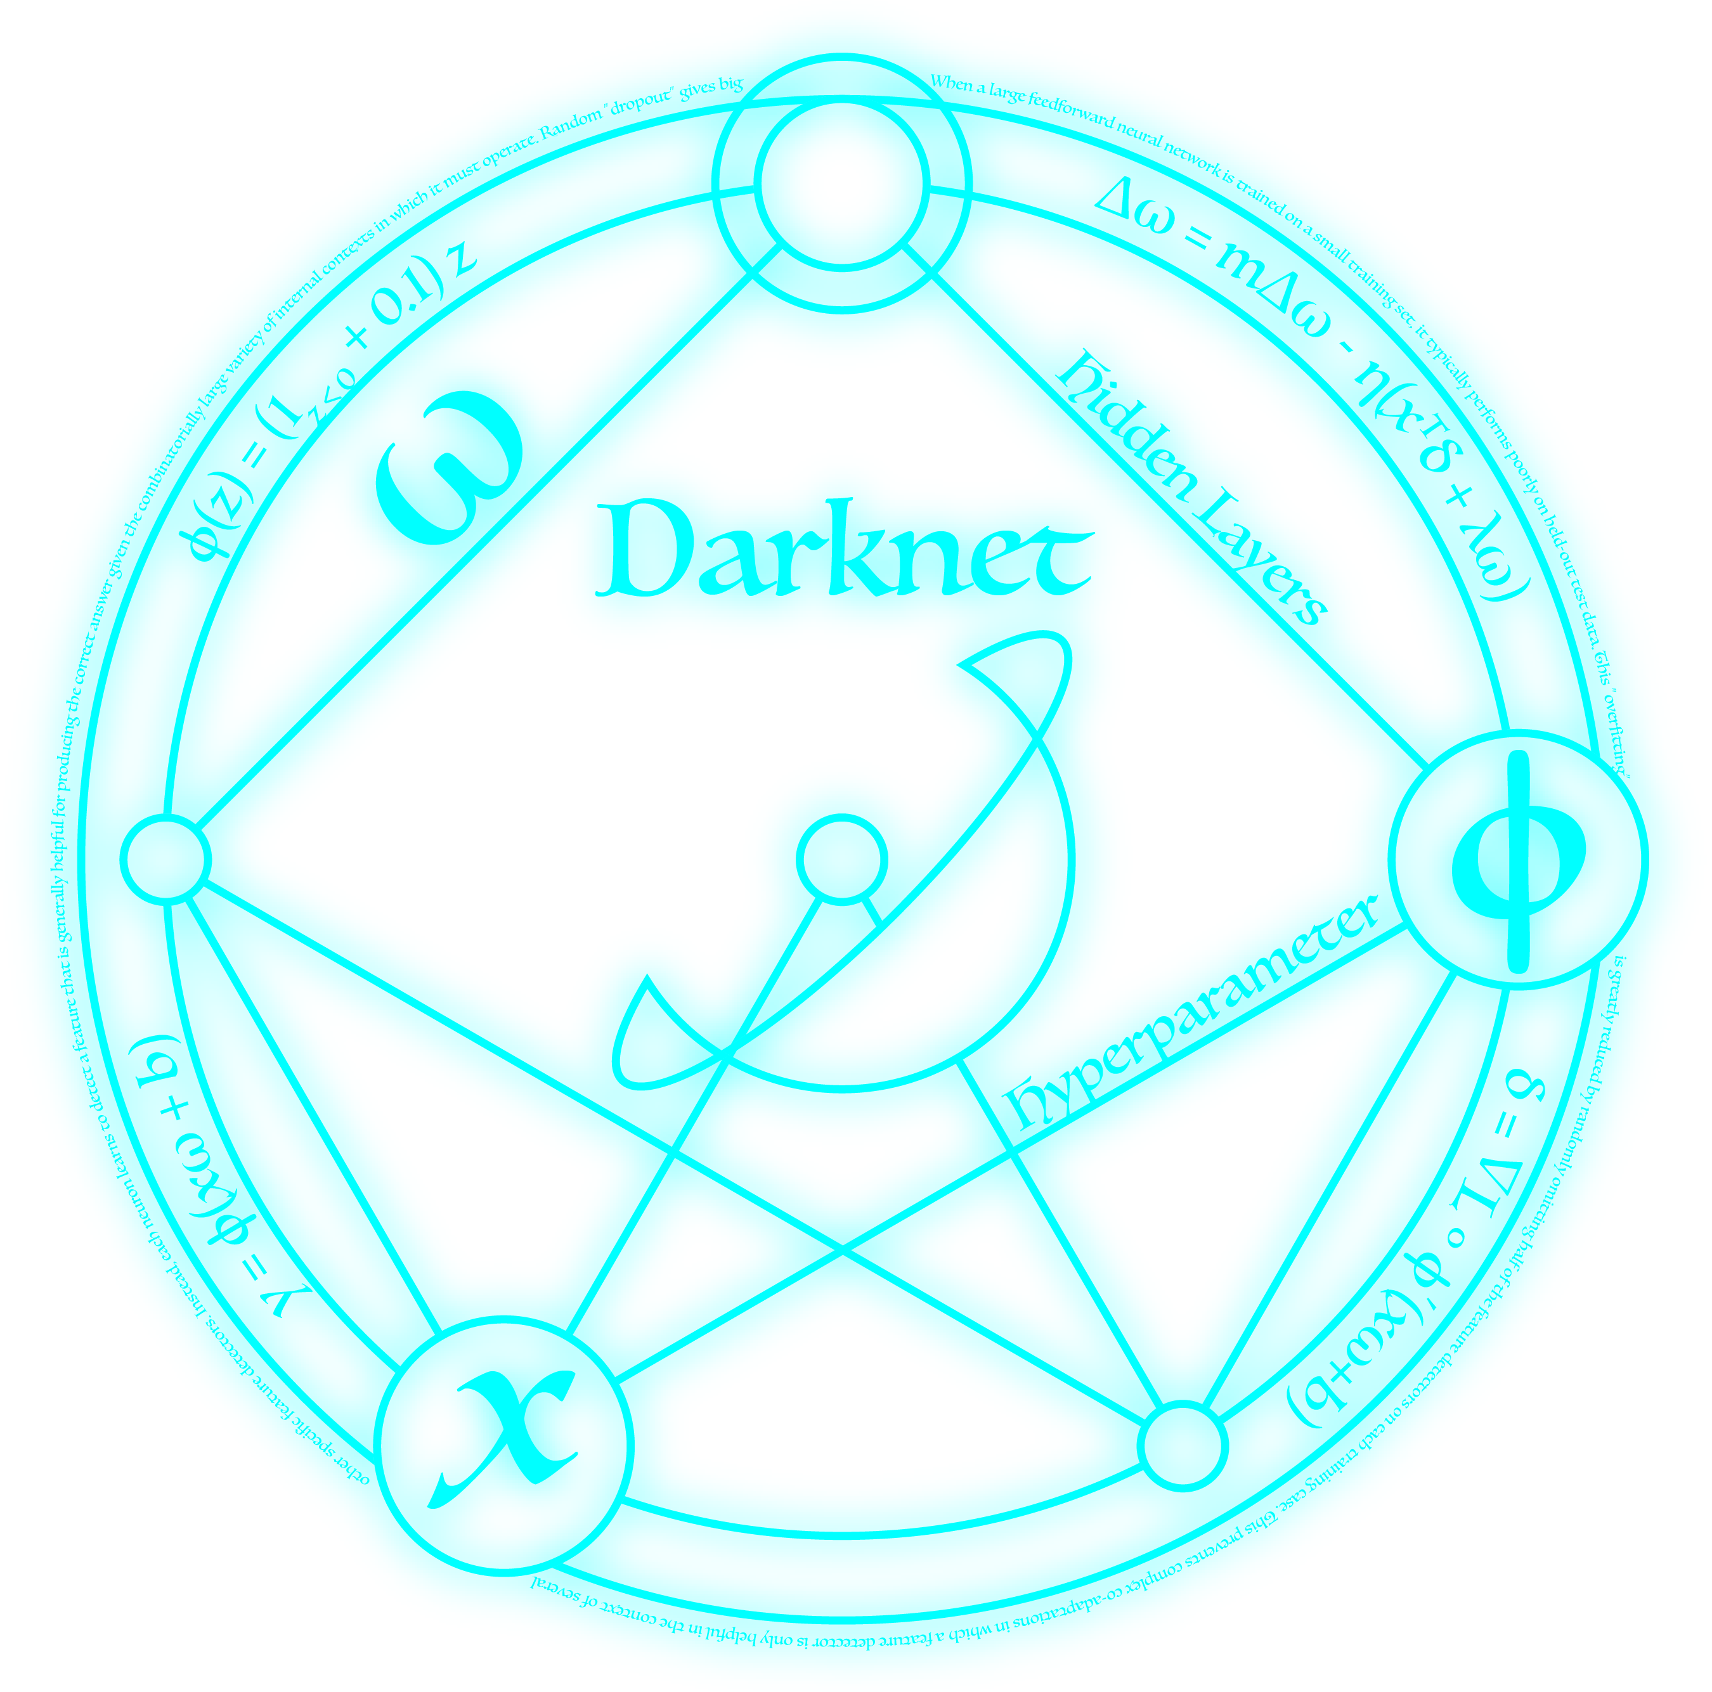
The YOLO Algorithm
model_data
yolov3
Evaluate mAP

Slide 9
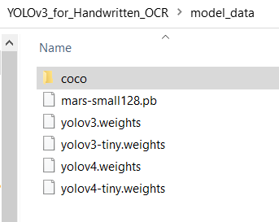
Model_data
Download the weights
Use the commands specified in the GitHub repository
Weights are related to particular models and configuration
Download as per requirement

Slide 10
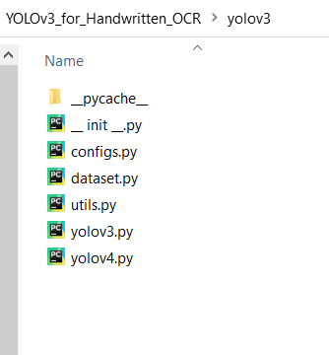
yolov3
configs.py → Input size, YOLO type, learning rate and other hyperparameter tunings.
utils.py → utility functions used during training and implementation phase.
yolov3.py → functions related to yolov3
yolov4.py → functions related to yolov4

Slide 11
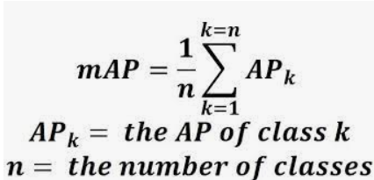
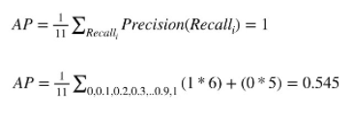
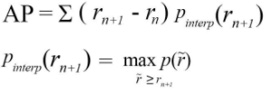
Evaluate mAP
Evaluate_mAP.py
mAP → mean Average Precision
It is calculated by taking mean AP over all classes and overall IoU thresholds.
Here AP is Average Precision which is measure that combines recall and precision for ranked relative results.

Slide 12
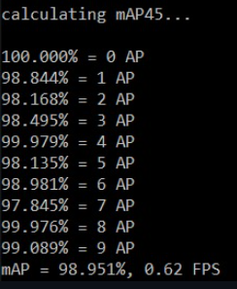
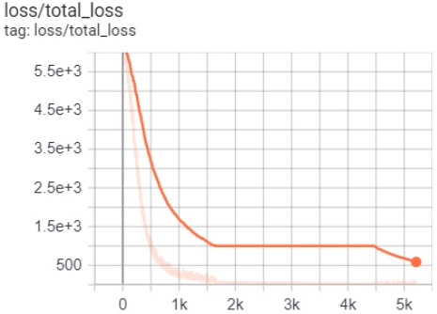
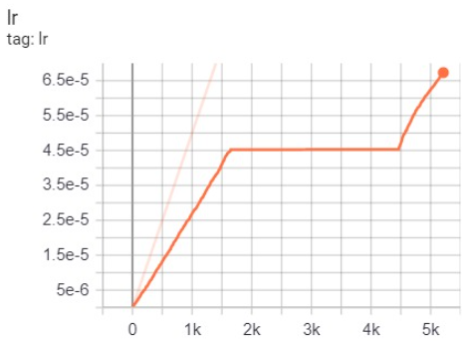
Training the Model
train.py
Building and compiling the model
Training on defined epochs and obtaining the results
Training loss curves, learning rate and mAP

Slide 13
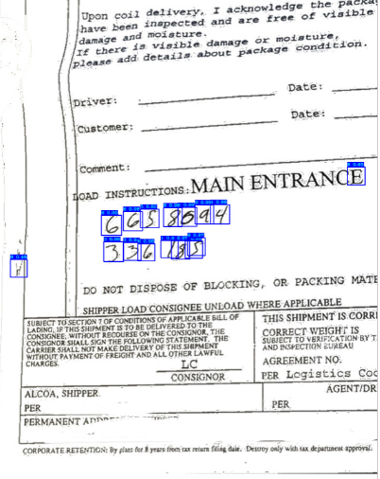
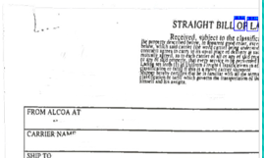
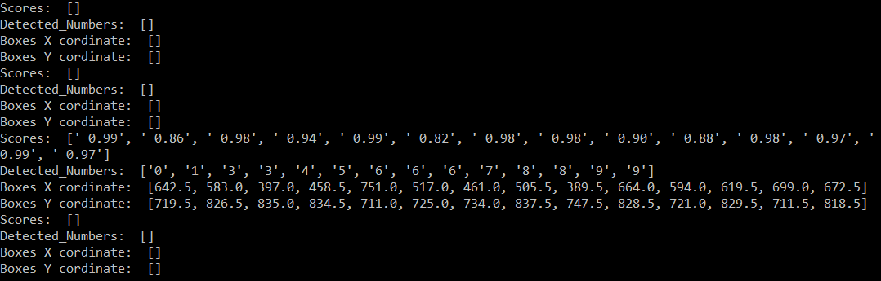
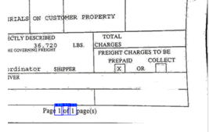
Implementation and Further Algorithm
detect_mnist.py
Current results → localization of all the handwritten digits with coordinates by splitting of input image.
Further Algorithm
To use these obtained coordinates for actual series extraction.
To further improve the accuracy of detections and tuning of thresholds for misdetections.

Slide 14
Questions?

