Slide 1
FXBox: Digital Audio Processing
Dante Viloria, EECE 490B

Slide 2
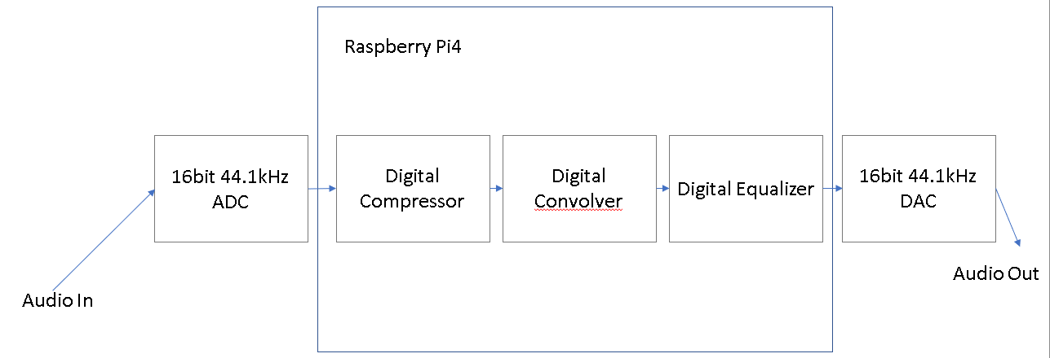
Project Overview
Specifications were
16-bit, 44.1kHz audio
Delay less than 15ms
Realtime implementations of a digital compressor, convolver, and equalizer

Slide 3
Tools used
Hardware
Raspberry Pi 4B 8GB
HiFiBerry DAC+ADC
Adafruit 20x4 Character LCD
Adafruit USB backpack
Software
Python 3.9
Numpy, Scipy for data processing
Pynput, Pyserial for the UI
Pyaudio for real time audio I/O
MATLAB
For testing purposes

Slide 4
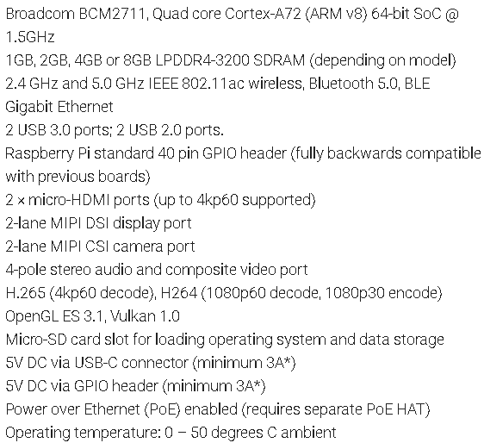
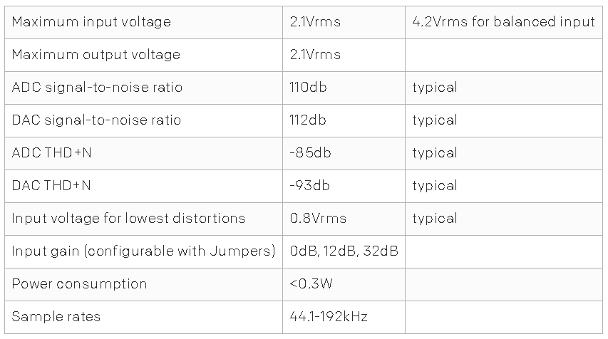
Raspberry Pi 4/Hifiberry DAC + ADC specifications

Slide 5
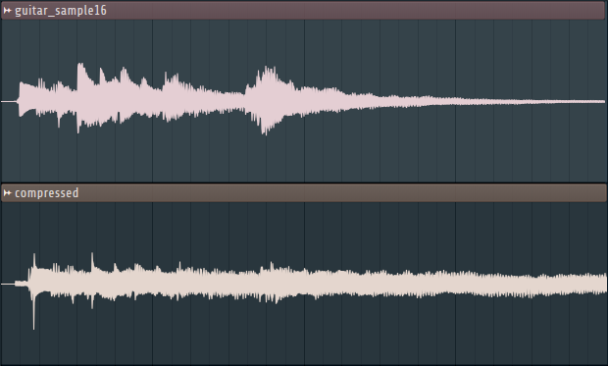
Digital Compressor
Purpose
To lower the volume of loud sounds
This evens out of the volume level of an audio signal

Slide 6
Digital Compressor Architecture
Many compressors can be constructed with the following blocks [1]
Absolute value block – get the absolute value of the signal
Linear to dB block – convert a linear audio signal to dB
dB to linear block – convert a dB audio signal to linear
Level detector – Create a smooth signal of the audio’s volume level
Gain computer – Calculates the what amount of gain should be applied to the signal

Slide 7
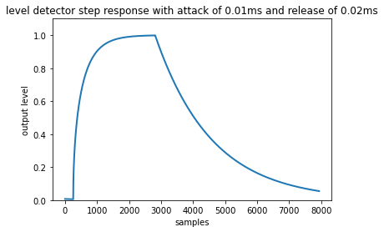
Level Detector [1]
Contains two 1-pole lowpass filters
One is the attack LPF, the other is the release LPF
The attack LPF is used if the current sample is louder than the previous sample
The release LPF is used otherwise
The time constants of these LPF filters are referred to as the attack and release times respectively
Attack and release affect how fast the compressor can react to changes in volume
They are separate because usually it is desirable to have a fast attack and a slow release

Slide 8
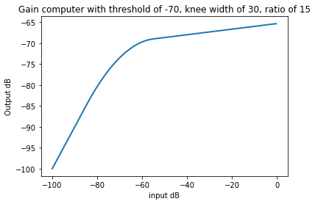
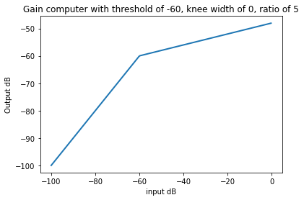
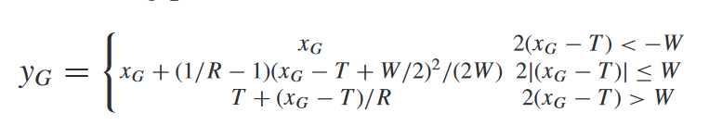
Gain Computer [1]
The gain computer maps an input dB level to an output dB level
The gain computer has the parameters of threshold, ratio, and knee width
The gain computer of Giannoulis et al (shown below) was used in this project
$${x_{G} is the input dB, y}_{G} is the output dB, T is the threshold, R is the ratio, W is the knee width \text{[1]}$$

Slide 9
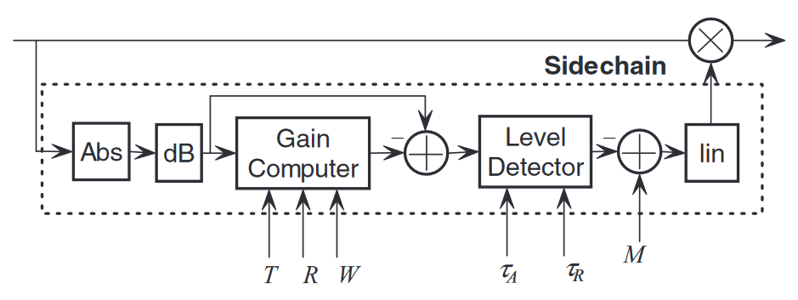
Compressor Architecture
The log-domain compressor architecture of Giannoulis et al was implemented in this project [1]

Slide 10
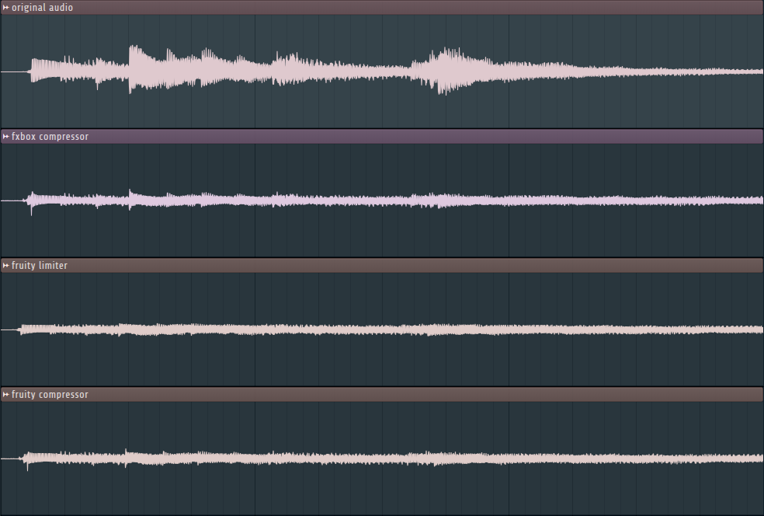
Compressor Test results
Unfortunately, it is difficult to test compressors in a “scientific” way because there is no standard for compressors
So, we will compare the fxbox compressor to two other compressors on the market
The fxbox compressor offers similar results to the other two compressors, so this is a success
In addition to the previously mentioned parameters, digital compressors can have features such as a hold time or RMS level detector that can cause differences between compressors
Settings
Threshold of -40dB
Knee width of 0dB
Ratio of 7
Attack of 1ms
Release of 500ms

Slide 11
Convolver
Convolvers have many uses, but they are typically used to add realistic sounding reverberations to an audio signal
The convolver will convolve an incoming audio signal with an impulse file in real time
Impulse files with a length of up to 5 seconds (220.5k taps) were confirmed to be working on a buffer size of 256
If we are working with impulses that are up to five seconds long, it is impractical to convolve each audio buffer with the entire impulse [2][4]
In order to accomplish this, we use the linear property of convolution in order to break the impulse into smaller parts and do convolutions when they are needed

Slide 12
Partitioned convolution
The idea is largely credited to William G. Gardner [2]
Impulse partitions start at one buffer length [4]
Partitions get larger until they reach the size at which the computer can most efficiently compute FFTs [4]
Usually 4096 – 16384 samples, but it depends on the system
General optimizations that are used are
Computing convolutions via fourier transform [2]
Using real fourier transforms [2][4]
Only using transform lengths that are powers of 2 [2]
Pre-computing the fourier transforms of impulse partitions [2][4]

Slide 13
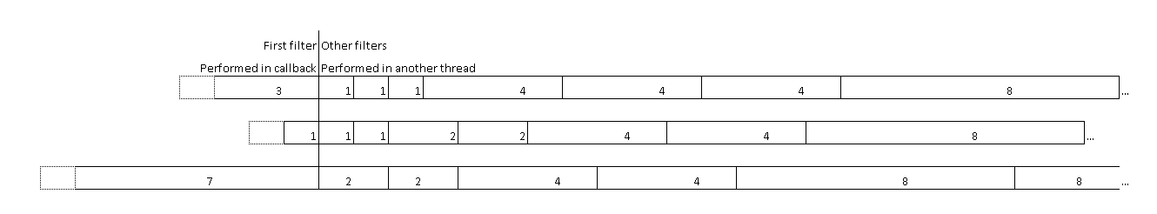

Impulse partitioning
A custom partitioning algorithm was created for this project
The parameters are first filter power, power start$,$power step, power stop, and height
A partition of size n is convolved with n previous buffers, except for the first filter which is always convolved with a single buffer
For partition 1: first filter power = 2, power start = 0, power step = 2, height = 3
For partition 2: first filter power =, 1 power start = 0, power step = 1, height = 2
For partition 3: first filter power = 3, power start = 1, power step = 2, height = 2

Slide 14
Partitioned Convolution Implementation Pt 1
In practice the following structures are needed:
Previous buffers – an array containing previous buffers
The number of previous buffers that need to be stored is the length of the longest partition
Convolution buffer – an array where the results of the convolutions are added to
Needs to be at least the length of the impulse
Impulse partitioner – decides how an impulse file should be partitioned, runs once at startup or whenever the impulse is changed
Impulse partitions – an array of objects that encapsulates a filter partition and contains info about it such as its offset, how many buffer lengths it is, etc.
Convolution queue(s) – one or many queues that contain the convolutions that need to be done
In this project a single priority queue based on a convolution’s deadline was used

Slide 15
Partitioned Convolution Implementation Pt 2
In the callback function:
Calculate convolution of first filter with most recent buffer
Add result to the convolution buffer
Determine which other convolutions can be performed and add them to the priority queue
In the worker thread:
Get a convolution task from the priority queue
Get the appropriate number of previous buffers
Calculate the convolution
Add the result to the convolution buffer

Slide 16
Partitioned Convolution Implementation Pt 3
Dry signal – the input signal to the covnolver
Wet signal – the result of the convolution of the input signal and impulse
The final convolver output is the dry signal added to the wet signal
The wet gain parameter is the gain of the wet signal
The dry gain parameter is the gain of the dry signal

Slide 17
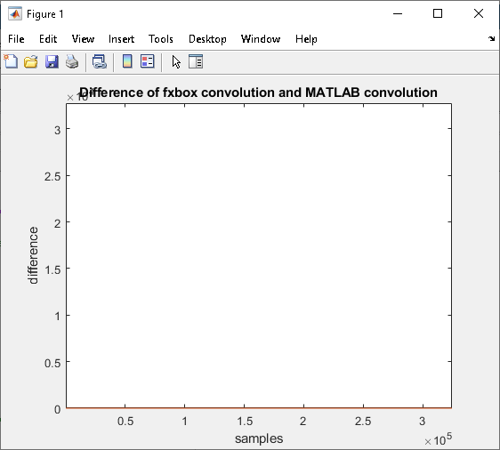
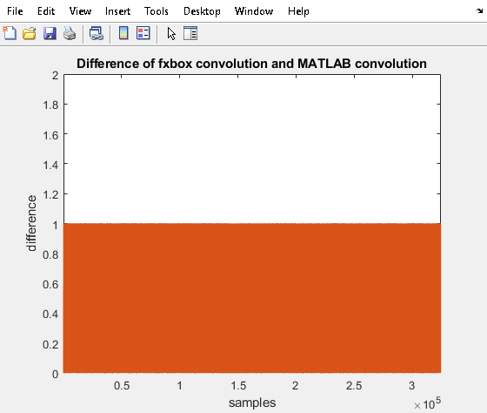
Convolver test results
Convolution is a well-defined mathematical function
The ideal situation is for the fxbox convolver to produce the same results as a ‘traditional’ convolution
In order to test this, we convolve an audio file with an impulse using the fxbox’s convolver and compare the result to MATLAB’s conv() command by subtracting the results from each other
The result is that the difference between the two methods is either 0 or 1
This is the ideal result for a 16-bit integer wave file as this indicates that the only errors are rounding errors

Slide 18
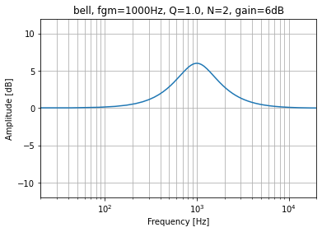
Digital Equalizer
The digital equalizer contains four filters that are cascaded
A low-pass, high-pass and two bell filters (also called peaking filters)
A bell filter is a band-pass filter + an all-pass filter
Its purpose is to attenuate or boost by a desired dB value at its center frequency but preserve the rest of the signal
Low-pass filter
High-pass filter
Bell filter 1
Bell filter 2
Audio in
Audio out

Slide 19
Digital Filter Design
The filters are designed to the user’s specification
Cutoff frequency and order for low-pass and high-pass filters
Center frequency, bandwidth (as a factor of the center frequency) and gain applied at the center frequency
Butterworth filters were chosen because of their level gain across the passband and smooth transition band which makes them desirable for audio applications
The filter coefficients themselves can be designed via Scipy’s butter() command which will design a filter given an order and cutoff frequency
This is sufficient to design the low-pass and band-pass filters, but the peaking filters require extra design work

Slide 20

Bell Filter design 1: Band-pass design
We want to choose upper $f_{1}$ and lower $f_{2}$ cutoff frequencies for a center frequency $f_{gm}$ and bandwidth as a multiple of the center frequency $Q^{−1}$
$$\left(1\right) f_{gm}=\sqrt{f_{1}f_{2}} where f_{1}=Rf_{gm} and f_{2}=\frac{1}{R}f_{gm}[5]$$
$$\left(2\right) Q= \frac{f_{gm}}{B} where B=f_{1}−f_{2}$$
$$R= \frac{Q^{−1}+\sqrt{Q^{−2}+4}}{2} is derived from \left(1\right) and (2)$$
Having found $R$ from $f_{gm}$ and $Q^{−1}$, appropriate values of $f_{1}$ and $f_{2}$ can be calculated

Slide 21

Bell Filter Design 2
We want to apply $KdB$ of gain at the center frequency of the bell filter
The transfer function of a bell filter is
$$Bell\left(s\right)=1+g∗BPF\left(s\right)$$
Where $BPF(s)$ is a band-pass filter and $g$ is the linear gain applied at the band-pass filter’s center frequency in order to obtain $KdB$ of gain
The total linear gain applied at the Bell filter’s center frequency is
$$K_{lin}=1+g$$
Converting to dB and solving for g yields
$$g= {10}^{K_{dB}/20}−1$$

Slide 22

Digital IIR filtering algorithm [3]
An implementation of a direct form II difference equation was created in order to perform the filtering
$$a\left[0\right]y\left[n\right]+a\left[1\right]y\left[n −1\right]+ …+a\left[N\right]y\left[n−N\right]=b\left[0\right]x\left[0\right]+b\left[1\right]x\left[n −1\right]+…+b\left[M\right]x[n−M]$$
$$Y\left(Z\right)= \frac{b\left[0\right]+b\left[1\right]Z^{−1}+…+b\left[M\right]Z^{−M}}{a\left[0\right]+a\left[1\right]Z^{−1}+…+a\left[N\right]Z^{−N}}$$

Slide 23
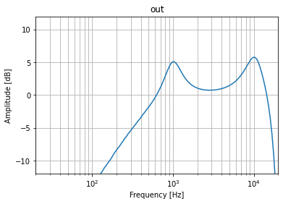
Equalizer Test results
The frequency response was measured experimentally in order to test the equalizer
A wave file was generated that increased in frequency every 0.2 seconds and spanned 20Hz to 20kHz
This file was run through the fxbox’s equalizer and used to determine the frequency response of the equalizer with settings
High-pass at 500Hz
Low-pass at 15kHz
Bell at 1kHz and at 10kHz, each with 6dB gain
The fxbox’s equalizer was able to generate a frequency response that reflects these settings

Slide 24
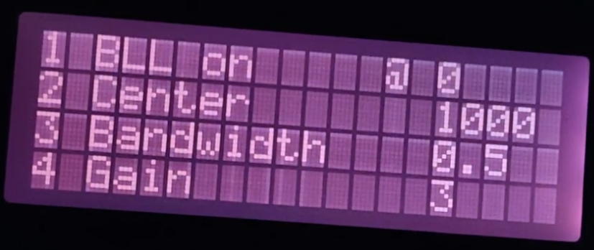
User interface
A user interface was implemented via a 20x4 character LCD screen
It allows the user to control the audio effects via a keyboard
Keys 1-4 select a menu item, the 0 key goes backwards into the menu
The +/- keys can increment/decrement a value on the screen

Slide 25
Results
The individual subsystems (compressor, convolver, equalizer) were confirmed to be functioning properly
All three of the subsystems could be enabled and run in realtime with a sampling frequency of 44.1kHz buffer size of 256
The UI works but is rough around the edges
There are minor issues that occur when settings are changed
These could be fixed and are due to some poor design choices
Overall, the project was a success
Demonstration: https://www.youtube.com/watch?v=CQCDXM29WBg

Slide 26
References
[1] D. Giannoulis and M. Massberg and J. Reiss, Digital Dynamic Range Compressor Design
[2] F. Wefers, Partitioned Convolution Algorithms for Real-time Auralization
[3] scipy.signal.lfilter, https://docs.scipy.org/doc/scipy/reference/generated/scipy.signal.lfilter.html
[4] W. G. Gardner, Efficient Convolution without Input-Output Delay
[5] V. Välimäki and J. Reiss, All About Audio Equalization: Solutions and Frontiers

