Slide 1
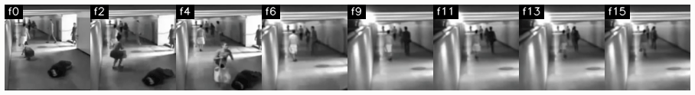
CSE4076 · IMAGE AND VIDEO ANALYTICS
Real-Time Illicit Activity Detection System
Video processing and analytics for detecting fighting, robbery and vandalism in CCTV footage
Project presentation to the faculty
Notes:
Title page. Add presenter name, register number, guide and date here before presenting.

Slide 2
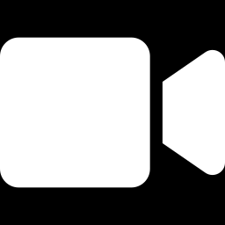
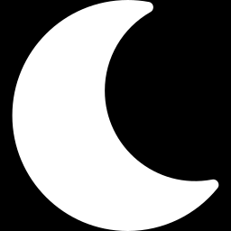
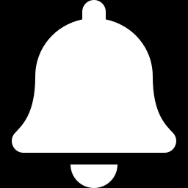
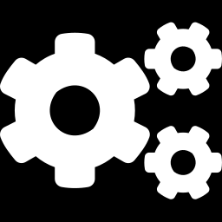
Introduction: why automatic CCTV analysis
Problem
Watching many CCTV feeds by hand does not scale, and incidents are noticed late
Challenge
Low-light, 320 × 240, heavily compressed footage with timestamps, bars and camera cuts
Objective
Classify Fighting, Robbery, Vandalism or Normal in real time and raise an alert with evidence
This work
Make the video processing and analytics before training explicit, measurable and visible
Notes:
State the problem and objective in one breath: a CCTV system that flags fighting, robbery and vandalism. The footage is hard: low light, 320 by 240, compressed. The contribution of this course project is the explicit video processing and analytics done before any deep-learning training.

Slide 3
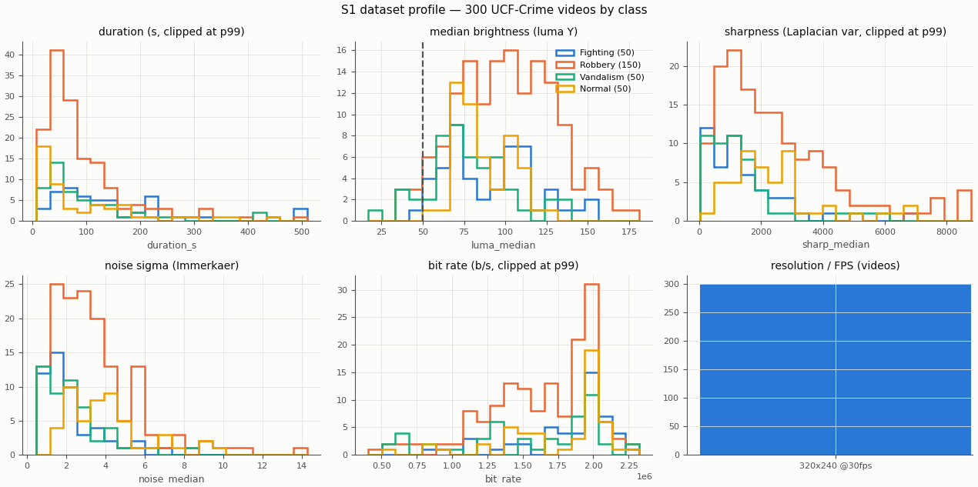
Dataset: UCF-Crime, four classes
Profile of all 300 videos by class
Official 4-fold Action_Recognition split, with a train/test leakage check
All videos 30 FPS, 320 × 240; 206 have letterbox bars, 218 a timestamp or logo
Temporal ground truth for the test videos
Supporting data: ExDARK (7,363 dark images) and LLVIP (15,488 night images) train Zero-DCE++; LLVIP + ExDARK People (12,634) fine-tune YOLOv11s.
Notes:
UCF-Crime: 300 videos in four classes, with 150 robbery and 50 for each other class. All are 30 FPS and 320 by 240. The profile found letterbox bars in 206 and an overlay in 218 videos. Zero-DCE++ and YOLO were trained earlier on ExDARK and LLVIP and are reused unchanged.

Slide 4
Proposed methodology: overview
S1
S2
S3
S4
Profile
Resample
Clean
Enhance
PyAV stats, thresholds
exactly 12 FPS
cuts, bars, overlay, frozen
Zero-DCE++, denoise, deflicker
S5
S6
S7
S8
S9
Camera comp.
Motion
Actors
Select
Package
skipped: 2 / 300 videos move
MOG2, optical flow, MHI
YOLO, ByteTrack, crop
activity, proposals, gate
uint8 clips, sidecars
Principles. No training here: Zero-DCE++ and YOLO weights are reused, RAFT-small, FastDVDnet and TransNetV2 are pretrained, the rest is classical. Every operation saves a sample input and output.
Notes:
Eight stages from raw video to training-ready clips. S1 sets data-driven thresholds, S2 fixes the frame rate, S3 and S4 clean and enhance, S6 and S7 turn video into motion and actor signals, S8 chooses which clips the model sees and S9 packages them. S5 is skipped by rule. The next two slides show the techniques.

Slide 5
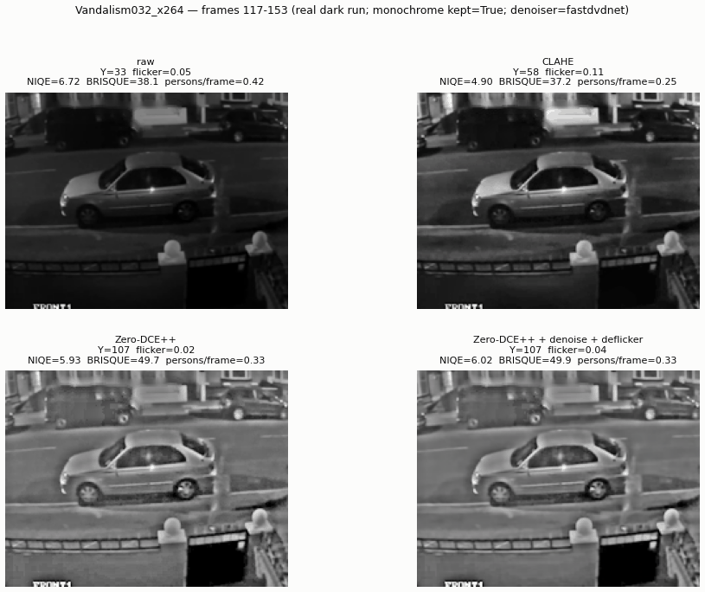
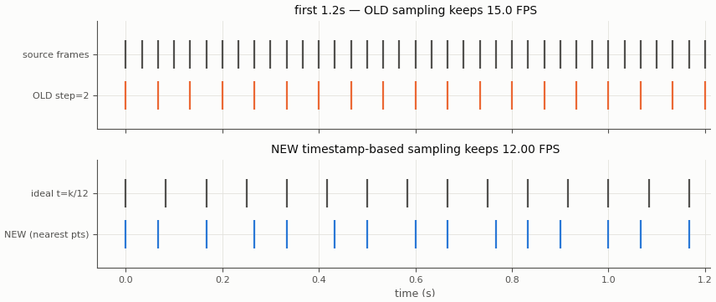
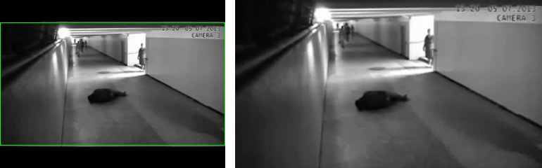
Methodology: consistent, clean, enhanced frames
S2 Exact 12 FPS
S3 Structural cleaning
S4 Enhancement
Pick the frame nearest to t = k/12 s. The old step rule gave 15 FPS.
Crop bars, inpaint timestamps, detect cuts (HSV + edges, TransNetV2), flag frozen frames.
One luma threshold, Zero-DCE++, FastDVDnet temporal denoise, brightness deflicker.
Notes:
Left: the old rule kept every second frame, 15 FPS; the new one is exactly 12 FPS. Middle: letterbox crop is shown, the same stage also removes timestamps and finds shot cuts. Right: Zero-DCE++ brightens the dark video; FastDVDnet and a deflicker filter remove the noise and brightness jumps it causes.

Slide 6
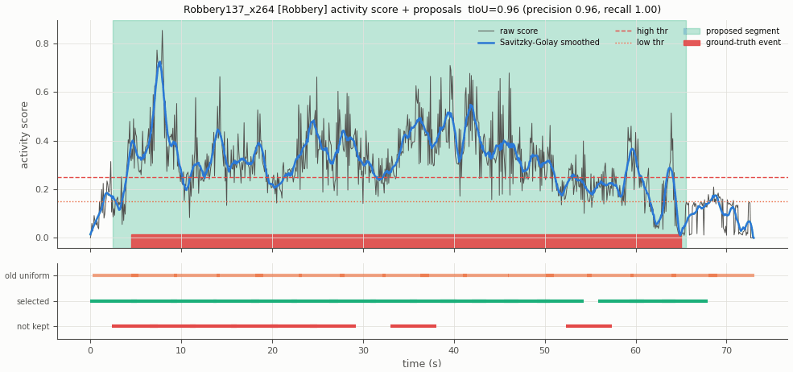
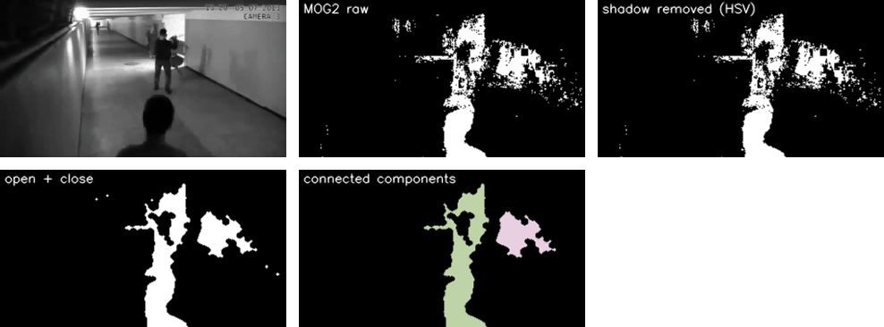
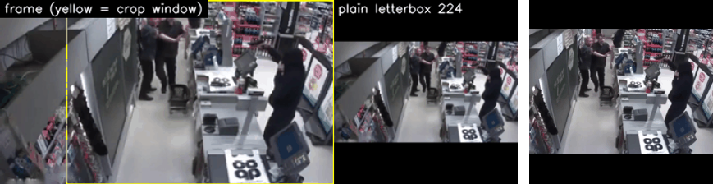
Methodology: motion, actors and clip selection
S6 Motion analysis
S7 Actor analysis
S8 Clip selection
MOG2 with HSV shadow removal, Farneback and RAFT-small flow, entropy, MHI.
Detection, ByteTrack IDs, interaction signals, smoothed actor-centred 224 crop.
Activity score and action proposals; clips inside proposals; six-rule quality gate.
Notes:
Left: foreground masks from background subtraction and the optical-flow features that form a motion-energy signal. Middle: tracked people and the actor-centred crop that keeps small people at usable resolution. Right: the activity score over time with the proposed segments; abnormal-class clips are sampled inside them, Normal clips uniformly plus hard negatives.

Slide 7
System architecture: from camera to alert
Input
›
Processing
›
Inference
›
Output
CCTV stream
Zero-DCE++
Redis Streams
Supabase storage + database
RTSP / mp4 / webcam
if luma below 50
VideoMAE worker
Twilio SMS / MMS
Frames at 12 FPS
YOLOv11s + ByteTrack
Fighting / Robbery / Vandalism / Normal
React live dashboard
16-frame clip buffer
Offline training path: UCF-Crime videos → S1 to S9 video processing and analytics → 16-frame clips → VideoMAE fine-tuning (4-fold CV) used by the inference worker
Notes:
Live path: frames from the camera at 12 FPS, enhanced when dark, people detected and tracked, a 16-frame clip pushed through Redis to the VideoMAE worker, and above-threshold detections stored with evidence, sent by SMS and shown on the dashboard. The amber strip is the offline path: this is where the video processing and analytics pipeline prepares the clips VideoMAE is trained on.

Slide 8
Results: effect of the video processing
15 → 12.00
Operation | Before | After
Framing | Stretched 640 × 640 | Letterbox + actor crop
Brightness | Three different checks | One luma rule, threshold 50
Sampling | Uniform, label noise | Inside proposals
Validity | std > 0.01 | Six-rule quality gate
Tracking | None committed | ByteTrack + signals
Clip size | 9.6 MB float32 | 2.4 MB uint8
effective clip FPS
8 / 8
demo videos with lower noise after denoising
0.96
best tIoU of proposals vs ground truth (0.35, 0.15 on the others)
Measured on the fixed 8-video sample set; every operation has a saved input/output sample.
Notes:
These are the measured effects of the new pre-training pipeline on the eight-video sample set. Frame rate is now exactly 12 FPS. Temporal denoising lowered noise in all eight demo windows. The proposals reach tIoU 0.96 on the robbery sample but only 0.35 and 0.15 on fighting and vandalism, because motion is not the same as crime. The table summarises what changed.

Slide 9
Results: detection and action recognition
0.907
YOLOv11s mAP50 (mAP50-95 0.534)
2.0 ms
per frame; precision 0.869, recall 0.850
Finding. On UCF-Crime frames 34 % of the fine-tuned boxes are frame-sized, so COCO yolo11s.pt is used for tracking and cropping.
Overall macro-F1 70.2 ± 5.6 %. Baseline from the old clips; retraining on the new clips is next.
Notes:
Model results from the earlier training runs: YOLOv11s mAP50 0.907 on LLVIP and VideoMAE macro-F1 70.2 percent plus or minus 5.6 over four folds, best on Normal and weakest on Fighting. These F1 numbers use the old clips, so they are the baseline against which the retrained model will be compared. The detector finding is worth discussing: the fine-tuned YOLO does not transfer to UCF-Crime frames.

Slide 10
Conclusion
1
A complete video processing and analytics pipeline, needing no training, now prepares every clip, with a saved input and output sample for each operation.
2
Five preprocessing gaps are fixed: frame rate, aspect ratio, brightness rule, clip sampling and clip validation.
3
Next: extract all four folds, retrain VideoMAE, and run ablations on sampling, framing, enhancement and cleaning.
Thank you. Questions?
Notes:
Close with the three messages. Backup: docs/vpa_samples/INDEX.md has the sample of every operation, and notebooks/vpa_walkthrough.ipynb replays one video through all stages.

