Slide 1
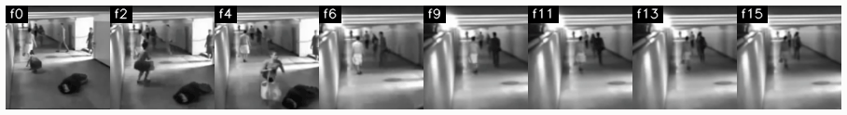
CSE4076 · IMAGE AND VIDEO ANALYTICS
Real-Time Illicit Activity Detection
What happens to the video before deep learning: processing and analytics, stage by stage
Sample clip produced by the pipeline (8 of 16 frames, 224 × 224 model input)
Notes:
Introduce the project: a CCTV system that detects fighting, robbery and vandalism. Today the focus is the course topic: the video processing and analytics that is done BEFORE any deep-learning training, and how each step is shown with a measurable input and output.

Slide 2
A CCTV system that flags illicit activity
CCTV stream
RTSP / mp4
Zero-DCE++
low-light enhancement
YOLOv11s
person boxes
ByteTrack
persistent IDs
VideoMAE
4-class action model
Alert
clip + SMS
›
›
›
›
›
Data preparation for these models is today's topic
0.907
70.2 ± 5.6 %
4 classes
mAP50 of the fine-tuned YOLOv11s (LLVIP + ExDARK)
macro-F1 of VideoMAE, official 4-fold UCF-Crime split
Fighting, Robbery, Vandalism, Normal (300 videos)
Notes:
One slide of context. The live pipeline: enhance dark frames with Zero-DCE++, detect people with YOLOv11s, track them with ByteTrack, classify 16-frame clips with VideoMAE, then raise an alert. Existing results: YOLO mAP50 0.907, VideoMAE macro-F1 70.2 percent plus or minus 5.6 over the official four folds. The teal boxes are the stages whose inputs are prepared by the video-processing pipeline.

Slide 3
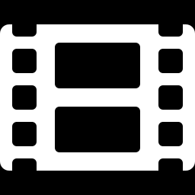
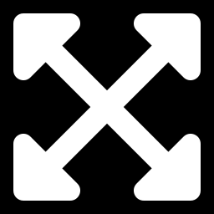

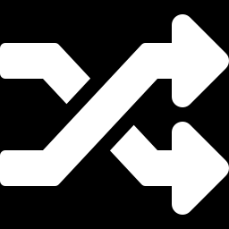

The old preprocessing had five silent gaps
Frame step = round(30 / 12) = 2
→
Clips run at 15 FPS, not 12: motion speed and the 5.3 s window are wrong
cv2.resize(frame, (640, 640))
→
4:3 frames get 33 % horizontal stretch: distorted bodies
Three brightness checks (50 / 80 / HSV)
→
The same frame is "dark" in one file and "bright" in another
16 uniform clips per video
→
Clips labelled Fighting often show no fighting: label noise
Validity check: clip.std() > 0.01
→
Frozen, blurry, black or cut-spanning clips all pass
Notes:
These five points are what the new pipeline fixes. All five were found by reading and running the existing extract_clips.py: the frame step, the resize, the three different brightness thresholds, the uniform sampling and the weak validity check. Each fix is measured on the following slides.

Slide 4
Eight stages from raw video to clips
S1
S2
S3
S4
Profile
Resample
Clean
Enhance
PyAV stats, thresholds
exactly 12 FPS
cuts, bars, overlay, frozen
Zero-DCE++, denoise, deflicker
S5
S6
S7
S8
S9
Camera comp.
Motion
Actors
Select
Package
skipped: 2 / 300 videos move
MOG2, optical flow, MHI
YOLO, ByteTrack, crop
activity, proposals, gate
uint8 clips, sidecars
No model is trained here. Zero-DCE++ and YOLO weights are the existing ones; RAFT-small, FastDVDnet and TransNetV2 are public pretrained models; everything else is classical (OpenCV, NumPy, SciPy).
Notes:
Eight stages, numbered as in the plan. S5 camera-motion compensation is deliberately skipped: the profile showed only 2 of 300 videos have a moving camera, below the 5 percent rule I set. Every stage can be switched off from the command line. No training happens in this pipeline: the existing Zero-DCE++ and YOLO weights are reused, other models are pretrained or classical.

Slide 5
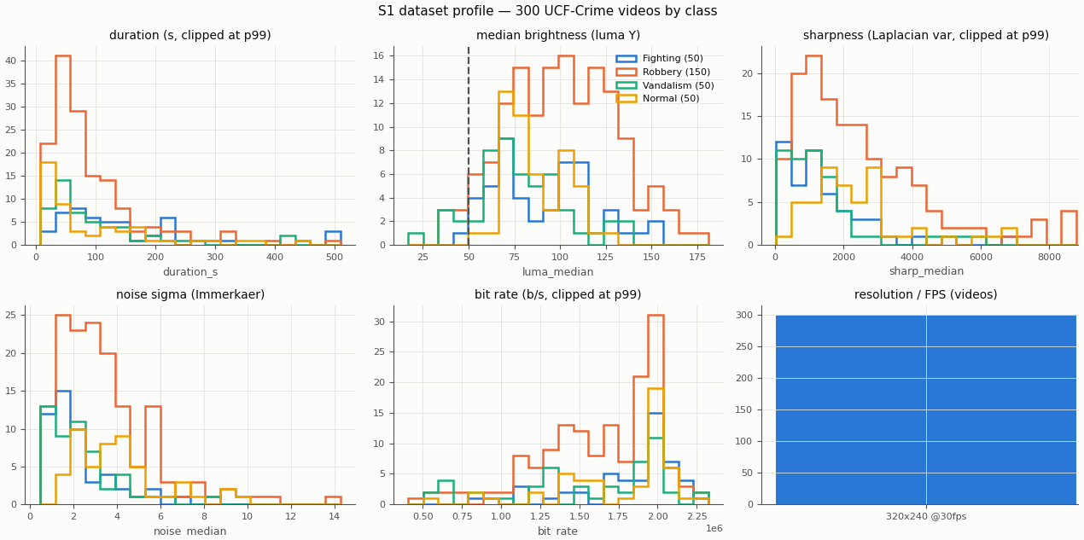
S1: profiling sets the thresholds
300
videos, all 30 FPS at 320 × 240
206
have black letterbox bars
218
carry a timestamp or logo overlay
50
Per-class histograms of all 300 videos (dashed line = dark threshold)
dark threshold: luma of the darkest 5 % of frames
Notes:
One decode pass per video with PyAV collects metadata, I/P/B frame shares, brightness, sharpness, noise and camera motion. The dataset-level numbers drive later decisions: for example the dark threshold of 50 is the luma below which the darkest 5 percent of all frames fall. Otsu would have said 76 and enhanced a third of the data. The same profile picks the fixed eight-video sample set used for every demonstration.

Slide 6
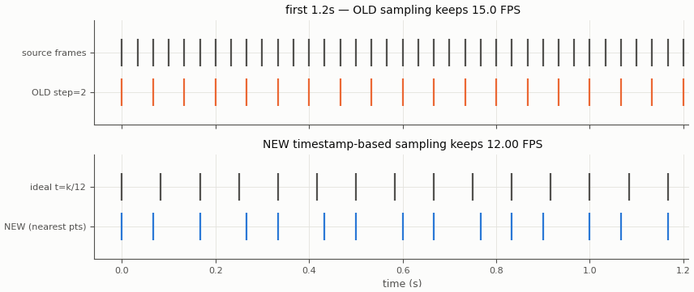
S2: exact 12 FPS from timestamps
15.0 → 12.00
effective FPS of every clip
PyAV decoding, max timing error 16.7 ms
VideoMAE stride 4 now spans the intended 5.3 s
Found on the way: many videos are only 10–15 unique FPS in a 30-FPS file, so motion is measured against the last distinct frame
Old rule keeps every 2nd frame (15 FPS); new rule picks the frame nearest to t = k/12 s
Notes:
The old code used step equals round of 30 over 12, which is 2, so every clip was 15 FPS. It only worked by accident of rounding. The new decoder picks, for each output time k over 12 seconds, the source frame with the nearest presentation timestamp, giving exactly 12 FPS. While validating this I found that many videos are really 10 to 15 unique frames per second stored at 30, which produced a sawtooth motion signal; the motion stage now compares against the last distinct frame.

Slide 7
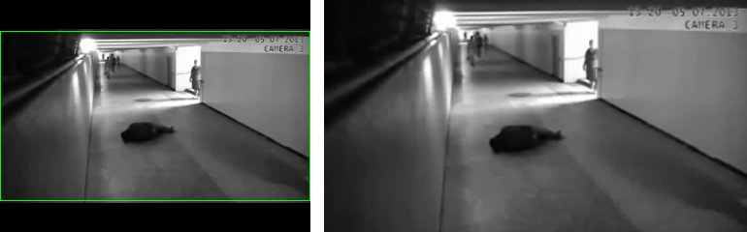
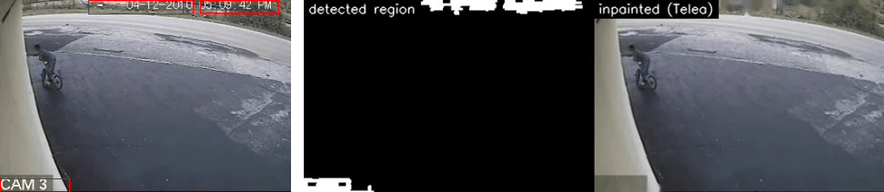
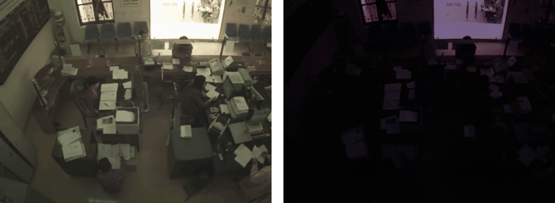
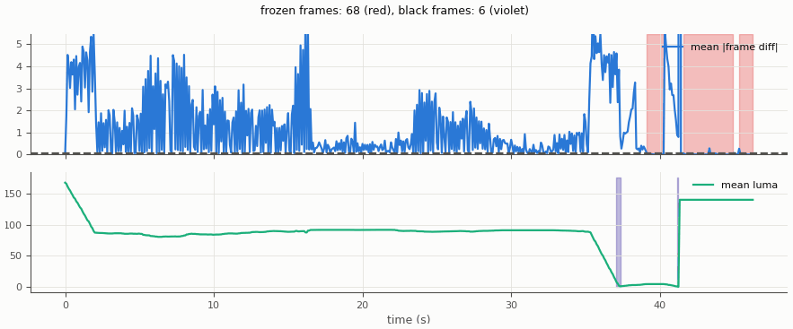
S3: cleaning removes non-scene content
Letterbox bars cropped (206 / 300 videos) (input | output)
Timestamp and caption detected, inpainted (input | output)
Shot cut found by HSV + edges and TransNetV2 (input | output)
Frozen and black frames flagged (68 in one video)
Notes:
Four operations, each with input on the left and output on the right in the saved samples. Letterbox: flat-black row and column profiles. Overlay: thin high-contrast strokes that recur at the same place, then Telea inpainting, because a camera-specific timestamp is a shortcut the model could learn. Shot cuts: histogram distance plus edge-change ratio, unioned with the pretrained TransNetV2. Frozen and black frames: identical or blank frames that look like no motion.

Slide 8
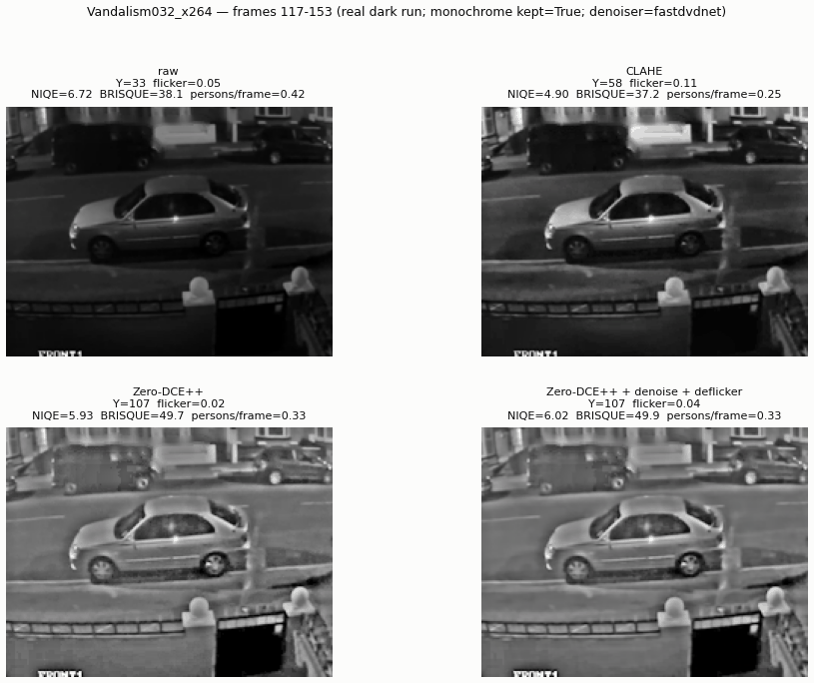
S4: enhance dark footage, then denoise
8 / 8
noise lowered by temporal denoising
7 / 8
NIQE better than Zero-DCE++ alone
5 / 8
flicker index improved (already tiny in static scenes)
Real dark video shown; 7 of 8 demos use clearly labelled simulated low light.
Notes:
One brightness measure, mean luma, with one threshold taken from the profile, replaces the three inconsistent checks. Zero-DCE++ brightens dark runs but also amplifies noise and its per-frame curves flicker. So the curve parameters are smoothed over time, FastDVDnet denoises using neighbouring frames, and a zero-phase filter smooths brightness. The image shows raw, CLAHE as a baseline only, Zero-DCE++ and the full chain on the one genuinely dark sample video. The counts on the right come from all eight demo windows; seven used simulated darkness because the videos are not dark. Be honest about the flicker result: it improved in five of eight.

Slide 9
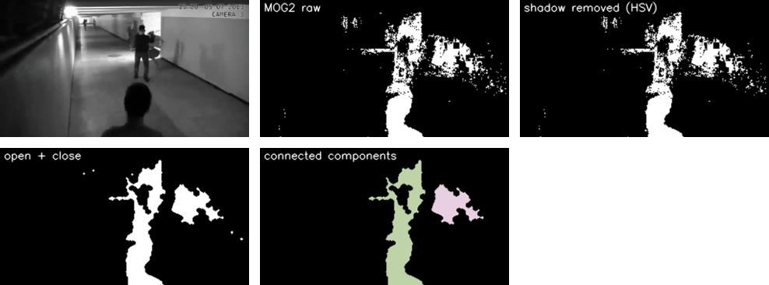
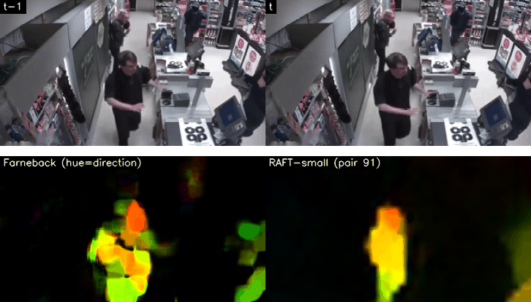
S6: motion analysis turns video into signals
Input frame, MOG2 mask, shadows removed, open + close, connected components
Frame pair, then Farneback and RAFT-small flow (HSV colour)
Foreground ratio and blob count; flow magnitude, direction entropy, divergence, curl
Motion History Image: the last second of movement in one picture
One motion-energy value per frame feeds clip selection (S8)
Notes:
Background subtraction with MOG2, then an explicit HSV shadow rule, morphological opening and closing and connected components give the foreground mask. Dense optical flow, Farneback on every frame and RAFT-small on sample pairs, gives magnitude, direction entropy, divergence and curl. Fights are fast and chaotic, walking is coherent. Fades and flashes are guarded against so they do not count as motion.

Slide 10
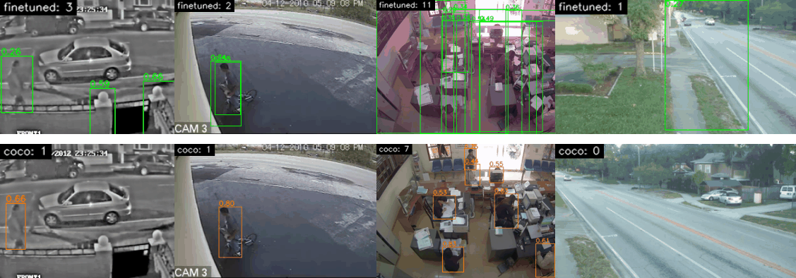
Finding: fine-tuned YOLO does not transfer
Top: fine-tuned best.pt (green). Bottom: COCO yolo11s.pt (orange). Same frames.
34 %
14 %
COCO
of fine-tuned boxes cover over a third of the frame
of its boxes are also found by the COCO model
yolo11s.pt chosen for S7; mAP 0.907 holds on LLVIP only
Notes:
An honest result. The fine-tuned YOLO reached mAP50 0.907 on LLVIP, but on UCF-Crime store and street footage a third of its boxes are frame-sized rectangles, and the COCO model rarely agrees with it. With no person ground truth on UCF-Crime, I judged by cross-confirmation and box plausibility and switched S7 to the COCO weights, which also need no training. This is domain shift, and it is a point worth discussing.

Slide 11
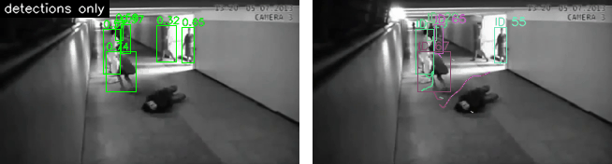
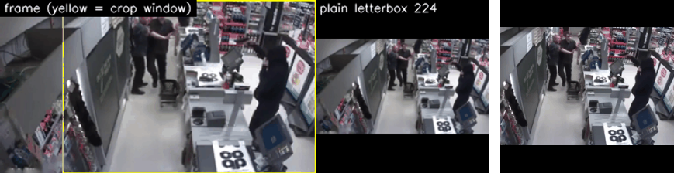
S7: tracks and an actor-centred crop
Interaction signals: people count, minimum distance in person heights, box overlap, speed
Crop: union of interacting people + 25 % margin, smoothed, letterboxed, INTER_AREA
Crop jitter drops about 3×, e.g. 3.4 → 1.2 px
ByteTrack: persistent IDs and trajectories
Crop window (yellow) and the 224 × 224 model input
Notes:
ByteTrack, driven directly from ultralytics, links the detections into tracks. This is new work: the tracker mentioned in the README was never committed. From the tracks I compute interaction signals per frame. The actor-centred crop keeps the people at usable resolution instead of shrinking the whole 320 by 240 frame to 224, and is smoothed over time so it does not jitter.

Slide 12
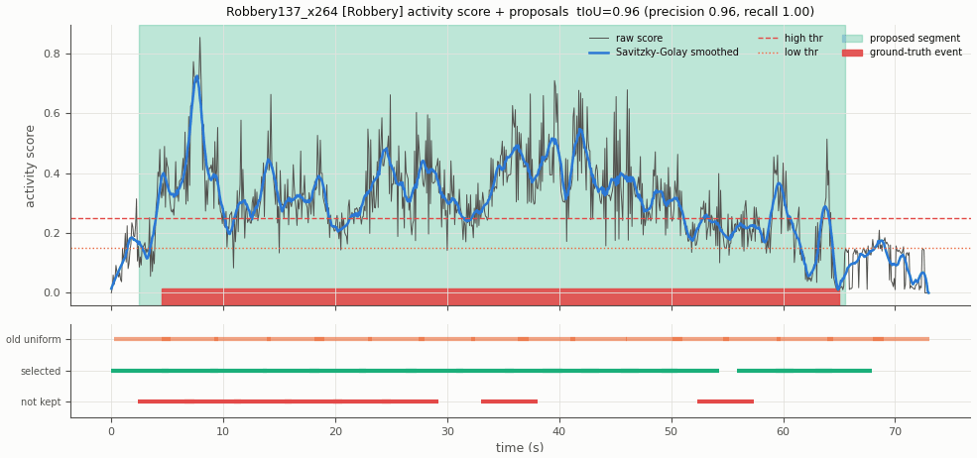
S8: sample clips where something happens
Activity score, proposed segments (green) and UCF-Crime ground truth (red bar)
Abnormal classes: clips inside proposals. Normal: uniform + 25 % hard negatives. Never across a shot cut.
Recall 1.0 everywhere; precision is limited because motion is not the same as crime.
Notes:
Per-frame activity combines motion energy, foreground ratio and the interaction signal, smoothed with a Savitzky-Golay filter. Hysteresis thresholds and peak detection give action proposals. Against the UCF-Crime temporal annotations the proposals reach tIoU 0.96 on the robbery sample, 0.35 on the fight and 0.15 on the vandalism; recall is 1.0 in all three, but precision is limited because motion is not crime. The thresholds were tuned on just these three annotated videos, so treat the numbers as indicative.

Slide 13
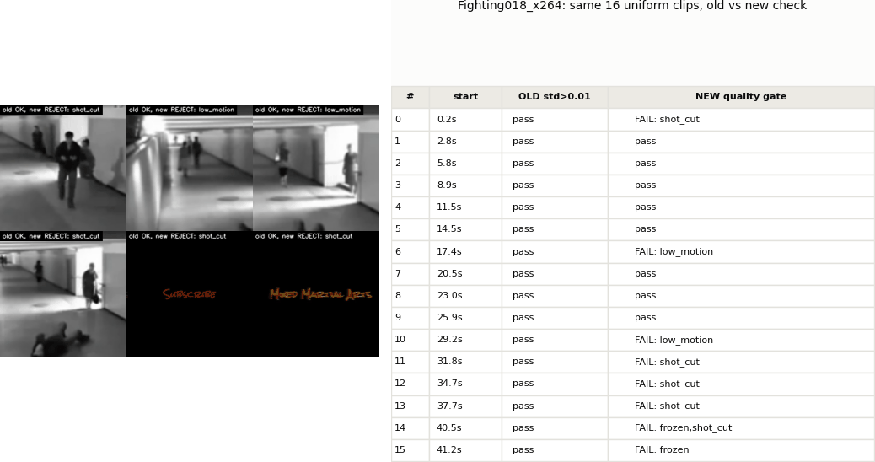
S8: a quality gate that sees real defects
The same clips, two checks
Old: clip.std() > 0.01 accepts a frozen title card and low-motion clips
New gate rejects frozen, black, blurry, low-motion (abnormal classes), clips spanning a cut, fades and flashes
Blur floor from S1: half of the 5th percentile of sharpness
Original motion-fingerprint dedup (0.99) kept unchanged
Notes:
On the same old-style uniform clips, the legacy standard-deviation check passes almost everything, including a frozen karate title card and clips with almost no motion. The new gate checks six defects. The existing motion-fingerprint deduplication is kept as it was; on the sample set it drops nothing because the clips are already spread out.

Slide 14
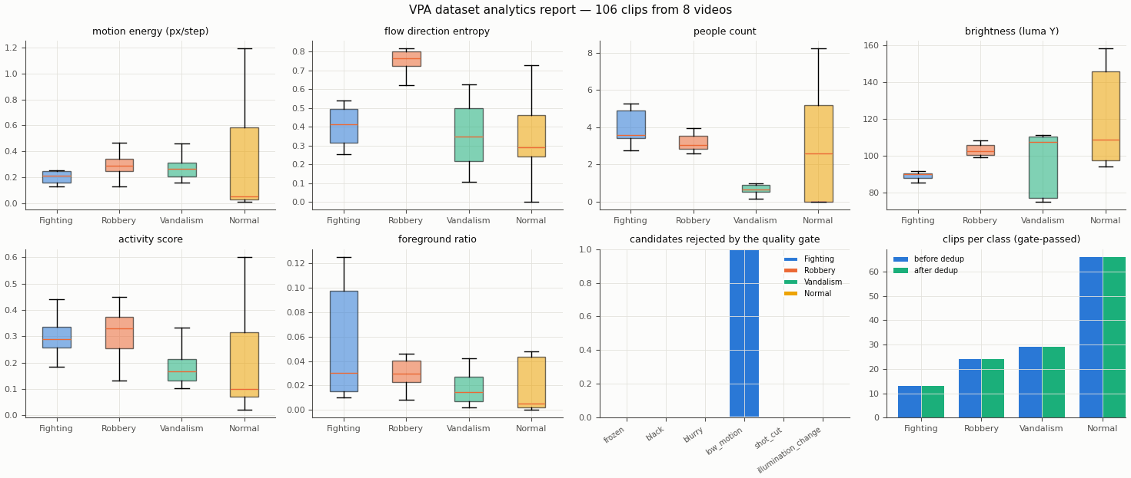
S9: packaged clips and a dataset report
2.4 MB
per clip as uint8, versus 9.6 MB as float32
JSON sidecar per clip: shot id, motion stats, people, crop box, brightness, enhanced?
Same folder layout as before
Per-class motion, entropy, people, brightness, gate rejections
One saved clip (8 of 16 frames)
Notes:
Clips are written as uint8 arrays of 16 by 224 by 224 by 3, four times smaller than the old float32 files and lossless because the pixels began as 8-bit. A JSON file next to each clip records how it was made, which makes ablations and error analysis possible. Note for later: the existing training loader expects float32 between 0 and 1, so it needs a division by 255 once these clips are used.

Slide 15
What changed, measured
Operation | Before | After
Clip frame rate | 15 FPS (step 2) | 12.00 FPS (timestamps)
Framing | Stretched 640 × 640 | Letterbox + actor-centred crop
Brightness rule | Three different checks | One luma measure, threshold 50
Clip sampling | Uniform, label noise | Inside proposals, hard negatives
Validity check | std > 0.01 | Six-rule quality gate
Tracking | None committed | ByteTrack + interaction signals
Clip size | 9.6 MB (float32) | 2.4 MB (uint8) + sidecar
Notes:
A one-slide summary of the measurable changes. Every row has a saved input and output sample for each of the eight sample videos, indexed in docs/vpa_samples/INDEX.md, and the same walkthrough is available as an executed notebook.

Slide 16
Limitations and next steps
Limitations
Next steps
Activity thresholds tuned on three annotated videos
S5 skipped: two moving-camera videos remain
Overlay detector over-fires on textured borders
No ground truth for person detection on UCF-Crime
Full extraction: about 3 hours, 24 GB for four folds
Retrain VideoMAE on the new clips (loader needs /255)
Ablations: sampling, framing, enhancement, cleaning
Use the shared brightness rule in the backend
Notes:
State the limits plainly. The activity thresholds were tuned on three annotated videos. The two moving-camera videos are not compensated. Next: run the full extraction, retrain VideoMAE on the new clips, and run the four planned ablations (uniform versus motion-guided sampling, stretched versus letterbox versus actor crop, Zero-DCE++ alone versus with denoise and deflicker, with and without cleaning) to show the effect of the processing on the deep model.

Slide 17
Better processing before training
1
Five silent preprocessing gaps found and fixed, each with a measurable input and output sample.
2
Video analytics (motion, tracks, activity) now decides which clips the model sees.
3
Honest findings: the fine-tuned detector does not transfer; proposals are recall-heavy.
Questions?
Notes:
Close with the three messages and invite questions. Backup material: docs/vpa_samples/INDEX.md lists the saved sample of every operation, SUMMARY.md has the full extraction plan, and notebooks/vpa_walkthrough.ipynb replays one video through all stages.

