Slide 1
RSE 2018
Birmingham, UK
The Hitchhiker’s Guide to Parallelism with Python
Workshop
Monday 3rd September
Declan Valters
University of Edinburgh, Scotland, UK
Research Software Engineer, School of GeoSciences
@dvalts

Slide 2
Workshop aims
Gentle introduction to parallel programming
Python parallel programming through 4 mini-tutorials
  Each covering a different library for parallelism
Not a ‘super-advanced’ parallelism tutorial
Based on own learning and topics interested
Doesn’t cover every parallel library in Python
Opportunity to share your own experiences

Slide 3
What is parallelism?
A
B
C
D
E
Serial
B
Parallel
A
C
E
D
Time

Slide 4
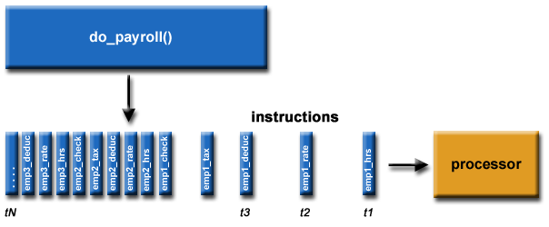
Serial programming

Slide 5
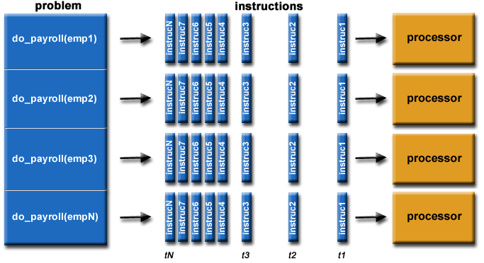
Parallel programming

Slide 6
Parallelism models
CPU multi-processing / Distributed-memory parallelism
  Create multiple OS/system processes
  Execute them in parallel
  Python MPI (mpi4py), multiprocessing module
CPU multi-threading (shared memory parallelism)
  Threads share the same portion of memory assigned to their parent process
  OpenMP (C/Fortran/C++) (Cython, Numba)

Slide 7
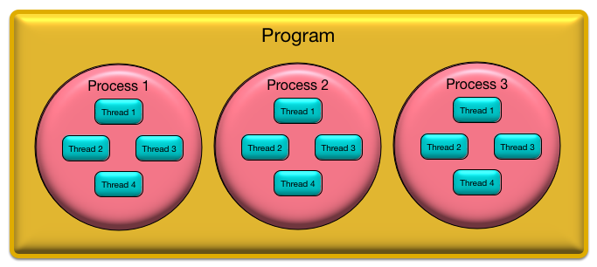
The Hitchhiker’s Guide to Parallel Programming

Slide 8
Parallelism and Python
CPython implementation – the de facto standard Python
The Global Interpreter Lock (GIL)
  Native Python multithreading?
  But not the only type of parallelism
    Process / task based parallelism
    Cheat and use C + OpenMP
    MPI (message passing interface)

Slide 9
Parallelism and Python
Where to begin?
  What problem are you trying to solve?
    Big data? → Multiprocessing, MPI
    Big computation? → Cython, Numba, MPI
    Is it “Embarrassingly parallel”? → Multiprocessing
Four ‘taster tutorials’
  Part 1: Multiprocessing
  Part 2: Numba
  Part 3: Cython (+OpenMP)
  Part 4: Mpi4py
  Wrap up session at end
https://github.com/dvalters/RSE18-Python-Parallel-workshop

Slide 10
Let’s go!
Tutorials in Jupyter Notebook format
  Introduction + Four Mini Tutorials
Links to the GitHub repository
Can use IPython, Jupyter notebook, Editor + terminal, whichever you prefer
Experiment! Break the examples!
  Discussion session at end?
  Share your other Python parallel programming experiences!
  Blog/write up?
https://github.com/dvalters/RSE18-Python-Parallel-workshop

Slide 11
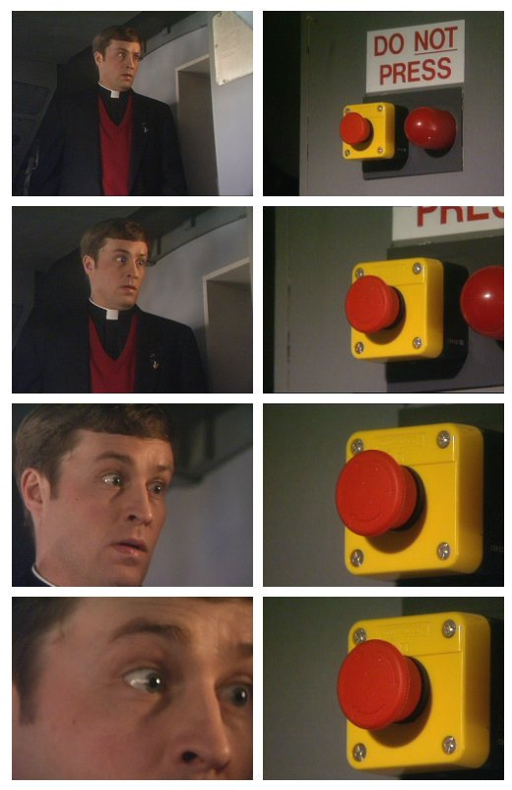
Let’s go!
Experiment!
Break the examples…
Discussion session at end?
Share your other Python parallel programming resources/experiences!

Slide 12
Part 1: Multiprocessing
Python’s built in multi-processing library
https://docs.python.org/3.4/library/multiprocessing.html
https://github.com/dvalters/RSE18-Python-Parallel-workshop

Slide 13
Part 2: Numba
Numpy optimising library
Uses Python decorators
Auto-parallelisation features
http://numba.pydata.org/
https://github.com/dvalters/RSE18-Python-Parallel-workshop

Slide 14
Part 3: Cython + parallelism
Cython – superset of Python with C-like type features
Also compiler that compiles Python/Cython code to binaries
Parallelism with OpenMP (shared-memory parallelism)
http://cython.org/
https://github.com/dvalters/RSE18-Python-Parallel-workshop

Slide 15
Part 4: mpi4py
Interface to the Message-passing Interface
Distributed memory parallelism
Cluster computers
https://mpi4py.readthedocs.io/en/stable/
https://github.com/dvalters/RSE18-Python-Parallel-workshop

