Slide 1
Functions and Modules

Slide 2
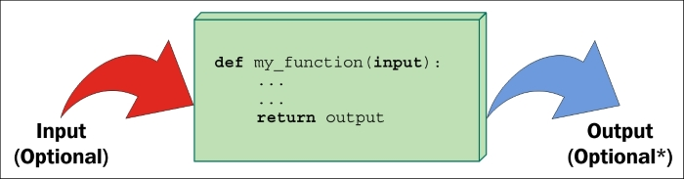
What are functions anyway?
Functions are functional blocks of code.
  They take input(s), called arguments
  They return output(s), called returns

Slide 3
Why should you use functions?
They reduce code duplication in a program
They help in split a complex tasks into small blocks
They hide the implementation details from their users.
They improve traceability
They improve readability

Slide 4
Defining functions
Defining a function requires
  Giving it a name
  Listing the required inputs
  Writing the code – specifying what the function does
  Returning the result

Slide 5
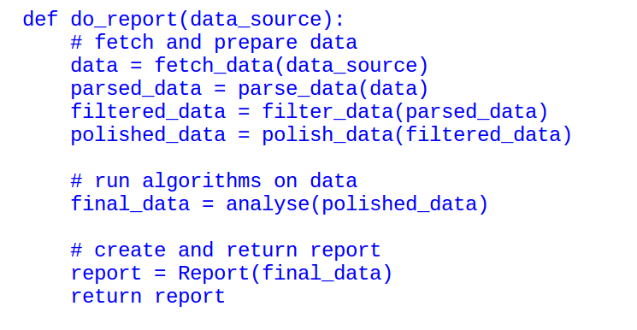
Functions: its a philosophy
Breaking code down into functions allow you to build a hierarchy of code

Slide 6
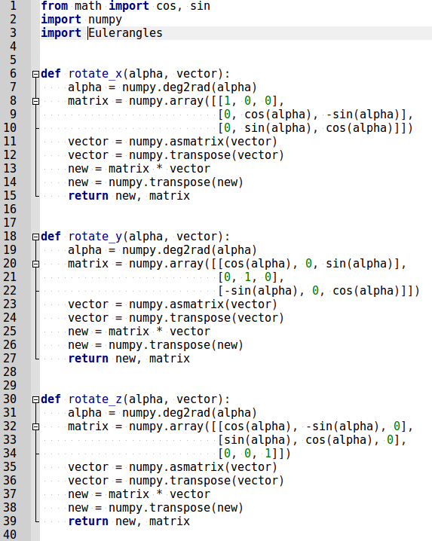
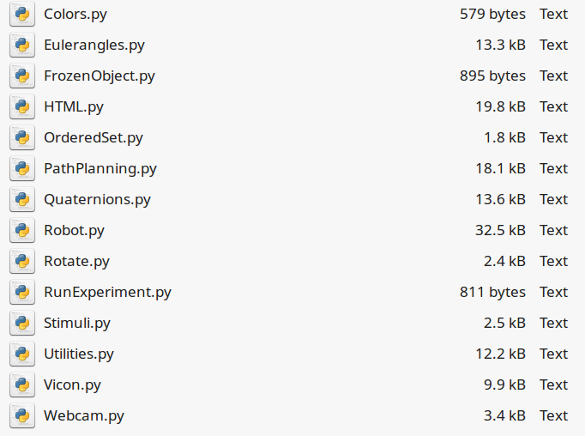
Modules: another level of organization
A module is a .py file that defines multiple functions
Typically, modules contain related functions

