Slide 1
Pygame

Slide 2
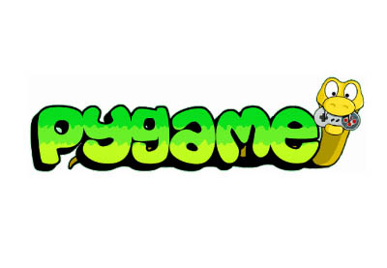
Pygame
Easy to use library for 2D games
  But games could be complex:
    https://www.youtube.com/watch?v=MkZXaDQfTSo
    https://en.wikipedia.org/wiki/Frets_on_Fire
Fun way of getting your head around programming logic
  Input/game flow/output/feedback

Slide 3

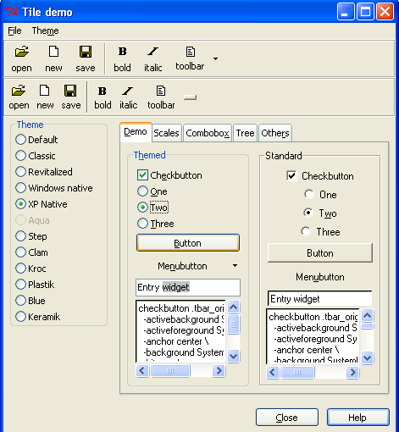
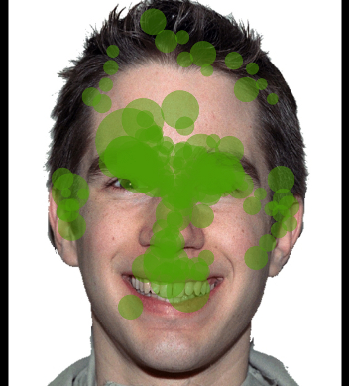
Why?
Could also be used to program experiments (requiring visuals/sound)
Other libraries:
  Tkinter
  Psychopy: timing!
  Pygaze: eye tracking

Slide 4
Examples
blah blah blah
Sun dial
Experiment

Slide 5
Docs
https://www.pygame.org/docs/

Slide 6
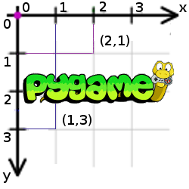
Coordinates

