Slide 1
Do incongruent cues increase reaction times?

Slide 2
Question
When responding to a stimulus, can we ignore its aspects that are irrelevant to the task at hand?

Slide 3
Experiment
Experimental Task:
  Stimuli with varying direction, location and color
  Respond to arrow color: green left, red right
  Direction & location are irrelevant

Slide 4
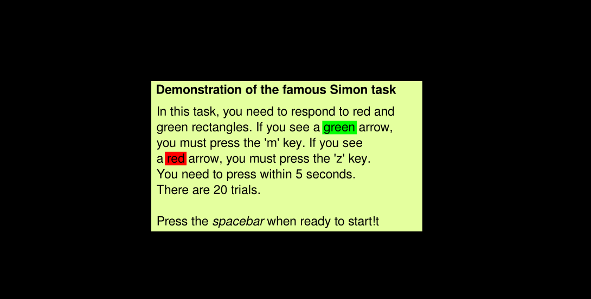
Experiment

Slide 5

Experiment

Slide 6
Data
Xx participants
College psychology students
Xx trials per experiment
Excluded rt > xx

Slide 7
Some stats
Reaction time:
  Mean: 484 Std: 132 Min: 281 Max: 995
Accuracy: > 95%

Slide 8
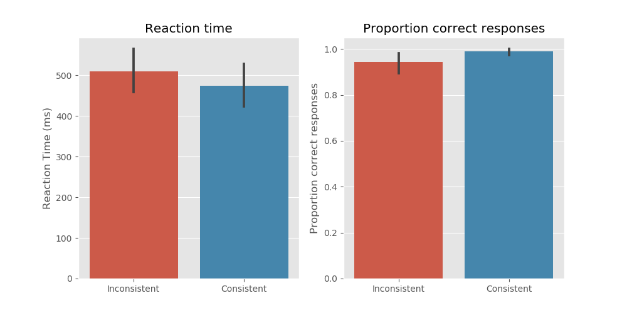
Results

Slide 9
Statistical tests
Reaction times:
  t(9) = -3.75, p < 0.00
Errors:
  W = 0.00, p < 0.05

Slide 10
Conclusion
Inconsistent trials incur longer rt and lower accuracy.
When responding to a stimulus, we can not ignore its aspects that are irrelevant to the task at hand?
Analyze effect of position?

