Slide 1
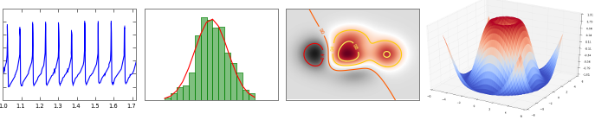
Matplotlib
Let’s do something useful for a change

Slide 2
Matplotlib
Programming plots instead of making them in excel, SPSS,…
  Write a program that constructs a plot step by step
Why?
  Flexibility: scientific plotting has moved beyond single line graphs
  Exploration and on-line visualization
  Data might change
  Your ideas might change
  Consistency: define a style and use in all plots
  Quality – there is no substitute for a good plot

Slide 3
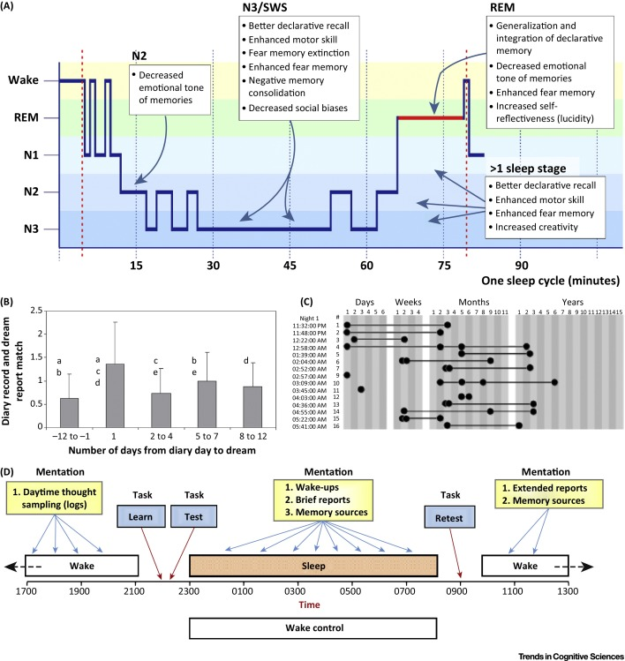
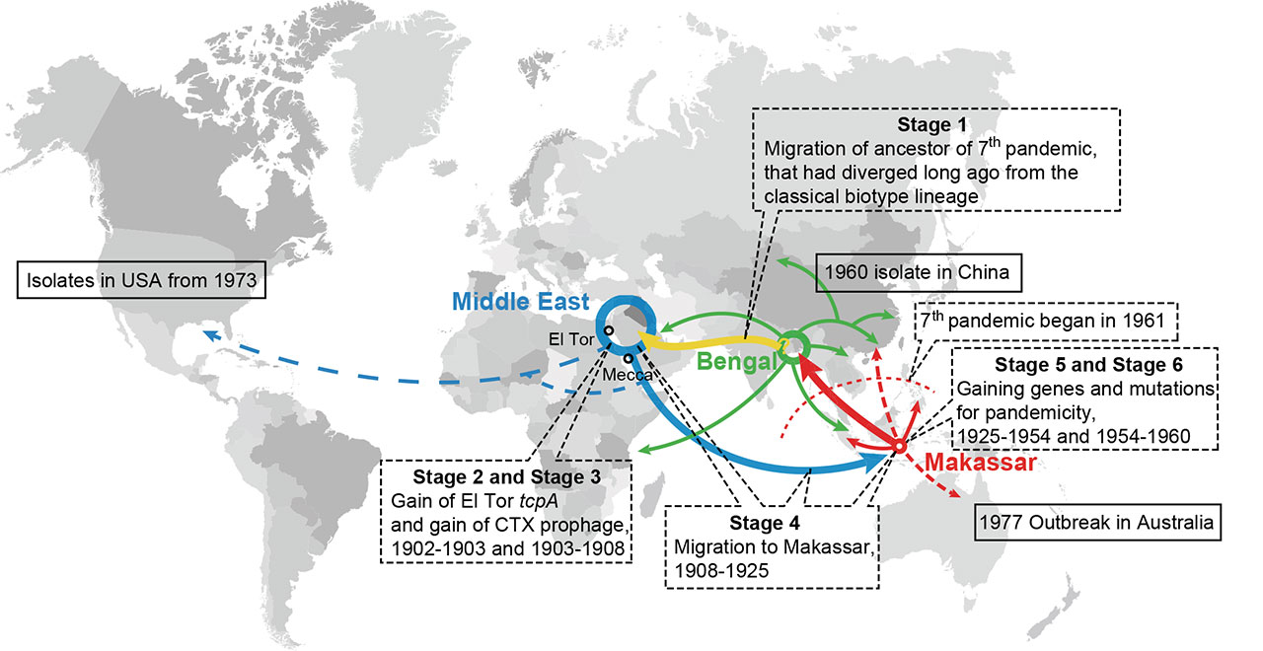
Flexibility

Slide 4
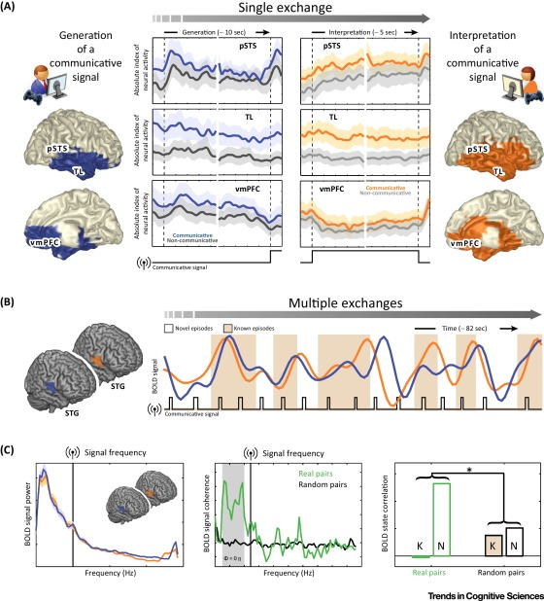
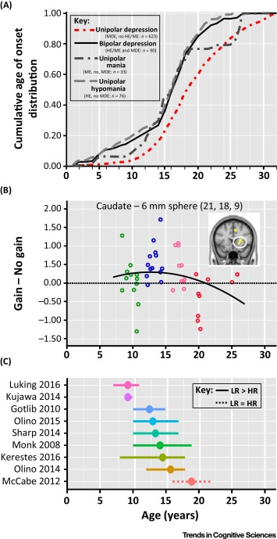
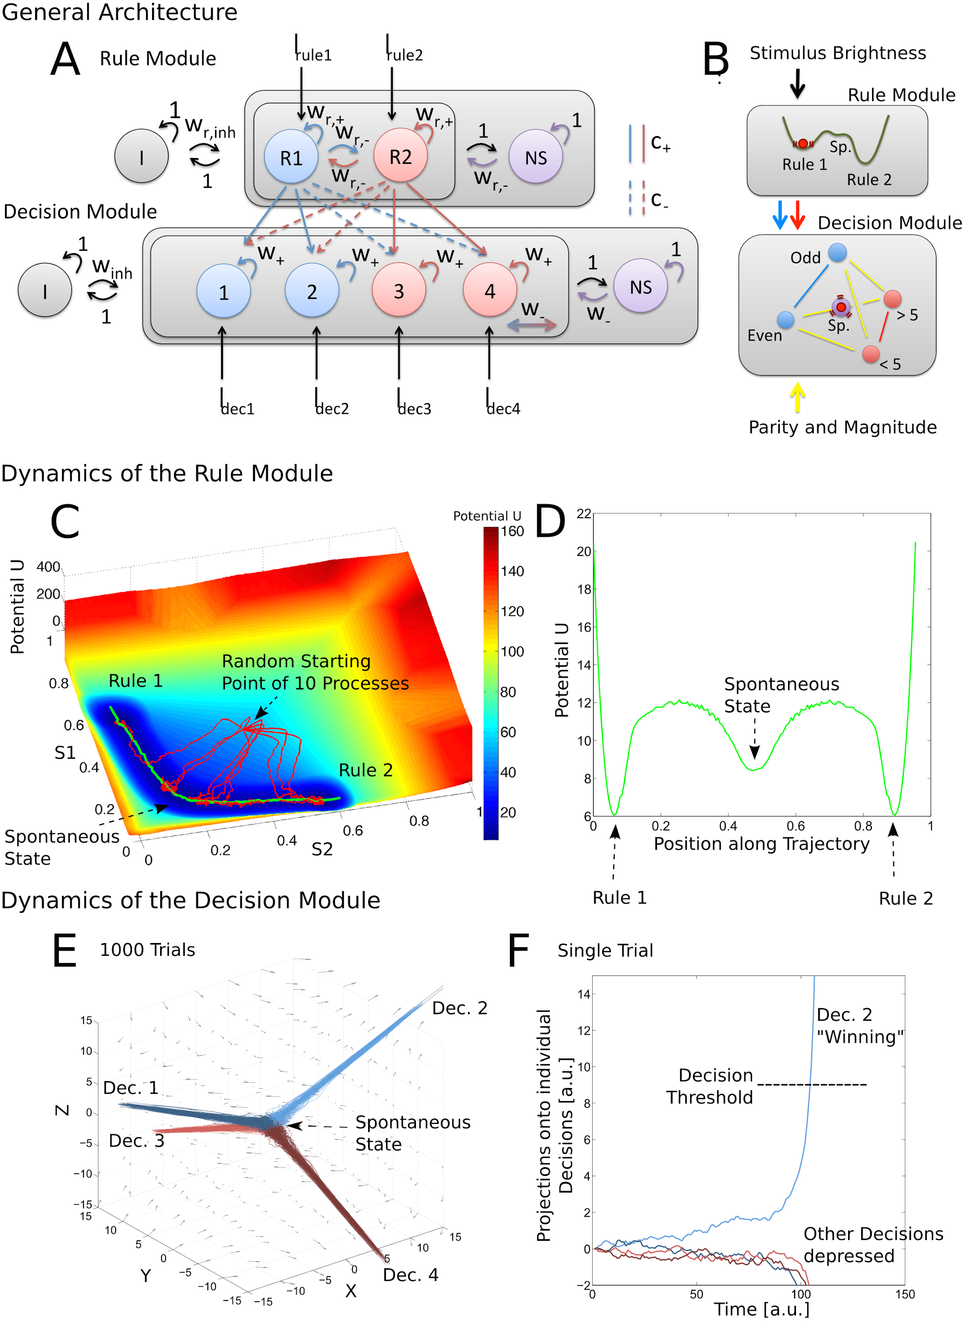
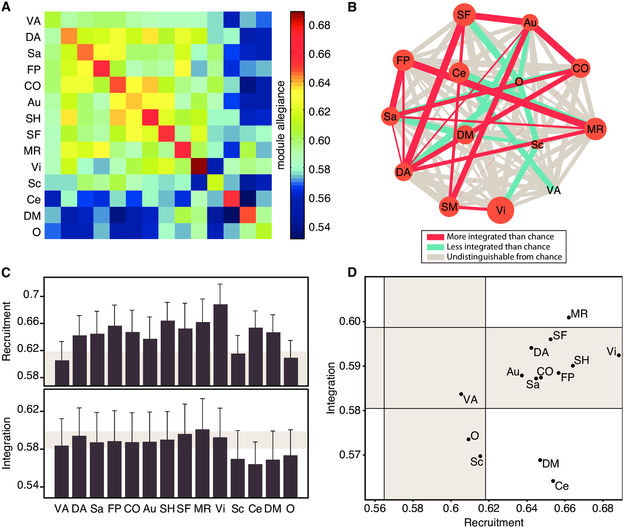

Slide 5
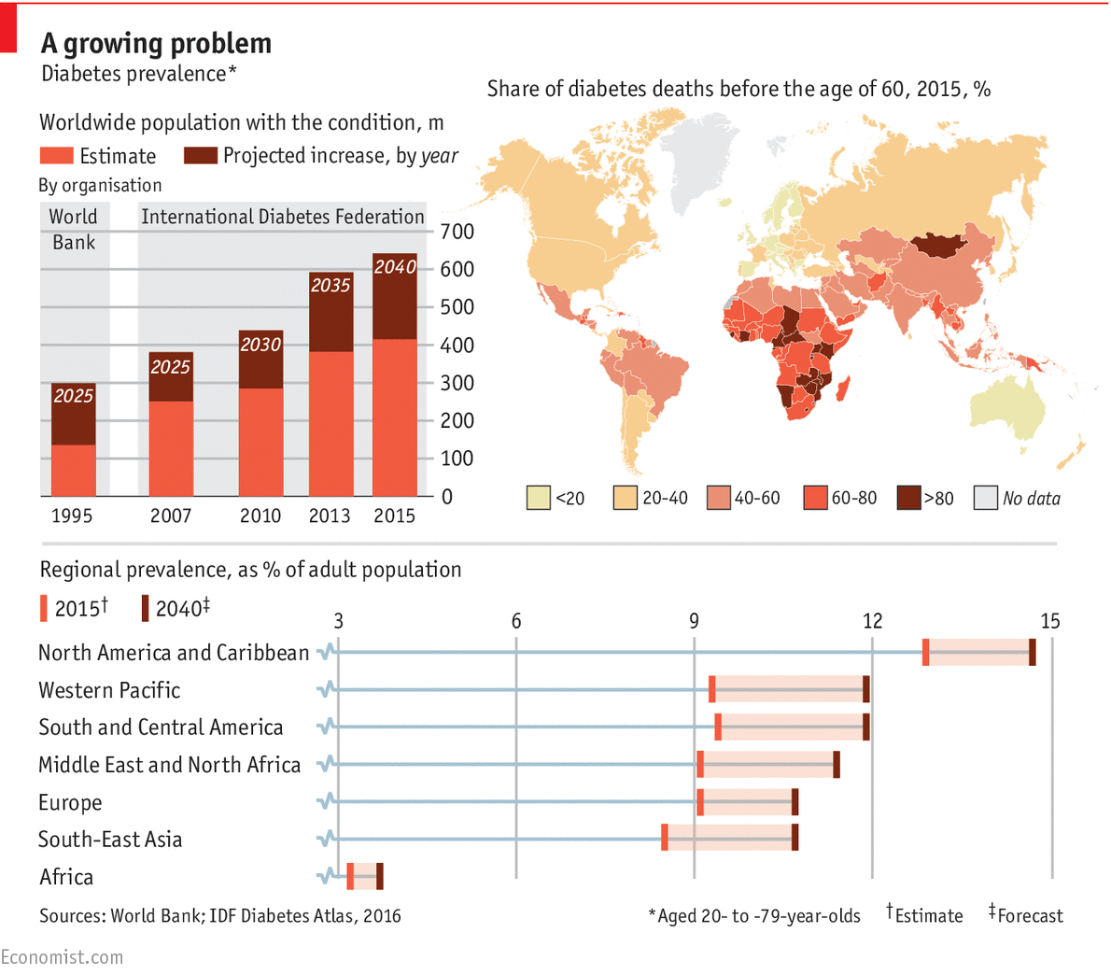
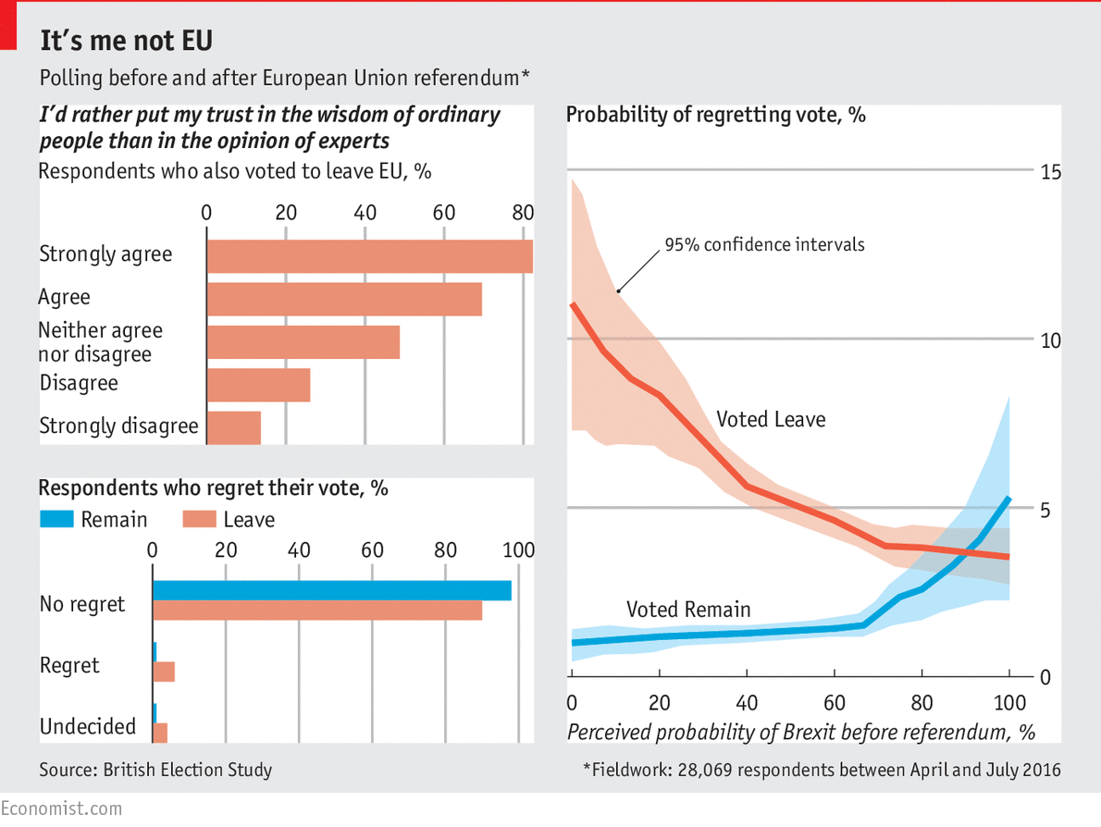
But it’s not just science journals

Slide 6
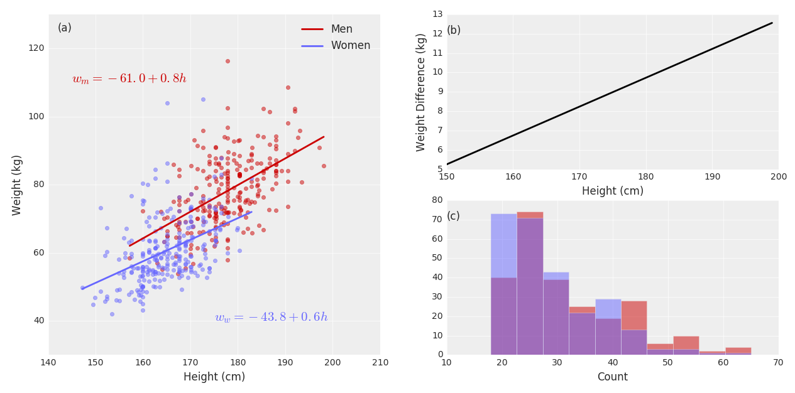
Example 1

Slide 7
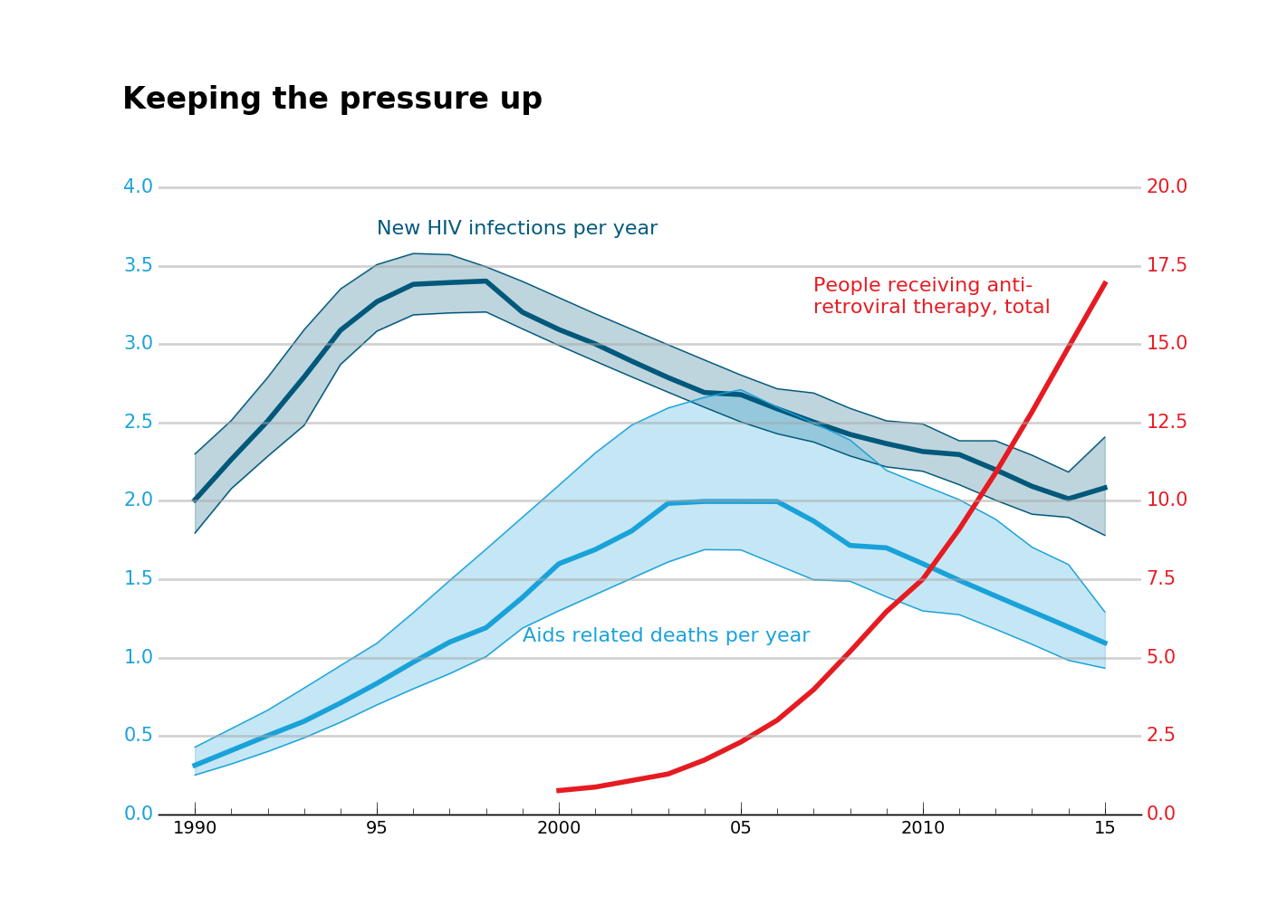
Example 2

Slide 8
Typical work flow
Enter or read in the data
Plot it quick and dirty
Spend a lot of time refining, tuning and polishing the plot
  Change aspect ratio, choose colors, line styles, add titles, labels, annotations
Think you’re done
Refine some more
Enjoy the work of art you’ve created
Mock excel and spss graphs

Slide 9
1 quick graph < 1 minute of work
1 good graph* = 1 day of work
* publication ready graph

Slide 10
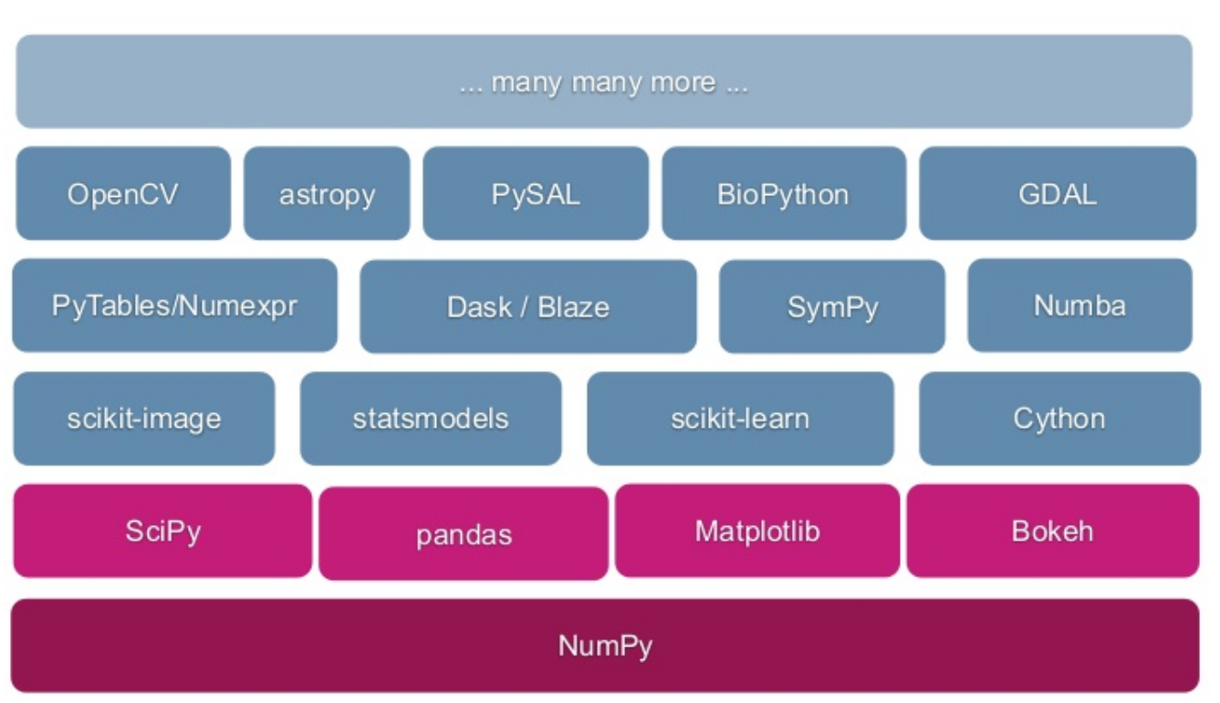
Matplotlib is compatible with Numpy
Matplotlib can plot data stored in Numpy arrays
Numpy arrays can be read in from files

Slide 11

Matplotlib
Pyplot is the (sub)module that contains most plotting commands
Documentation:
  Go to the matplotlib website
  Go to pyplot: https://tinyurl.com/y8xslmv6
  Go over the scatter command

Slide 12
Matplotlib
X and Y are required arguments
All the others are optional and their default value is listed

Slide 13
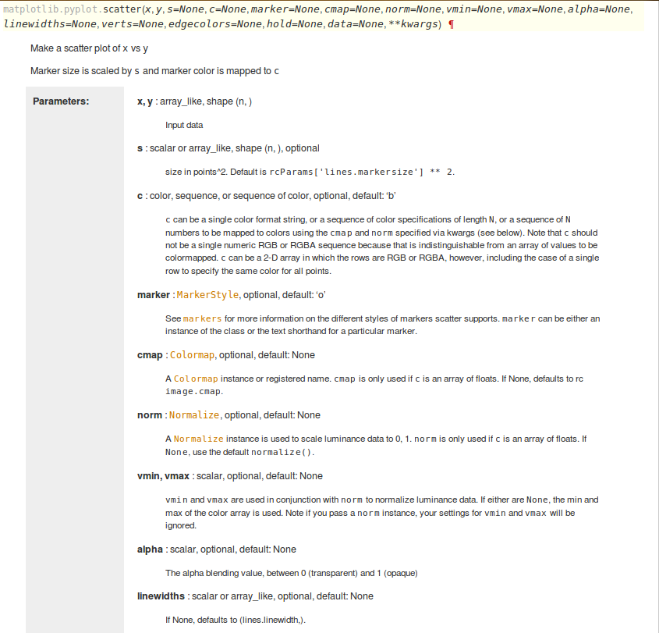
Input data
Size of the points
Color of the points
Markers used [See link]

Slide 14
Matplotlib
Gallery: good source of examples
  Go to the matplotlib website
  Go to the gallery:
    simple_plot

Slide 15
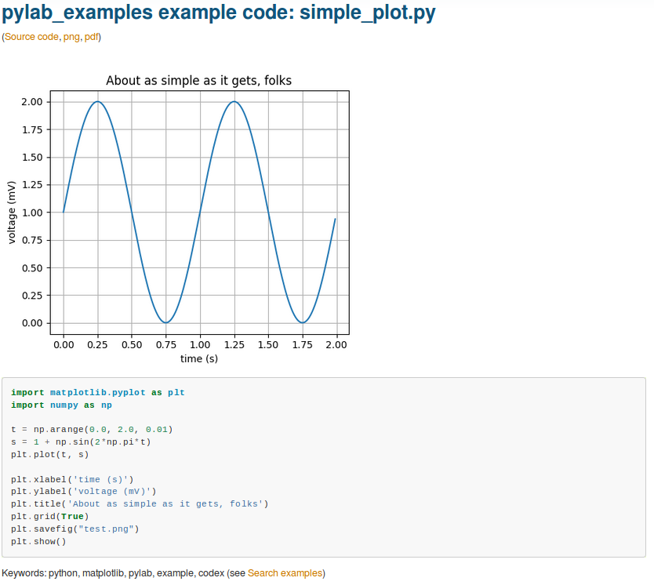

Slide 16
seaborn
https://seaborn.pydata.org/index.html
Built on top of matplotlib

Slide 17
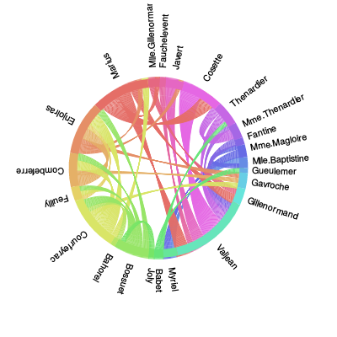
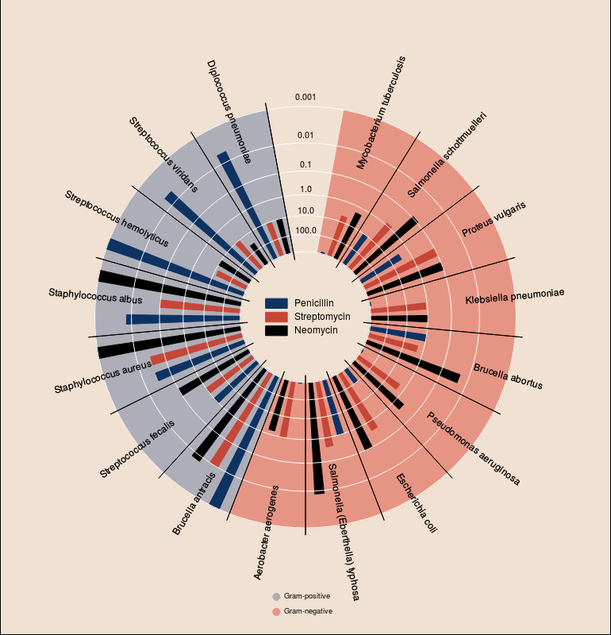
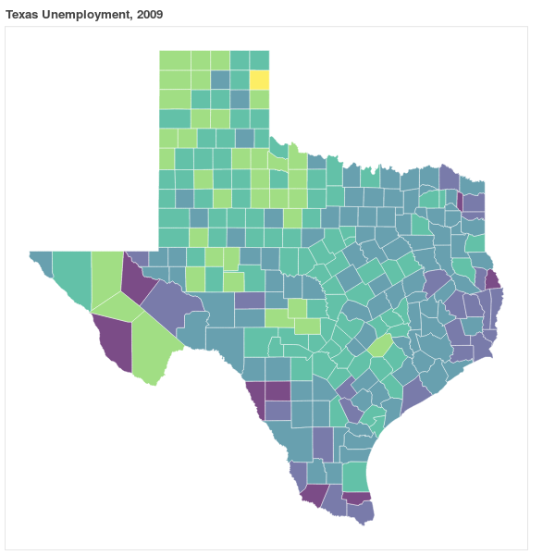
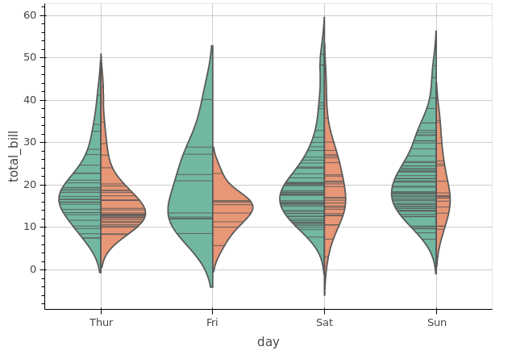
Other plotting packages: bokeh
New plot types
Interactivity
Large data

Slide 18
Exercises
Choose two variables and create a scatter plot using orange triangles as markers.
Calculate the average weight for 5-year age groups. Plot the average weight per age group.
Plot the weight as a function of age, for the men only
Plot the wrist diameter and the Ankle diameter as a function of weight on the same plot, using two different colors.
Add a label for the x and the y-axis for one of your plots above.

Slide 19
Even more
See:
  http://pbpython.com/visualization-tools-1.html
  https://dansaber.wordpress.com/2016/10/02/a-dramatic-tour-through-pythons-data-visualization-landscape-including-ggplot-and-altair/
Notable ggplot:
  First available in R
  Grammar of plotting
  Good for statistics

Slide 20
Early term evaluation

Slide 21
Other plotting packages: bokeh
New plot types
Interactivity
Large data

Slide 22
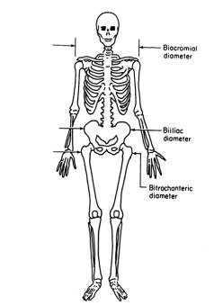
Homework: visualize body dimension relationships
Download the body data
  https://ww2.amstat.org/publications/jse/jse_data_archive.htm
Visualize part of the data set:
  Use a histogram, a line plot, a scatter plot or a bar plot
  Label the axes, provide a title
  Extra credit:
    Aesthetics, Subplots, Annotations
Prepare a 3 minute presentation (2-3 slides):
  Put your name(s) on the slides
  Show the plot
  Tell us what the code does
  Answer questions
Email me the code, the graph and the presentation
  put your names in the subject line

