Slide 1
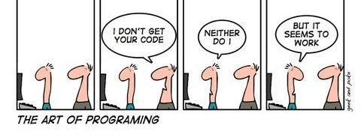
How python works

Slide 2
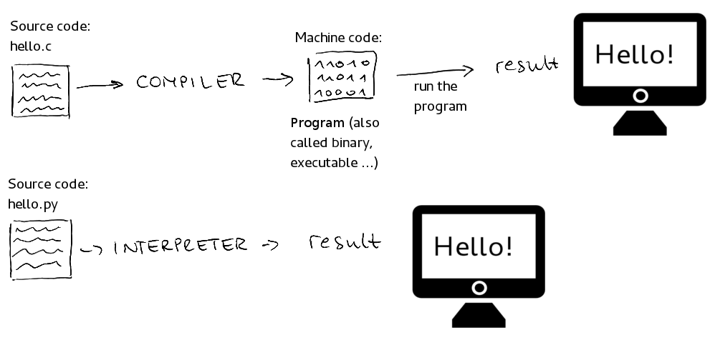
Python is an interpreted language

Slide 3
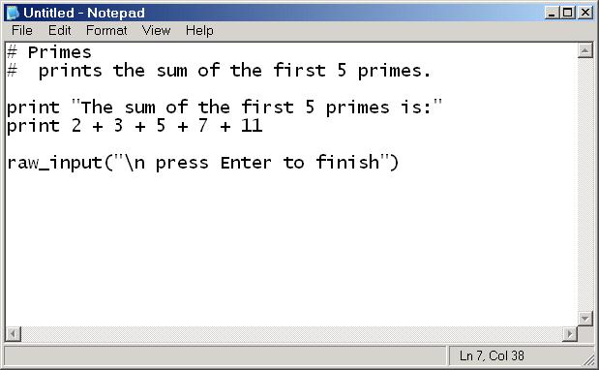

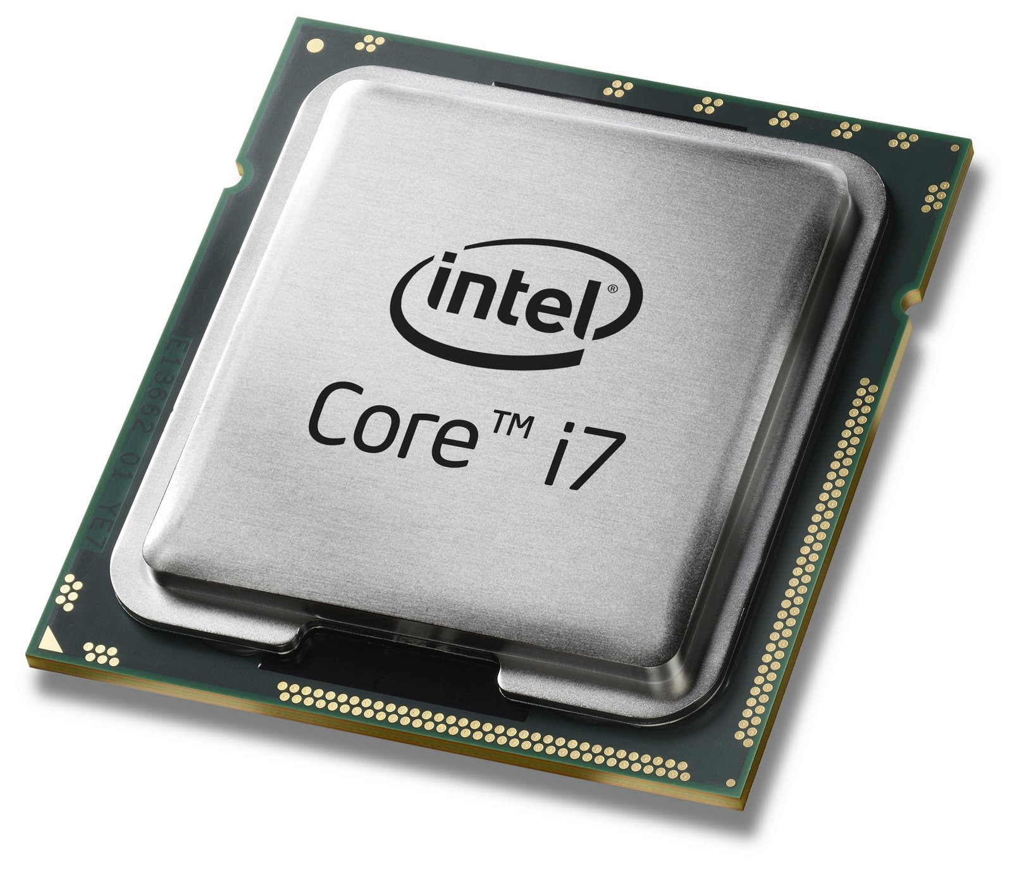

Slide 4
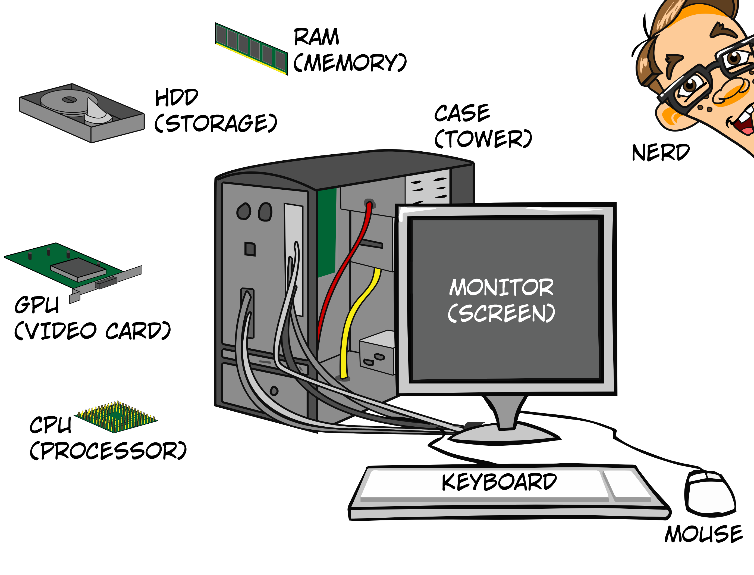
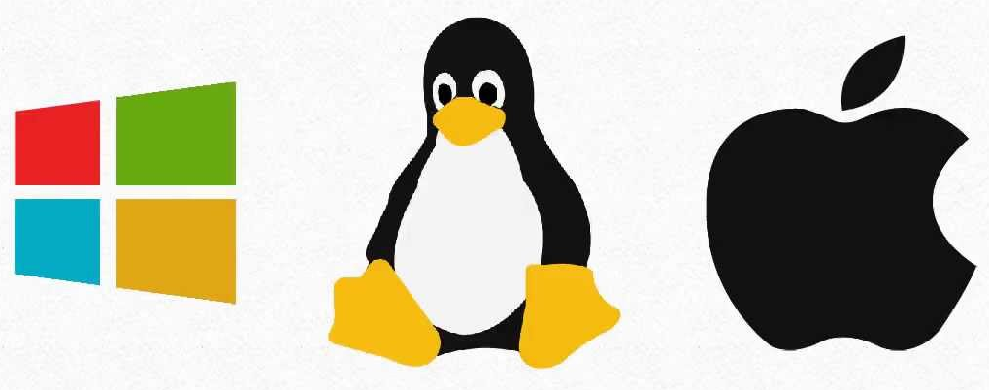
Python is an interpreted language
Instructions
(computer program)
Operating system

Slide 5
Side note (this will not be on the exam)
CPython internals: A ten-hour codewalk through the Python interpreter source code
http://pgbovine.net/cpython-internals.htm

Slide 6
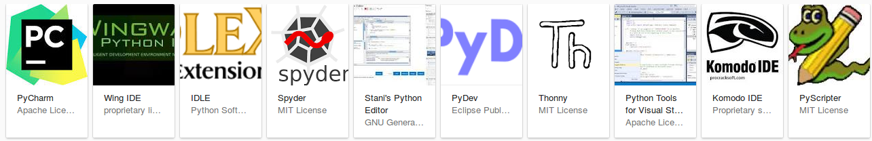
A good editor makes talking to Python easier
https://wiki.python.org/moin/PythonEditors
IDE = integrated development environment

Slide 7

Operating system

Slide 8
Why?
It comes with Anaconda
And has good functionality – without being too complex

Slide 9
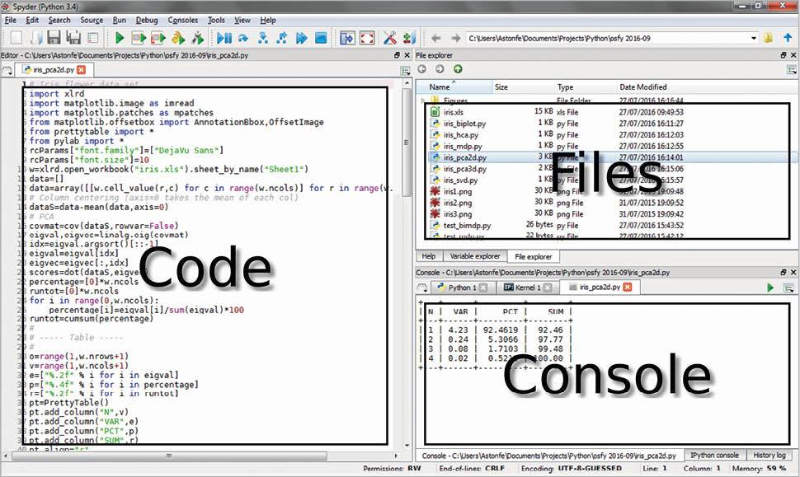
Spyder: Main components
Working Directory
Variable Explorer

Slide 10
We can talk to python in two ways
Interactively
  Send one instruction at a time
  Does not save your work!
Write a program or script file
  Send many instructions at a time
  Your work is saved in a file!

Slide 11
Remember: you use Spyder to talk to python
Operating system

Slide 12
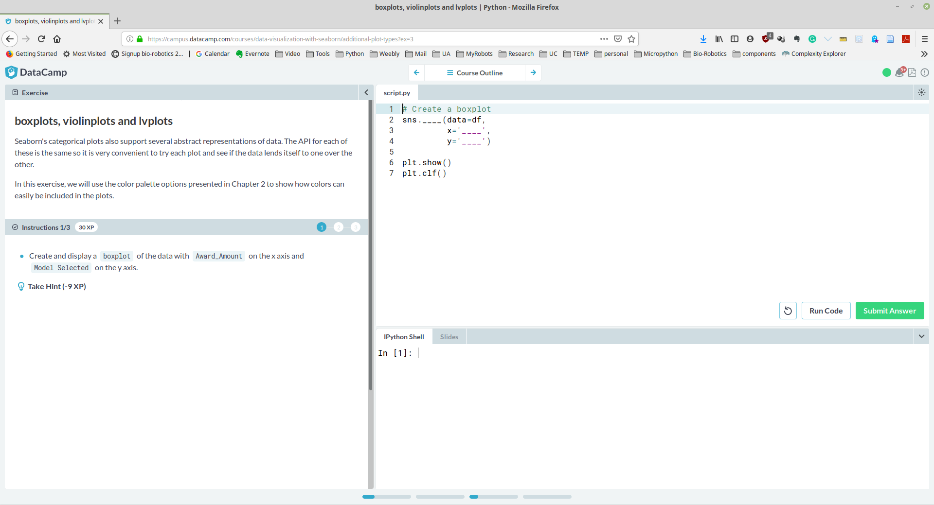
On the datacamp website things look different
Equivalent to the code editor in Spyder
Equivalent to the console window in Spyder

