Slide 1
Programming for behavioral scientists

Slide 2
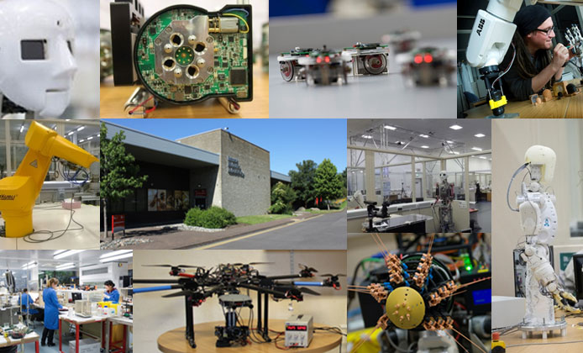
About me
Education
  Msc Experimental Psychology
  Msc Artificial Intelligence
Models of bat echolocation
PhD in Biology at Engineering lab
Postdoc at dept. Biology
Bristol Robotics Lab
Notes:
I want to give you an overview of my background to give you an idea of where my research approach is coming from

Slide 3
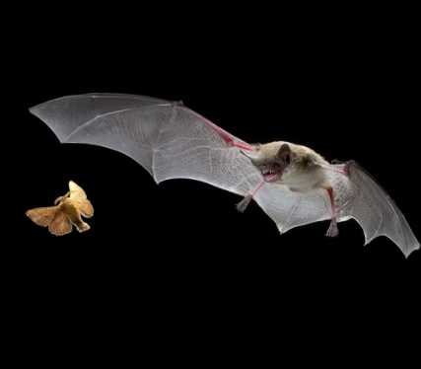
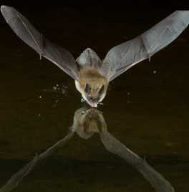
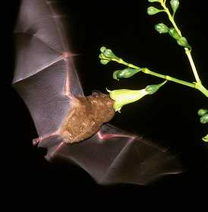

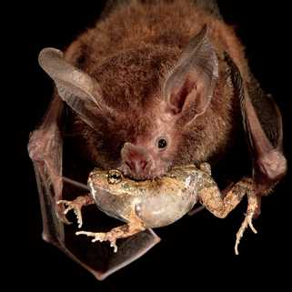
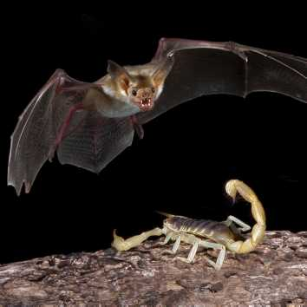
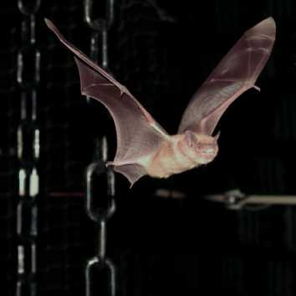
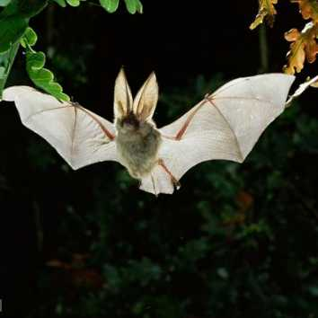
Sonar Supported Behavior
Notes:
Well-studied sensory system: bio-sonar
Acoustics well-known
Aerodynamics have been studied
Lots of behavioural data

Slide 4
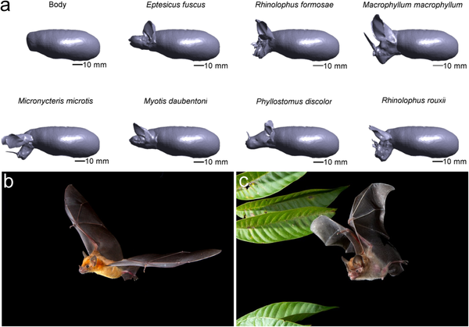
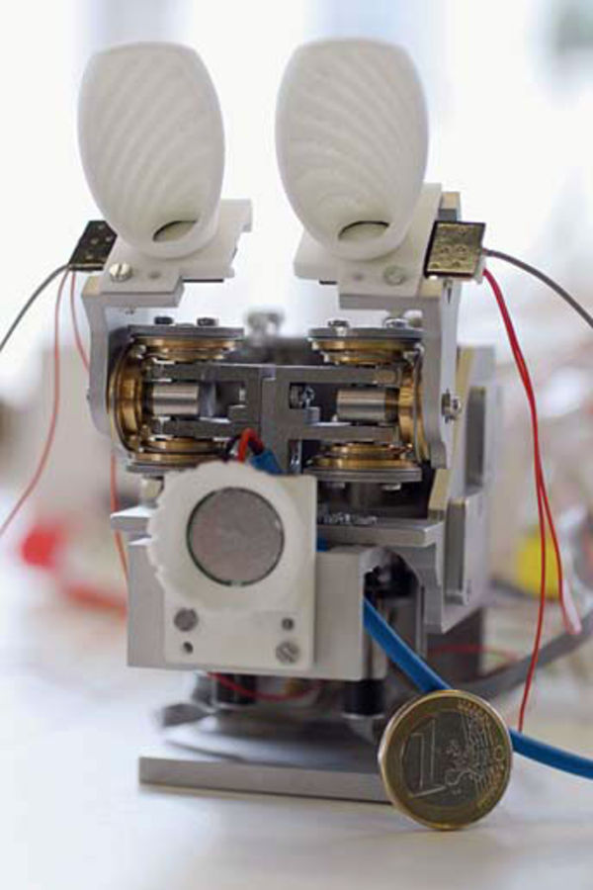
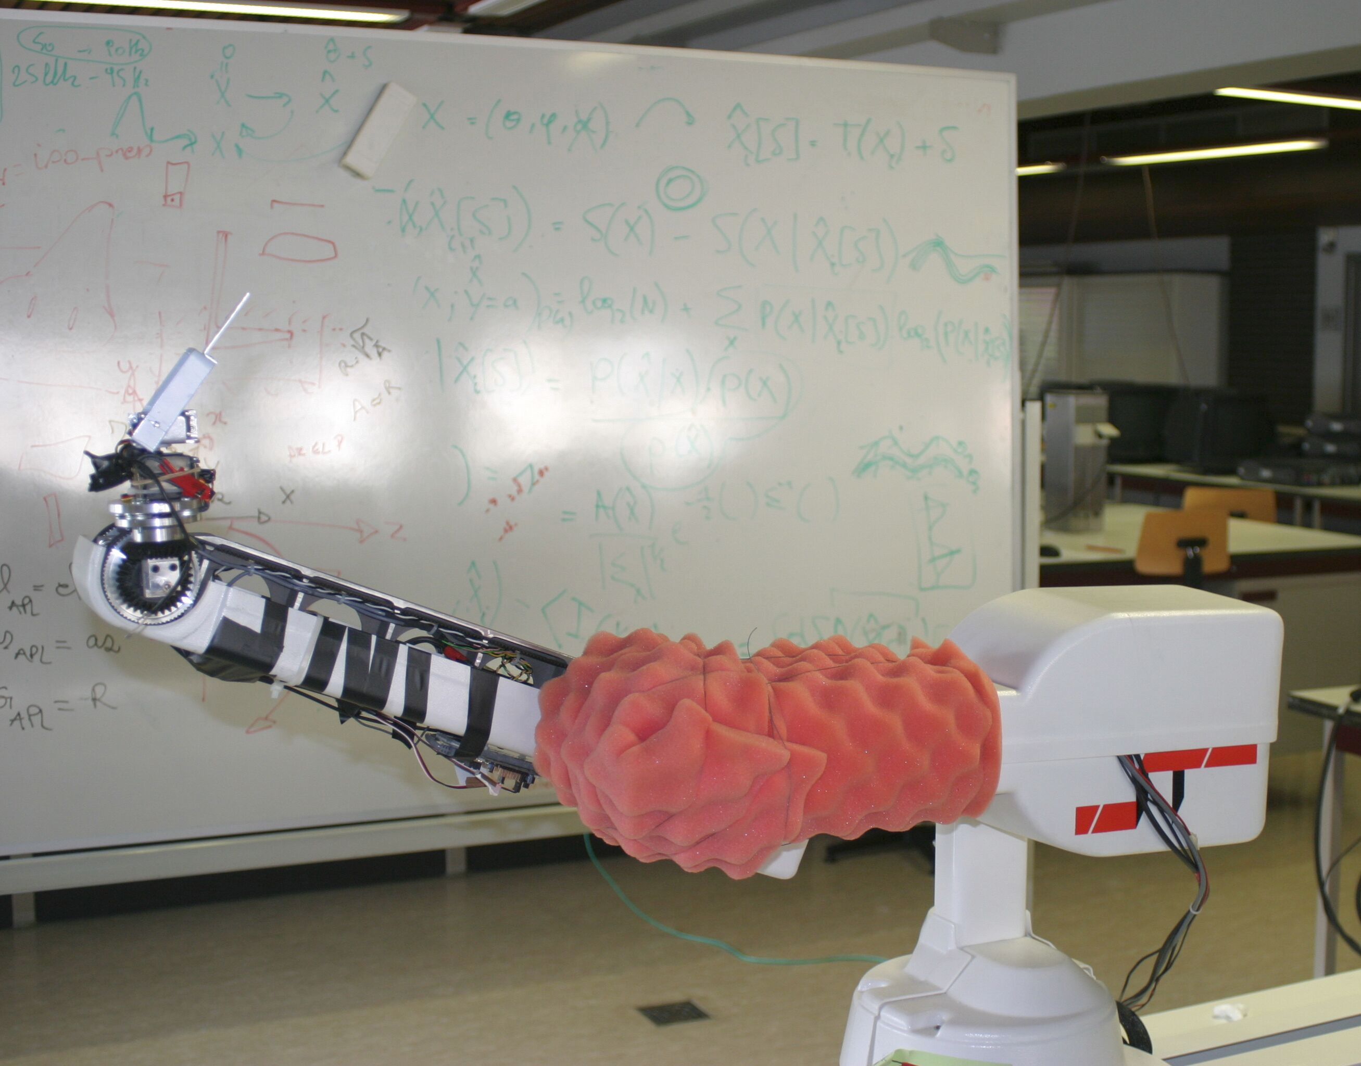
Models and robots

Slide 5
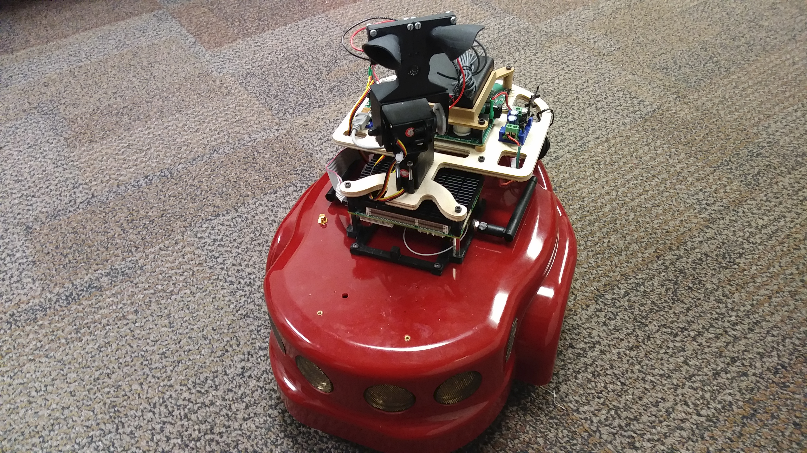


Slide 6
Write down my email address
The email address listed on blackboard might be wrong.
vanderdt@ucmail.uc.edu

Slide 7
Python

Slide 8
Installing Python

Slide 9
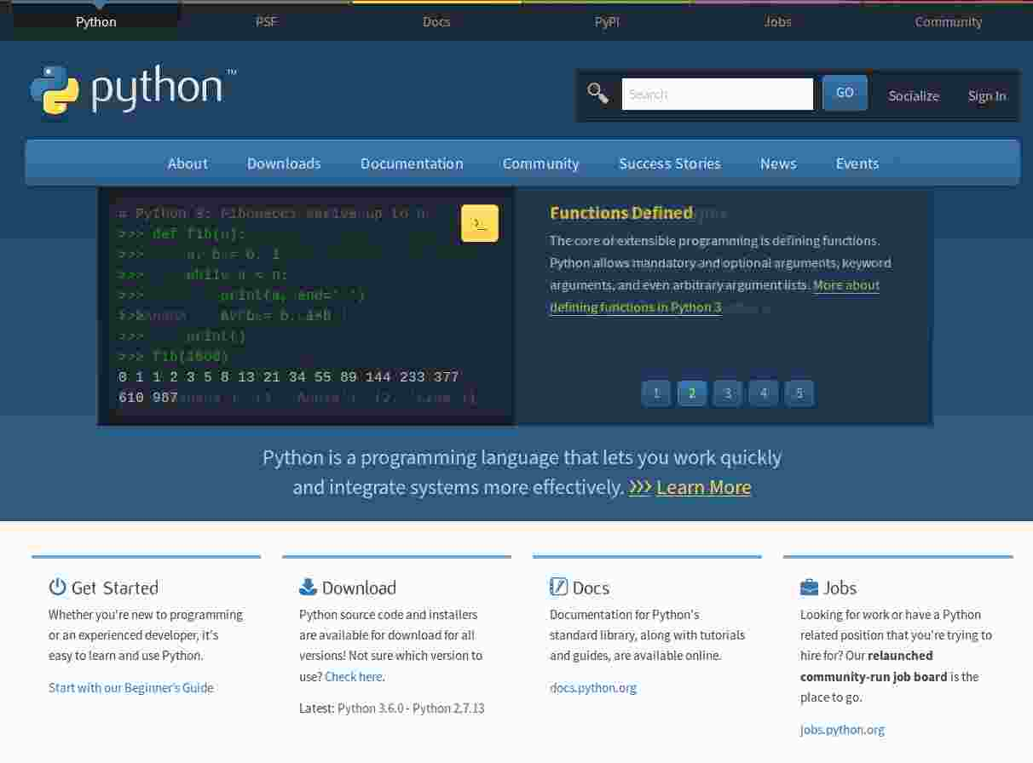
Plain Python: python.org

Slide 10
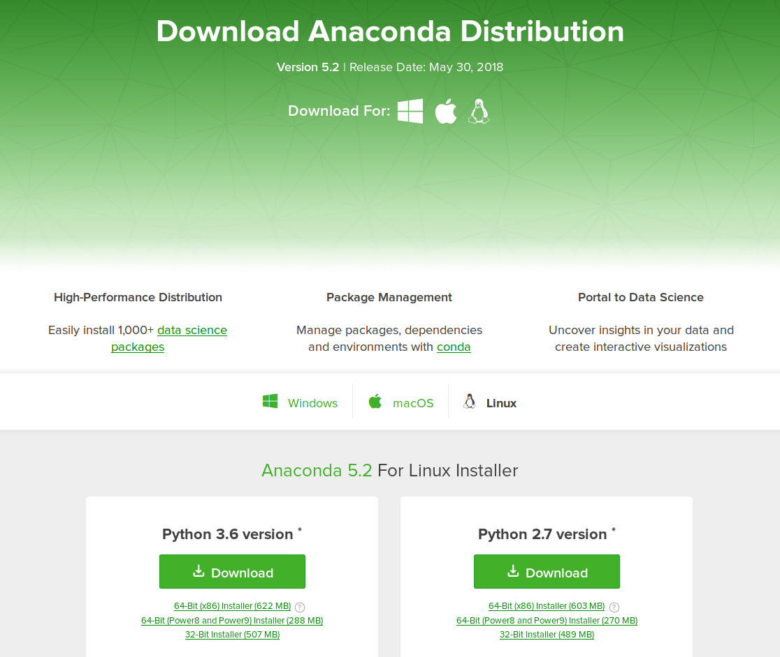
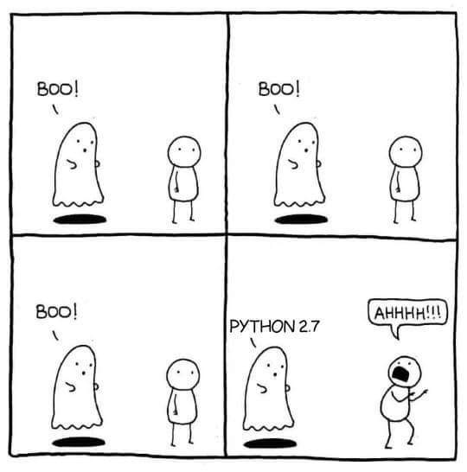
Anaconda
https://www.anaconda.com/download/
We will use Anaconda:
  Python + many scientific extensions + package manager
  Windows, Mac and Linux
  We will use Python 3.7

Slide 11
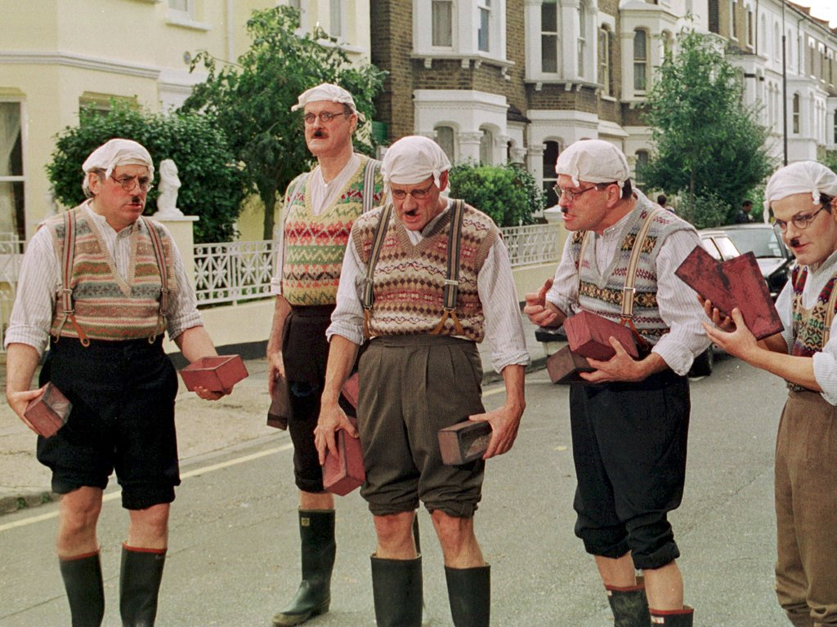


Introducing Python
General Programming Language
  This means that in principle it can be used for any programming task.
  However, it excels in getting things done, quickly and efficiently
Named after Monty Python

Slide 12
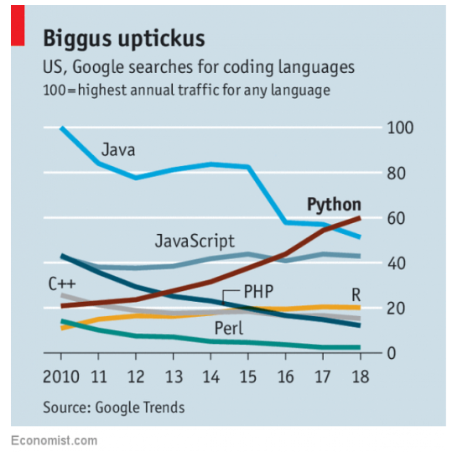
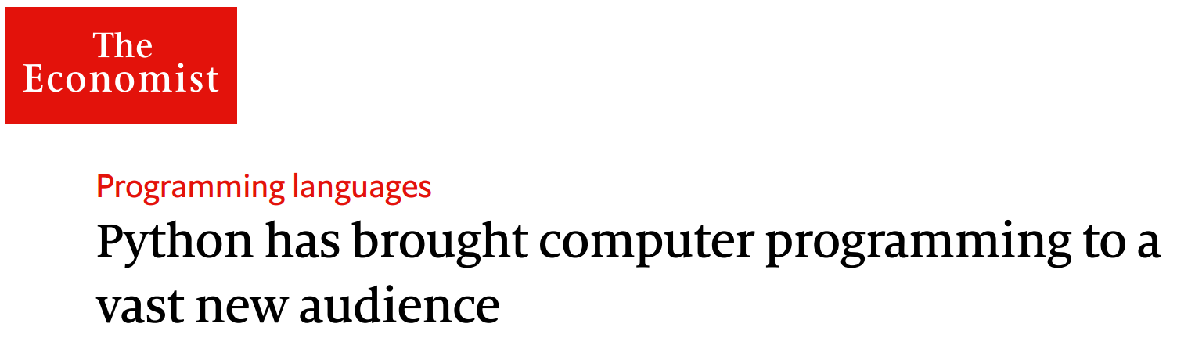
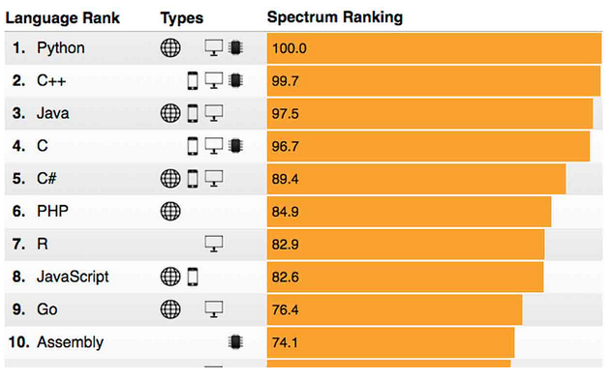
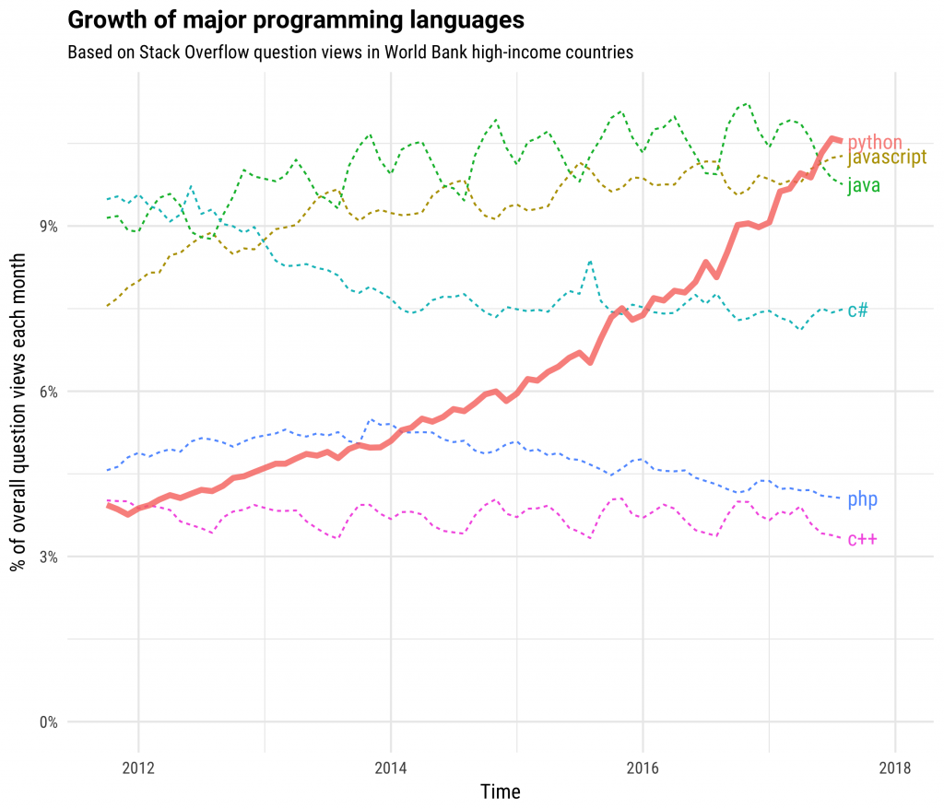
Popularity
http://tinyurl.com/y75qj2ea

Slide 13
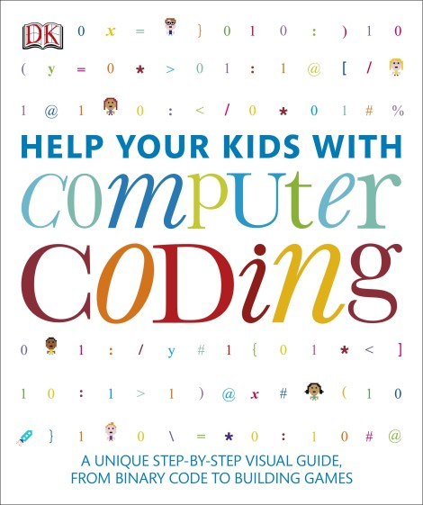
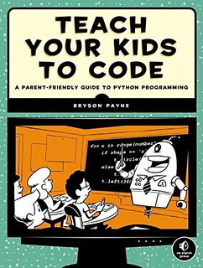
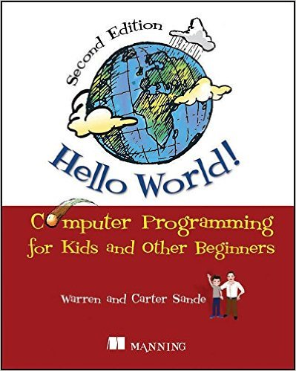
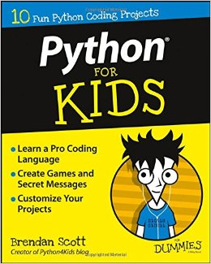
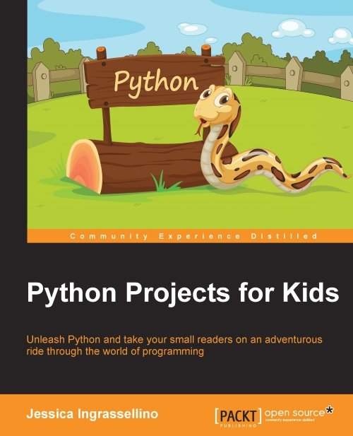
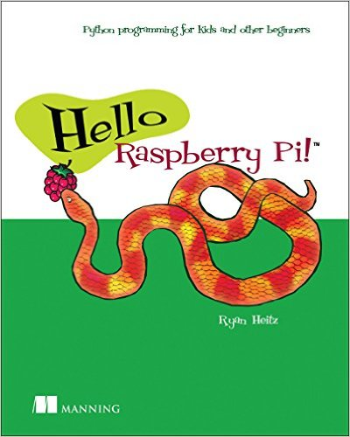
Why it’s a good choice
Easy(ish):
  Its design makes it very readable
  High level programming language
  Python has a gentle learning curve
But powerful:
  Many libraries – for real world tasks
  Applicable to a wide range/size of problems
Python is valued by employers
It’s free

Slide 14
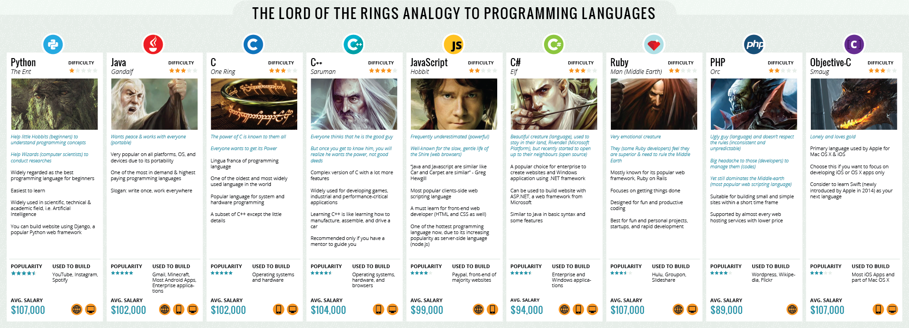
http://carlcheo.com/startcoding

Slide 15
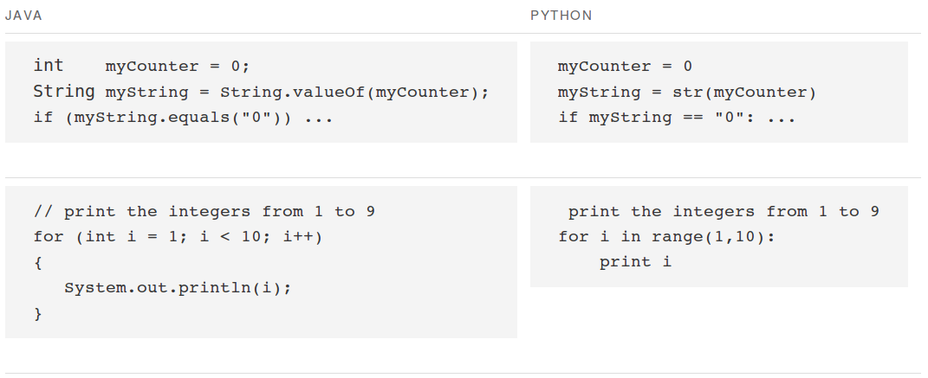
Readability
http://tinyurl.com/hb28hlp

Slide 16
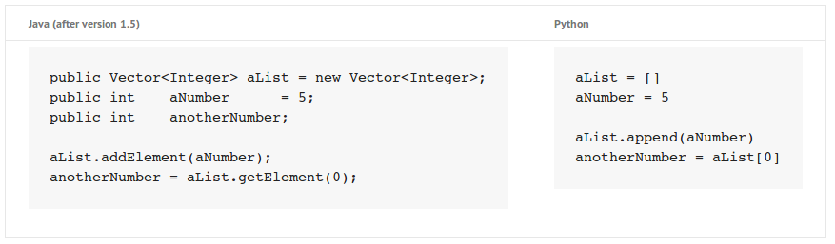

Slide 17
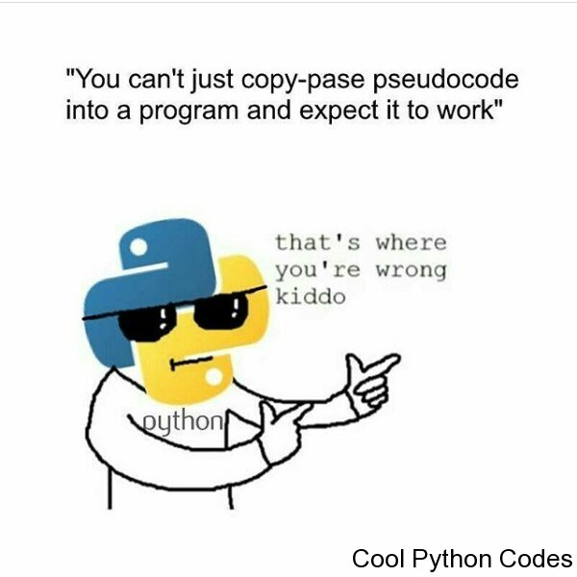

Slide 18
Powerful
Python comes with a large library included:
  See https://docs.python.org/3/py-modindex.html
  Examples: email, sockets, random numbers, wave, time, webbrowser, ...
But the real power is in the many extensions:
  The Python Package Index contains >92K packages:
    See https://pypi.python.org/pypi
    Examples:
      Numpy: matrix and array manipulations
      Matplotlib: 2D plotting, data visualization
      Scikit-image: image processing
      Pandas: data analysis

Slide 19
Stuff you can do with Python

Slide 20
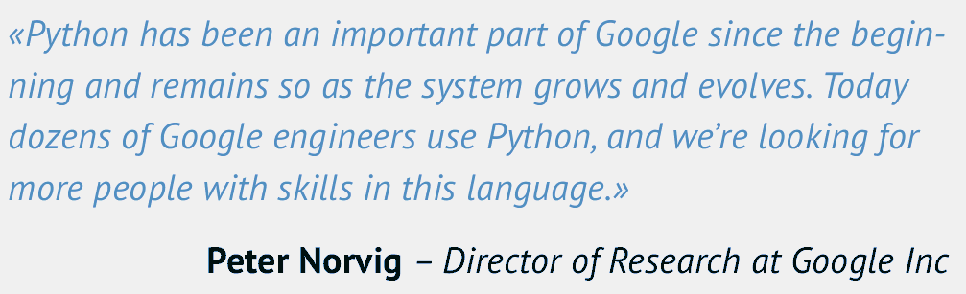
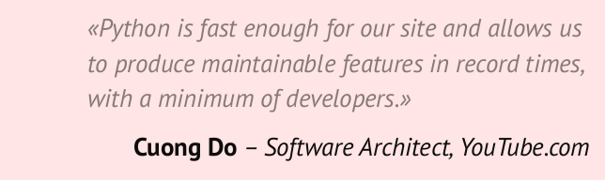
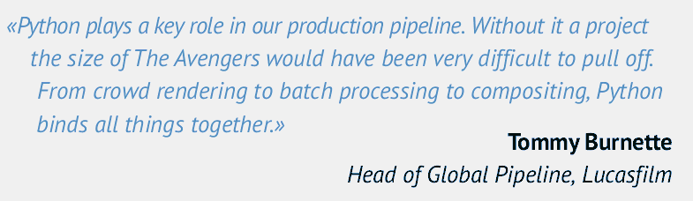
Industry
Some big projects use Python
Python Brochure:
  http://tinyurl.com/lqufvj6

Slide 21
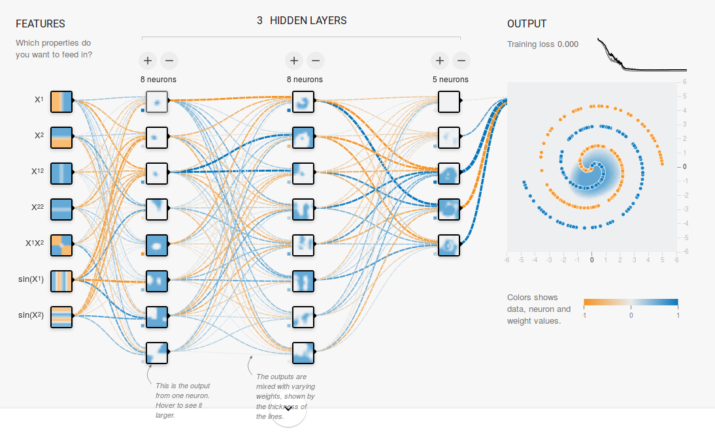
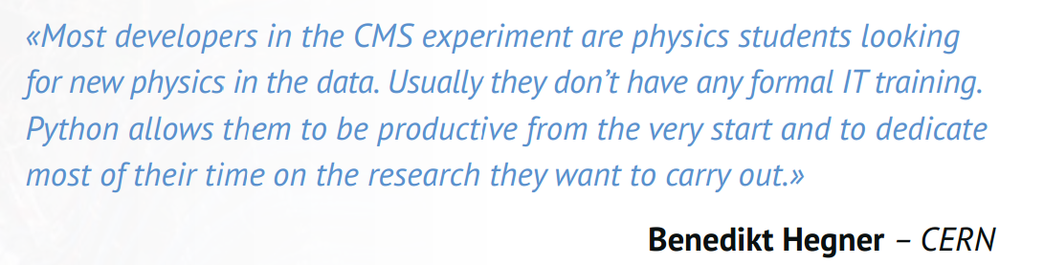
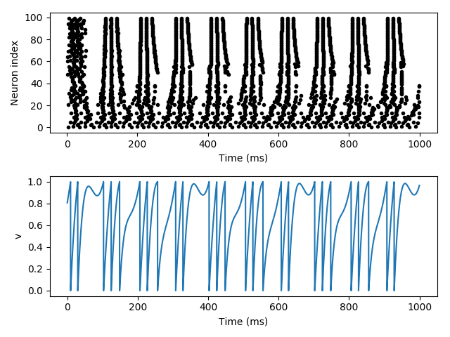


Academia

Slide 22
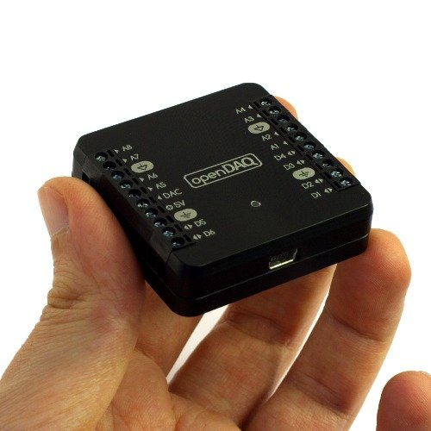
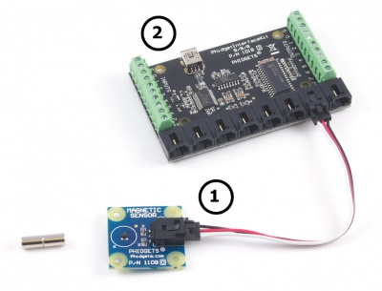
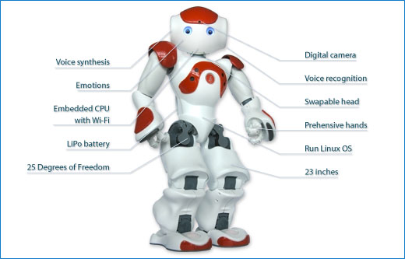
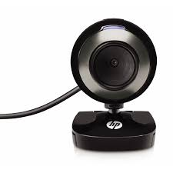
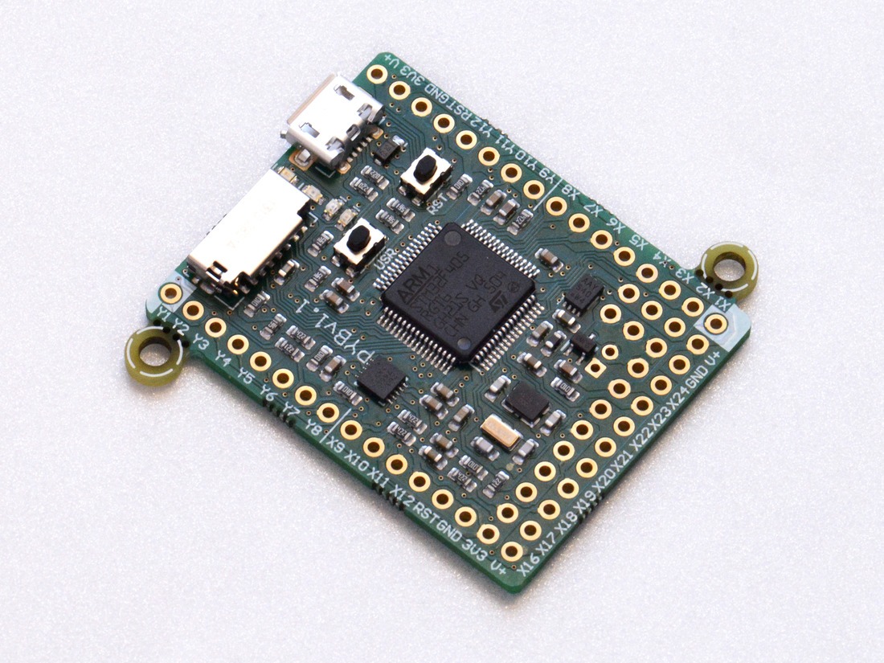
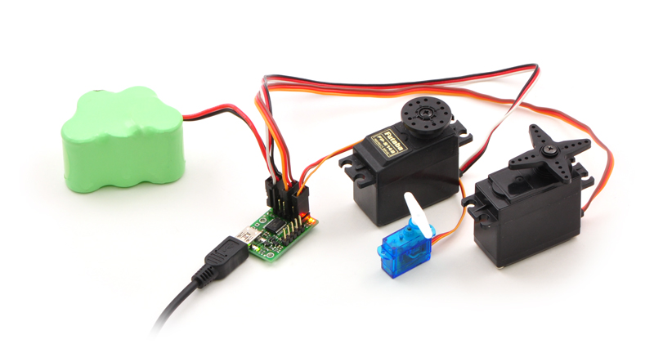
Controlling hardware
http://www.phidgets.com/
http://tinyurl.com/zdb8aeh
https://www.open-daq.com/
https://www.pololu.com/product/1350/
http://micropython.org/

Slide 23
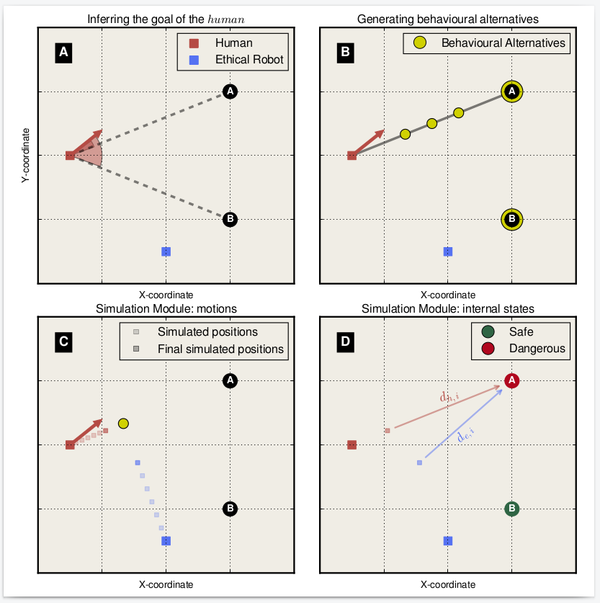
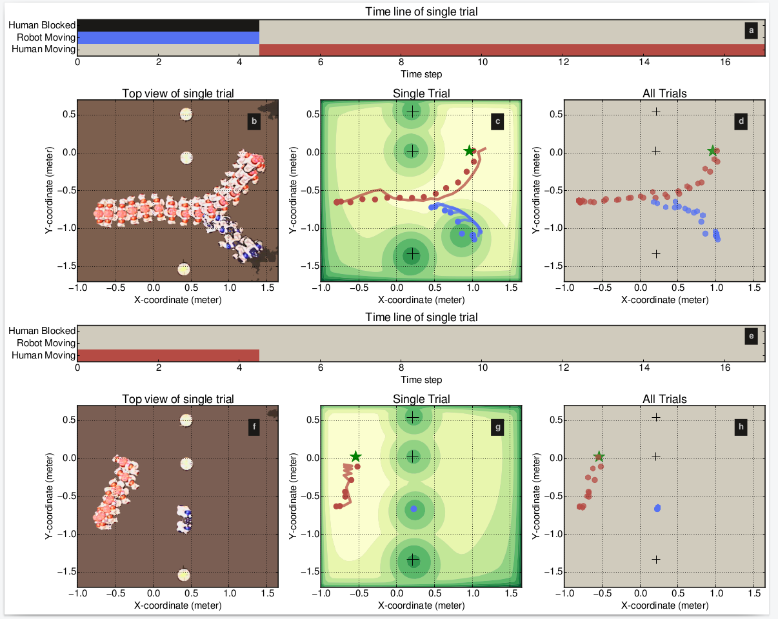
Data visualization & Analysis

Slide 24
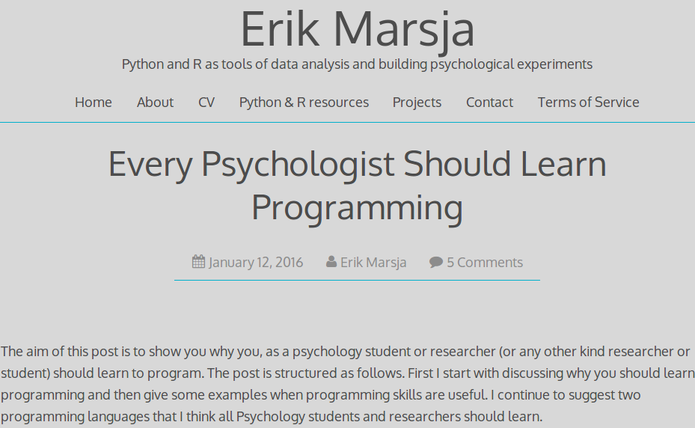
As a psychologist
Data collection
Data visualization
Data analysis
Hardware control
Admin tasks/automate stuff
Text processing
Stimulus creation
Fun
And it’s a marketable skill
https://www.marsja.se/every-psychologist-learn-programming/

Slide 25
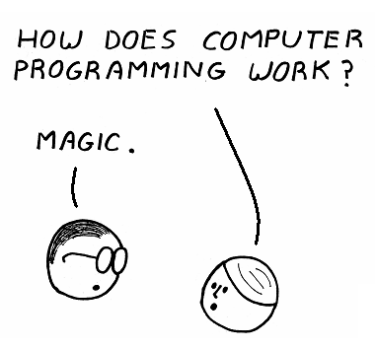
Goal: using your computer more efficiently

Slide 26
Demos

Slide 27
Demos
Plotting
Robot
Text messaging

Slide 28
Organization
Data analysis and visualization
Image processing, website development, robotics, gaming
simulation, hardware control, text processing, data mining
Playtime
Robot arm, hardware control, text messaging, games
Foundations
Logic, Flow and Functions

Slide 29
Zen of programming

Slide 30


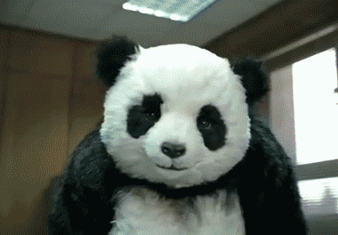
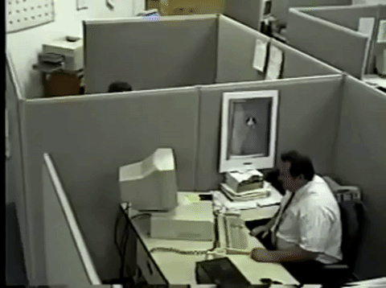


After week 1...

Slide 31
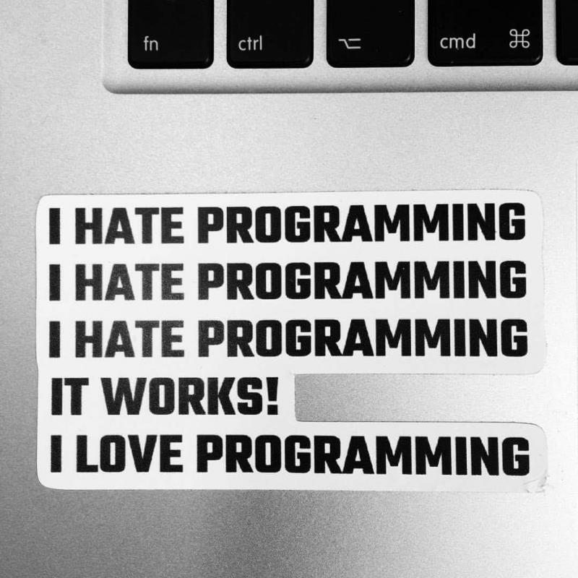

Slide 32
Materials & Grades

Slide 33
Materials
The materials are on GitHub:
  Course home page: https://github.uc.edu/vanderdt/PythonCourse
  Use the correct branch: spring2019
  Sign in with your UC username and password

Slide 34
Go over the readme file here...

Slide 35
Guides
Quick overview guides:
  https://github.uc.edu/vanderdt/PythonCourse/tree/master/Guides
There is one for Python and one for the Pandas package

Slide 36
Taking notes
Consider the code you write in class as notes.
Organize and comment the code you write in class.

Slide 37
Grading
Quizzes (75%):
  Most topics will be followed by a quiz
  Often; started in class, finalized at home
  On GitHub: https://github.uc.edu/vanderdt/PythonCourse/tree/master/Quizzes
Final project (25%)

Slide 38
questions?

