Slide 1
Modules

Slide 2
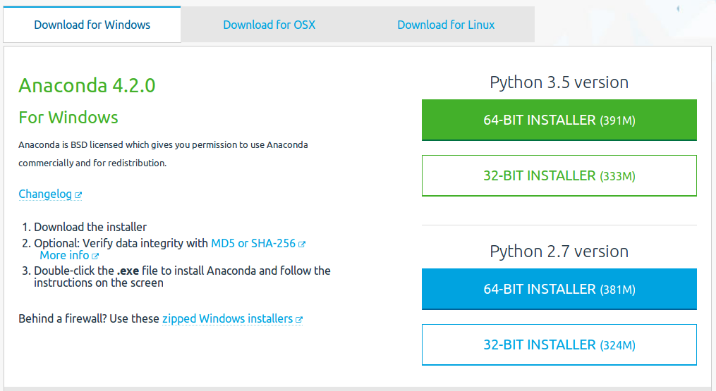
Anaconda
We will use Anaconda:
  Python
  many scientific extensions
  package manager
https://www.continuum.io/

Slide 3
Python standard library
https://docs.python.org/3/library/index.html
The functionality you get installing default Python from python.org
Standard syntax + a bunch of default modules

Slide 4
Modules
Modules ~ Package ~ Library
Give you additional functionality:
  Examples: working with images, plotting, sending text messages, math, statistics, machine learning, …

Slide 5
How to get packages/modules/libraries
Internet
  How to find them?
    Easiest way: google them. e.g. “Python text processing”
  How to install them?
    Easiest way: using one of the package managers (pip*, conda*)
Write them yourself
(*) pip and conda are tools that make it easy to install additional packages from the internet. By installing Anaconda Python, these are already on your computer

