Slide 1
Pyboard

Slide 2
Organization
Data analysis and visualization
Image processing, website development, robotics, gaming
simulation, hardware control, text processing, data mining
Playtime
Robot arm, hardware control, text messaging, games
Foundations
Logic, Flow and Functions

Slide 3
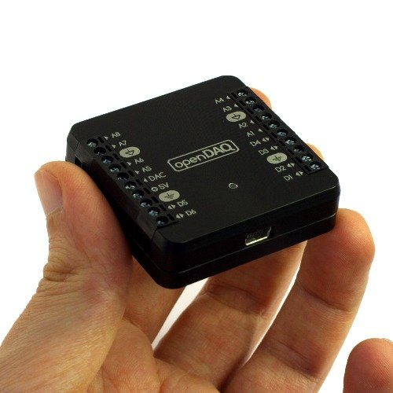
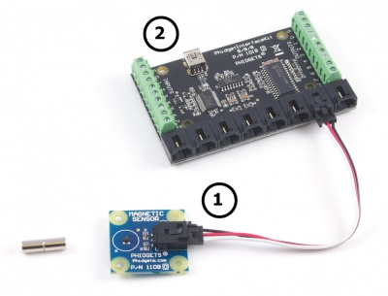
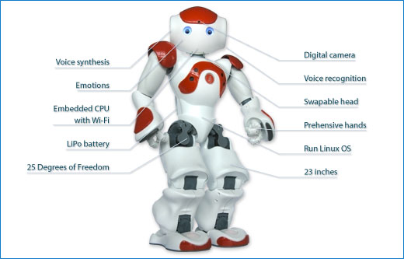
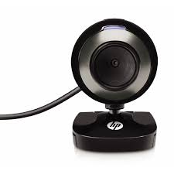
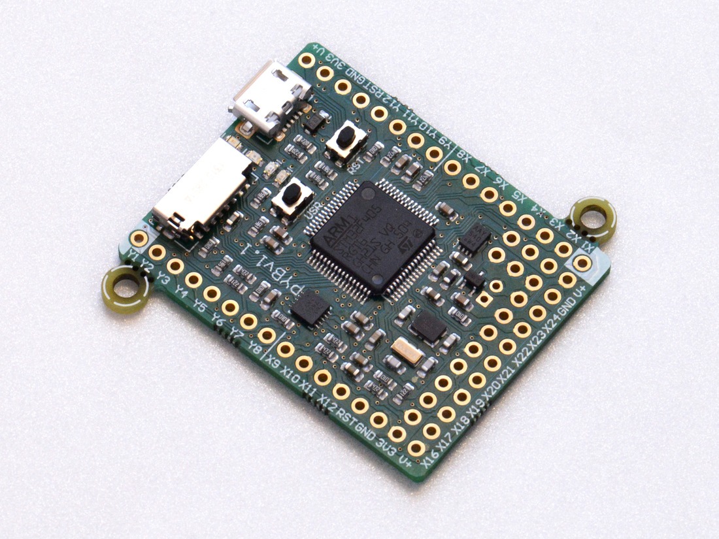
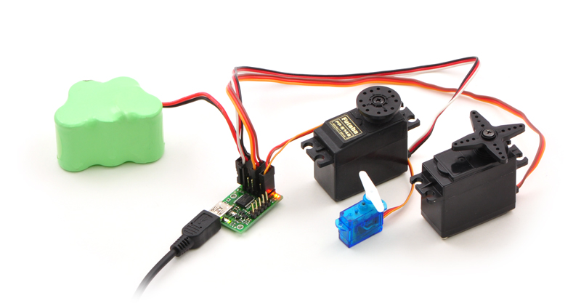
Controlling hardware: a few examples
http://www.phidgets.com/
http://tinyurl.com/zdb8aeh
https://www.pololu.com/product/1350/
http://micropython.org/

Slide 4
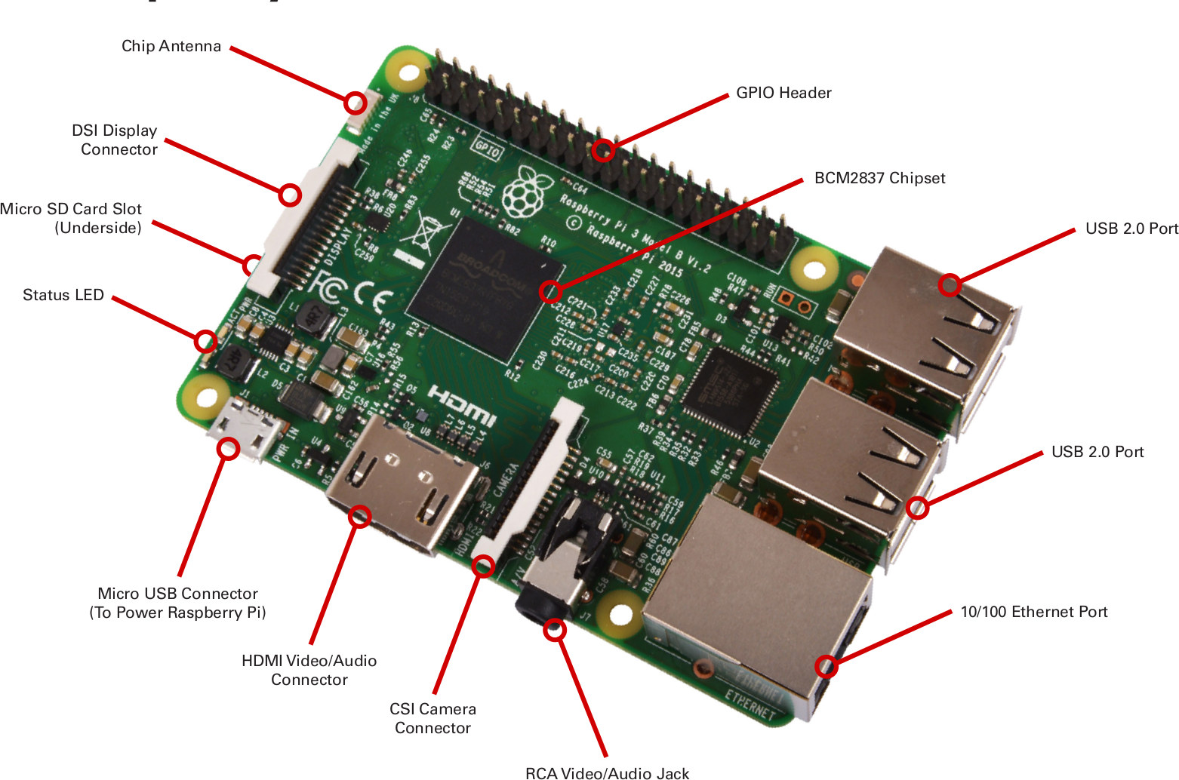
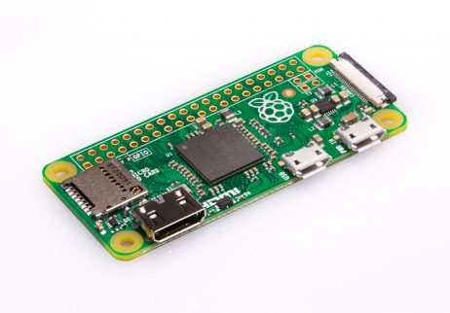
Example 1 Raspberry Pi
Raspberry Pi: A tiny, cheap computer that runs python.

Slide 5
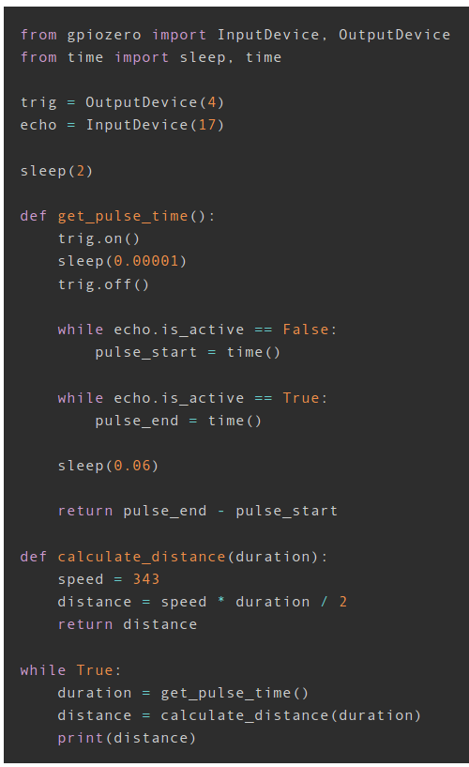
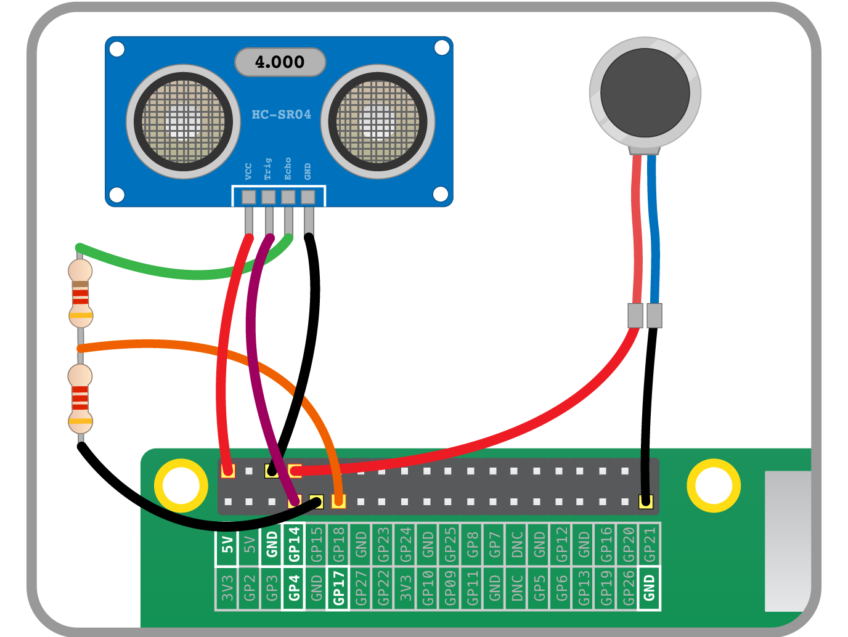
https://projects.raspberrypi.org/en/projects?hardware%5B%5D=raspberry-pi
Note: This code does not contain the code for driving the vibration motor. See the original source for the complete code.

Slide 6
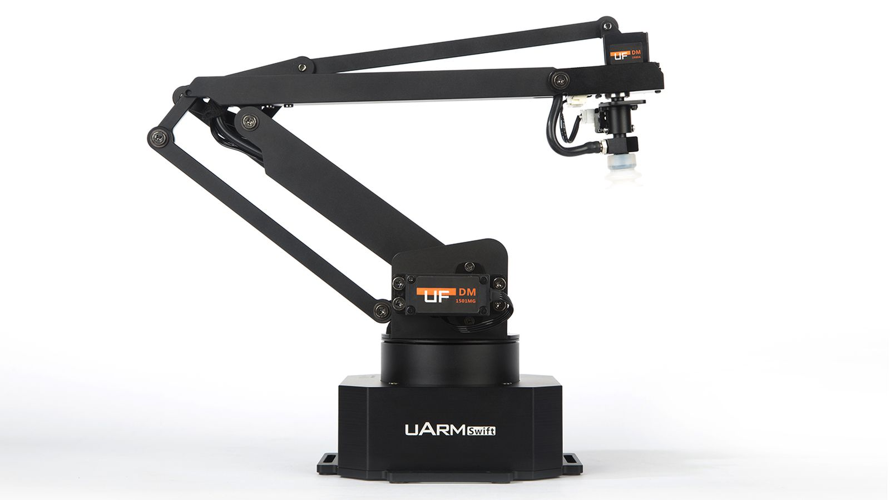
Example 2: robot arm

Slide 7
MicroPython/CircuitPython
MicroPython
CircuitPython:
  Adafruit.com
  Based on MicroPython
  A bit easier for beginners
  Editor
  See https://www.adafruit.com/product/3333

Slide 8
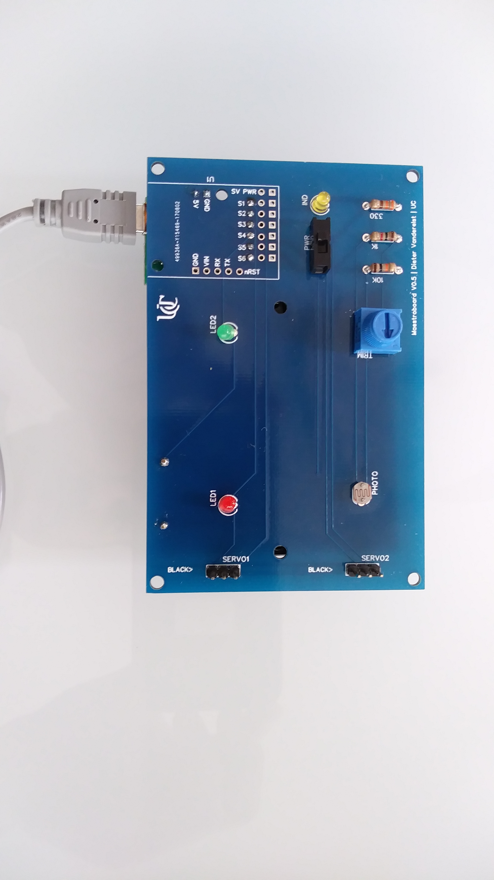
Example 3: Pyboard
LEDs
Motor ports
Motors power switch
Photoresistor (light detector)
Potentiometer (dial)

Slide 9
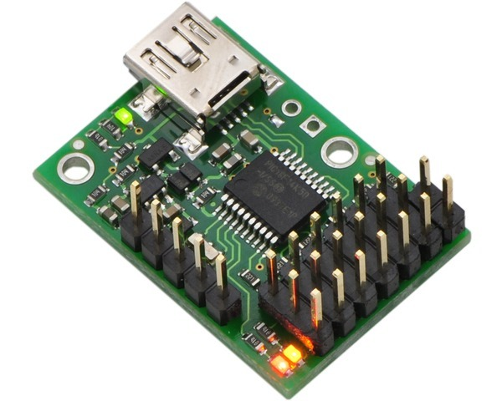
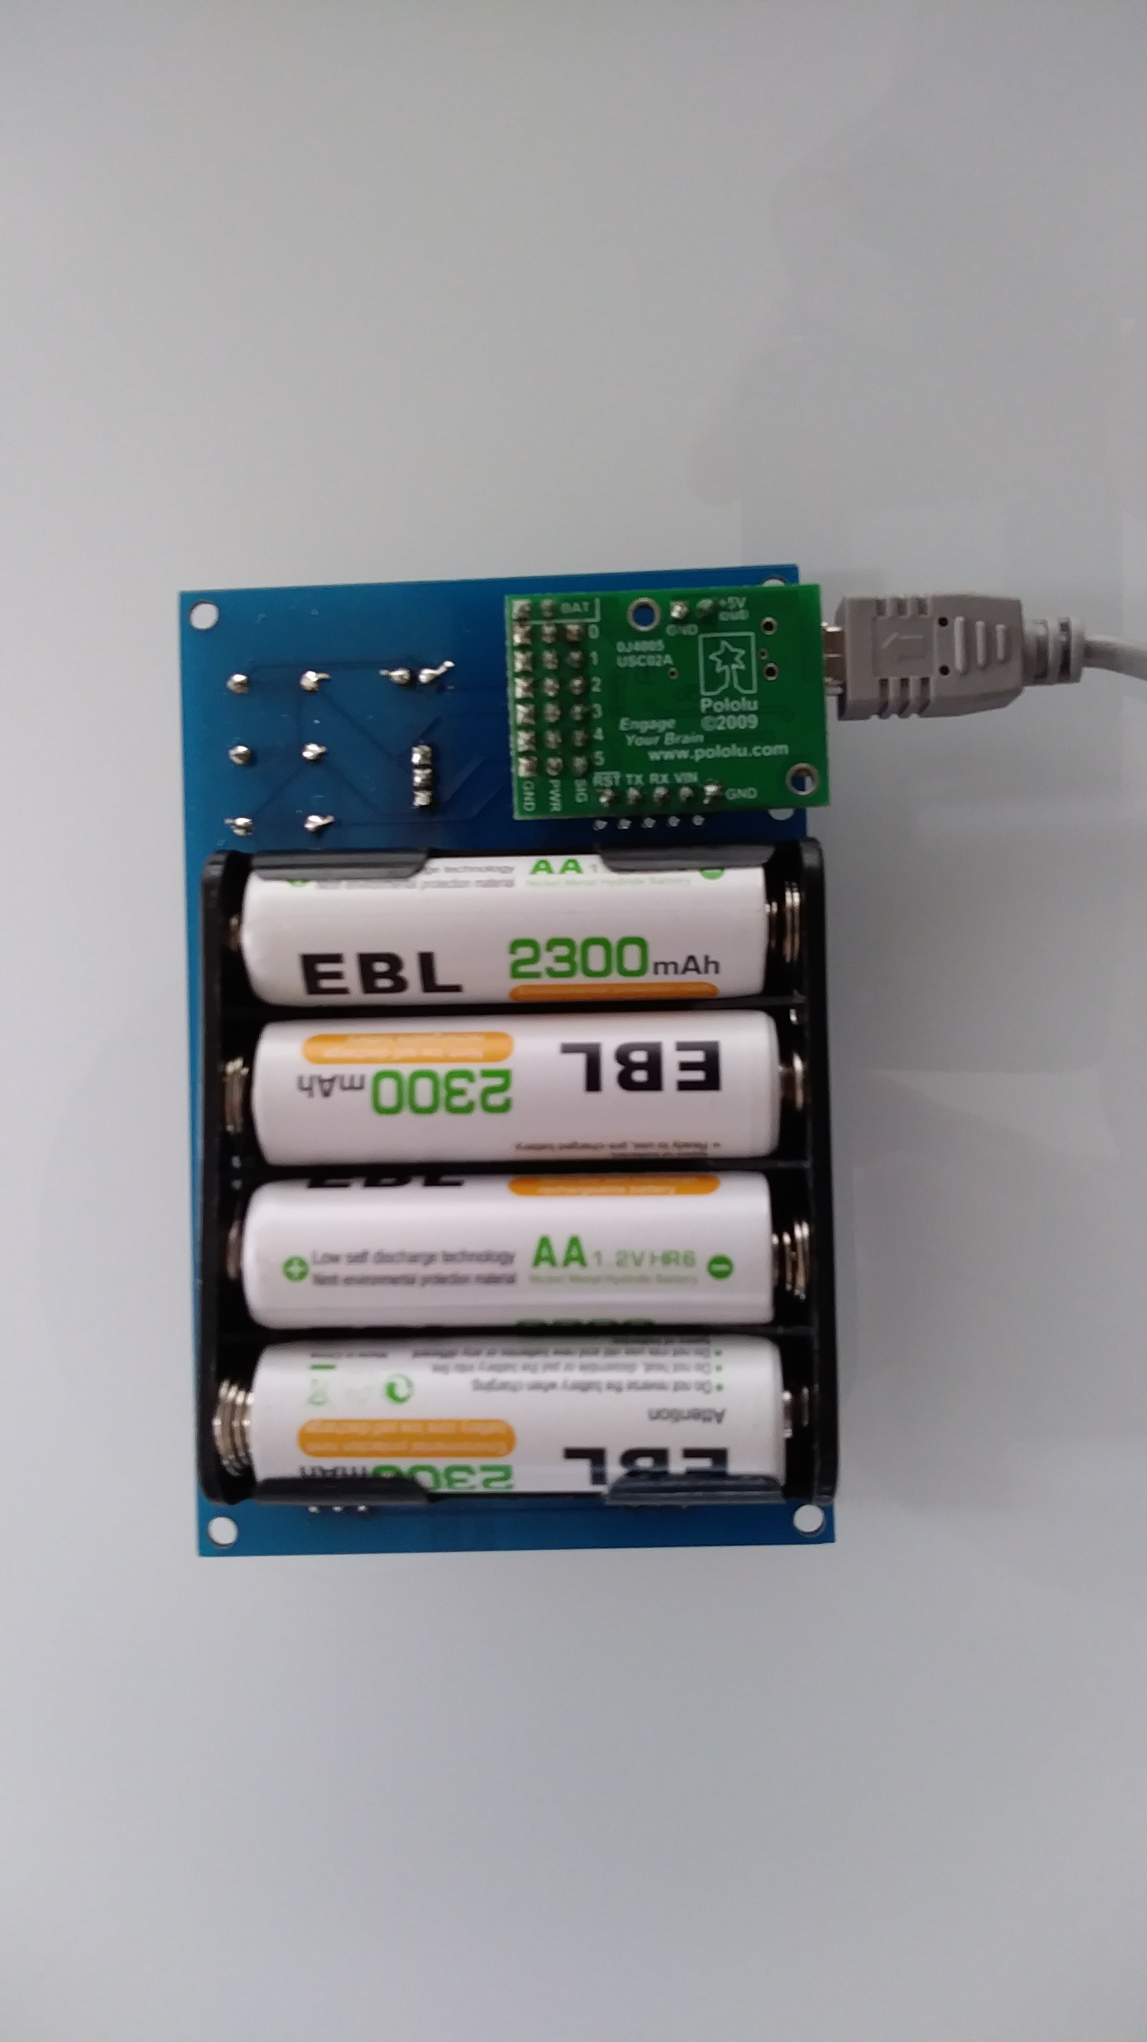
https://www.pololu.com/product/1350/resources

Slide 10
Code hierarchy
Course (Board.py)
Code that makes it easier to connect, read out and control the functions of the pyboard
Code to communicate with the maestrobard
Pyserial
Python module to communicate over serial ports using python

Slide 11
What are we going to do?
The board provides access to
  two sensors (dial and photocell)
  Four outputs (2 leds and 2 motors)
Practice program flow
I hope that connecting to the real world is going to be fun.

