Slide 1
Some tips

Slide 2
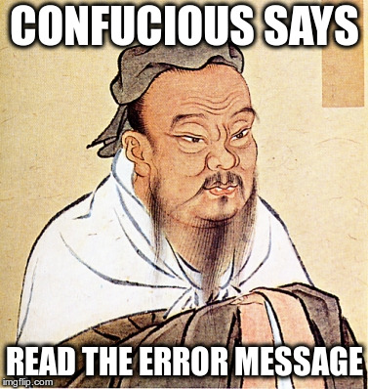
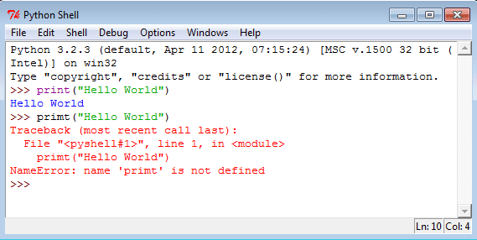
Tip 1

Slide 3
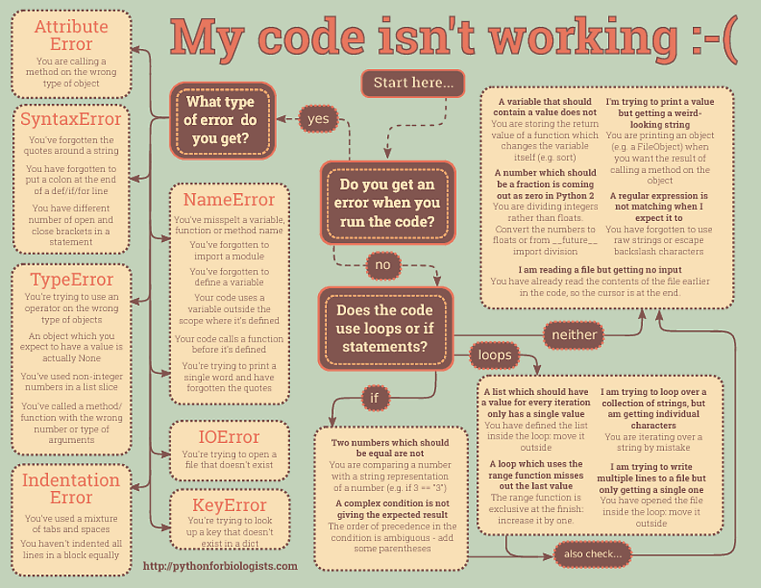
Also posted on the gihthub page

Slide 4

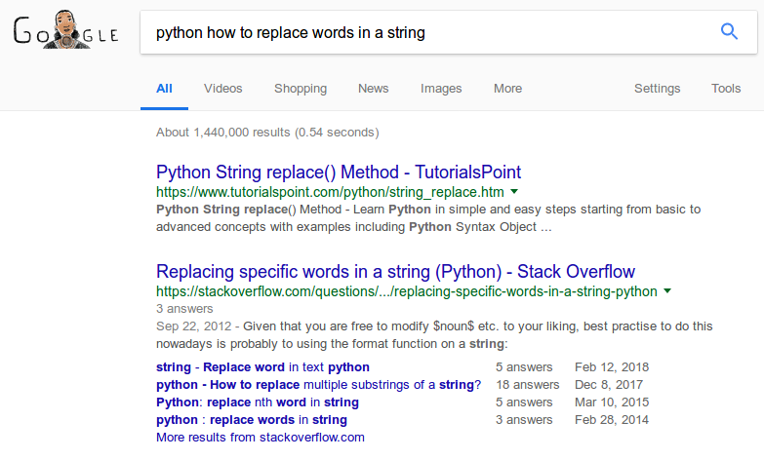
Tip 2

Slide 5

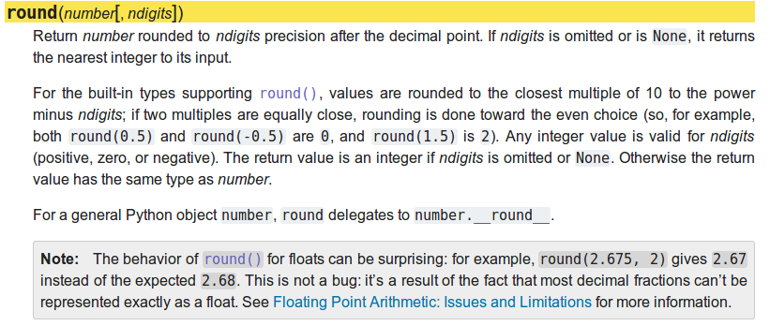
Tip 3

Slide 6
Flow diagrams
Assign value to var
Var even?
Var even?
print(‘even’)
Print(‘odd’)

Slide 7
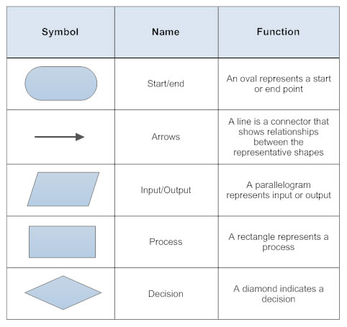
Flow diagrams

