Slide 1
Web API’s and Twilio

Slide 2


Web api’s
Partial lists:
  https://github.com/realpython/list-of-python-api-wrappers
  http://www.pythonforbeginners.com/api/list-of-python-apis

Slide 3

Quandl

Slide 4
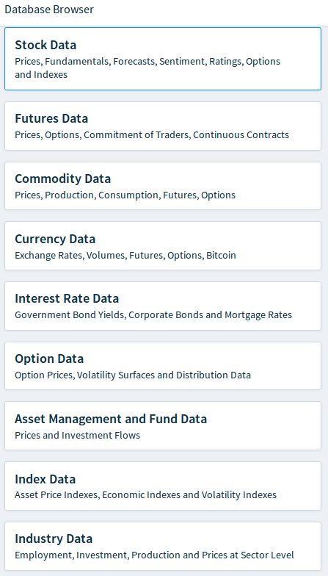

Slide 5

Notes:
Give the students a few minutes to work on this.

Slide 6

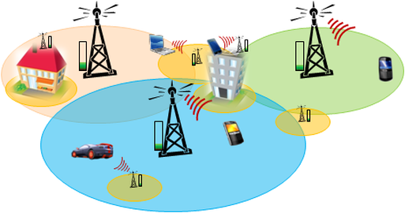



Slide 7
Easy.sms
This is my code, based on Twilio’s python code
Uses my (paid) account. This allows:
  Sending text msgs to an arbitrary cell phone number
  Checking the messages sent to the account number, 513 546-6031
  Check all msgs sent to/from the account
You are welcome to use the code outside of class
  However, remember that traffic is logged and accessible by all students
  Don’t send any sensitive stuff

Slide 8
Using Easy.sms
Requires the twilio package
Can be installed using pip

Slide 9
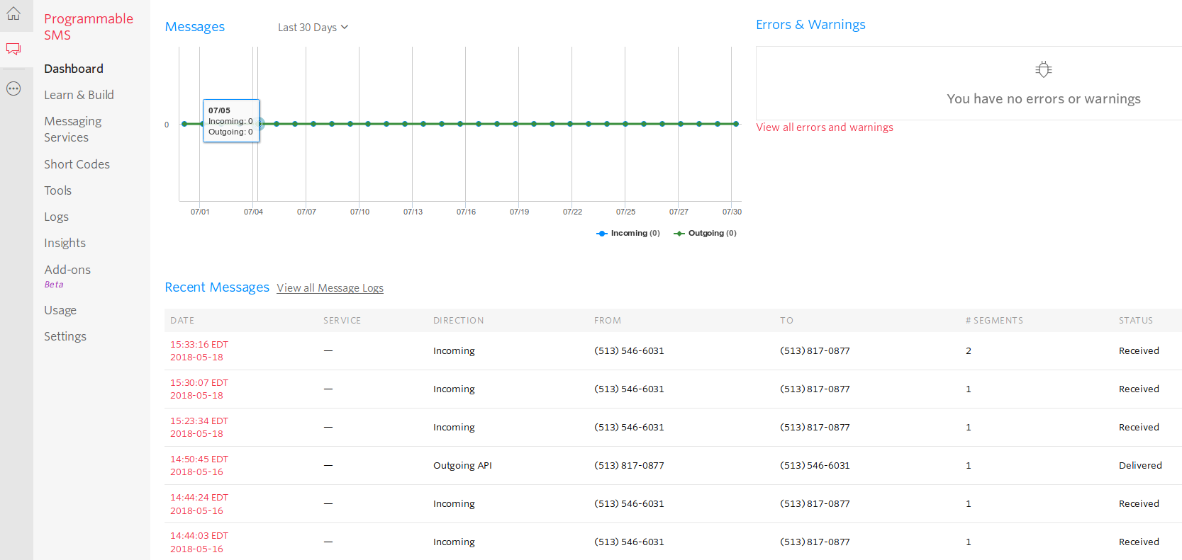
Twilio SMS Dashboard

Slide 10
Free account
You can get your own free account.
  This allows sending texts to your own phone only
  No receiving texts

