Slide 1
Pandas
Data processing in Python

Slide 2


Python and Pandas

Slide 3
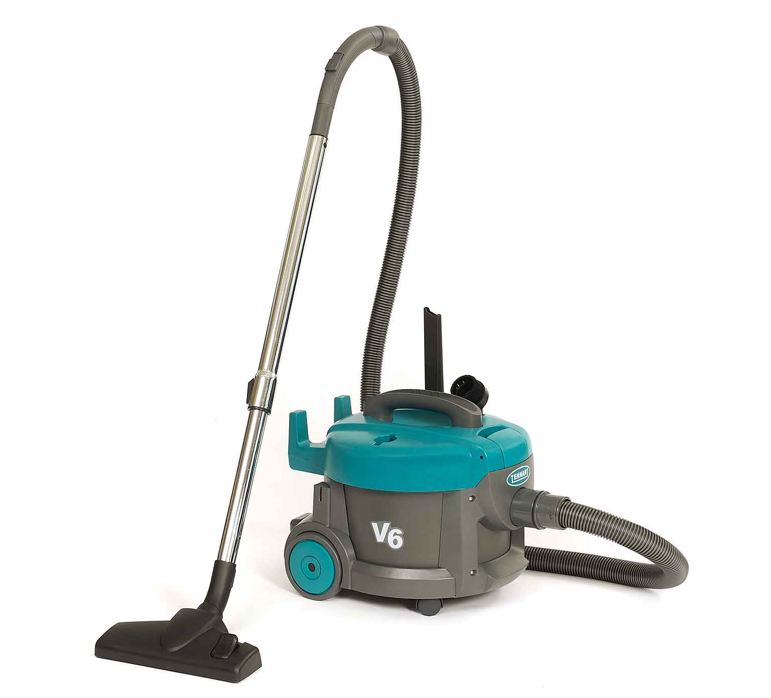

Pandas
It is an extension/package/tool for Python to make data processing easier.
Pandas
Python

Slide 4
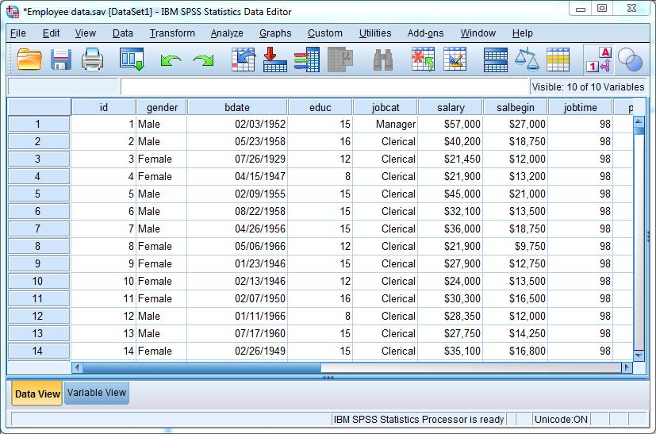
Why?
Spreadsheet like data:
  Records with multiple fields
  Multiple formats

Slide 5
Select/Filter data
Summarize per group
Merging data
Complexer field, e.g. dates
IBM SPSS

Slide 6
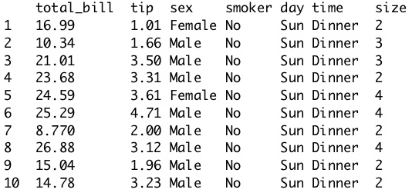
Pandas: dataframe data format
2-dimensional
labeled data
Indexed data
Columns different types
Very much like excel spreadsheet

Slide 7


Sidenote: dataframes in R and Matlab
R: software for data analysis and statistics:
  Dataframe is the bread and butter data format
Matlab: software for numerical calculations
  Uses arrays as default data structure
  Has recently also added the dataframe

Slide 8

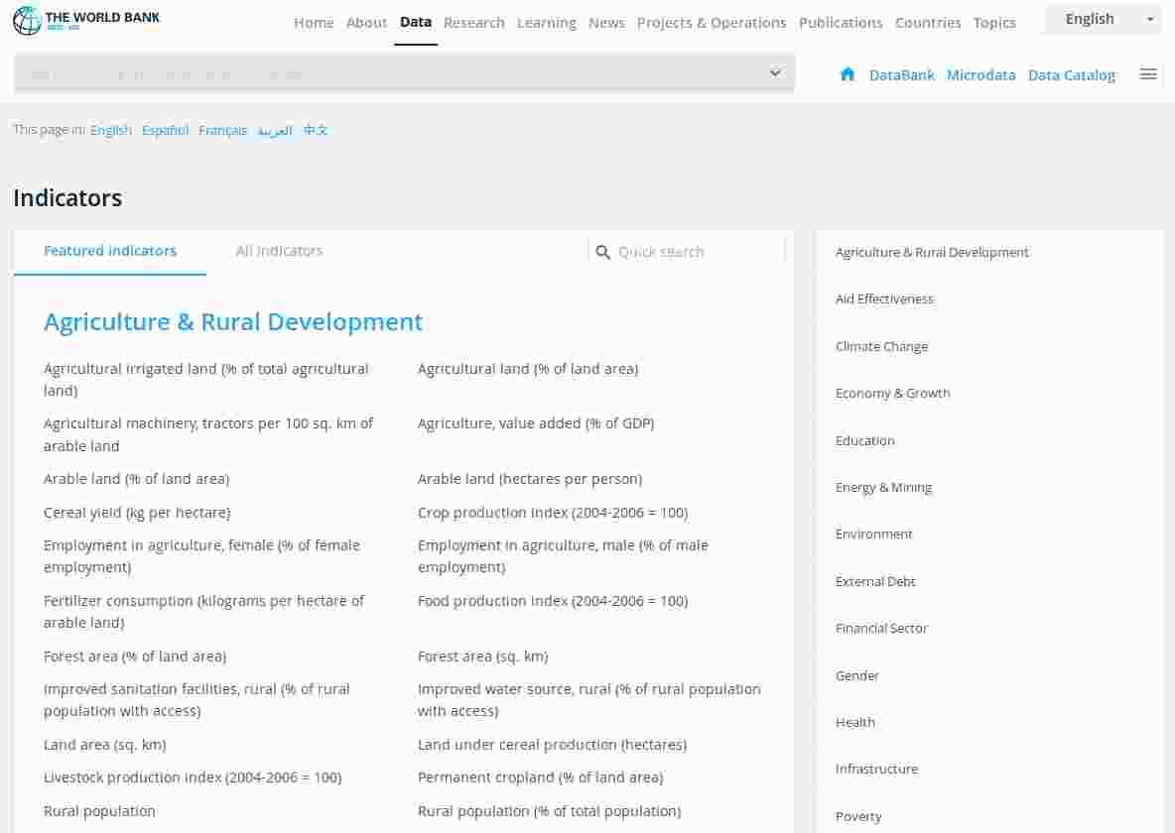


Where does the data come from?
Surveys
Services and organization
Experiments

Slide 9
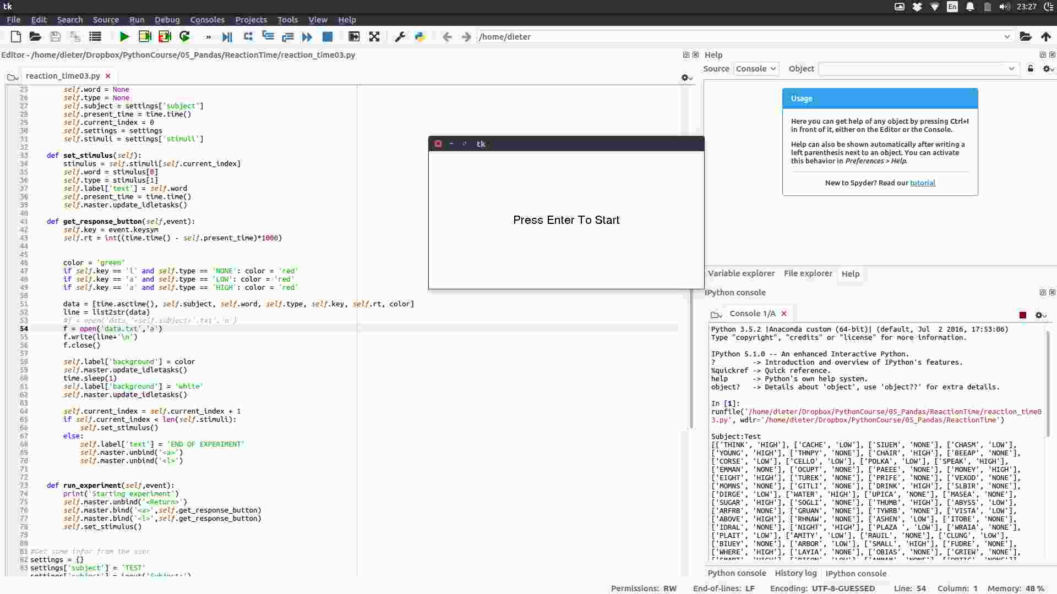
Our experiment: a reaction time experiment

Slide 10
The anatomy of a Pandas dataframe

Slide 11
Pandas DataFrame
Both numerical and textual data
1 | 0.3 | A | xyz | True
5 | 0.6 | B | abc | False
6 | 0.7 | C | ddf | True
7 | 0.8 | D | qer | False
9 | 0.9 | E | dft | False

Slide 12
Pandas DataFrame
lab1
data1 | sx | age | dft | type
Numbers and text as data
Names for the columns
Names for the rows [index]
  Rows names can be numbers
0
1
2
3
4
1 | 0.3 | 5 | xyz | True
5 | 0.6 | 9 | abc | False
6 | 0.7 | 3 | ddf | True
7 | 0.8 | 6 | qer | False
9 | 0.9 | 1 | dft | False

Slide 13
Pandas DataFrame
lab1
data1 | sx | age | dft | type
data1 | sx | age | dft | type
Numbers and text as data
Names for the columns
Names for the rows [index]
  Rows names can be numbers
  Or textual labels
1 | 0.3 | A | xyz | True
5 | 0.6 | B | abc | False
6 | 0.7 | C | ddf | True
7 | 0.8 | D | qer | False
9 | 0.9 | E | dft | False
rt
pt
qt
ad
ar
1 | 0.3 | 5 | xyz | True
5 | 0.6 | 9 | abc | False
6 | 0.7 | 3 | ddf | True
7 | 0.8 | 6 | qer | False
9 | 0.9 | 1 | dft | False
rt
dt
qt
my
op

Slide 14
Pandas DataFrame
nms
lab1
data1 | sx | age | dft | type
data1 | sx | age | dft | type
Numbers and text as data
Names for the columns
Names for the rows [index]
  Row labels can be numbers
  Or textual labels
It is possible to have a multi index:
  each rows has a unique combination of names
1 | 0.3 | A | xyz | True
5 | 0.6 | B | abc | False
6 | 0.7 | C | ddf | True
7 | 0.8 | D | qer | False
9 | 0.9 | E | dft | False
a
a
b
b
b
rt
pt
qt
ad
ar
1 | 0.3 | 5 | xyz | True
5 | 0.6 | 9 | abc | False
6 | 0.7 | 3 | ddf | True
7 | 0.8 | 6 | qer | False
9 | 0.9 | 1 | dft | False
1
2
1
2
3

Slide 15
Selecting data based on data properties
nms
lab1
data1 | sx | age | dft | type
data1 | sx | age | dft | type
Selecting a number of rows
  Based on a selecting criterion
  Here: age < 5
1 | 0.3 | A | xyz | True
5 | 0.6 | B | abc | False
6 | 0.7 | C | ddf | True
7 | 0.8 | D | qer | False
9 | 0.9 | E | dft | False
a
a
b
b
b
rt
pt
qt
ad
ar
1 | 0.3 | 5 | xyz | True
5 | 0.6 | 9 | abc | False
6 | 0.7 | 3 | ddf | True
7 | 0.8 | 6 | qer | False
9 | 0.9 | 1 | dft | False
1
2
1
2
3

Slide 16
Selecting data based on column labels
nms
lab1
data1 | sx | age | dft | type
data1 | sx | age | dft | type
Often by column label
1 | 0.3 | A | xyz | True
5 | 0.6 | B | abc | False
6 | 0.7 | C | ddf | True
7 | 0.8 | D | qer | False
9 | 0.9 | E | dft | False
a
a
b
b
b
rt
pt
qt
ad
ar
1 | 0.3 | 5 | xyz | True
5 | 0.6 | 9 | abc | False
6 | 0.7 | 3 | ddf | True
7 | 0.8 | 6 | qer | False
9 | 0.9 | 1 | dft | False
1
2
1
2
3

Slide 17
Selecting data based on column labels and row labels
nms
lab1
data1 | sx | age | dft | type
data1 | sx | age | dft | type
Often by column label
Sometimes: row & column labels
  Rows: a,2 → b,2
  Columns: sx → age
1 | 0.3 | A | xyz | True
5 | 0.6 | B | abc | False
6 | 0.7 | C | ddf | True
7 | 0.8 | D | qer | False
9 | 0.9 | E | dft | False
a
a
b
b
b
rt
pt
qt
ad
ar
1 | 0.3 | 5 | xyz | True
5 | 0.6 | 9 | abc | False
6 | 0.7 | 3 | ddf | True
7 | 0.8 | 6 | qer | False
9 | 0.9 | 1 | dft | False
1
2
1
2
3

Slide 18
Summary
nms
lab1
data1 | sx | age | dft | type
data1 | sx | age | dft | type
Different types of data
Unique column names
Unique combination of row names
Selecting data:
  Rows by criterion
    Example: age < 5
  By column and/or rows label:
    Example:
      Colums: sx → age
      Rows: a,2 → b,2
1 | 0.3 | A | xyz | True
5 | 0.6 | B | abc | False
6 | 0.7 | C | ddf | True
7 | 0.8 | D | qer | False
9 | 0.9 | E | dft | False
a
a
b
b
b
rt
pt
qt
ad
ar
1 | 0.3 | 5 | xyz | True
5 | 0.6 | 9 | abc | False
6 | 0.7 | 3 | ddf | True
7 | 0.8 | 6 | qer | False
9 | 0.9 | 1 | dft | False
1
2
1
2
3

Slide 19

By the way

Slide 20
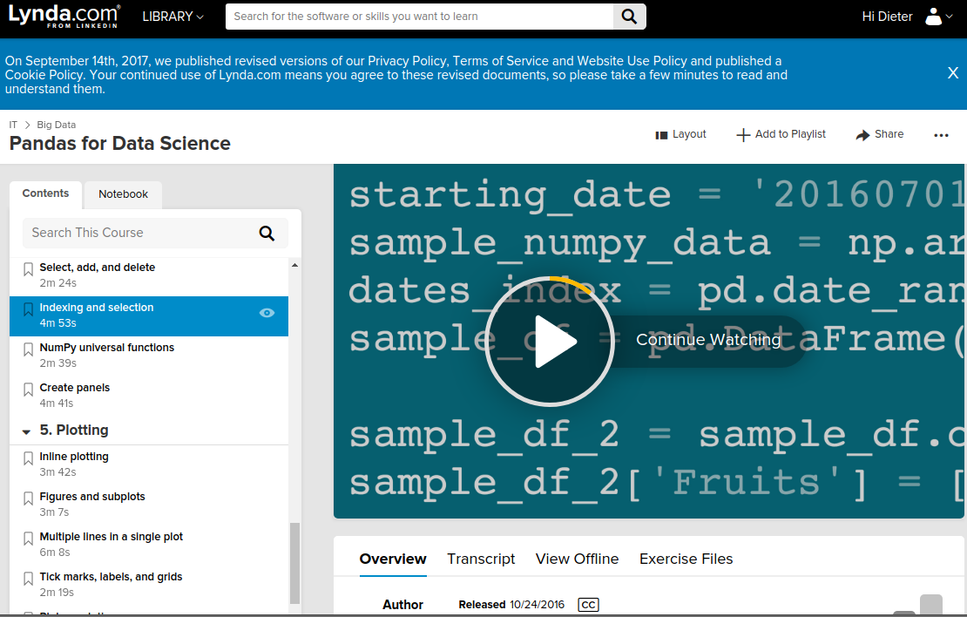

Slide 21
Pandas
Data Analysis Workflow
(pin this on your wall)
Read in the data
SOME CONSIDERATIONS
How many records are in the data?
What are the ranges and scales of the variables?
How are variable levels encoded?
How are missing/invalid values encoded?
Would it make sense to create new variables based on the existing ones?
Optional: Merge datasets
Use reset_index()
Explore the data
All data needed?
Select subset of data
e.g. all people aged 25 and over
NOTE: MAKE YOUR LIFE EASIER
Try to avoid having to select rows by their labels by selecting the correct subset of data early in the processing. Selecting rows can be challenging when working with data with multiple row indices. This will be often the case when working with aggregated data.
Need aggregated
Numbers?
A subset of the data or aggregated data can be considered as a new data set
Aggregate the data
e.g. pct smokers vs sex and age
Finished?
Table is end result
Often, statistical tests will be ran on the table.
Select labeled columns
e.g. pct smokers and sex
Select labeled rows
Plot

Slide 22
Homework
Pick two data sets:
  https://vincentarelbundock.github.io/Rdatasets/datasets.html
For each data set:
  Read it in using Pandas using pandas.read_csv()
  Make a summary table using the groupby() function
  Note: the data file has not header – you can define one when reading the file:
    http://pandas.pydata.org/pandas-docs/stable/generated/pandas.read_csv.html
Presentation:
  Show the code for each data set
  Show the resulting table

Slide 23
Homework
Run the experiment for at least two people.
Read in all data using Pandas using pandas.read_csv()
Make two summary tables, stimulus type by subject:
  Table 1: reaction times (using only the correct trials)
  Table 2: proportion of errors
Send me (before 9am on Monday, so I can aggregate all files):
  Your data file (rename it to group_names.txt)
  A ppt in which you copy paste your code AND your tables
Bring your code/tables to class on Tuesday

