Slide 2

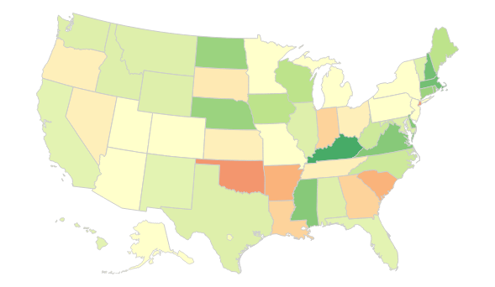
Polio vaccination coverage among children 19-35 months by State, 2017
https://www.cdc.gov/vaccines/imz-managers/coverage/childvaxview/data-reports/polio/trend/index.html

