Slide 1
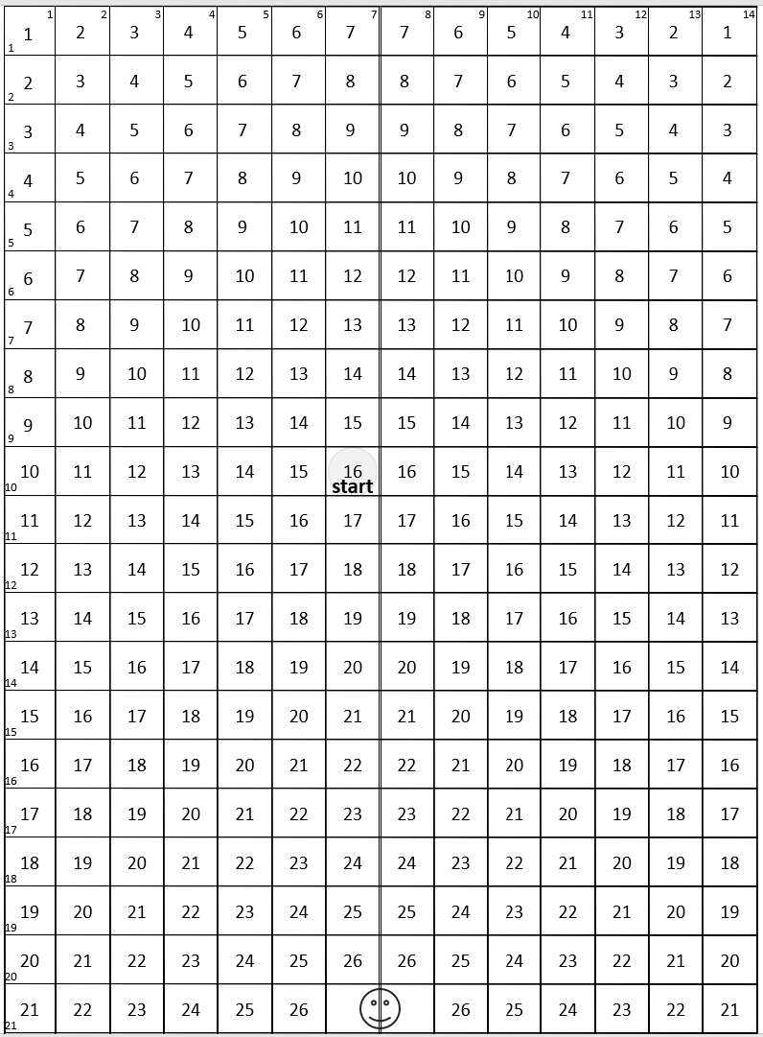
Grid 1

Slide 2
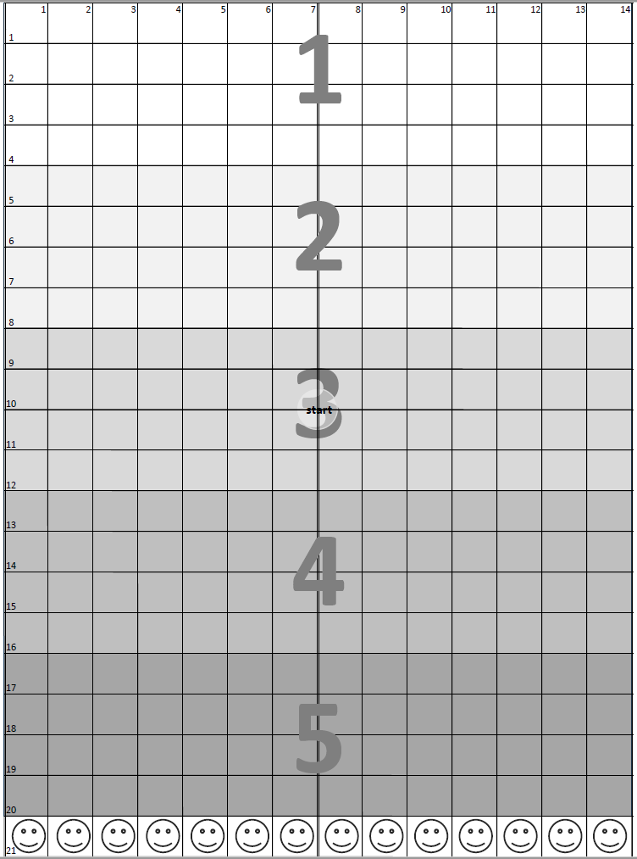
Grid 2

Slide 3
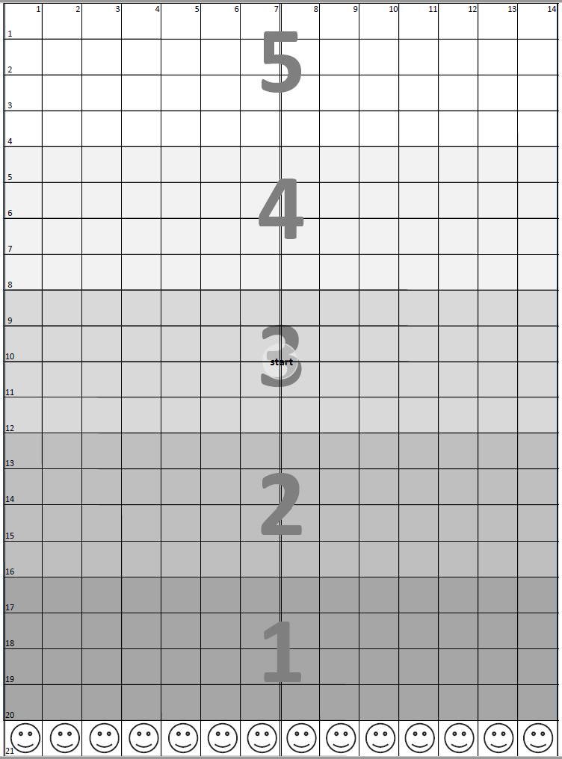
Grid 3

Slide 4
Grid 4
Narrow
Wide

