Slide 1

Urban Heat Mitigation Decision-Support Toolkit for Omaha

Slide 2

AGENDA
The Problem
The Gap
The Proposed Solution
What does the user get?
The GIS and technical work
Feasibility and scope
The ask

Slide 3

The Problem
Omaha is already thinking about climate resilience.
  Environment and Resilience
  Omaha's Charge
We know that heat is not distributed evenly across Omaha. We also know that tree canopy, impervious surfaces, land cover, and population are not distributed evenly.
Where could urban heat mitigation potentially provide the greatest benefit, and how does that answer change depending on what a planner is trying to accomplish?

Slide 4

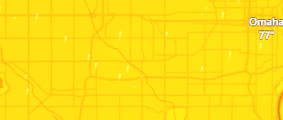
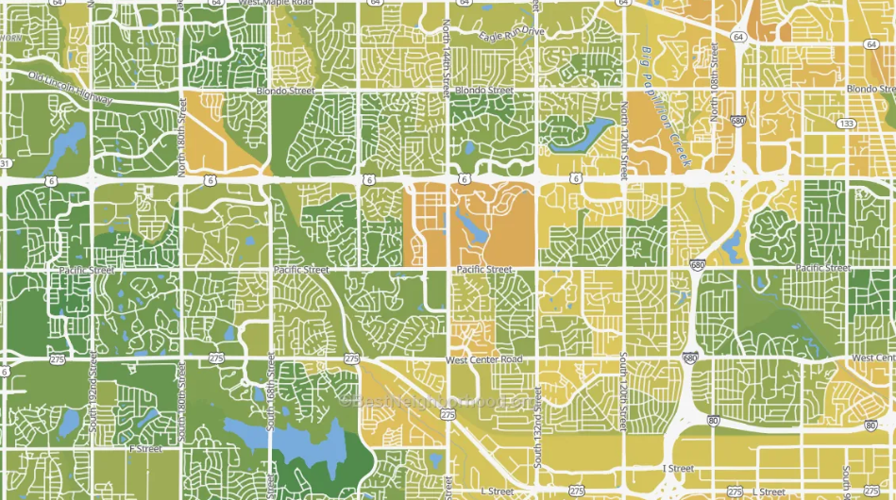
The Gap
There are already datasets that can help answer pieces of that question.
But looking at those datasets individually doesn't necessarily help someone make a planning decision.
  A heat map tells you where it is hot.
  A tree canopy map tells you where trees are or aren't.
  A population map tells you where people live.
What is missing is a way to bring those pieces together and ask:
  Why is this area a priority?
  What type of mitigation opportunity might exist here?
  How would the priorities change if the planning criteria changed?

Slide 5
The Proposed Solution
My proposed solution is an Urban Heat Mitigation Decision-Support Toolkit for Omaha.
The goal is to build a GIS-based prototype that combines environmental, demographic, land-cover, and local geographic information into an interactive planning tool.
The core datasets I'm planning to work with include Landsat-derived land surface temperature, tree canopy data from the USDA Forest Service, annual NLCD land-cover data, Census demographic data, and relevant Omaha GIS data.
I'll process those datasets through a reproducible Python workflow and store the processed and derived spatial information in PostgreSQL with PostGIS.
From there, I'll calculate spatial indicators and use a multi-criteria analysis approach to produce priority areas.

Slide 6
The Proposed Solution
For example, one scenario could emphasize heat intensity and population exposure. Another could emphasize canopy deficit and potential opportunities for additional tree canopy
The purpose isn't to tell the City, "This is where you must plant trees."
It is to give planners a way to examine the geographic evidence and understand how different planning priorities produce different results.

Slide 7

What the user gets
The final product will be an interactive web application rather than simply a static map.
So instead of just showing a map that says, "Here are the hottest areas in Omaha," the application could support a conversation like:
This area has high heat intensity, significant population exposure, and relatively low canopy.
Or:
This area ranks differently when we place more emphasis on canopy deficit and potential planting opportunities.
The application is intended to make those assumptions visible rather than hiding them inside a single score.

Slide 8
The GIS and technical work
Technically, this project brings together several areas of GIS and geospatial development.
The workflow begins with data acquisition and Python-based ETL.
Those datasets are standardized, spatially aligned, and processed into analytical variables.
PostGIS provides the spatial database for managing the processed data.
The analysis layer calculates spatial metrics, normalizes the criteria, and performs the multi-criteria analysis and scenario calculations.
Then the results are delivered through the web application and interactive map.
Data Sources → Python ETL → PostgreSQL/PostGIS → Python Analysis Engine → Spatial Metrics → Multi-Criteria Analysis → Scenario Analysis → Application Interface → JavaScript Web Application → Interactive Map
Architecture Diagram
It means the analysis and data workflow can potentially be rerun when datasets or planning assumptions change without having to rebuild the entire visualization.
This project is demonstrating a reproducible geospatial workflow that combines programming, spatial databases, analysis, visualization, and application development.

Slide 9
Feasibility and scope
I designed the project around a defined minimum viable product so that the scope remains realistic for the semester.
The project is planned around approximately 160 hours of work and does not require additional paid software, data, or infrastructure.
The core deliverable is an Omaha study area using public environmental and demographic datasets, an automated Python workflow, a PostGIS database, a defensible priority analysis, at least two planning scenarios, and an interactive map that allows users to understand the results.

Slide 10
Feasibility and scope
That means if something takes longer than expected, I can reduce the optional features without losing the central purpose of the project.
More advanced features will become optional and time dependent:
  Installation wizard for headless PostgreSQL / web applicaiton
  Historical analysis
  Intervention categories
  Sensitivity analysis
  Public deployment

Slide 11
The Ask
Ultimately, the value of this project is not simply producing another urban heat map.
My project takes one part of that problem, urban heat, and asks how GIS can help move from identifying the problem to exploring where mitigation efforts could potentially have the greatest benefit.
The result would be a working decision-support prototype, a reproducible geospatial workflow, and a framework that makes the assumptions behind those priorities visible.
So what I'm asking for is the opportunity to build and test that system.
The goal is to turn Omaha's existing geographic data into something planners can actually use to explore urban heat mitigation decisions.

Slide 12

THANK YOU
David Vanosdall
Vanosdall@wisc.edu
GEOG 778
Urban Heat Mitigation Decision-Support Toolkit for Omaha

