Slide 1


Flight Delay Prediction
Using Machine Learning and Network Analysis
Data Science Capstone Project
June 2025

Slide 2

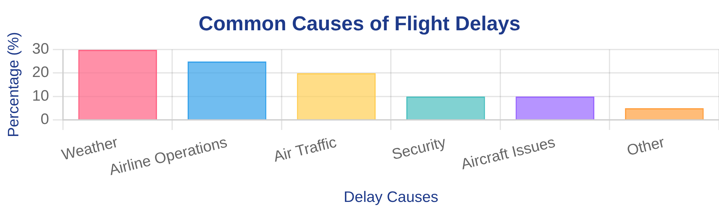
Problem Statement & Objectives
The Challenge:
Project Objectives:
Flight delays cost airlines billions annually
Develop a binary classification model to predict flight delays
Negative impact on passenger experience
Apply network analysis to understand airport connectivity impacts
Resource optimization challenges for airports and airlines
Complex interplay between weather, network structure, and operational factors
Engineer features from time, network, and weather data
Identify the most predictive factors for flight delays

Slide 3
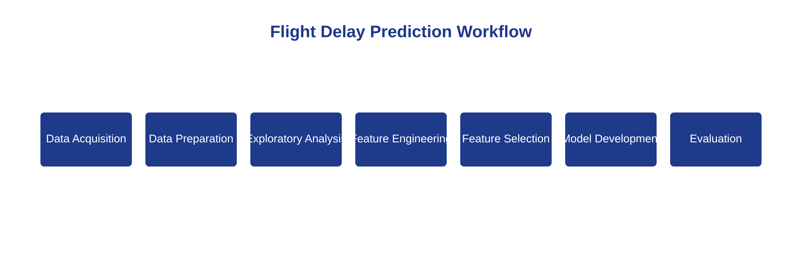
Project Methodology
Data Science Workflow:
Modeling Approach:
Data Acquisition & Preparation
Feature Engineering
Exploratory Data Analysis
Feature Selection
Network Analysis
Model Development & Evaluation

Slide 4
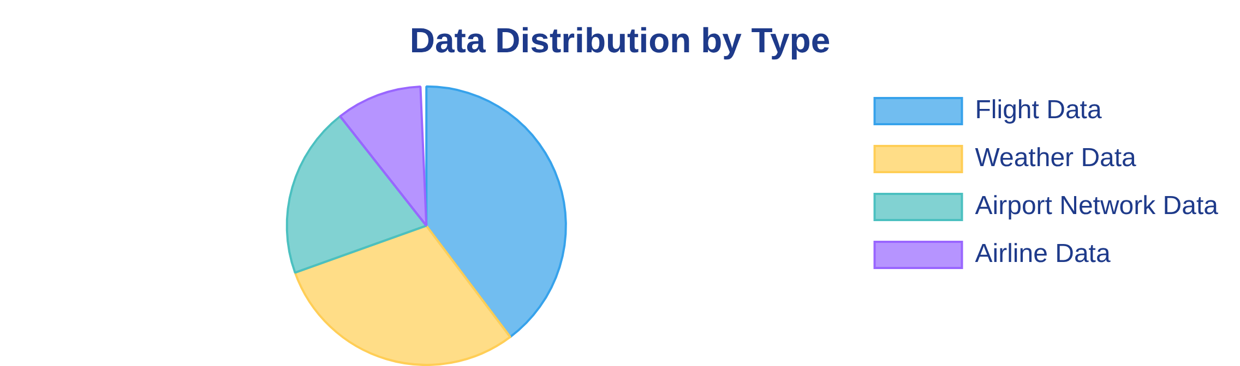
Data Acquisition & Preparation
Data Sources:
Preprocessing Steps:
Synthetic airline data for 15 major US airports
Cleaning and handling missing values
10 airlines across different seasons (2023-2024)
Converting timestamps to datetime formats
Simulated weather conditions at airports
Creating delay indicators (>15 min = delayed)
Generated airport network connectivity data
Joining flight data with weather conditions

Slide 5

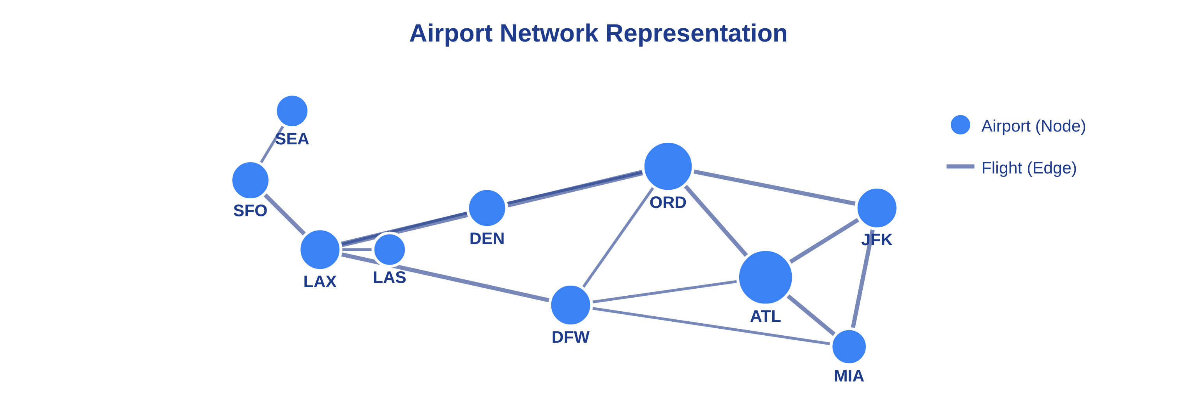
Network Analysis Approach
Network Representation:
Network Metrics:
Airports as nodes
Centrality measures (degree, betweenness)
Flights as edges
Community detection
Edge weights based on flight frequency
Hub-and-spoke identification
Matrix representations (adjacency, incidence)
Route importance scoring

Slide 6

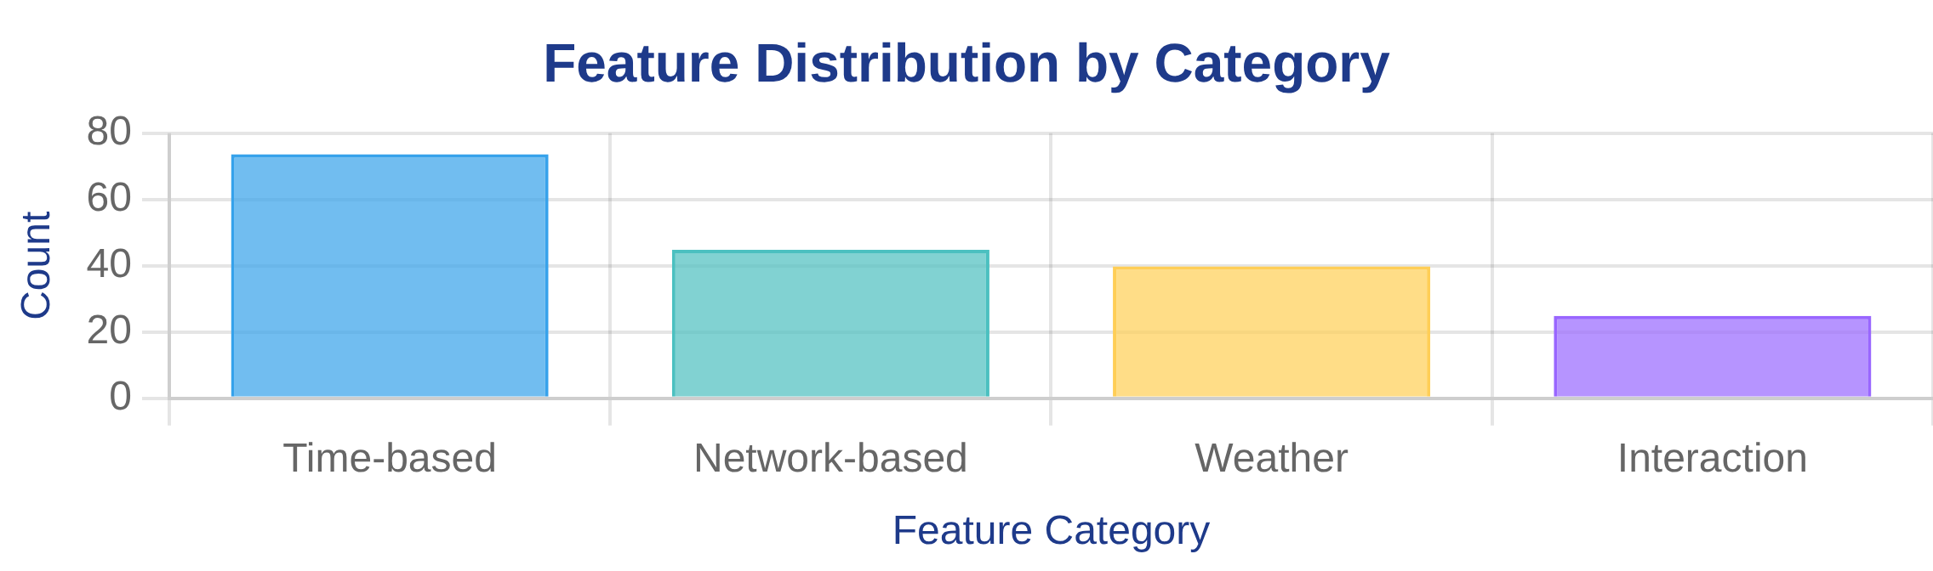
Feature Engineering
Feature Categories:
Key Engineering Techniques:
Time-based features (74) - time of day, day of week, holidays
Cyclical encoding for time variables
Network metrics extraction
Network-based features (45) - centrality measures, community structure
Weather condition classification
Weather features (40) - temperature, precipitation, visibility
Feature interaction creation
Interaction features (25) - combinations of time, network, weather

Slide 7

Feature Selection
Selection Methods:
Key Findings:
Statistical tests (F-tests, mutual information)
Time-based features most predictive (46%)
Tree-based models (Random Forest, Gradient Boosting)
Network metrics highly important (18%)
Advanced techniques (Permutation, SHAP values)
Selected top 50 features from 184 candidates

Slide 8

Model Development & Evaluation
Models Developed:
Training Approach:
Logistic Regression (with L1/L2 regularization)
Grid search for hyperparameter tuning
Random Forest (ensemble of decision trees)
5-fold cross-validation to prevent overfitting
Gradient Boosting (sequential tree building)
ROC AUC as optimization metric
Support Vector Machine (optimal hyperplane)
Feature availability challenge (only 6 of 50)

Slide 9
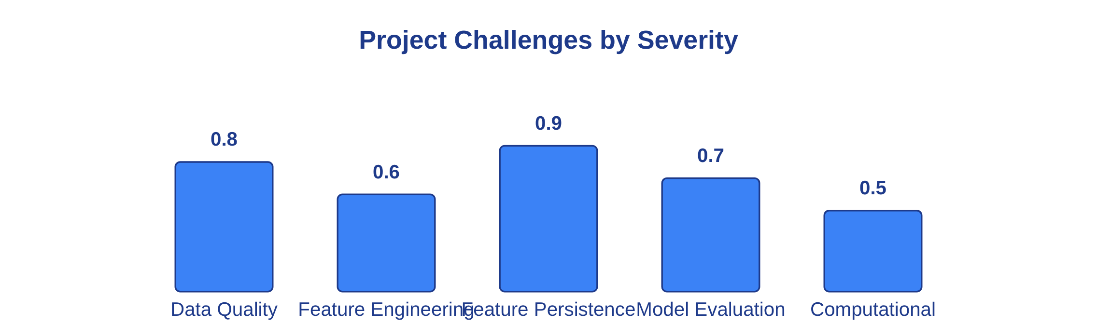
Limitations & Challenges
Data Limitations:
Methodological Challenges:
Use of synthetic data rather than real-world data
Limited feature availability for model training (6 of 50)
Limited number of airports and airlines (15 airports, 10 airlines)
Lack of feature persistence in data pipeline
Perfect model performance indicating potential data issues
Simplified weather conditions and network structures
Computational constraints for advanced feature selection
Restricted time period (2023-2024)

Slide 10
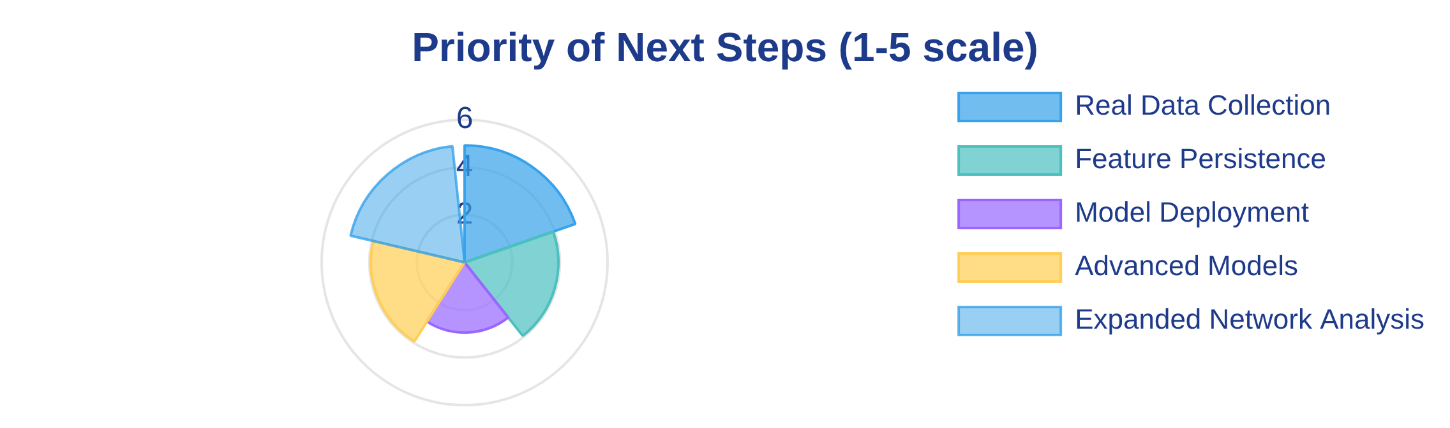
Conclusions & Recommendations
Key Findings:
Recommendations:
Network analysis provides valuable insights into flight delay patterns
Implement feature persistence in data pipeline
Use real-world data from BTS and NOAA
Time-based features are particularly important for prediction
Expand feature engineering for network characteristics
Feature engineering significantly enhances model performance
Develop API for real-time flight delay predictions
Multiple feature selection methods provide robust rankings

