Slide 1
MongoDB Hands on test drive Dan Van Valin & Kevin McGinty
Notes:
What we are going to do today it take an abbreviated tour of MongoDB. Will spend a little time talking about what it is. Then we will trying out some queries and updates, and finally we will take a very quick look at its use.

Slide 2

What is MongoDB?
NoSQL
Notes:
No SQL queries with joins
No tables
No columns
No predefined schema
No commit/rollback

Slide 3
What is MongoDB?
No SQL
Collections of Documents
Notes:
Instead Mongo is based on collections of documents

Slide 4
Stores BSON Documents
{
"_id" : ObjectId("5932cdb9c72a3fb0c0ecbd75"),
"title" : "The Incredibles",
"plot" : "A family of undercover superheroes, while trying to live the quiet suburban life, are forced into action to save the world.",
"actors" : [ "Craig T. Nelson", "Samuel L. Jackson" ],
"details" : {
"year" : "2004",
"rated" : "PG",
"genre" : "Animation",
"director" : "Brad Bird"
}
}
Notes:
MongoDB stores something very close to JSON (javascript object notiation) called BSON - binary JSON. Documnts contain fields and values and can mirror what you would get in a rest call using json.

Slide 5
Stores BSON Documents
{
"_id" : ObjectId("5932cdb9c72a3fb0c0ecbd75"),
"title" : "The Incredibles",
"plot" : "A family of undercover superheroes, while trying to live the quiet suburban life, are forced into action to save the world.",
"actors" : [ "Craig T. Nelson", "Samuel L. Jackson" ],
"details" : {
"year" : "2004",
"rated" : "PG",
"genre" : "Animation",
"director" : "Brad Bird"
}
}
Notes:
Every document has a primary key that can be assigned by MongoDB which is a GUID. Documents can contain references to other document, pointing to the “_id” of another document.

Slide 6
Stores BSON Documents
{
"_id" : ObjectId("5932cdb9c72a3fb0c0ecbd75"),
"title" : "The Incredibles",
"plot" : "A family of undercover superheroes, while trying to live the quiet suburban life, are forced into action to save the world.",
"actors" : [ "Craig T. Nelson", "Samuel L. Jackson" ],
"details" : {
"year" : "2004",
"rated" : "PG",
"genre" : "Animation",
"director" : "Brad Bird"
}
}
Notes:
Documents can contain sub-documents. This allows you to put all the data for your most heavily used queries in one document even de-normalizing data to fix your most common use cases. Sub-portions of documents can be modified directly rather than updating an entire document. Updates to a document can also be atomic, so although there is not a concept of transaction across documents, an operation against a single document can be atomic.

Slide 7
Stores BSON Documents
{
"_id" : ObjectId("5932cdb9c72a3fb0c0ecbd75"),
"title" : "The Incredibles",
"plot" : "A family of undercover superheroes, while trying to live the quiet suburban life, are forced into action to save the world.",
"actors" : [ "Craig T. Nelson", "Samuel L. Jackson" ],
"details" : {
"year" : "2004",
"rated" : "PG",
"genre" : "Animation",
"director" : "Brad Bird"
}
}
Notes:
And documents can contain arrays including arrays of documents. Indices can be added to fields and arrays so that access based on complex structures can be efficient. There is a maximum document size, but it is 16M.

Slide 8

What is MongoDB?
No SQL
Collections of Documents
Horizontal Scaling
Notes:
SQL databases are usually build on the idea that if you need more performance or space you will beef up your database server. This is called vertical scaling.
Mongo uses Horizontal scaling: documents can be partitioned between servers to distribute the load

Slide 9
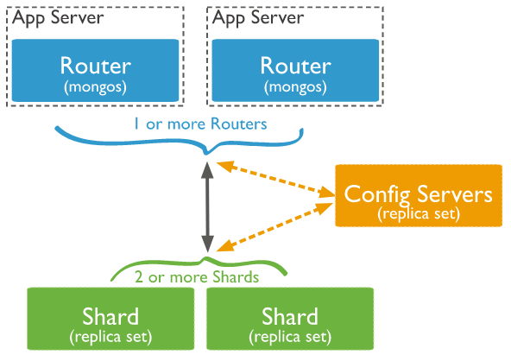
Horizontal Scaling: Sharding
https://docs.mongodb.com/manual/sharding/
Notes:
Here we have the components of a sharded cluster – data is partitioned into shards by defining a sharding key.
A MongoDB sharded cluster consists of the following components:
shard: Each shard contains a subset of the sharded data. Each shard can be deployed as a replica set.
router: The router provides an interface between client applications and the sharded cluster directing queries and updates to the correct shard
config servers: Config servers store metadata and configuration settings for the cluster. As of MongoDB 3.4, config servers must be deployed as a replica set (CSRS).
For example, movies could be partitioned into shards by country, or by popularity.

Slide 10
What is MongoDB?
No SQL
Collections of Documents
Horizontal Scaling
High Performance
High Availability
Notes:
High performance is a primary goal of MongoDB
- Documents can be designed to contain the data needed for heaviest activity which supports embedded data models reduces I/O activity on database file system.
- Indexes support faster queries and can include keys from embedded documents and arrays.
High availably: structured to replicate data and partition data across servers.
- automatic failover and data redundancy.

Slide 11
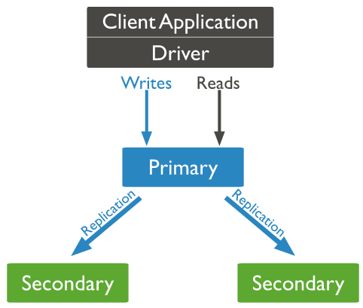
High Availability: Replica Sets
https://docs.mongodb.com/manual/replication/
Notes:
Each shard in Mongo uses replica sets for redundancy and data availability. In this diagram there are three copies of data. All writes go to the primary, but all three can be used for reads. There are other configurations possible. If a primary goes down then the secondary's will detect this and hold an election for a new primary which can take 10 seconds or more. I guess recent changes make this process much faster.

Slide 12
Starting MongoDB
Start the server:
mongod
Start the command shell (from Intellij Terminal helps):
mongo
In the shell, display the mongo version running:
db.version()
Notes:
Remove install, etc.
Explain that mongo locally will have a server running and we communicate with the server using a shell. To see that everything is ok, open the shell and get the version.
This belong in github or wiki. Maybe have slides with info – let them get them get off dropbox or email in advance since may know who signed up?
Explain this slide and stop to make sure people are ready before you start demonstrating things…
Go back and forth between slide and demo, finally do some exercises.

Slide 13
Try Out The Shell
Some Simple Commands
List your databases:
show dbs
Start using a database (or create one) :
use <db name>
List the collections in the database:
show collections
Notes:
Databases – like oracle instances
Collections – like tables
Collections – contain documents
When you use a database or collection mongo will create them.
Go into shell and demo these. Finally, “use movies”

Slide 14

Querying Documents
db.<collection>.find()
– queries everything
Check to see if you have the movies data inserted:
db.movies.find()
Should display 12 documents.
Notes:
Explain
selector and projection are JSON objects
Selector just matches documents. In it’s simplest form it can be a key and value (we will see more complex selectors later)
If left off or you pass an empty document, it will return everything
Projection indicates what to return like selecting columns in a select.
Projection is key followed by 0 or 1. 1 displays, 0 removes. Other than _id, you can’t mix 1’s and 0’s.
Show: select by imdbRating
db.movies.find({imdbRating: 8})
And then with pretty
db.movies.find({imdbRating: 8}).pretty()
Can use dot notation:
db.movies.find({"details.rated": "PG"})
Projection:
db.movies.find({"details.rated": "PG"}, {title: 1})
_id has to be removed explicitly since it is the primary key and is likely to be needed
db.movies.find({"details.rated": "PG"}, {title: 1, _id: 0})
Really cool: show that you can select from an array:
db.movies.find({actors: "Samuel L. Jackson"}, {title: 1, actors: 1, _id: 0})

Slide 15
Shell Operators
Find can be followed with these shell operators:
.count()
.pretty()
.limit(rows)
.skip(rows)
.sort({“key”: order})
order:1 for ascending, -1 for descending
Notes:
These operators are shell operators, but they are available in a slightly different form from a mongo client.
There are also ways to do aggregation – count, average, sum, and ways to do pipeline style queries that can even unwind arrays to get each value individually
And there is a mapReduce operator as well

Slide 16
Querying Documents
db.<collection>.find(selector, projection)
Selector and projection look like javascript objects
The simplest selector just matches object fields
Projection limits the portion of the document returned
List fields to display or remove: 1=display, 0=remove
db.movies.find({title: “Batman”}, {plot: 1})
Returns the plot for Batman
Also returns the _id field
Notes:
Explain
selector and projection are JSON objects
Selector just matches documents. In it’s simplest form it can be a key and value (we will see more complex selectors later)
If left off or you pass an empty document, it will return everything
Projection indicates what to return like selecting columns in a select.
Projection is key followed by 0 or 1. 1 displays, 0 removes. Other than _id, you can’t mix 1’s and 0’s.
Show: select by imdbRating
db.movies.find({imdbRating: 8})
And then with pretty
db.movies.find({imdbRating: 8}).pretty()
Can use dot notation:
db.movies.find({"details.rated": "PG"})
Projection:
db.movies.find({"details.rated": "PG"}, {title: 1})
_id has to be removed explicitly since it is the primary key and is likely to be needed
db.movies.find({"details.rated": "PG"}, {title: 1, _id: 0})
Really cool: show that you can select from an array:
db.movies.find({actors: "Samuel L. Jackson"}, {title: 1, actors: 1, _id: 0})

Slide 17
Selectors
Search value can also be an operator:
$lt less than
$lte less than or equal to
$gt greater than
$gte greater than or equal to
$ne not equal
db.movies.find( { title: { $gt: “Spider” } })
Notes:
Properties can never start with a $ - that is reserved

Slide 18
Querying Documents
Conjunctions can be used with an array:
$or
$and
db.movies.find(
{$or: [ { title: “Batman” },
{ title: “The Incredibles” } ] } )
Notes:
By default multiple keys will be an and

Slide 19
Querying Documents
You can reference embedded documents with dot notation:
db.movies.find({“details.rated”: “PG”})
Notes:
And indices can be created using dot notation as well. Also, indices can be created on array values.

Slide 20
Querying Exercise
1. Find all movie titles in our database with the actor Ian McKellen
2. List the names of directors for all movies
3. List the title and imdbRating for movies since 2000 or that have a rating greater than 8
Example: db.movies.find( { imdbRating: { $gt: 8 } },
{title: 1, _id: 0})
Operators: $lt, $lte, $gt, $gte, $ne
Notes:
db.movies.find({actors: "Ian McKellen"}, {title: 1})
Note that we don’t have to do anything special to the query even though the actors is an array
db.movies.find({},{"details.director":1, _id: 0})
db.movies.find({$or: [{"details.year": {$gte: 2000}}, {imdbRating: {$gt: 8}}]},
{title: 1, imdbRating: 1, _id: 0})

Slide 21
Solutions
1. Find all movie titles in our database with the actor Ian McKellen
> db.movies.find({actors: "Ian McKellen"}, {title: 1, _id: 0})
{ "title" : "X-Men" }
{ "title" : "The Hobbit: An Unexpected Journey" }
>
Notes:
db.movies.find({actors: "Ian McKellen"}, {title: 1})
Note that we don’t have to do anything special to the query even though the actors is an array
db.movies.find({},{"details.director":1, _id: 0})
db.movies.find({$or: [{"details.year": {$gte: 2000}}, {imdbRating: {$gt: 8}}]},
{title: 1, imdbRating: 1, _id: 0})

Slide 22
Solutions
2. List the names of directors for all movies
> db.movies.find({},{"details.director":1, _id: 0})
{ "details" : { "director" : "Peter Jackson" } }
{ "details" : { "director" : "Bryan Singer" } }
{ "details" : { "director" : "Tim Burton" } }
{ "details" : { "director" : "Jon Favreau" } }
{ "details" : { "director" : "Patty Jenkins" } }
{ "details" : { "director" : "George Lucas" } }
{ "details" : { "director" : "Alex Proyas" } }
{ "details" : { "director" : "Sam Raimi" } }
{ "details" : { "director" : "Tim Story" } }
{ "details" : { "director" : "Peter Jackson" } }
{ "details" : { "director" : "Joss Whedon" } }
{ "details" : { "director" : "Brad Bird" } }
Notes:
db.movies.find({actors: "Ian McKellen"}, {title: 1})
Note that we don’t have to do anything special to the query even though the actors is an array
db.movies.find({},{"details.director":1, _id: 0})
db.movies.find({$or: [{"details.year": {$gte: 2000}}, {imdbRating: {$gt: 8}}]},
{title: 1, imdbRating: 1, _id: 0})

Slide 23
Solutions
3. List the title and imdbRating for movies since 2000 or that have a rating greater than 8
> db.movies.find({$or: [{"details.year":{$gte: 2000}},
{imdbRating: {$gt: 8}}]},
{title: 1, imdbRating: 1, _id: 0})
{ "title" : "The Lord of the Rings: The Fellowship of the Ring", "imdbRating" : 8.8 }
{ "title" : "Wonder Woman", "imdbRating" : 8.4 }
{ "title" : "Star Wars: Episode IV - A New Hope", "imdbRating" : 8.7 }
{ "title" : "The Avengers", "imdbRating" : 8.1 }
>
Notes:
db.movies.find({actors: "Ian McKellen"}, {title: 1})
Note that we don’t have to do anything special to the query even though the actors is an array
db.movies.find({},{"details.director":1, _id: 0})
db.movies.find({$or: [{"details.year": {$gte: 2000}}, {imdbRating: {$gt: 8}}]},
{title: 1, imdbRating: 1, _id: 0})

Slide 24
Updates
Save: create or overwrite a document:
db.<collection>.save(document)
Update: a portion of a document:
db.<collection>.update(criteria, { op : portion },
parameters)
Remove: remove documents:
db.<collection>.remove(criteria, optional_limit)
Notes:
Figure out how remove works

Slide 25

Updates
db.movies.update(selector, document with optional operator)
db.movies.update({title: “Batman"},
{$set: {boxOffice: “$251,188,924"}} )
Notes:
We have already seen the selector. The document with operator can just be replacement document. But it is also possible to operate on sections of a document. For example, we can set a field in the document. If you leave off the operator the document will be replaced. If you try to update multiple documents, it will just update the first document it comes to, although you can add a parameter that updates multiples.
Add boxoffice to incredibles
Talk about array operators: add “Holly Hunter” to incredibles with a push
Mention that if the field has a scalar value, it will turn it into an array!
Show the next slide and mention operators
db.movies.update({title: "The Incredibles"},
{$set: {boxOffice: "$261,441,092"}})

Slide 26
Array Operators
$push Adds an item to an array.
$pop Removes an item.
$addToSet Adds elements to an array only if they do not
already exist in the set.
Notes:
These operators update an array inside a document.
db.students.update( { _id: 1 }, { $pop: { scores: -1 } } ) removes the first
db.students.update( { _id: 1 }, { $pop: { scores: 1 } } ) removes the last
db.stores.update( { }, { $pull: { fruits: { $in: [ "apples", "oranges" ] }, vegetables: "carrots" } }, { multi: true } )
db.test.update( { _id: 1 }, { $addToSet: {letters: "c"} } )

Slide 27
Updates Exercises
1. Add “Jack Palance” to the actors for Batman.
2. Add “Action” to the genre for “The Incredibles”.
3. Add “copies” with a value of 3 and “rented” with a value of 0 to every movie in the database.
Example: db.movies.update({title: “Batman"},
{$set: {boxOffice: “$251,188,924"}}, {multi: false})
Operators: $set, $push, $pop, $addToSet
Notes:
db.movies.update({title:"Batman"},{$set: {boxOffice: “$251,188,924”}})
db.movies.update({title:"Batman"},{$push: {actors: "Jack Palance"}})
db.movies.update({title:“The Incredibles"}, {$push: {"details.genre": “Action"}})

Slide 28
Solutions
1. Add “Jack Palance” to the actors for Batman.
db.movies.update({title:"Batman"},
{$push: {actors: "Jack Palance"}})
Notes:
db.movies.update({title:"Batman"},{$set: {boxOffice: “$251,188,924”}})
db.movies.update({title:"Batman"},{$push: {actors: "Jack Palance"}})
db.movies.update({title:“The Incredibles"}, {$push: {"details.genre": “Action"}})

Slide 29
Solutions
2. Add “Action” to the genre for “The Incredibles”.
db.movies.update( { title:”The Incredibles” },
{ $push: { “details.genre” : ”Action” } } )
Notes:
db.movies.update({title:"Batman"},{$set: {boxOffice: “$251,188,924”}})
db.movies.update({title:"Batman"},{$push: {actors: "Jack Palance"}})
db.movies.update({title:“The Incredibles"}, {$push: {"details.genre": “Action"}})

Slide 30
Solutions
3. Add “copies” with a value of 3 and “rented” with a value of 0 to every movie in the database.
db.movies.update({}, {$set: {copies: 3, rented: 0}},
{multi: true})
Notes:
db.movies.update({title:"Batman"},{$set: {boxOffice: “$251,188,924”}})
db.movies.update({title:"Batman"},{$push: {actors: "Jack Palance"}})
db.movies.update({title:“The Incredibles"}, {$push: {"details.genre": “Action"}})

Slide 31
Other Operators
$inc Increments the value of the field by the
specified amount.
$mul Multiplies the value of the field by the
specified amount.
$unset Removes the specified field from a
document.
$rename Renames a field.

Slide 32
Atomic Updates
db.movies.findAndModify( {query: {selectors},
update:{operators});
Select the row to update and then update in a single operation
Notes:
Atomic updates promise to update the document without allowing another user to corrupt the update. Multiples can operate concurrently without causing problems.
> db.movies.update({}, {$set: {rented: 0, copies: 3}}, {multi: true})
WriteResult({ "nMatched" : 12, "nUpserted" : 0, "nModified" : 11 })
> db.movies.findAndModify({query: {}, update: {$set: {rented: 0, copies: 3}}, multi: true})
{
"_id" : ObjectId("5948451471cdca783265ae96"),
"title" : "The Lord of the Rings: The Fellowship of the Ring",
"details" : {
"year" : "2001",
"rated" : "PG-13",
"genre" : [
"Adventure",
"Drama",
"Fantasy"
],
"director" : "Peter Jackson"
},
"actors" : [
"Alan Howard",
"Noel Appleby",
"Sean Astin",
"Sala Baker"
],
"plot" : "A meek Hobbit from the Shire and eight companions set out on a journey to destroy the powerfu
l One Ring and save Middle Earth from the Dark Lord Sauron.",
"imdbRating" : 8.8,
"boxOffice" : "$251,188,924",
"copiesRented" : 0,
"rented" : 0,
"copies" : 3
}
> db.movies.update({}, {$set: {rented: 0, copies: 3}}, {multi: true})
WriteResult({ "nMatched" : 12, "nUpserted" : 0, "nModified" : 11 })
> db.movies.findAndModify({query: {title: "Batman"}, update: {$inc: {rented: 1, copies: -1}}})
{
…
"rented" : 0,
"copies" : 3
}
> db.movies.find({title: "Batman"})
{ "_id" : ObjectId("5948451471cdca783265ae98"), "title" : "Batman", "details" : { "year" : "1989", "rated" : "P
G-13", "genre" : [ "Action", "Adventure" ], "director" : "Tim Burton" }, "actors" : [ "Michael Keaton", "Jack N
icholson", "Kim Basinger" ], "plot" : "The Dark Knight of Gotham City begins his war on crime with his first ma
jor enemy being the clownishly homicidal Joker.", "imdbRating" : 7.6, "copiesRented" : 0, "boxOffice" : "$muimu
i", "rented" : 1, "copies" : 2 }
>

Slide 33
Other Features
Validation
Aggregation/Map Reduce
Text Search
Capped Collections
Geospatial Indices and Queries
Free training
Notes:
db.runCommand( { collMod: "movies",
validator: { $and:
[ { title: { $type: "string" } },
{ plot: { $type: "string"} },
{imdbRating: {$lte: 10 } } ]
} ,
validationLevel: "moderate" } )

Slide 34
MEAN example
MongoDB
Express
Angular
Node
Notes:
Mongo DB - The persistent storage that we have been discussing so far. The equivalent of Cassandra of mysql
Express - The server side framework that handles serving static content and routing of service requests such as GETS and POSTS. Similar to Struts/Spring framework.
Angular - The client side framework handling display of data in the browser, and sending/receiving data from the server using requests such as GET,POST, etc
Node - The server side runtime that handles executing the express app.

Slide 35
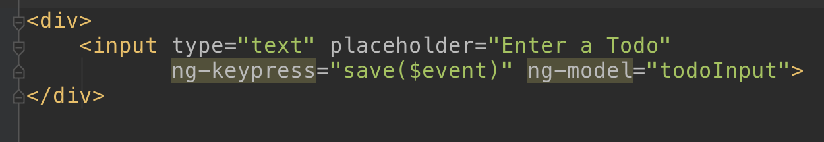
Angular view - Creating
Notes:
Here we are adding a span that will be a font awesome icon to represent if the high priority status. We add an ng-click to the icon to toggle updating the priority

Slide 36
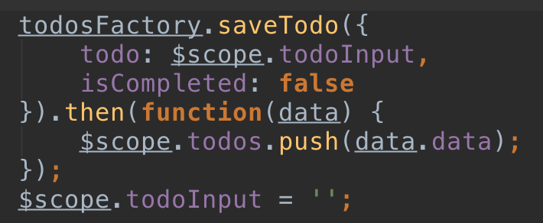
Angular Controller - Creating
Notes:
Here is the save method where we can see the todo object being POSTed to the server. This will create a new todo

Slide 37
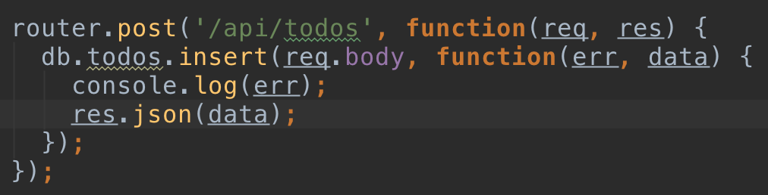
Express Server - Creating
Notes:
The express app has a route registered for a POST request. You can see that it’s doing a simple insert and passing directly in the todo JSON object

Slide 38
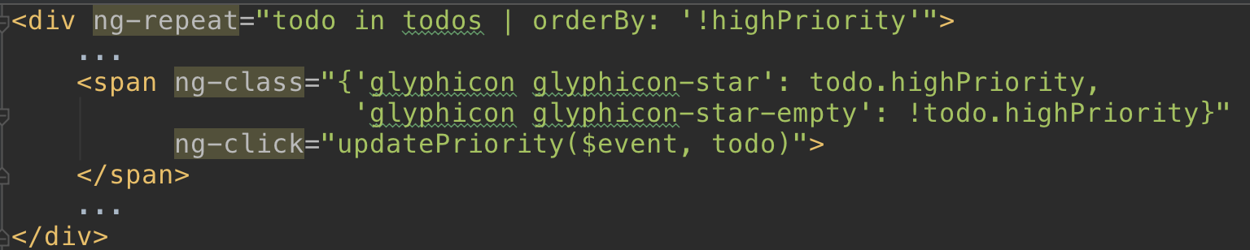
Angular view - Update
Notes:
Here we are adding a span that will be a font awesome icon to represent if the high priority status. We add an ng-click to the icon to toggle updating the priority

Slide 39
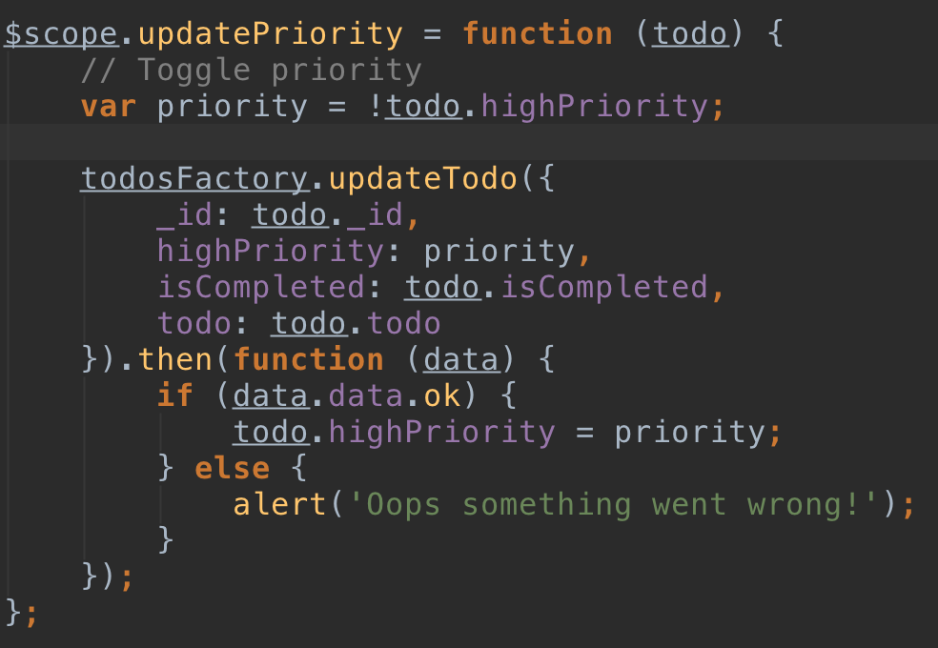
Angular Controller - Update
Notes:
Here in the update method in the controller we see that we are passing in the priority and completed attributes. Looking at our update route in the express server we can see that no changes had to be made to the underlying mongo structure to handle the fields

Slide 40
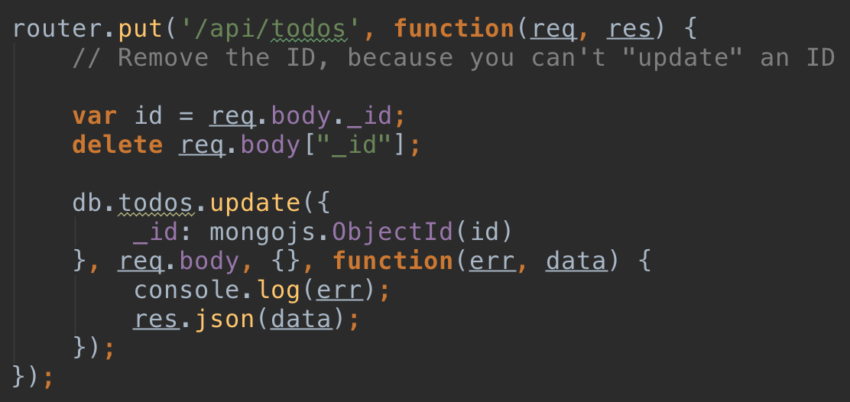
Express Server - Update
Notes:
The express server has a route for a PUT request to update the object. You can see we are passing in the whole request body object.

