Slide 1
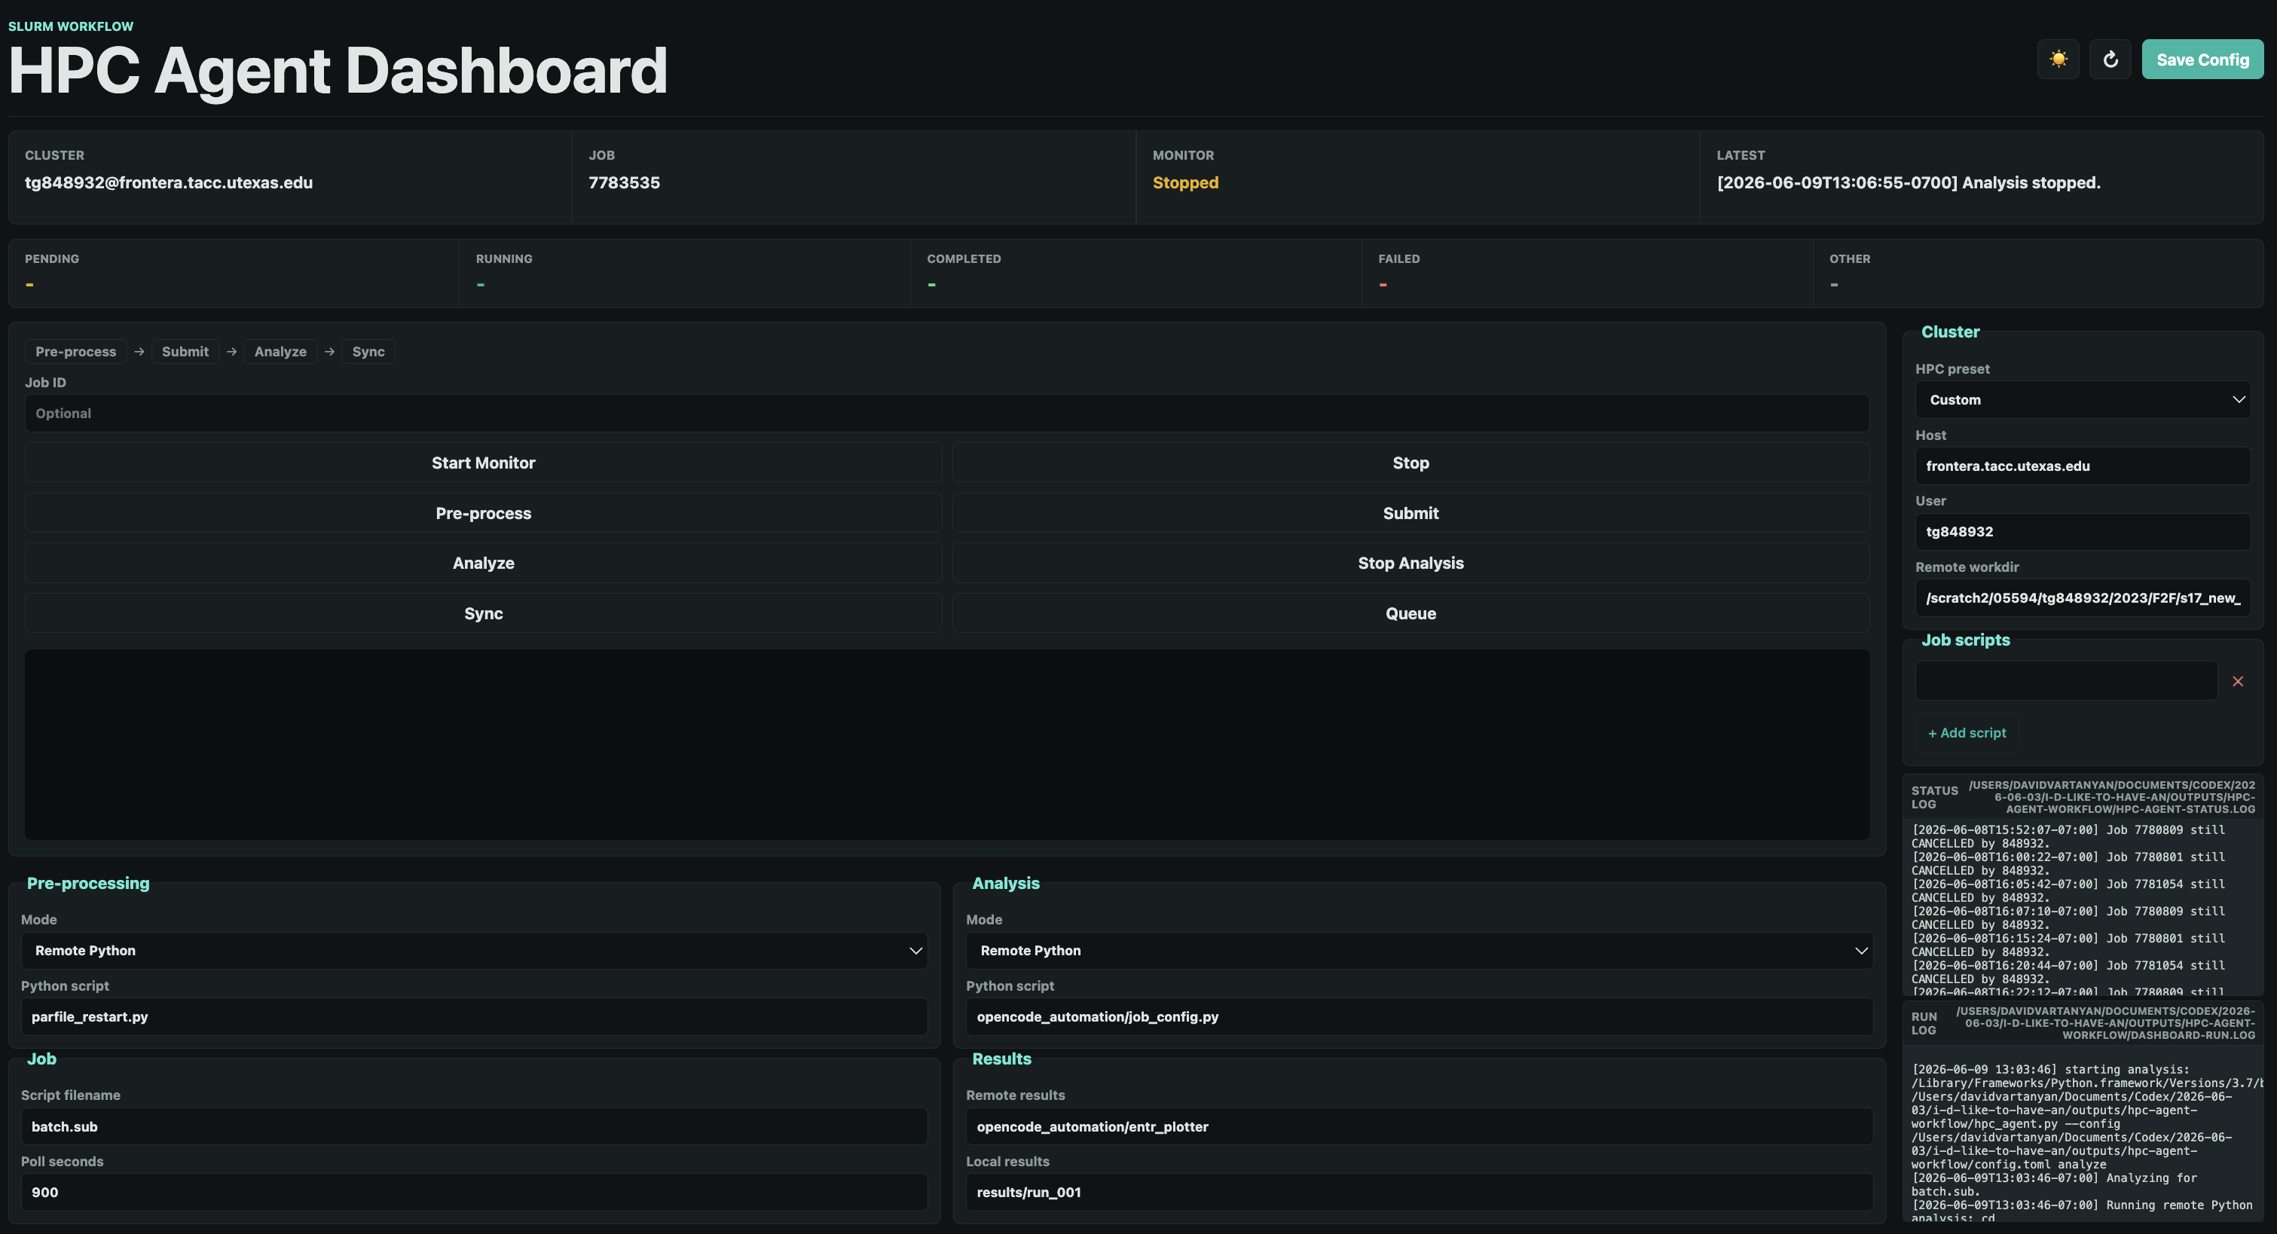

ASTRA:
Automated Scheduling & Tracking for Research Applications
1. Motivation
HPC research today means juggling SSH terminals, sbatch scripts, and manual file transfers .
• Fragile and prone to human error
• Disconnected pre-process, submit, analysis, and sync steps
• No unified status view → wasted compute hours
• Goal: one repeatable workflow any lab member can run
2. Process
One dashboard runs the full pipeline for every model:
pre-process → submit → poll → analyze → sync
• Start Monitor iterates all job scripts in their own subdirectory
• Phase indicators light up for each pipeline step in real time
• Stop buttons cancel the model job
• Settings persist in config.toml — reproducible every time
3. Key Challenges
Left panel: one-click pipeline buttons (Start Monitor → Pre-process → Submit → Analyze → Sync), phase indicators for cluster, jobs, analysis modes.
Right panel: HPC connection settings, dynamic job scripts,compact status + run logs.
Multi-job HPC pipelines break in predictable ways without the right safeguards built in.
• Reproducibility — each script runs in its own remote workspace
• Scalability — job scripts touching the workflow
• Transparency — live logs so you never SSH blind again
• Safety — cancel at the scheduler level, not just locally
Waste less time babysitting jobs:
more time on interpreting results
ASTRA — github.com/dvartany/hpc-agent-workflow · Built with opencode agents

