Slide 1

PROJECT BASED LEARNING — FWD
🏥
Hospital Inpatient
Meal Planning System
HIMPS
A Smart Digital Solution for Inpatient Dietary & Nutrition Management
HTML5 · CSS3 · JavaScript · Node.js · Express.js · localStorage · REST API
Team Members
M Ramya Sree - 2520030094 | D VarunTeja Reddy – 2520090221
KLH BACHUPALLY

Slide 2
Table of Contents
HIMPS — Hospital Inpatient Meal Planning System
01
Abstract & Problem Statement
06
Meal Planner & Calorie Calculator
02
Project Overview & Objectives
07
Kitchen Orders & Approvals
03
System Architecture (Class Diagram)
08
Technical Stack
04
Key Features & Modules
09
Course Outcome Mapping
05
Dietary Profile & Allergy Check

Slide 3
Abstract & Problem Statement
OVERVIEW
HIMPS (Hospital Inpatient Meal Planning System) is a fully functional, role-based web platform for hospital nutrition management. It enables staff to manage patient dietary profiles, allergies, caloric requirements, meal planning, kitchen orders, and approval workflows in one centralized system. Built using HTML5, CSS3, Vanilla JavaScript, and Node.js/Express.js with localStorage and JSON file storage. Designed for Admins, Dietitians, Nurses, and Kitchen Staff with role-based access control.
PROBLEM STATEMENT
📋
Manual paper-based diet orders cause errors & delays
⚠
No allergy verification — patients receive unsafe meals
🔥
Caloric tracking done manually — no formula-based calc
👨‍🍳
Kitchen receives unorganized verbal orders
📅
No structured approval workflow for meal plans
📊
Zero audit trail — no history of dietary decisions

Slide 4
Project Overview & Objectives
What is HIMPS?
Objectives
🏥
A web-based hospital nutrition management platform
Eliminate manual paper-based diet ordering
📋
Manage dietary profiles with allergies & restrictions
Implement role-based access (Admin / Dietitian / Nurse / Kitchen)
🍽
Automate caloric requirement calculation via BMR formula
Create daily meal plans per patient — breakfast to dinner
🔥
Auto-compute caloric needs using BMR formula
Provide real-time allergy conflict detection before serving
‍🍳
Generate and track kitchen orders in real-time
Create structured meal plan approval workflow
✅
Approval workflow for dietitian-created meal plans
Track all kitchen orders from preparation to delivery
Generate exportable CSV reports for all modules
📤
Export reports as CSV for all modules
⚙
Build zero-install, browser-only deployable system
Admin panel to manage users, roles & system settings

Slide 5
System Architecture — Entity Relationships
🛏 Patient
📋 DietaryProfile
🍽 Meal
👤User
• patientId: String
• id: String
• id: String
• dietType: String
• name: String
• id: String
• name: String
• ward: String
• caloricNeeds: Number
• type: Breakfast|Lunch…
• name: String
• allergies: String[]
• calories: Number
• email: String
• bed: String
• role: admin|dietitian|nurse|kitchen
• condition: String
• restrictions: String[]
• allergens: String[]
📅 MealPlan
👨‍🍳 KitchenOrder
🔔 Notification
📜 AuditLog
• id: String
• planId: String
• id: String
• id: String
• patientId: String
• patientId: String
• type: allergy|approval
• action: String
• date: String
• mealName: String
• message: String
• userId: String
• breakfast|lunch|dinner: MealId
• ward, bed: String
• read: Boolean
• details: String
• status: pending|approved
• status: pending→delivered
User/Auth
Patient/Plan
Dietary Profile
Meal
Kitchen
Alerts
Audit

Slide 6
Key Features & Modules
🏠
Dashboard
👨‍🍳
Kitchen Orders
KPI cards, pending approvals, kitchen status, allergy alerts
Pending → Preparing → Delivered tracking by ward and bed
🛏️
Patients
✅
Approvals
CRUD operations, auto-generated IDs, ward & bed management
Admin reviews and approves/rejects dietitian meal plans
📋
Dietary Profiles
📜
History / Audit
Diet type, caloric needs, macro targets, allergies, restrictions
Full audit trail of every login, edit, approve, delete action
🍽️
Meal Library
📤
Export (CSV)
Meals with nutritional info, diet tags and allergen labels
6 downloadable reports — patients, plans, orders, allergies
📅
Meal Planner
🔔
Notifications
5 daily slots (Breakfast → Dinner) with live calorie tracker
Allergy alerts, approval requests and system-wide messages
⚠
Allergy Check
⚙
Admin Panel
Real-time conflict detection — patient allergies vs meal allergens
Manage users, roles, settings and reset to demo data
🔥
Calorie Calculator
BMR & TDEE via Harris-Benedict formula with activity factor

Slide 7
Dietary Profile & Allergy Check
📋 Dietary Profile Management
⚠️ Allergy Check Engine
Diet Type:
Diabetic · Low Sodium · High Protein · Renal · Cardiac
Step 1
Select patient
System loads dietary profile with allergy list
Caloric Needs:
Daily kcal target used for meal plan progress tracking
Macros:
Protein (g) · Carbohydrates (g) · Fat (g) targets
Step 2
Select meal
System loads meal's allergen array
Water Intake:
Daily fluid target in litres (restricted for renal patients)
Step 3
Cross-match
Allergies:
Gluten · Dairy · Eggs · Nuts · Shellfish · Soy · Wheat
Compares patient.allergies vs meal.allergens
Restrictions:
High Sugar · High Salt · Fried Foods · High Potassium
Step 4
Result
Notes:
Free-text special instructions for kitchen & nursing staff
🚨 ALERT if conflict / ✅ SAFE if no match

Slide 8
Meal Planner & Calorie Calculator
📅 Daily Meal Planner
🔥 Calorie Calculator
🌅
Breakfast
Selectable from meal library ✓
Harris-Benedict BMR Formula
7:00 – 8:30 AM
Male: 88.36 + (13.4×W) + (4.8×H) − (5.7×Age)
Female: 447.6 + (9.2×W) + (3.1×H) − (4.3×Age)
🥐
Morning Snack
Selectable from meal library ✓
10:30 – 11:00 AM
Weight (kg)
Activity Level
Gender
☀️
Lunch
Selectable from meal library ✓
12:30 – 1:30 PM
Height (cm)
Medical Condition
Daily Target
🍵
Evening Snack
Selectable from meal library ✓
4:00 – 4:30 PM
Outputs:
🌙
Dinner
BMR
TDEE
Protein
Selectable from meal library ✓
Base rate
Daily needs
Grams
7:00 – 8:00 PM
Carbs
Fat
Water
→ Live calorie progress bar: red/amber/green vs daily target
Grams
Grams
Litres

Slide 9
Kitchen Orders & Approval Workflow
👨‍🍳 Kitchen Order Management
✅ Approval Workflow
⏳
PENDING
Dietitian creates meal plan
1
Meal plan approved, order queued
Selects meals for each time slot
🔄
2
Plan saved as PENDING
PREPARING
Kitchen orders auto-generated
Kitchen staff started cooking
3
Admin reviews plan
✅
DELIVERED
Checks meals, calories, allergies
Meal delivered to ward & bed
4
Approve / Reject
Filter by date, ward, status, patient name
Table View and Card View toggle
Approved plans move to PREPARING
Mark all orders delivered in one click
Auto-created from approved meal plans

Slide 10
Technical Stack
FULL STACK WEB DEVELOPMENT
🖥️
FRONTEND
⚙️
BACKEND
🏗️
ARCHITECTURE
🛠️
TOOLS & QA
Node.js + Express.js REST API
VS Code — Development IDE
HTML5 — Semantic structure, 10 pages
Role-Based Access Control (RBAC)
11 REST API endpoints
Postman — API endpoint testing
CSS3 — Flexbox, Grid, animations
Session-based authentication
JSON file storage (data/*.json)
Git & GitHub — Version control
JavaScript ES6+ — DOM, modules, localStorage
Modular JS — Auth, DB, Utils, Sidebar
Auto-seed demo data on startup
Node.js v18+ runtime + npm
Chart.js — Monthly bar charts
Vanilla JS — zero framework frontend
Browser DevTools for debugging
CORS enabled for frontend access
Google Fonts — Plus Jakarta Sans
localStorage fallback (offline mode)
REST API: POST /auth/login · GET /patients · POST /dietary-profiles · GET /meals · POST /meal-plans · PUT /kitchen-orders/:id · GET /allergy-check · GET /dashboard

Slide 11
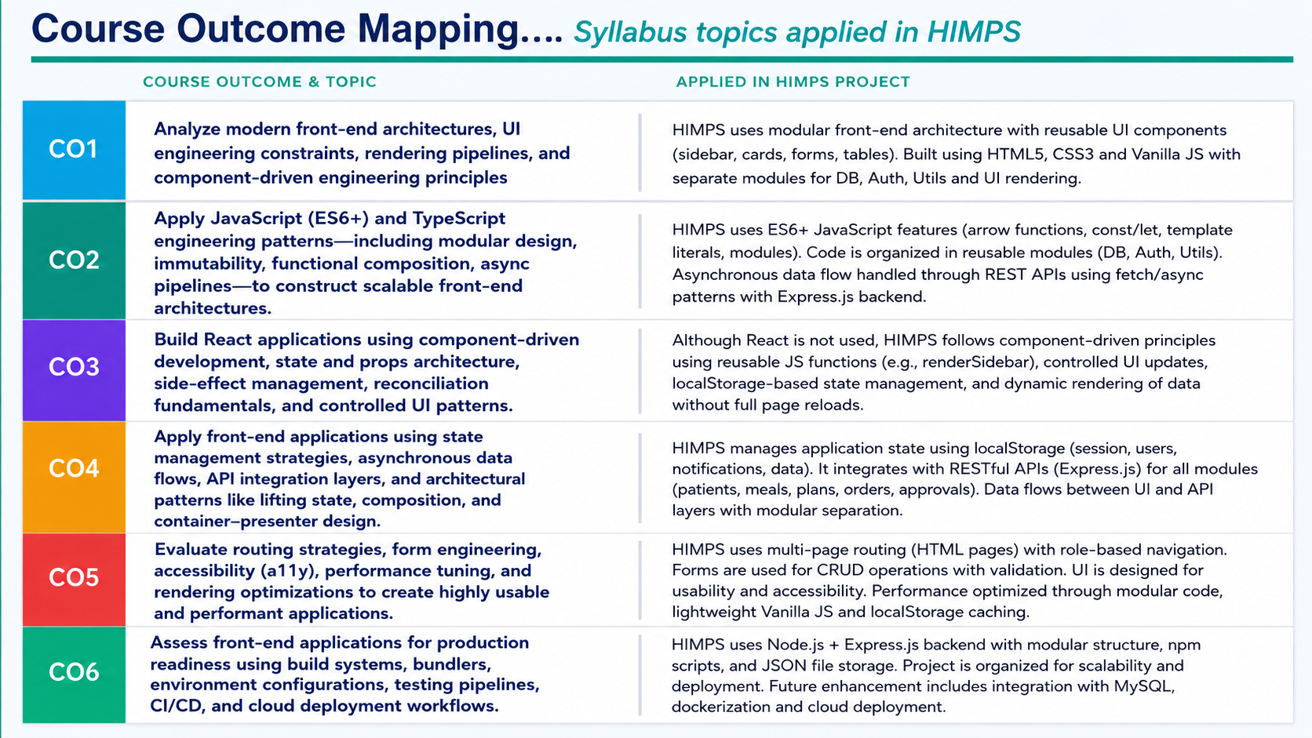

Slide 12
Future Enhancements
🗄️
🔐
MySQL Integration
JWT Authentication
Replace JSON storage with MySQL/PostgreSQL via Sequelize for production-grade persistence and multi-user concurrency
Replace session-based auth with JWT tokens + refresh tokens for stateless, scalable and secure API access
📄
📧
PDF Report Generation
Email Notifications
Auto-generate printable PDF reports for meal records and hospital billing using jsPDF or Puppeteer
Automated email alerts for allergy warnings, meal plan approvals and kitchen delivery confirmations via NodeMailer
🤖
📱
AI Diet Recommendations
Mobile Application
ML-based meal suggestions tailored to patient medical condition and nutritional history using TensorFlow.js
React Native app for nurses and kitchen staff to update order status and view patient profiles on-the-go

Slide 13
🏥
Thank You!
HIMPS — Hospital Inpatient Meal Planning System

