Slide 1
WEEKLY REPORT
POST STROKE REHABILITATION SYSTEM
WEEK 6 – September 28th 2026

Slide 2
Outline
Quick Update
Literature Review Paper
Active Sensing

Slide 3
1. Quick Update
Review paper summary
Pipeline for measurement

Slide 4
2. Literature Review Paper – Background
Sheet | Unit of record | Question answered
Individual Studies | One study-level claim | What was measured, how, in whom, and for which tested endpoint?
Existing Reviews | One prior review | What literature has already been synthesized, with which scope and method?
Paper Tracker | One PDF/file | How many papers?

Slide 5
2. Literature Review Paper – Background
Individual Studies contains seven linked evidence groups
Group | Primary purpose | Downstream use
Record and Provenance | Connects every extracted claim to the PDF, bibliography, and tracker. | Audit and deduplication
Eligibility and Author Intent | Defines what the paper is, why it is relevant, and the exact claim being audited. | Eligibility and claim audit
Population and Clinical Context | Defines who the result applies to and which transfer claims remain defensible. | Transferability matrix
Speech Task and Sensing Setup | Specifies the speech question and the exact acquisition conditions that shape the signal. | Coverage and deployment matrices
Measurement and Computation | Traces the signal from physical quantity through instrument output and computational inference. | Measurand and processing comparison
Results and Evidence Quality | Records what the study actually tested, what it found, and how stable that evidence is. | Evidence maturity and result synthesis
Translation and Critical Synthesis | Converts extracted facts into bounded claims and tests whether clinical promises match the evidence. | T1-T5 and gap verification

Slide 6
2. Literature Review Paper – Background
Existing Reviews contains four comparison groups
Group | Primary purpose | Downstream use
Review Identification | Identifies the review and separates bibliographic identity from review methodology. | Deduplication and recency
Review Method | Shows how reproducibly each review found and selected evidence. | Transparency and update window
Review Scope | Maps what each review actually covered across population, subsystem, technology, and use. | Overlap matrix
Review Positioning | Separates the authors' synthesis from our comparison and novelty argument. | Competitor classification and novelty

Slide 7
2. Literature Review Paper – Background
What each group contributes
0 Direct competitor
Would test the whole-review novelty claim. None identified in this 35-review set.
12 Narrow direct predecessors
Dysarthria and sensing are central, but the review is restricted by modality, subsystem, etiology, or use.
6 Structural analogs
Use a similar measurement-to-application logic, but in a different population or narrower technical scope.
16 Adjacent topical reviews
Overlap in one topic only; useful for a section, not for defining the whole review.
1 Foundational source
Supplies terminology.

Slide 8
2. Literature Review Paper – Progress

Slide 9
2. Literature Review Paper – Progress
Week 5
Subsystem | Acoustic/ Audio sensing | Aerodynamic/ pressure measurement | EGG/Electroglottography | Respiration motion sensing | EPG/ Electropalatography | UTI/ Ultrasound Tongue Imaging | EMA/kin. Electromagnetic articulography/ kinematic tracking | sEMG
Respiration | 7 | 4 | 1 | 3 | 0 | 0 | 0 | 0
Phonation | 15 | 4 | 3 | 1 | 0 | 0 | 0 | 2
Resonance | 6 | 3 | 0 | 0 | 0 | 0 | 0 | 0
Articulation | 24 | 0 | 0 | 0 | 3 | 1 | 8 | 5
 | 13 | 1 | 0 | 0 | 1 | 0 | 2 | 1
Prosody

Slide 10
2. Literature Review Paper – Progress
Week 6
Subsystem | Acoustic/ Audio sensing | Aerodynamic/ pressure measurement | EGG/Electroglottography | Respiration motion sensing | EPG/ Electropalatography | UTI/ Ultrasound Tongue Imaging | EMA/kin. Electromagnetic articulography/ kinematic tracking | sEMG
Respiration | 15 | 5 | 1 | 3 | 0 | 0 | 0 | 0
Phonation | 32 | 4 | 5 | 2 | 2 | 0 | 1 | 5
Resonance | 14 | 5 | 1 | 0 | 0 | 0 | 0 | 0
Articulation | 45 | 1 | 0 | 0 | 11 | 5 | 20 | 10
 | 17 | 1 | 1 | 0 | 0 | 0 | 3 | 0
Prosody

Slide 11
2. Literature Review Paper – Progress
Sensing modality growth

Slide 12
2. Literature Review Paper – Progress
Population | Acoustic/ Audio sensing | Aerodynamic/ pressure measurement | EGG/Electroglottography | Respiration motion sensing | EPG/ Electropalatography | UTI/ Ultrasound Tongue Imaging | EMA/kin. Electromagnetic articulography/ kinematic tracking | sEMG
Parkinson disease | 19 | 5 | 3 | 1 | 3 | 1 | 3 | 0
ALS/MND | 10 | 1 | 0 | 0 | 0 | 1 | 4 | 0
Stroke | 3 | 0 | 0 | 0 | 0 | 0 | 0 | 1
Multiple sclerosis | 3 | 0 | 0 | 0 | 0 | 0 | 1 | 0
Ataxia/cerebellar | 3 | 0 | 0 | 0 | 0 | 1 | 0 | 0
TBI/concussion | 3 | 0 | 0 | 0 | 0 | 0 | 1 | 1
Other neurologic | 8 | 0 | 1 | 0 | 0 | 1 | 1 | 0
No dysarthria cohort | 4 | 0 | 0 | 2 | 0 | 0 | 1 | 4

Slide 13
2. Literature Review Paper – Progress
Population | Acoustic/ Audio sensing | Aerodynamic/ pressure measurement | EGG/Electroglottography | Respiration motion sensing | EPG/ Electropalatography | UTI/ Ultrasound Tongue Imaging | EMA/kin. Electromagnetic articulography/ kinematic tracking | sEMG
Parkinson disease | 32 | 7 | 4 | 2 | 3 | 1 | 10 | 2
ALS/MND | 18 | 2 | 1 | 0 | 0 | 3 | 8 | 0
Stroke | 16 | 0 | 2 | 0 | 5 | 1 | 1 | 3
Multiple sclerosis | 4 | 0 | 0 | 0 | 0 | 0 | 2 | 0
Ataxia/cerebellar | 9 | 0 | 0 | 0 | 1 | 1 | 2 | 1
TBI/concussion | 1 | 0 | 0 | 0 | 0 | 0 | 2 | 0
Other neurologic | 8 | 0 | 1 | 0 | 0 | 0 | 1 | 0
No dysarthria cohort | 16 | 1 | 0 | 1 | 2 | 1 | 2 | 11
Cleft palate/VPI | 3 | 2 | 0 | 0 | 0 | 0 | 0 | 0
Down syndrome | 0 | 0 | 0 | 0 | 2 | 0 | 0 | 0

Slide 14
2. Literature Review Paper – Progress
Population coverage growth

Slide 15
2. Literature Review Paper – Progress
Subsystem coverage growth

Slide 16
2. Literature Review Paper – Future
1. Starting to have a draft in Overleaf based on current papers

Slide 17

3. Active Sensing – Background
ADG2128 chooses electrodes
AD5940
Excite
Inject
Sense
Compute Z
B. Liu et al. / SoftwareX 7 (2018) 304–308

Slide 18
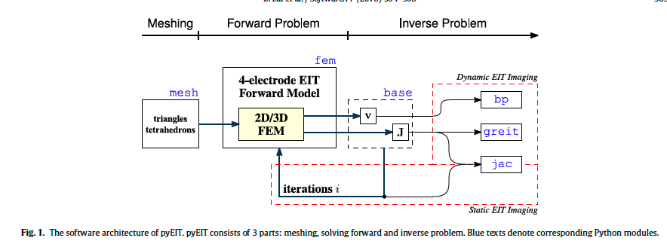
3. Active Sensing – Background
B. Liu et al. / SoftwareX 7 (2018) 304–308

Slide 19
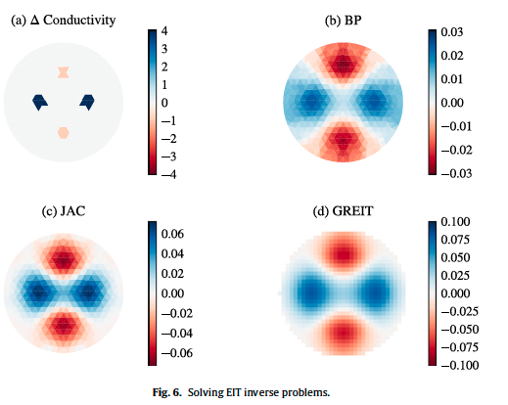
3. Active Sensing – Background

Slide 20
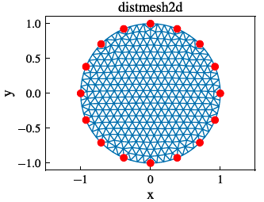
3. Active Sensing – Background
Mesh
Forward Problem (module fem)
Inverse Problem
The region Ω is cut into many small triangles (2D) or tetrahedrons (3D). This turns a continuous space with infinitely many points into a finite, countable list of node values
Known conductivity distribution
↓
Forward model
↓
Calculated boundary voltages
Measured boundary voltages ↓
Reconstruction algorithm
↓
Estimated conductivity changes

Slide 21
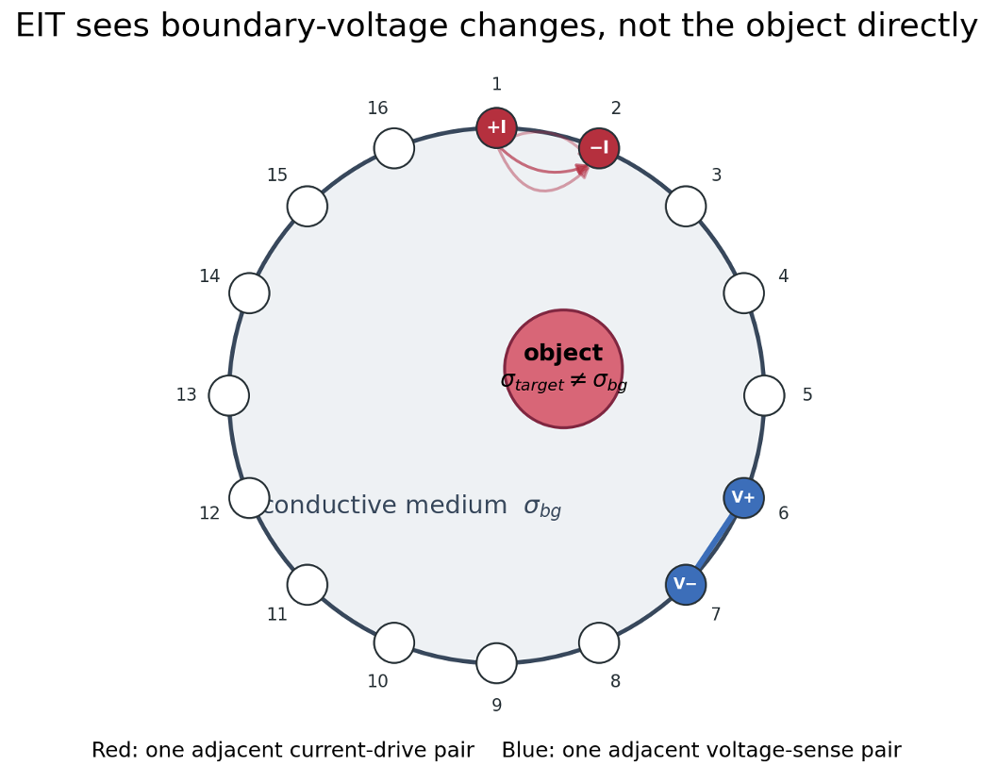
3. Active Sensing – Progress
1. Conductive medium
Saline or tissue provides background conductivity σbg.
2. Boundary current
One adjacent pair injects +I and removes −I.
3. Boundary voltage
A conductivity change perturbs current paths and the voltage pattern measured by the sense pairs.
EIT infers the object from the complete boundary pattern.

Slide 22
3. Active Sensing – Progress
16 drive pairs
13 sense pairs
The adjacent drive rotates through all electrodes.
Each drive retains 13 valid adjacent sense pairs.
208
16 × 13 sequential voltage differences.

Slide 23
3. Active Sensing – Progress
Δv = v₁ − v₀
208 measured changes
This change vector is the input to BP, JAC, and GREIT.
Reference state v₀
Target state v₁

Slide 24
3. Active Sensing – Progress
Object Simulated
1
2
3
4
Define ground truth
Forward solve
Reconstruct
Compare
Known σ at every mesh element
Predict v₀ and v₁ at the boundary
Give the same Δv to BP, JAC, GREIT
Check each image against the known answer

Slide 25

3. Active Sensing – Progress

Slide 26
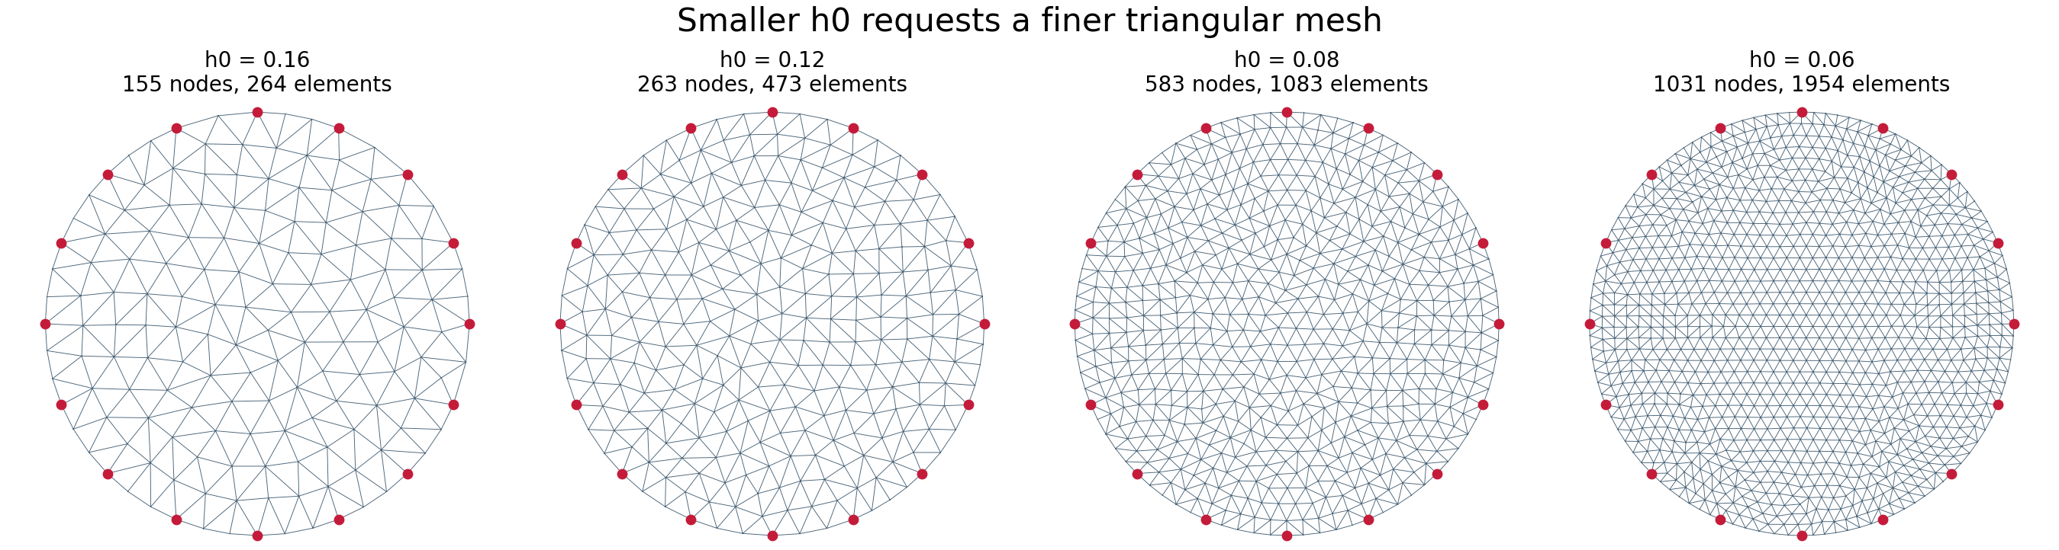
3. Active Sensing – Progress
h0 = 0.08
583 nodes
1083 elements
Requested characteristic triangle spacing in the unit-radius geometry.
Locations where the FEM solves electric potential u.
Triangles carrying piecewise conductivity values σ.

Slide 27

3. Active Sensing – Progress
BP: broad / diffuse
JAC: sharper + artifacts
GREIT: smooth pixel grid

Slide 28
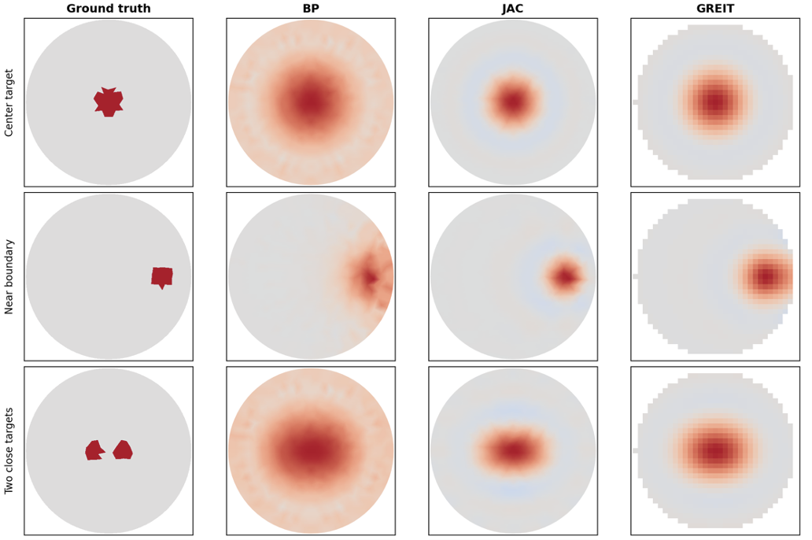
3. Active Sensing – Progress

Slide 29
3. Active Sensing – Future
1. Starting to have a draft in Overleaf based on current papers

Slide 30
References
[1] B. Liu et al., “pyEIT: A Python Based Framework for Electrical Impedance Tomography,” SoftwareX 7 (2018), 304-308.
[2] A. Adler et al., “Temporal Image Reconstruction in Electrical Impedance Tomography,” Physiological Measurement 28 (2007), S1-S11.
[3] A. Adler et al., “GREIT: A Unified Approach to 2D Linear EIT Reconstruction of Lung Images,” Physiological Measurement 30 (2009), S35-S55.
[4] Analog Devices, “CN0565: Electrical Impedance Tomography Measurement System,” Rev. A, Figure 14.
[5] pyEIT 1.2.4 source used by scripts/eit_sim_playground.py for BP, JAC, GREIT, protocol, FEM, and mesh configuration.

Slide 31
Thank you

Slide 32

3. Active Sensing – Progress
If I already knew the conductivity everywhere, what would the measurements be?”
Mesh
Forward Problem (module fem)
2. Sigma times the partial derivative of u with respect to n, evaluated on the boundary of omega, equals g.
This is the boundary condition, it tells the equation exactly how much current flows OUT at the boundary: it must equal g, the current injected
The region Ω is cut into many small triangles (2D) or tetrahedrons (3D). This turns a continuous space with infinitely many points into a finite, countable list of node values
3. The integral of u over the boundary of omega equals zero.
Since EIT only measures voltage DIFFERENCES (never an absolute value), the system would otherwise have infinitely many valid solutions differing by a constant. This equation fixes the average boundary voltage at zero, picking exactly one solution
The divergence of sigma gradient u equals zero.
This says electric current is neither created nor destroyed inside the tissue, it only flows through

Slide 33
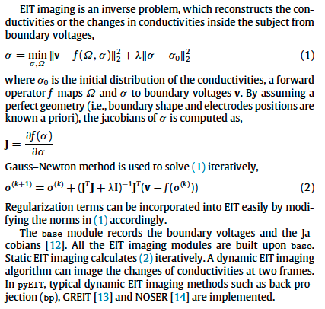
3. Active Sensing – Progress
I have the real measurement. What must be happening inside to cause it?
1. Sigma equals the minimum, over sigma and omega, of the squared norm of v minus f of omega sigma, plus lambda times the squared norm of sigma minus sigma-naught
This defines what "the best guess" for σ actually means: search for the σ whose predicted measurements (f) come as close as possible to the real measurements (v), while not straying too far from a sensible starting point (σ₀). It's a balance between fitting the data and staying stable.
Inverse Problem
J equals the partial derivative of f of sigma with respect to sigma
This defines sensitivity, how much the predicted measurement changes if σ changes by a tiny amount.
Sigma at iteration k plus one equals sigma at iteration k, plus, J transpose J plus lambda I, inverse, times J transpose, times, v minus f of sigma at iteration k
The update rule for iterative refinement

Slide 34
3. Active Sensing – Progress
Algorithm | Formula | What It Means | Result
BP | H = Bᵀ | Weights each mesh element by geometric distance from the measurement path, no real sensitivity (J) used. | Rough, blurry δσ map. Fast, but not physically grounded.
JAC | δσ = (JᵀJ+λR)⁻¹Jᵀ·Δv | Uses real sensitivity J. Balances matching Δv against staying smooth (λR). | Sharper, more accurate δσ. Slower; shape depends on the mesh.
GREIT | H = W·Jᵀ·(JJᵀ+λR)⁻¹ | Same sensitivity as JAC, reordered (JJᵀ), plus pre-trained grid weights W. | Smooth, standardized image on a pixel grid. Comparable across scans, but fixed in advance.

Slide 35
3. Active Sensing – Progress

Slide 36
Symbols
Symbol | Meaning
Ω | The region (domain) being imaged
∂Ω | The boundary of the domain
σ | Conductivity
u | Electric potential
∇ | Gradient operator
∇· | Divergence operator
∇u | Gradient of u
∂u/∂n | Rate of change of u across the boundary
g | Current injected at the boundary
∫ | Integral of
v | Measurement vector (voltages)
ℝᴹ | Space of M real numbers
M (nM) | Number of measurements
f(Ω,σ) | Forward operator — predicts measurements
σ₀ | Initial / reference conductivity guess
λ | Regularization parameter (smoothing strength)

Slide 37
Symbols
Symbol | Meaning
‖x‖² | Squared norm — overall magnitude of a vector
J | Jacobian matrix (sensitivity)
nE | Number of mesh elements
σᵏ | Conductivity estimate at iteration k
σᵏ⁺¹ | Updated conductivity estimate
Jᵀ | J transpose
JᵀJ | J transpose times J
JJᵀ | J times J transpose
(...)⁻¹ | Matrix inverse
I | Identity matrix
R | Regularization matrix
δσ | Change in conductivity (unknown to solve for)
Δv | Difference in measurements between two frames
W | Grid-weighting matrix (GREIT only)
B | Smear matrix (BP only)
H | Reconstruction matrix
p | Exponent controlling where noise concentrates

