Slide 1
WEEKLY REPORT
POST STROKE REHABILITATION SYSTEM
WEEK 6 – September 27th 2026

Slide 2
Agenda
Quick Update
Literature Review Paper
Active Sensing

Slide 3
1. Quick Update
Review paper summary
Pipeline for measurement

Slide 4
2. Literature Review Paper – Background
Spreadsheet to keep track with papers

Slide 5
2. Literature Review Paper – Progress
Sheet | Unit of record | Question answered
Individual Studies | One study-level claim | What was measured, how, in whom, and for which tested endpoint?
Existing Reviews | One prior review | What literature has already been synthesized, with which scope and method?
Paper Tracker | One PDF/file | How many papers?

Slide 6
2. Literature Review Paper – Progress
Individual Studies contains seven linked evidence groups
Group | Primary purpose | Downstream use
Record and Provenance | Connects every extracted claim to the PDF, bibliography, and tracker. | Audit and deduplication
Eligibility and Author Intent | Defines what the paper is, why it is relevant, and the exact claim being audited. | Eligibility and claim audit
Population and Clinical Context | Defines who the result applies to and which transfer claims remain defensible. | Transferability matrix
Speech Task and Sensing Setup | Specifies the speech question and the exact acquisition conditions that shape the signal. | Coverage and deployment matrices
Measurement and Computation | Traces the signal from physical quantity through instrument output and computational inference. | Measurand and processing comparison
Results and Evidence Quality | Records what the study actually tested, what it found, and how stable that evidence is. | Evidence maturity and result synthesis
Translation and Critical Synthesis | Converts extracted facts into bounded claims and tests whether clinical promises match the evidence. | T1-T5 and gap verification

Slide 7
2. Literature Review Paper – Progress
Existing Reviews contains four comparison groups
Group | Primary purpose | Downstream use
Review Identification | Identifies the review and separates bibliographic identity from review methodology. | Deduplication and recency
Review Method | Shows how reproducibly each review found and selected evidence. | Transparency and update window
Review Scope | Maps what each review actually covered across population, subsystem, technology, and use. | Overlap matrix
Review Positioning | Separates the authors' synthesis from our comparison and novelty argument. | Competitor classification and novelty

Slide 8
2. Literature Review Paper – Progress
Existing Reviews contains four comparison groups
What each group contributes
0 Direct competitor
Would test the whole-review novelty claim. None identified in this 35-review set.
12 Narrow direct predecessors
Dysarthria and sensing are central, but the review is restricted by modality, subsystem, etiology, or use.
6 Structural analogs
Use a similar measurement-to-application logic, but in a different population or narrower technical scope.
16 Adjacent topical reviews
Overlap in one topic only; useful for a section, not for defining the whole review.
1 Foundational source
Supplies terminology.

Slide 9
2. Literature Review Paper – Progress
Subsystem | Acoustic/ Audio sensing | Aerodynamic/ pressure measurement | EGG/Electroglottography | Respiration motion sensing | EPG/ Electropalatography | UTI/ Ultrasound Tongue Imaging | EMA/kin. Electromagnetic articulography/ kinematic tracking | sEMG
Respiration | 15 | 5 | 1 | 3 | 0 | 0 | 0 | 0
Phonation | 32 | 4 | 5 | 2 | 2 | 0 | 1 | 5
Resonance | 14 | 5 | 1 | 0 | 0 | 0 | 0 | 0
Articulation | 45 | 1 | 0 | 0 | 11 | 5 | 20 | 10
 | 17 | 1 | 1 | 0 | 0 | 0 | 3 | 0
Prosody
Values reflect the corpus as of Week 6 (Sep 27). See the growth-comparison slides below for the Week 5 -> Week 6 change.

Slide 10
2. Literature Review Paper – Progress
Population | Acoustic/ Audio sensing | Aerodynamic/ pressure measurement | EGG/Electroglottography | Respiration motion sensing | EPG/ Electropalatography | UTI/ Ultrasound Tongue Imaging | EMA/kin. Electromagnetic articulography/ kinematic tracking | sEMG
Parkinson disease | 32 | 7 | 4 | 2 | 3 | 1 | 10 | 2
ALS/MND | 18 | 2 | 1 | 0 | 0 | 3 | 8 | 0
Stroke | 16 | 0 | 2 | 0 | 5 | 1 | 1 | 3
Multiple sclerosis | 4 | 0 | 0 | 0 | 0 | 0 | 2 | 0
Ataxia/cerebellar | 9 | 0 | 0 | 0 | 1 | 1 | 2 | 1
TBI/concussion | 1 | 0 | 0 | 0 | 0 | 0 | 2 | 0
Other neurologic | N/A* | N/A* | N/A* | N/A* | N/A* | N/A* | N/A* | N/A*
No dysarthria cohort | N/A* | N/A* | N/A* | N/A* | N/A* | N/A* | N/A* | N/A*
* N/A rows: population mapping not yet resolved. All other cells = Week 6 (Sep 27).

Slide 11
2. Literature Review Paper – Progress
Corpus growth this week: Individual Studies vs. Existing Reviews
Reconstructed Week 5 totals from dated extraction-status stamps in the Paper Tracker (cross-checked against Week 5’s own Existing Reviews count of 35 - exact match).
Individual Studies more than doubled (+151%, +74 papers); Existing Reviews grew only slightly (+2). This week’s effort was almost entirely primary-study intake.

Slide 12
2. Literature Review Paper – Progress
Subsystem coverage growth (tag-instances, multi-label)
Each paper can be tagged with more than one subsystem, so these are tag-instance sums, not paper counts - the same basis as the Subsystem × Modality table.
Articulation grew fastest (+124%) and now accounts for nearly half of all tagged evidence; Prosody grew slowest (+22%) and is falling behind in relative share.

Slide 13
2. Literature Review Paper – Progress
Sensing modality growth (tag-instances, the 8 tracked modalities)
Same 8 modality columns as the Subsystem × Modality and Population × Modality tables.
EPG (+225%), UTI and EMA/kinematic grew fastest in relative terms - all Articulation-linked, matching this week’s intake pattern.
12 more modality categories are now substantial but not yet columns here: Nasometry (11), Accelerometer (7), Smartphone app (6), No sensing device (5), Video/optical mocap (5), MRI static (4), IMU (3), Fiberscopy (3), Wearable piezo (3), EEG (2), Multimodal fusion (2), NMES (1).

Slide 14
2. Literature Review Paper – Progress
Population coverage growth (tag-instances, 6 of 8 rows - see note)
“Other neurologic” and “No dysarthria cohort” are excluded here (marked N/A* in the table above) - their category definitions are not stable enough this pass to compare with confidence.
Stroke grew fastest by far (4→28, +600%). TBI/concussion appears to shrink (5→3) - a schema split, not lost data (see note below).
TBI/concussion note: concussion cases in otherwise-healthy participants without confirmed dysarthria are now filed under "Non-dysarthria clinical population" instead of this row, per the current classification rules.

Slide 15
2. Literature Review Paper – Progress
Existing Reviews update, and corpus quality under growth
Metric | Week 5 | Week 6
Existing Reviews (total) | 35 | 37
Confirmed "direct competitor" reviews | 0 | 0
The Week 5 positioning breakdown (Foundational 1 / Adjacent 16 / Structural 6 / Narrow 12 / Direct 0) is not recomputed this week: the source column now uses granular free-text labels instead of those 5 buckets, so a clean re-bucketing needs your call before that chart (slide 8) can be safely updated.
Data quality (current, full 123-paper corpus):
Verified clean | Minor issue | Moderate issue | Critical issue
89 / 123 | 12 | 21 | 1
All 123 papers were individually re-checked; flagged issues are already logged and corrected - rapid growth this week did not cost extraction quality.

Slide 16
2. Literature Review Paper – Progress
Conclusions: what changed between Week 5 and Week 6
• Corpus growth is intake-driven, not review-driven. Individual Studies +151% (49→123) vs. Existing Reviews +5.7% (35→37): this week added primary evidence, not new comparison literature.
• Articulation is pulling ahead of the other subsystems. Articulation tag-instances +124% (41→92, now ~44% of all tagged evidence); Prosody lags at +22% (18→22) despite the corpus nearly doubling overall.
• Stroke is now the fastest-growing mapped population. Stroke tag-instances 4→28 (+600%), ahead of Ataxia/cerebellar (+250%) and ALS/MND (+100%); Parkinson’s disease remains the largest population in absolute terms (61).
• Two apparent drops are reclassifications, not lost data. EPG×Prosody (1→0) reflects an automatic-vs-manual tagging disagreement; TBI/concussion (5→3) reflects healthy-participant concussion cases moving to a separate non-dysarthria category.
• The novelty argument still holds. Even after +2 Existing Reviews, 0 have been classified as a true direct competitor to this thesis.
• The 8-column modality schema is starting to lag the data. 12 modality categories (Nasometry, Accelerometer, Smartphone app, MRI, etc.) are now substantial enough to deserve their own columns next update.

Slide 17
2. Literature Review Paper – Future
1. Population eligibility
Some studies use sensing modalities in Parkinson’s disease, ALS, stroke, or other neurological populations, but they do not explicitly confirm that the participants have dysarthria. Should these studies be excluded from the core dysarthria evidence?
2. Sensor-to-subsystem evidence
Some technologies measure a physical variable related to a speech subsystem, but they were tested only in healthy participants or neurological populations without confirmed dysarthria. Can we use these studies only to discuss technical feasibility

Slide 18
3. Active Sensing – Background
Computational Model

Slide 19

3. Active Sensing – Progress
ADG2128 chooses electrodes
AD5940
Excite
Inject
Sense
Compute Z
B. Liu et al. / SoftwareX 7 (2018) 304–308

Slide 20
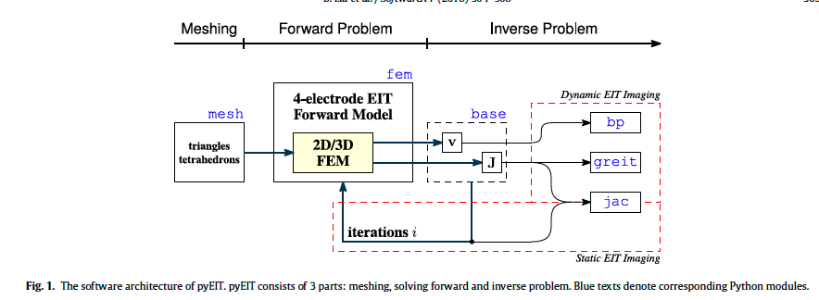
3. Active Sensing – Progress
B. Liu et al. / SoftwareX 7 (2018) 304–308

Slide 21

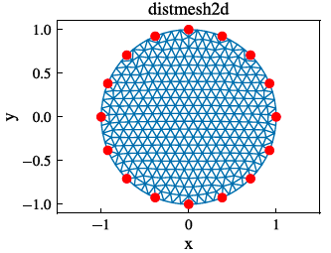
3. Active Sensing – Progress
If I already knew the conductivity everywhere, what would the measurements be?”
Mesh
Forward Problem (module fem)
2. Sigma times the partial derivative of u with respect to n, evaluated on the boundary of omega, equals g.
This is the boundary condition, it tells the equation exactly how much current flows OUT at the boundary: it must equal g, the current injected
The region Ω is cut into many small triangles (2D) or tetrahedrons (3D). This turns a continuous space with infinitely many points into a finite, countable list of node values
3. The integral of u over the boundary of omega equals zero.
Since EIT only measures voltage DIFFERENCES (never an absolute value), the system would otherwise have infinitely many valid solutions differing by a constant. This equation fixes the average boundary voltage at zero, picking exactly one solution
The divergence of sigma gradient u equals zero.
This says electric current is neither created nor destroyed inside the tissue, it only flows through

Slide 22
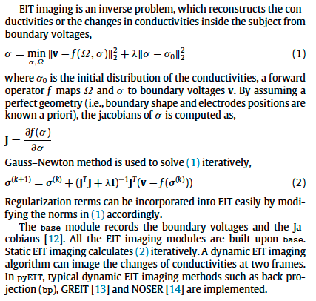
3. Active Sensing – Progress
I have the real measurement. What must be happening inside to cause it?
1. Sigma equals the minimum, over sigma and omega, of the squared norm of v minus f of omega sigma, plus lambda times the squared norm of sigma minus sigma-naught
This defines what "the best guess" for σ actually means: search for the σ whose predicted measurements (f) come as close as possible to the real measurements (v), while not straying too far from a sensible starting point (σ₀). It's a balance between fitting the data and staying stable.
Inverse Problem
J equals the partial derivative of f of sigma with respect to sigma
This defines sensitivity, how much the predicted measurement changes if σ changes by a tiny amount.
Sigma at iteration k plus one equals sigma at iteration k, plus, J transpose J plus lambda I, inverse, times J transpose, times, v minus f of sigma at iteration k
The update rule for iterative refinement

Slide 23
3. Active Sensing – Progress
Algorithm | Formula | What It Means | Result
BP | H = Bᵀ | Weights each mesh element by geometric distance from the measurement path, no real sensitivity (J) used. | Rough, blurry δσ map. Fast, but not physically grounded.
JAC | δσ = (JᵀJ+λR)⁻¹Jᵀ·Δv | Uses real sensitivity J. Balances matching Δv against staying smooth (λR). | Sharper, more accurate δσ. Slower; shape depends on the mesh.
GREIT | H = W·Jᵀ·(JJᵀ+λR)⁻¹ | Same sensitivity as JAC, reordered (JJᵀ), plus pre-trained grid weights W. | Smooth, standardized image on a pixel grid. Comparable across scans, but fixed in advance.

Slide 24
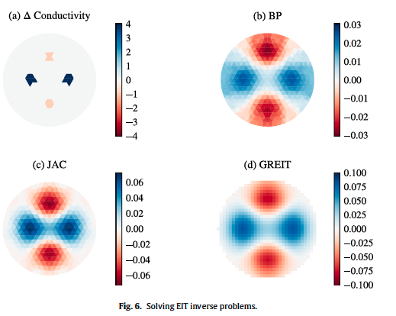
3. Active Sensing – Progress

Slide 25
Symbols
Symbol | Meaning
Ω | The region (domain) being imaged
∂Ω | The boundary of the domain
σ | Conductivity
u | Electric potential
∇ | Gradient operator
∇· | Divergence operator
∇u | Gradient of u
∂u/∂n | Rate of change of u across the boundary
g | Current injected at the boundary
∫ | Integral of
v | Measurement vector (voltages)
ℝᴹ | Space of M real numbers
M (nM) | Number of measurements
f(Ω,σ) | Forward operator — predicts measurements
σ₀ | Initial / reference conductivity guess
λ | Regularization parameter (smoothing strength)

Slide 26
Symbols
Symbol | Meaning
‖x‖² | Squared norm — overall magnitude of a vector
J | Jacobian matrix (sensitivity)
nE | Number of mesh elements
σᵏ | Conductivity estimate at iteration k
σᵏ⁺¹ | Updated conductivity estimate
Jᵀ | J transpose
JᵀJ | J transpose times J
JJᵀ | J times J transpose
(...)⁻¹ | Matrix inverse
I | Identity matrix
R | Regularization matrix
δσ | Change in conductivity (unknown to solve for)
Δv | Difference in measurements between two frames
W | Grid-weighting matrix (GREIT only)
B | Smear matrix (BP only)
H | Reconstruction matrix
p | Exponent controlling where noise concentrates

Slide 27
References
[1] Benyuan Liu, "pyEIT: A python based framework for Electrical Impedance
Tomography"

Slide 28
Thank you

