Slide 1
WEEKLY REPORT
POST STROKE REHABILITATION SYSTEM
WEEK 6 – September 27th 2026

Slide 2
Agenda
Quick Update
Literature Review Paper
Active Sensing

Slide 3
1. Quick Update
Review paper summary
Pipeline for measurement

Slide 4
2. Literature Review Paper – Background
Spreadsheet to keep track with papers

Slide 5
2. Literature Review Paper – Progress
Sheet | Unit of record | Question answered
Individual Studies | One study-level claim | What was measured, how, in whom, and for which tested endpoint?
Existing Reviews | One prior review | What literature has already been synthesized, with which scope and method?
Paper Tracker | One PDF/file | How many papers?

Slide 6
2. Literature Review Paper – Progress
Individual Studies contains seven linked evidence groups
Group | Primary purpose | Downstream use
Record and Provenance | Connects every extracted claim to the PDF, bibliography, and tracker. | Audit and deduplication
Eligibility and Author Intent | Defines what the paper is, why it is relevant, and the exact claim being audited. | Eligibility and claim audit
Population and Clinical Context | Defines who the result applies to and which transfer claims remain defensible. | Transferability matrix
Speech Task and Sensing Setup | Specifies the speech question and the exact acquisition conditions that shape the signal. | Coverage and deployment matrices
Measurement and Computation | Traces the signal from physical quantity through instrument output and computational inference. | Measurand and processing comparison
Results and Evidence Quality | Records what the study actually tested, what it found, and how stable that evidence is. | Evidence maturity and result synthesis
Translation and Critical Synthesis | Converts extracted facts into bounded claims and tests whether clinical promises match the evidence. | T1-T5 and gap verification

Slide 7
2. Literature Review Paper – Progress
Existing Reviews contains four comparison groups
Group | Primary purpose | Downstream use
Review Identification | Identifies the review and separates bibliographic identity from review methodology. | Deduplication and recency
Review Method | Shows how reproducibly each review found and selected evidence. | Transparency and update window
Review Scope | Maps what each review actually covered across population, subsystem, technology, and use. | Overlap matrix
Review Positioning | Separates the authors' synthesis from our comparison and novelty argument. | Competitor classification and novelty

Slide 8
2. Literature Review Paper – Progress
Existing Reviews contains four comparison groups
What each group contributes
0 Direct competitor
Would test the whole-review novelty claim. None identified in this 35-review set.
12 Narrow direct predecessors
Dysarthria and sensing are central, but the review is restricted by modality, subsystem, etiology, or use.
6 Structural analogs
Use a similar measurement-to-application logic, but in a different population or narrower technical scope.
16 Adjacent topical reviews
Overlap in one topic only; useful for a section, not for defining the whole review.
1 Foundational source
Supplies terminology.

Slide 9
2. Literature Review Paper – Progress
Subsystem | Acoustic/ Audio sensing | Aerodynamic/ pressure measurement | EGG/Electroglottography | Respiration motion sensing | EPG/ Electropalatography | UTI/ Ultrasound Tongue Imaging | EMA/kin. Electromagnetic articulography/ kinematic tracking | sEMG
Respiration | 15 | 5 | 1 | 3 | 0 | 0 | 0 | 0
Phonation | 32 | 4 | 5 | 2 | 2 | 0 | 1 | 5
Resonance | 14 | 5 | 1 | 0 | 0 | 0 | 0 | 0
Articulation | 45 | 1 | 0 | 0 | 11 | 5 | 20 | 10
 | 17 | 1 | 1 | 0 | 0 | 0 | 3 | 0
Prosody
Values reflect the corpus as of Week 6 (Sep 27). See the growth-comparison slides below for the Week 5 -> Week 6 change.

Slide 10
2. Literature Review Paper – Progress
Population | Acoustic/ Audio sensing | Aerodynamic/ pressure measurement | EGG/Electroglottography | Respiration motion sensing | EPG/ Electropalatography | UTI/ Ultrasound Tongue Imaging | EMA/kin. Electromagnetic articulography/ kinematic tracking | sEMG
Parkinson disease | 32 | 7 | 4 | 2 | 3 | 1 | 10 | 2
ALS/MND | 18 | 2 | 1 | 0 | 0 | 3 | 8 | 0
Stroke | 16 | 0 | 2 | 0 | 5 | 1 | 1 | 3
Multiple sclerosis | 4 | 0 | 0 | 0 | 0 | 0 | 2 | 0
Ataxia/cerebellar | 9 | 0 | 0 | 0 | 1 | 1 | 2 | 1
TBI/concussion | 1 | 0 | 0 | 0 | 0 | 0 | 2 | 0
Other neurologic | N/A* | N/A* | N/A* | N/A* | N/A* | N/A* | N/A* | N/A*
No dysarthria cohort | N/A* | N/A* | N/A* | N/A* | N/A* | N/A* | N/A* | N/A*
* N/A rows: population mapping not yet resolved. All other cells = Week 6 (Sep 27).

Slide 11
2. Literature Review Paper – Progress
Corpus growth this week: Individual Studies vs. Existing Reviews
Reconstructed Week 5 totals from dated extraction-status stamps in the Paper Tracker (cross-checked against Week 5’s own Existing Reviews count of 35 - exact match).
Individual Studies more than doubled (+151%, +74 papers); Existing Reviews grew only slightly (+2). This week’s effort was almost entirely primary-study intake.

Slide 12
2. Literature Review Paper – Progress
Subsystem coverage growth (tag-instances, multi-label)
Each paper can be tagged with more than one subsystem, so these are tag-instance sums, not paper counts - the same basis as the Subsystem × Modality table.
Articulation grew fastest (+124%) and now accounts for nearly half of all tagged evidence; Prosody grew slowest (+22%) and is falling behind in relative share.

Slide 13
2. Literature Review Paper – Progress
Sensing modality growth (tag-instances, the 8 tracked modalities)
Same 8 modality columns as the Subsystem × Modality and Population × Modality tables.
EPG (+225%), UTI and EMA/kinematic grew fastest in relative terms - all Articulation-linked, matching this week’s intake pattern.
12 more modality categories are now substantial but not yet columns here: Nasometry (11), Accelerometer (7), Smartphone app (6), No sensing device (5), Video/optical mocap (5), MRI static (4), IMU (3), Fiberscopy (3), Wearable piezo (3), EEG (2), Multimodal fusion (2), NMES (1).

Slide 14
2. Literature Review Paper – Progress
Population coverage growth (tag-instances, 6 of 8 rows - see note)
“Other neurologic” and “No dysarthria cohort” are excluded here (marked N/A* in the table above) - their category definitions are not stable enough this pass to compare with confidence.
Stroke grew fastest by far (4→28, +600%). TBI/concussion appears to shrink (5→3) - a schema split, not lost data (see note below).
TBI/concussion note: concussion cases in otherwise-healthy participants without confirmed dysarthria are now filed under "Non-dysarthria clinical population" instead of this row, per the current classification rules.

Slide 15
2. Literature Review Paper – Progress
Existing Reviews update, and corpus quality under growth
Metric | Week 5 | Week 6
Existing Reviews (total) | 35 | 37
Confirmed "direct competitor" reviews | 0 | 0
The Week 5 positioning breakdown (Foundational 1 / Adjacent 16 / Structural 6 / Narrow 12 / Direct 0) is not recomputed this week: the source column now uses granular free-text labels instead of those 5 buckets, so a clean re-bucketing needs your call before that chart (slide 8) can be safely updated.
Data quality (current, full 123-paper corpus):
Verified clean | Minor issue | Moderate issue | Critical issue
89 / 123 | 12 | 21 | 1
All 123 papers were individually re-checked; flagged issues are already logged and corrected - rapid growth this week did not cost extraction quality.

Slide 16
2. Literature Review Paper – Progress
Conclusions: what changed between Week 5 and Week 6
• Corpus growth is intake-driven, not review-driven. Individual Studies +151% (49→123) vs. Existing Reviews +5.7% (35→37): this week added primary evidence, not new comparison literature.
• Articulation is pulling ahead of the other subsystems. Articulation tag-instances +124% (41→92, now ~44% of all tagged evidence); Prosody lags at +22% (18→22) despite the corpus nearly doubling overall.
• Stroke is now the fastest-growing mapped population. Stroke tag-instances 4→28 (+600%), ahead of Ataxia/cerebellar (+250%) and ALS/MND (+100%); Parkinson’s disease remains the largest population in absolute terms (61).
• Two apparent drops are reclassifications, not lost data. EPG×Prosody (1→0) reflects an automatic-vs-manual tagging disagreement; TBI/concussion (5→3) reflects healthy-participant concussion cases moving to a separate non-dysarthria category.
• The novelty argument still holds. Even after +2 Existing Reviews, 0 have been classified as a true direct competitor to this thesis.
• The 8-column modality schema is starting to lag the data. 12 modality categories (Nasometry, Accelerometer, Smartphone app, MRI, etc.) are now substantial enough to deserve their own columns next update.

Slide 17
2. Literature Review Paper – Future
1. Population eligibility
Some studies use sensing modalities in Parkinson’s disease, ALS, stroke, or other neurological populations, but they do not explicitly confirm that the participants have dysarthria. Should these studies be excluded from the core dysarthria evidence?
2. Sensor-to-subsystem evidence
Some technologies measure a physical variable related to a speech subsystem, but they were tested only in healthy participants or neurological populations without confirmed dysarthria. Can we use these studies only to discuss technical feasibility

Slide 18
3. Active Sensing - EIT Simulation Study
From boundary measurements to a reconstructed conductivity-change image
Physical setup → 208 voltage differences → BP / JAC / GREIT
Goal: understand what is simulated, what each parameter means, and how to compare algorithms fairly before testing hardware.
18
Notes:
ENGLISH SCRIPT
This section starts from the physical measurement, not from the algorithms. I will first show where the 208 values come from, then explain the conductivity model, the finite-element mesh, the voltage data, and finally the three reconstruction methods.
VIETNAMESE EXPLANATION
Phần này bắt đầu từ phép đo vật lý chứ chưa vào thuật toán ngay. Trình tự là: 16 điện cực tạo ra 208 hiệu điện thế, xây dựng mô hình conductivity, forward solve, rồi mới so sánh BP, JAC và GREIT.

Slide 19
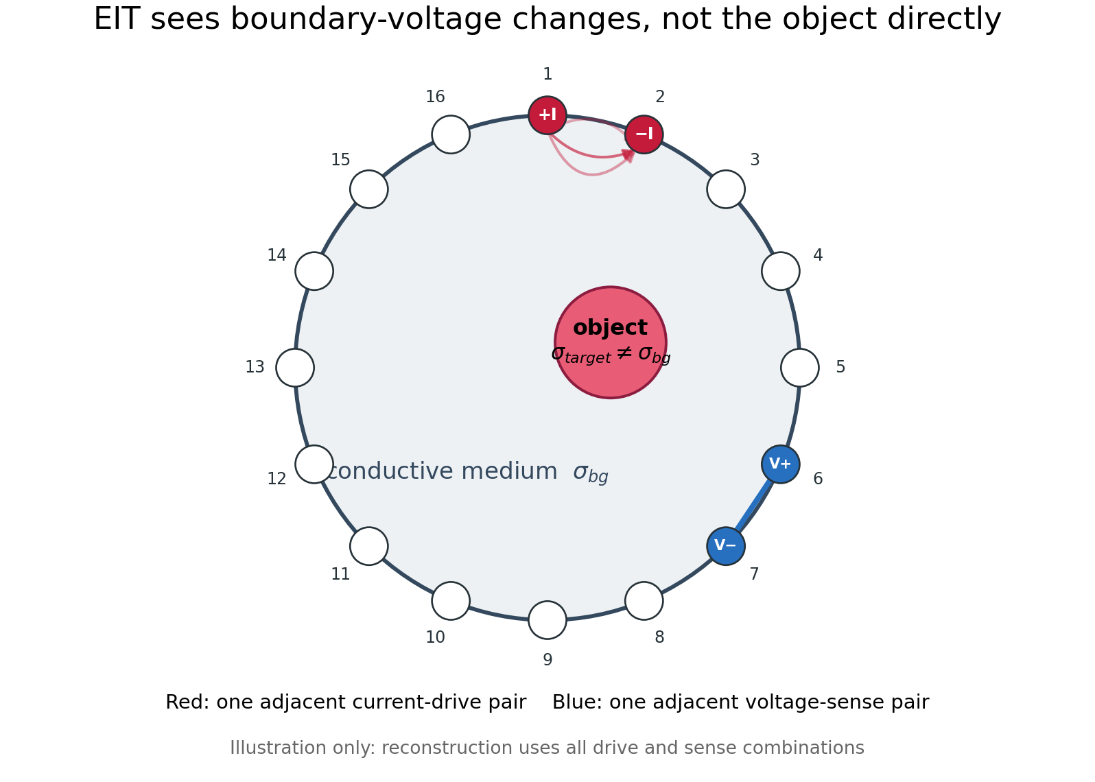
What EIT Actually Measures
1. Conductive medium
Saline or tissue provides background conductivity σbg.
2. Boundary current
One adjacent pair injects +I and removes −I.
3. Boundary voltage
A conductivity change perturbs current paths and the voltage pattern measured by the sense pairs.
EIT infers the object from the complete boundary pattern.
Concept supported by Liu et al. (2018): current is injected through a boundary pair and voltage differences are measured on remaining pairs.
19
Notes:
ENGLISH SCRIPT
A useful sentence is: EIT does not photograph the object. It applies current on the boundary and observes how the boundary-voltage pattern changes. A more conductive or less conductive object perturbs the current distribution. Reconstruction is the inverse step that estimates where that internal conductivity change occurred.
VIETNAMESE EXPLANATION
Câu dễ nhớ: EIT không chụp trực tiếp vật thể. Nó bơm dòng ở biên, đo hiệu điện thế ở biên, rồi suy ngược vị trí thay đổi conductivity bên trong. Object chỉ được nhận ra vì nó làm thay đổi pattern điện áp.

Slide 20
Where the 208 Voltage Differences Come From
16 drive pairs
13 sense pairs
208 / frame
The adjacent drive rotates through all electrodes.
Each drive retains 13 valid adjacent sense pairs.
16 × 13 sequential voltage differences.
Example for drive pair E1-E2
Invalid pairs
E16-E1, E1-E2, E2-E3
Valid pairs
E3-E4, E4-E5, ... , E15-E16
Why 13, not 12?
Remove the two drive electrodes: 14 electrodes remain on one open arc, and 14 points form 13 adjacent sensing gaps.
20
Notes:
ENGLISH SCRIPT
A frame is not one simultaneous reading. It is a sequence. First drive E1-E2 and measure thirteen valid adjacent voltage pairs. Then rotate the drive to E2-E3 and repeat. Sixteen drive positions times thirteen values gives 208. The three adjacent pairs touching E1 or E2 are excluded in the E1-E2 example.
VIETNAMESE EXPLANATION
Một frame là chuỗi phép đo. Với drive E1-E2, ba cặp sense chạm vào điện cực drive bị loại, còn 13 cặp hợp lệ. Lặp cho 16 vị trí drive nên được 16 × 13 = 208. Không phải 12 vì 14 điện cực còn lại tạo 13 khoảng liền kề trên cung mở.

Slide 21
Reference, Target, and Change Frames
Δv = v₁ − v₀
208 measured changes
This change vector is the input to BP, JAC, and GREIT.
Reference state v₀
Target state v₁
Important interpretation
One positive or negative Δv does not alone identify a conductive or resistive target: its sign depends on the drive/sense geometry. Infer location and sign from all 208 values together.
21
Notes:
ENGLISH SCRIPT
We use time-difference EIT. v0 is the homogeneous or initial reference frame. v1 is measured after the target is present. The algorithms reconstruct from delta-v. Do not interpret one voltage sign in isolation because electrode geometry changes the sign and sensitivity of each channel.
VIETNAMESE EXPLANATION
Đây là time-difference EIT. v0 là trạng thái reference, v1 là trạng thái có target, và đầu vào thuật toán là Δv. Một phần tử Δv âm hoặc dương riêng lẻ chưa đủ kết luận target dẫn tốt hay dẫn kém; phải dùng toàn bộ 208 giá trị cùng sensitivity model.

Slide 22
Why Simulate Before Using CN0565 Hardware?
1
2
3
4
Define ground truth
Forward solve
Reconstruct
Compare
Known σ at every mesh element
Predict v₀ and v₁ at the boundary
Give the same Δv to BP, JAC, GREIT
Check each image against the known answer
The simulation provides an answer key.
Because the true object is known, output differences can be attributed to the algorithm and its settings—not unknown hardware errors.
22
Notes:
ENGLISH SCRIPT
Simulation is not a replacement for hardware testing. It is a controlled algorithm experiment. Because the conductivity map is known, I can quantify whether an algorithm localizes the target, preserves its sign, resolves two targets, or amplifies noise.
VIETNAMESE EXPLANATION
Simulation không thay thế hardware. Nó tạo một bài test có đáp án: ta biết target thật ở đâu nên có thể đánh giá localization, sign, resolution và noise sensitivity của thuật toán.

Slide 23

How to Read the Conductivity Model
Relative conductivity
σrel = σ/σbg. Background = 1 by normalization; it is not automatically water, air, tissue, or 1 S/m.
Target radius = 0.12R
R is tank radius. Target radius is 12% of R; target diameter is 24% of R.
Normalized coordinates
x/R and y/R run from −1 to +1. (0.5, −0.5) means half a radius right and half a radius down.
Log colour scale
log₁₀(σ/σbg): 10× → +1, 1× → 0, 0.1× → −1, so reciprocal contrasts are visually symmetric.
23
Notes:
ENGLISH SCRIPT
Background equals one because the simulation is normalized. We divide every conductivity by the background value. The target value ten means ten times the background conductivity, and therefore one tenth of the background resistivity. Radius 0.12R and coordinates are also normalized by the tank radius. The base-ten log maps ten-times and one-tenth to plus one and minus one.
VIETNAMESE EXPLANATION
Background = 1 chỉ là chuẩn hóa. perm = 10 nghĩa là conductivity gấp 10 lần background và resistivity bằng 1/10. r = 0.12R nghĩa là bán kính object bằng 12% bán kính tank. Trục x/R, y/R là tọa độ chuẩn hóa. log10 giúp 10× và 0.1× nằm đối xứng +1 và −1.

Slide 24
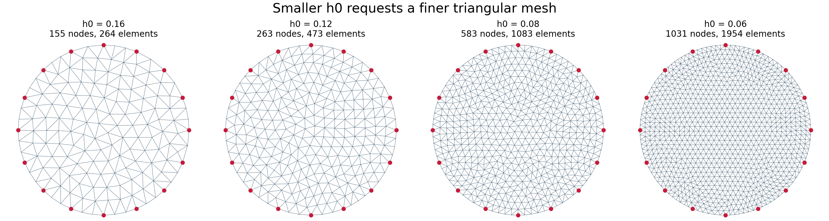
Where 583 Nodes and 1083 Elements Come From
h0 = 0.08
583 nodes
1083 elements
Requested characteristic triangle spacing in the unit-radius geometry.
Locations where the FEM solves electric potential u.
Triangles carrying piecewise conductivity values σ.
Counts are outputs of mesh.create(16, h0=0.08), not universal EIT constants. Smaller h0 increases computation and reduces discretization error.
24
Notes:
ENGLISH SCRIPT
The numbers 583 and 1083 are not chosen independently. I specify the circle, sixteen electrode locations, and h0 equals 0.08. The distmesh-style generator then returns a valid triangular mesh. Nodes hold potential unknowns; elements hold conductivity. A smaller h0 creates a finer mesh and more unknowns, but after a point it costs more computation without adding measurement information.
VIETNAMESE EXPLANATION
583 và 1083 là output của mesh generator. Input là geometry, 16 electrodes và h0 = 0.08. Node là nơi giải potential; element là tam giác giữ conductivity. Giảm h0 làm mesh mịn hơn, tăng số node/element và thời gian tính, nhưng không tạo thêm dữ liệu đo.

Slide 25
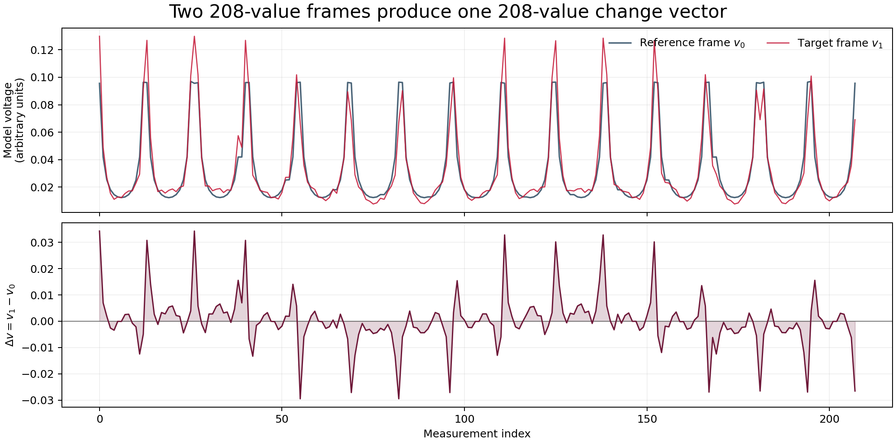
How to Interpret the Synthetic Voltage Chart
Top: v₀ and v₁
Each curve has 208 channels: 16 repeated drive groups × 13 sense values.
Why they nearly overlap
The target only perturbs the baseline field; Δv is smaller than the absolute model voltage.
Bottom: Δv
The algorithms use the full 208-value shape. Peaks mark drive/sense channels that are strongly affected.
Not hardware volts
The y-axis is ideal unit-current model output, not yet calibrated to CN0565 amplitude.
25
Notes:
ENGLISH SCRIPT
The x-axis is channel index, not time or physical position. Channels zero to twelve belong to the first drive, the next thirteen to the second drive, and so on. The top plot confirms that v1 is a small perturbation of v0. The lower plot isolates that perturbation. A peak means that a particular drive-sense geometry is sensitive to the target, not that the target is located at that x-axis index.
VIETNAMESE EXPLANATION
Trục x là index của 208 channels, không phải thời gian hay vị trí target. Mỗi block 13 channels thuộc một drive pair. Hai đường trên gần nhau vì target chỉ perturb baseline. Plot dưới là Δv dùng để reconstruct. Peak chỉ nói channel đó nhạy với target, không phải target nằm tại index đó.

Slide 26
Three Algorithms, One Shared Input
All three receive the same mesh, protocol, v₀, and v₁. None is told the target location.
BP — smear map
JAC — Jacobian map
GREIT — grid map
Paint each voltage change back into every region that could have produced it.
Fast baseline; broad and blurry.
Use the lookup table of how each triangle affects each channel, then solve backward with a stability penalty.
Detail versus noise trade-off.
Use one matrix to convert the 208-value pattern directly into a regular pixel image.
Smooth and fast at run time.
Compare location, sign, spread, separation, artifacts, and noise sensitivity - not only which image looks prettier.
26
Notes:
ENGLISH SCRIPT
This is a fair comparison because all input data are identical. BP is a direct smearing or backprojection. JAC explicitly uses the derivative of each channel with respect to each mesh element. GREIT precomputes a linear reconstruction matrix designed to produce a regular output image with useful performance characteristics.
VIETNAMESE EXPLANATION
So sánh công bằng vì input giống nhau. BP smear ngược signal. JAC dùng sensitivity của từng measurement đối với từng element. GREIT precompute một matrix từ 208 measurements sang pixel image. Không nên chỉ chọn ảnh đẹp nhất; phải đo position, spread, artifacts và noise.

Slide 27
JAC: Jacobian Sensitivity and Regularization
Jacobian J: “If element j changes slightly, how does measurement i change?”
Why regularization is necessary
1083 unknown element changes > 208 measurements. Multiple images can fit similar data, and noise makes direct inversion unstable.
One-step solution
Δσ̂ = (JᵀJ + λR)⁻¹ JᵀΔv
λ controls the trade-off
Small λ: more detail and noise. Large λ: more stable, but more blur and lower amplitude.
R and p define the prior
Kotre R weights elements by sensitivity. Current p=0.5 and λ=0.01 are starting values to sweep—not universal constants.
 | elem 1 | elem 2 | ... | elem 1083
meas 1 | J₁₁ | J₁₂ | ... | J₁,₁₀₈₃
meas 2 | J₂₁ | J₂₂ | ... | J₂,₁₀₈₃
... | ... | ... | ... | ...
meas 208 | J₂₀₈,₁ | J₂₀₈,₂ | ... | J₂₀₈,₁₀₈₃
Linearized forward model
Δv ≈ J Δσ + noise
Adler et al. (2007): λ trades resolution against noise attenuation; p=0.5 is a heuristic compromise between boundary and centre noise bias.
27
Notes:
ENGLISH SCRIPT
The Jacobian has 208 rows and 1083 columns in this model. Entry J-i-j predicts the change in voltage channel i for a small conductivity change in element j. Because there are more unknown elements than measurements, direct inversion is unstable. Regularization adds a prior penalty. Lambda must be tuned using noise and resolution tests; the paper supports the trade-off, not a universal lambda of 0.01.
VIETNAMESE EXPLANATION
J có 208 hàng và 1083 cột. J(i,j) cho biết measurement i nhạy thế nào với conductivity của element j. Vì unknown nhiều hơn measurements nên inverse problem không duy nhất và rất nhạy noise. Regularization thêm penalty để ổn định. Paper chứng minh trade-off của λ, nhưng không chứng minh λ=0.01 luôn đúng; phải sweep.

Slide 28
BP and GREIT: Two Different Linear Maps
Back Projection (BP)
Δσ̂ = −HBP Δv
HBP is a smear matrix: each measurement contributes to many sensitive nodes.
Current setting
weight='none', normalize=True
Expected behaviour
Very fast baseline, but diffuse sensitivity often creates broad or streaked targets.
GREIT in pyEIT
image pixels = RGREIT Δv
Each output pixel is a weighted sum of all 208 voltage changes: pixel k = Σᵢ Rₖᵢ Δvᵢ.
Current settings
n=32, s=20, ratio=0.1, p=0.5, λ=0.01
What they mean
n samples the output grid; s and ratio shape mesh-to-grid weighting. They change appearance, not the 208 independent data values.
GREIT paper: linear reconstruction can be a fast matrix multiplication and should be evaluated using amplitude, position, resolution, shape, ringing, and noise metrics.
28
Notes:
ENGLISH SCRIPT
Both methods are linear after their reconstruction matrix has been built. BP uses a direct smear map. GREIT uses a matrix that maps the measurement vector to a regular grid. In the original GREIT framework the matrix is optimized using forward, target, and noise models. The pyEIT implementation here is a sensitivity-based GREIT-style linear map. Increasing n only draws more pixels; it cannot create information that was not present in the 208 channels.
VIETNAMESE EXPLANATION
Sau khi setup, cả BP và GREIT đều là matrix multiplication. BP dùng smear matrix. GREIT map 208 values sang grid pixel. n=32 chỉ là sampling của output grid, không tăng resolution vật lý. s và ratio thay đổi spatial weighting/blur nên cũng phải sensitivity test.

Slide 29
How the Reconstruction Becomes a Heat Map
Δv
H or R
Δσ̂
Plot
Colour
208 × 1
change vector
precomputed
reconstruction matrix
node, element,
or grid values
place values on
mesh or 32×32 grid
red = positive
blue = negative
The heat map is an estimate, not a camera image.
The algorithm outputs numbers; plotting assigns positions and colours. Interpolation or separate normalization can change apparent smoothness and amplitude, so quantitative tests need consistent scaling.
29
Notes:
ENGLISH SCRIPT
The algorithm first returns numbers, not colours. BP returns node values, JAC returns element values which I interpolate to nodes for plotting, and GREIT returns a regular grid. The plotting code assigns red to positive conductivity change and blue to negative change. In the demonstration figure I normalize each algorithm independently, so I compare location and shape, not raw amplitude.
VIETNAMESE EXPLANATION
Thuật toán output số. BP output node values, JAC output element values rồi interpolate, GREIT output grid. Heatmap chỉ là cách đặt các số lên vị trí và tô màu. Nếu normalize từng ảnh riêng thì chỉ nên so sánh location, sign, spread, artifacts, không so raw amplitude.

Slide 30

Same Four Targets, Three Reconstructions
BP: broad / diffuse
JAC: sharper + artifacts
GREIT: smooth pixel grid
Noise = 0. Each reconstruction is normalized independently. This is a conceptual Figure 14 workflow, not a pixel-level reproduction of CN0565.
30
Notes:
ENGLISH SCRIPT
All three methods recover the four general locations and signs in this ideal noise-free example. BP spreads the targets broadly. JAC produces concentrated peaks but also mesh-related structure. GREIT is smoother because it maps to a regular grid with target weighting. This single case is not enough to declare a winner.
VIETNAMESE EXPLANATION
Cả ba tìm được vị trí và sign cơ bản khi noise = 0. BP blur rộng, JAC peak tập trung nhưng có artifact theo mesh, GREIT smooth trên regular grid. Một case duy nhất chưa đủ xếp hạng thuật toán.

Slide 31
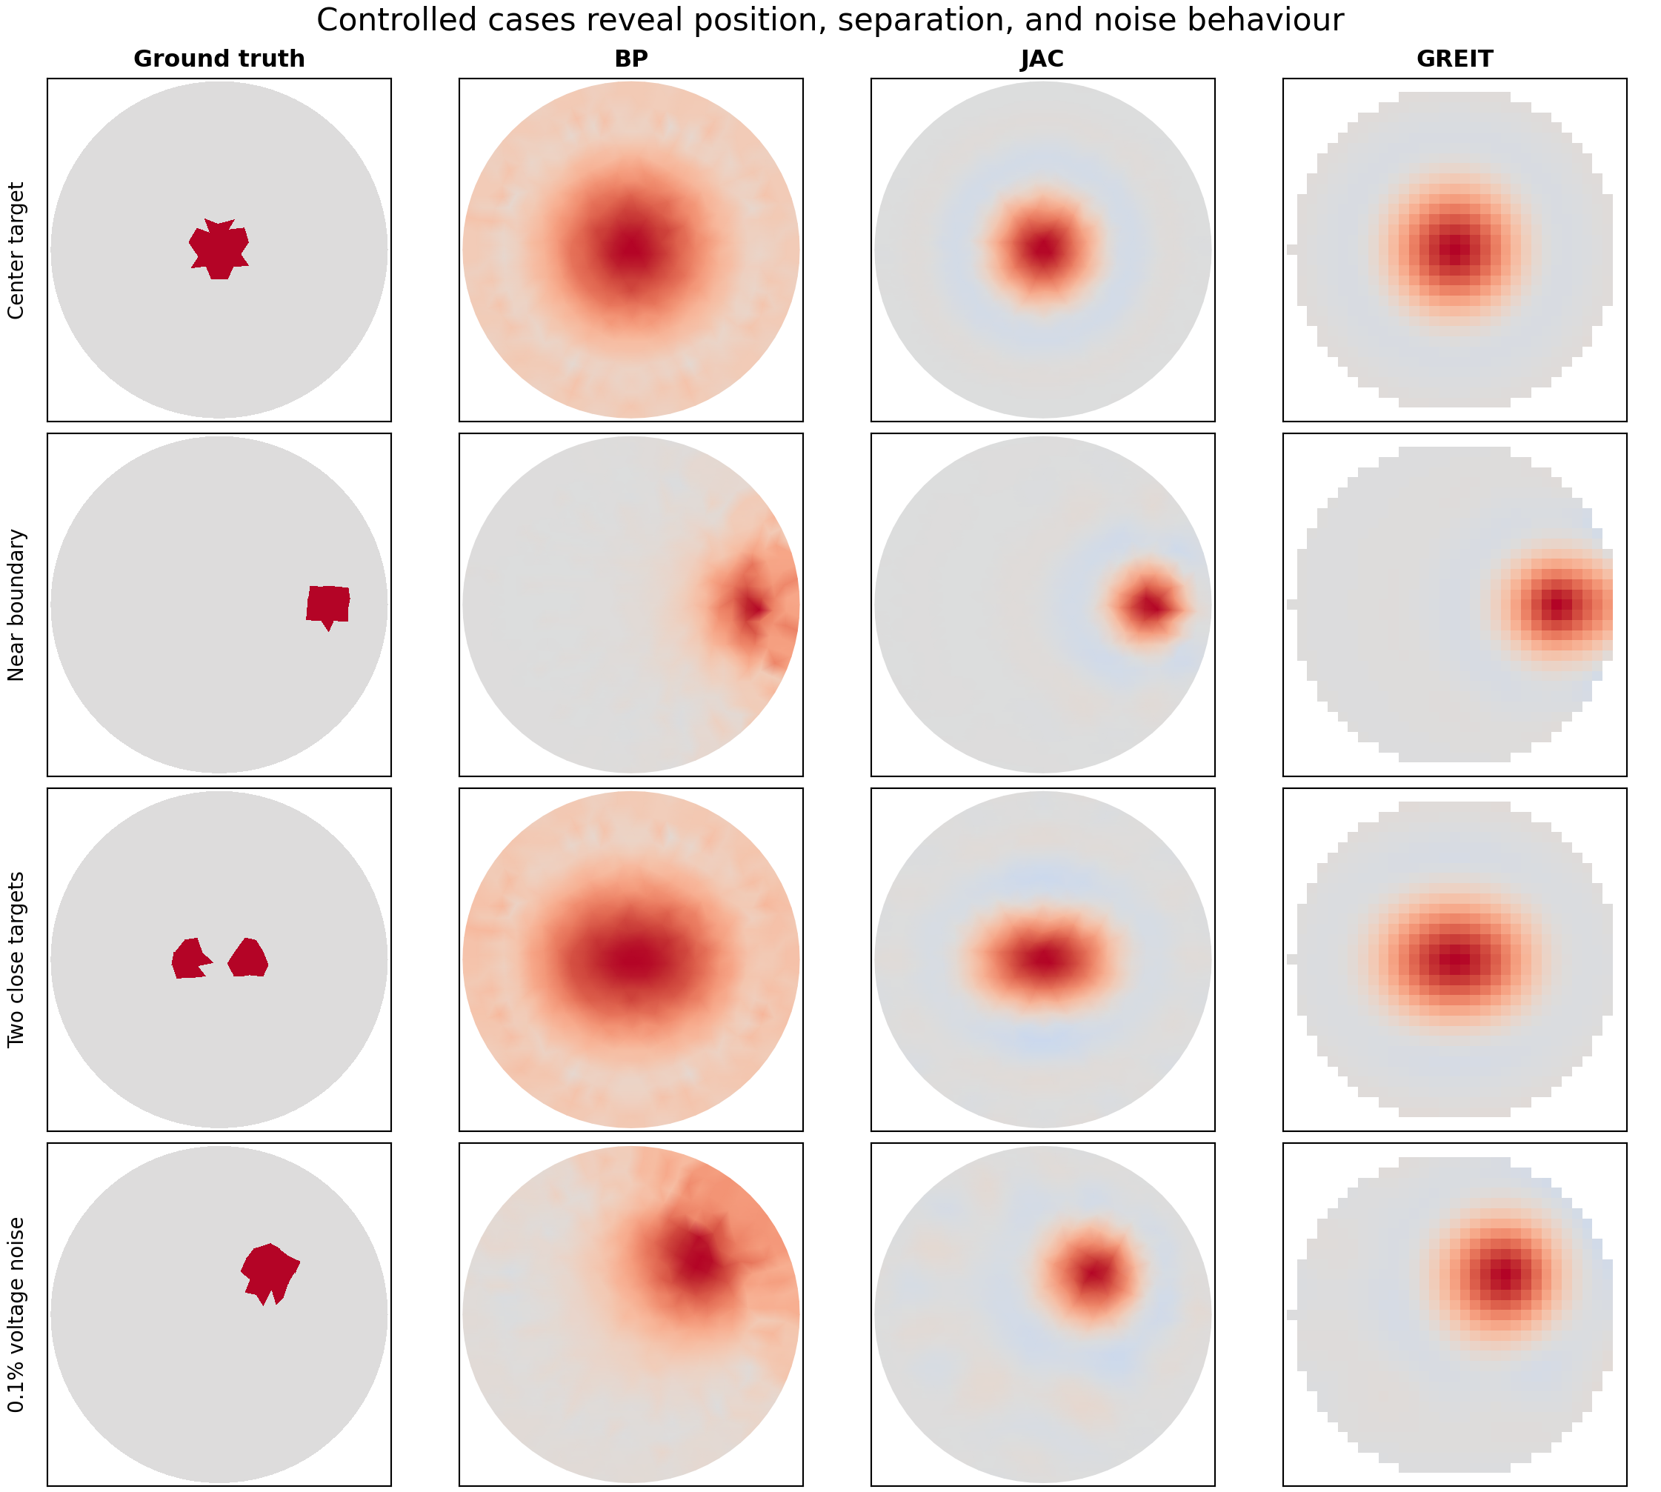
Additional Cases Reveal Different Failure Modes
What changes?
Center
Spread and symmetry
Near boundary
Position bias and distortion
Two close targets
Merge or remain separate?
0.1% noise
Artifacts and noise gain
31
Notes:
ENGLISH SCRIPT
The center case shows the point-spread shape. The boundary case exposes radial bias and edge distortion. The two-target case tests spatial resolution; in this setup the targets tend to merge. The noisy case tests stability. These rows already show why one visually attractive four-target image is not a complete comparison.
VIETNAMESE EXPLANATION
Center case đo point-spread. Boundary case lộ position bias và distortion. Two close targets kiểm tra resolution và thường bị merge. Noise case kiểm tra stability. Vì vậy cần nhiều case có kiểm soát, không thể kết luận từ một ảnh Figure 14.

Slide 32
A Fair Test Matrix for BP, JAC, and GREIT
Change one variable | Suggested values | Measure | Why it matters
Target position | r/R = 0, 0.3, 0.6, 0.8 | Position error | Sensitivity is weaker and less uniform toward the centre.
Target radius | 0.05R, 0.10R, 0.20R | Resolution / spread | Tests whether apparent size follows true size.
Conductivity ratio | 0.1×, 0.5×, 2×, 5×, 10× | Sign + amplitude response | Tests linear range and positive/negative contrast.
Voltage noise | 0, 0.01%, 0.1%, 0.5%, 1% | Noise figure / artifacts | Tests regularization and hardware tolerance.
Target separation | 0.1R to 0.6R | Two-peak separability | Tests ability to distinguish nearby objects.
Mesh / model mismatch | h0 and boundary shape | Robustness | Avoids testing only on the exact inverse model.
Algorithm parameters | λ, p, GREIT n/s/ratio | Metric curves | Shows why an algorithm behaves differently.
Rule: change one variable at a time; reuse the same v₀/v₁ for all algorithms; report metrics before choosing a winner.
32
Notes:
ENGLISH SCRIPT
The GREIT paper recommends performance measures such as amplitude response, position error, resolution, shape deformation, ringing, and noise amplification. I will use the same principle for all three algorithms. I should also avoid the inverse crime by eventually generating data on a different or finer mesh than the reconstruction mesh.
VIETNAMESE EXPLANATION
Test đúng là thay một variable mỗi lần, giữ nguyên data giữa ba thuật toán và đo metric. Có thể dùng position error, resolution/spread, amplitude response, shape deformation, ringing và noise amplification. Sau đó nên tránh inverse crime bằng forward mesh khác reconstruction mesh.

Slide 33
What the Papers Support - and What We Must Validate
Supported concept | Evidence | Current implementation choice
Boundary current + boundary voltage measurements | pyEIT paper, Fig. 2 and Section 2 | 16 electrodes; adjacent drive and adjacent sense
FEM forward model and Jacobian sensitivity | pyEIT paper; Adler 2007 | 2D unit circle; point-electrode model
Regularization trades resolution against noise | Adler 2007; GREIT 2009 | JAC: method='kotre', p=0.5, λ=0.01
Linear reconstruction matrices enable fast imaging | Adler 2007 and GREIT 2009 | BP/JAC/GREIT one-step difference imaging
GREIT should be evaluated by performance metrics | Adler 2009 | n=32, s=20, ratio=0.1 in pyEIT
Mesh density, target geometry, and exact contrasts | Not fixed by these papers or CN0565 Fig. 14 | h0=0.08; r=0.12R; selected positions and ratios
A paper can justify the model or trade-off. It usually does not prove one parameter value is universally optimal for this hardware and medium.
33
Notes:
ENGLISH SCRIPT
This slide separates evidence from configuration. The papers support the measurement model, FEM, Jacobian, regularization trade-off, linear reconstruction, and evaluation metrics. They do not establish that h0 equals 0.08 or lambda equals 0.01 is optimal for CN0565. Those values are hypotheses or starting settings that must be tested with parameter sweeps and physical data.
VIETNAMESE EXPLANATION
Cần phân biệt paper support concept với prove parameter. Paper support EIT model, FEM, Jacobian, regularization trade-off và metrics. Nhưng h0=0.08, λ=0.01, n=32 hay object r=0.12R là lựa chọn implement ban đầu, phải sweep và validate bằng hardware.

Slide 34
Next: Validate the CN0565 Measurement Chain
1. Electrical load
2. Homogeneous saline tank
3. Known inclusions
4. Human study
Known resistors / RC network
Check channel order, gain, repeatability
Stable conductive medium
Measure baseline, drift, and noise
Move conductive and resistive objects
Compare position and contrast
Only after safety, ethics, electrodes,
and performance are established
A Petri dish or saline tank is the correct next medium test—not yet a human test.
It exposes electrode, contact, switching, noise, amplitude, and model errors that simulation cannot test.
34
Notes:
ENGLISH SCRIPT
The saline tank is the bridge between simulation and human measurements. Begin with an electrical phantom or known load to verify the switching matrix and acquisition. Then use homogeneous saline to quantify baseline stability and noise. Finally insert known objects at controlled positions. Human testing comes only after safety, ethics, and repeatable performance are established.
VIETNAMESE EXPLANATION
Petri dish/saline tank là bước đúng trước human. Trước đó nên test electrical load để xác minh switching và gain. Saline homogeneous đo baseline/noise/drift. Sau đó đặt inclusion biết rõ vị trí và conductivity. Human chỉ sau safety, ethics và performance ổn định.

Slide 35
References
[1] B. Liu et al., “pyEIT: A Python Based Framework for Electrical Impedance Tomography,” SoftwareX 7 (2018), 304-308.
[2] A. Adler et al., “Temporal Image Reconstruction in Electrical Impedance Tomography,” Physiological Measurement 28 (2007), S1-S11.
[3] A. Adler et al., “GREIT: A Unified Approach to 2D Linear EIT Reconstruction of Lung Images,” Physiological Measurement 30 (2009), S35-S55.
[4] Analog Devices, “CN0565: Electrical Impedance Tomography Measurement System,” Rev. A, Figure 14.
[5] pyEIT 1.2.4 source used by scripts/eit_sim_playground.py for BP, JAC, GREIT, protocol, FEM, and mesh configuration.
35
Notes:
ENGLISH SCRIPT
The first three papers are available in the repository's papers folder. The CN0565 circuit note motivates the four-target example, but it does not publish enough simulation detail for a pixel-level reproduction. The exact solver parameter meanings are also checked against the pyEIT implementation used by the script.
VIETNAMESE EXPLANATION
Ba paper đầu nằm trong folder papers. CN0565 Figure 14 là nguồn cảm hứng cho four-target case nhưng không công bố đủ parameter để reproduce pixel-by-pixel. Ý nghĩa parameter cụ thể được đối chiếu thêm với source code pyEIT đang dùng.

Slide 36
Thank you

