Slide 1
WEEKLY REPORT
POST STROKE REHABILITATION SYSTEM
WEEK 6 – September 27th 2026

Slide 2
Agenda
Quick Update
Literature Review Paper
Active Sensing

Slide 3
1. Quick Update
Review paper summary
Pipeline for measurement

Slide 4
2. Literature Review Paper – Background
Spreadsheet to keep track with papers

Slide 5
2. Literature Review Paper – Progress
Sheet | Unit of record | Question answered
Individual Studies | One study-level claim | What was measured, how, in whom, and for which tested endpoint?
Existing Reviews | One prior review | What literature has already been synthesized, with which scope and method?
Paper Tracker | One PDF/file | How many papers?

Slide 6
2. Literature Review Paper – Progress
Individual Studies contains seven linked evidence groups
Group | Primary purpose | Downstream use
Record and Provenance | Connects every extracted claim to the PDF, bibliography, and tracker. | Audit and deduplication
Eligibility and Author Intent | Defines what the paper is, why it is relevant, and the exact claim being audited. | Eligibility and claim audit
Population and Clinical Context | Defines who the result applies to and which transfer claims remain defensible. | Transferability matrix
Speech Task and Sensing Setup | Specifies the speech question and the exact acquisition conditions that shape the signal. | Coverage and deployment matrices
Measurement and Computation | Traces the signal from physical quantity through instrument output and computational inference. | Measurand and processing comparison
Results and Evidence Quality | Records what the study actually tested, what it found, and how stable that evidence is. | Evidence maturity and result synthesis
Translation and Critical Synthesis | Converts extracted facts into bounded claims and tests whether clinical promises match the evidence. | T1-T5 and gap verification

Slide 7
2. Literature Review Paper – Progress
Existing Reviews contains four comparison groups
Group | Primary purpose | Downstream use
Review Identification | Identifies the review and separates bibliographic identity from review methodology. | Deduplication and recency
Review Method | Shows how reproducibly each review found and selected evidence. | Transparency and update window
Review Scope | Maps what each review actually covered across population, subsystem, technology, and use. | Overlap matrix
Review Positioning | Separates the authors' synthesis from our comparison and novelty argument. | Competitor classification and novelty

Slide 8
2. Literature Review Paper – Progress
Existing Reviews contains four comparison groups
What each group contributes
0 Direct competitor
Would test the whole-review novelty claim. None identified in this 35-review set.
12 Narrow direct predecessors
Dysarthria and sensing are central, but the review is restricted by modality, subsystem, etiology, or use.
6 Structural analogs
Use a similar measurement-to-application logic, but in a different population or narrower technical scope.
16 Adjacent topical reviews
Overlap in one topic only; useful for a section, not for defining the whole review.
1 Foundational source
Supplies terminology.

Slide 9
2. Literature Review Paper – Progress
Subsystem | Acoustic/ Audio sensing | Aerodynamic/ pressure measurement | EGG/Electroglottography | Respiration motion sensing | EPG/ Electropalatography | UTI/ Ultrasound Tongue Imaging | EMA/kin. Electromagnetic articulography/ kinematic tracking | sEMG
Respiration | 15 | 5 | 1 | 3 | 0 | 0 | 0 | 0
Phonation | 32 | 4 | 5 | 2 | 2 | 0 | 1 | 5
Resonance | 14 | 5 | 1 | 0 | 0 | 0 | 0 | 0
Articulation | 45 | 1 | 0 | 0 | 11 | 5 | 20 | 10
 | 17 | 1 | 1 | 0 | 0 | 0 | 3 | 0
Prosody
Values reflect the corpus as of Week 6 (Sep 27). See the growth-comparison slides below for the Week 5 -> Week 6 change.

Slide 10
2. Literature Review Paper – Progress
Population | Acoustic/ Audio sensing | Aerodynamic/ pressure measurement | EGG/Electroglottography | Respiration motion sensing | EPG/ Electropalatography | UTI/ Ultrasound Tongue Imaging | EMA/kin. Electromagnetic articulography/ kinematic tracking | sEMG
Parkinson disease | 32 | 7 | 4 | 2 | 3 | 1 | 10 | 2
ALS/MND | 18 | 2 | 1 | 0 | 0 | 3 | 8 | 0
Stroke | 16 | 0 | 2 | 0 | 5 | 1 | 1 | 3
Multiple sclerosis | 4 | 0 | 0 | 0 | 0 | 0 | 2 | 0
Ataxia/cerebellar | 9 | 0 | 0 | 0 | 1 | 1 | 2 | 1
TBI/concussion | 1 | 0 | 0 | 0 | 0 | 0 | 2 | 0
Other neurologic | N/A* | N/A* | N/A* | N/A* | N/A* | N/A* | N/A* | N/A*
No dysarthria cohort | N/A* | N/A* | N/A* | N/A* | N/A* | N/A* | N/A* | N/A*
* N/A rows: population mapping not yet resolved. All other cells = Week 6 (Sep 27).

Slide 11
2. Literature Review Paper – Progress
Corpus growth this week: Individual Studies vs. Existing Reviews
Reconstructed Week 5 totals from dated extraction-status stamps in the Paper Tracker (cross-checked against Week 5’s own Existing Reviews count of 35 - exact match).
Individual Studies more than doubled (+151%, +74 papers); Existing Reviews grew only slightly (+2). This week’s effort was almost entirely primary-study intake.

Slide 12
2. Literature Review Paper – Progress
Subsystem coverage growth (tag-instances, multi-label)
Each paper can be tagged with more than one subsystem, so these are tag-instance sums, not paper counts - the same basis as the Subsystem × Modality table.
Articulation grew fastest (+124%) and now accounts for nearly half of all tagged evidence; Prosody grew slowest (+22%) and is falling behind in relative share.

Slide 13
2. Literature Review Paper – Progress
Sensing modality growth (tag-instances, the 8 tracked modalities)
Same 8 modality columns as the Subsystem × Modality and Population × Modality tables.
EPG (+225%), UTI and EMA/kinematic grew fastest in relative terms - all Articulation-linked, matching this week’s intake pattern.
12 more modality categories are now substantial but not yet columns here: Nasometry (11), Accelerometer (7), Smartphone app (6), No sensing device (5), Video/optical mocap (5), MRI static (4), IMU (3), Fiberscopy (3), Wearable piezo (3), EEG (2), Multimodal fusion (2), NMES (1).

Slide 14
2. Literature Review Paper – Progress
Population coverage growth (tag-instances, 6 of 8 rows - see note)
“Other neurologic” and “No dysarthria cohort” are excluded here (marked N/A* in the table above) - their category definitions are not stable enough this pass to compare with confidence.
Stroke grew fastest by far (4→28, +600%). TBI/concussion appears to shrink (5→3) - a schema split, not lost data (see note below).
TBI/concussion note: concussion cases in otherwise-healthy participants without confirmed dysarthria are now filed under "Non-dysarthria clinical population" instead of this row, per the current classification rules.

Slide 15
2. Literature Review Paper – Progress
Existing Reviews update, and corpus quality under growth
Metric | Week 5 | Week 6
Existing Reviews (total) | 35 | 37
Confirmed "direct competitor" reviews | 0 | 0
The Week 5 positioning breakdown (Foundational 1 / Adjacent 16 / Structural 6 / Narrow 12 / Direct 0) is not recomputed this week: the source column now uses granular free-text labels instead of those 5 buckets, so a clean re-bucketing needs your call before that chart (slide 8) can be safely updated.
Data quality (current, full 123-paper corpus):
Verified clean | Minor issue | Moderate issue | Critical issue
89 / 123 | 12 | 21 | 1
All 123 papers were individually re-checked; flagged issues are already logged and corrected - rapid growth this week did not cost extraction quality.

Slide 16
2. Literature Review Paper – Progress
Conclusions: what changed between Week 5 and Week 6
• Corpus growth is intake-driven, not review-driven. Individual Studies +151% (49→123) vs. Existing Reviews +5.7% (35→37): this week added primary evidence, not new comparison literature.
• Articulation is pulling ahead of the other subsystems. Articulation tag-instances +124% (41→92, now ~44% of all tagged evidence); Prosody lags at +22% (18→22) despite the corpus nearly doubling overall.
• Stroke is now the fastest-growing mapped population. Stroke tag-instances 4→28 (+600%), ahead of Ataxia/cerebellar (+250%) and ALS/MND (+100%); Parkinson’s disease remains the largest population in absolute terms (61).
• Two apparent drops are reclassifications, not lost data. EPG×Prosody (1→0) reflects an automatic-vs-manual tagging disagreement; TBI/concussion (5→3) reflects healthy-participant concussion cases moving to a separate non-dysarthria category.
• The novelty argument still holds. Even after +2 Existing Reviews, 0 have been classified as a true direct competitor to this thesis.
• The 8-column modality schema is starting to lag the data. 12 modality categories (Nasometry, Accelerometer, Smartphone app, MRI, etc.) are now substantial enough to deserve their own columns next update.

Slide 17
2. Literature Review Paper – Future
1. Population eligibility
Some studies use sensing modalities in Parkinson’s disease, ALS, stroke, or other neurological populations, but they do not explicitly confirm that the participants have dysarthria. Should these studies be excluded from the core dysarthria evidence?
2. Sensor-to-subsystem evidence
Some technologies measure a physical variable related to a speech subsystem, but they were tested only in healthy participants or neurological populations without confirmed dysarthria. Can we use these studies only to discuss technical feasibility

Slide 18
3. Active Sensing – Simulation Study
Controlled comparison of BP, JAC, and GREIT
Notes:
I will now focus on the computational model used to compare three EIT reconstruction methods: BP, JAC, and GREIT.
The goal is to understand the software behavior before introducing hardware variability.

Slide 19

Simulation Rationale
How do BP, JAC, and GREIT reconstruct the same known conductivity change?
Known conductivity map
›
Forward simulation
›
208 voltage changes
›
BP, JAC, GREIT
Ground truth
Synthetic measurement
Shared input
Three estimates
The simulation provides an answer key. Each algorithm receives the same data, so differences in the images come from the reconstruction method and its settings.
Notes:
Simulation gives me a known answer. I define the internal conductivity map, generate synthetic boundary data with a forward model, and ask three algorithms to reconstruct the hidden change.
All three methods receive exactly the same input. This isolates the effect of the reconstruction method and its parameters.

Slide 20

Known Conductivity Map
Model definition
2D circular domain
16 boundary electrodes
Background σrel = 1
Target radius = 0.12R
Target ratios: 0.1×, 10×, 5×, 0.1×
The value 1 is a normalized reference. It does not identify the physical material or imply 1 S/m.
Notes:
The domain is a two-dimensional unit circle with sixteen boundary electrodes. The background conductivity is normalized to one.
The four circular targets are defined by position, radius, and conductivity ratio. A value of ten means ten times the background conductivity. A value of 0.1 means one tenth.
This is a conceptual reproduction of the four-target CN0565 Figure 14 workflow. The circuit note does not publish the exact simulation parameters, so I do not claim a pixel-level reproduction.
Source: Analog Devices, CN0565 Rev. A, Figure 14.

Slide 21
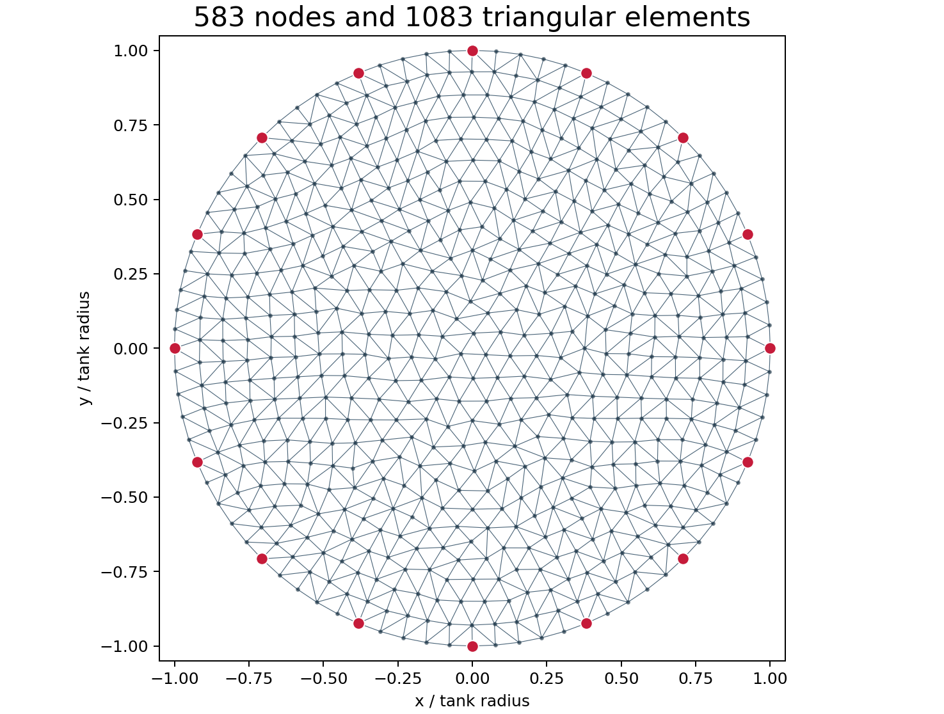

Finite-Element Representation
583 nodes
Calculation points for electric potential
1083 elements
Triangular regions that store conductivity
16 electrodes
Boundary locations for the measurement protocol
h0 = 0.08 controls the approximate triangle size. The mesher determines the final node and element counts.
Notes:
The computer represents the continuous domain with a finite triangular mesh. This mesh contains 583 nodes and 1083 elements.
Nodes are calculation points for electric potential. Each triangular element stores one conductivity value. The sixteen red boundary points represent the electrodes.
These counts describe the computational model. They are not measurement counts. The mesh generator obtains them from h0 equals 0.08.

Slide 22
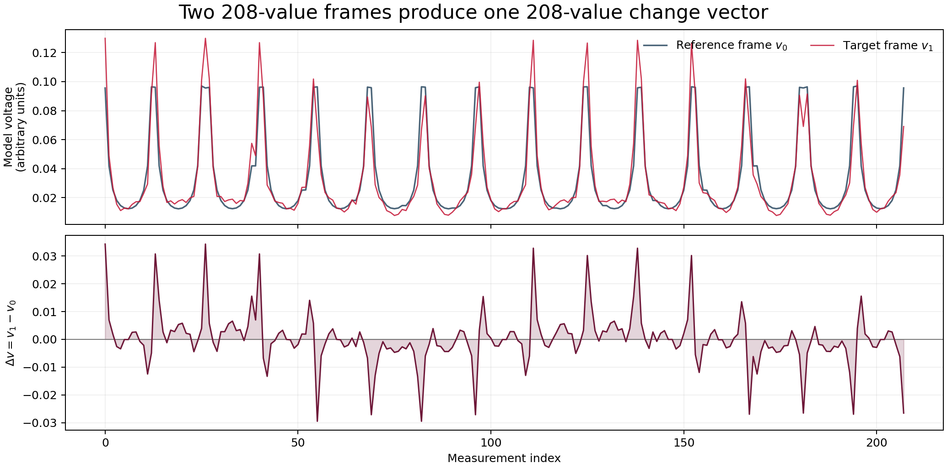
Synthetic Boundary-Voltage Data
v₀
Reference frame
v₁
Target frame
Δv = v₁ − v₀
16 drive pairs × 13 sense pairs = 208 voltage differences per frame
Forward-model data only: ideal 2D geometry, point electrodes, normalized current, and zero added noise
Notes:
The forward solver acts as a virtual measurement system. It calculates a reference frame v0 for the homogeneous background and a target frame v1 after adding the four anomalies.
Each frame contains 208 voltage differences. The count comes from sixteen adjacent drive pairs and thirteen valid sensing pairs per drive.
The reconstruction input is the change vector v1 minus v0. No CN0565 hardware data are used at this stage.

Slide 23
Same Data, Three Reconstruction Methods
Algorithm | Core idea | Output space | What to look for
BP | Direct back-projection of voltage changes | Mesh nodes | Fast, broad response
JAC | Jacobian sensitivity with regularization | Mesh elements | Detail versus stability
GREIT | Sensitivity-based linear map to a regular grid | 32 × 32 grid | Smooth, standardized output
Shared input: the same mesh, electrode protocol, v₀, and v₁. The algorithms do not receive the ground-truth target locations.
Notes:
BP directly back-projects voltage changes into the domain and provides a fast baseline result.
JAC uses the Jacobian sensitivity matrix with regularization. Its settings control the balance between spatial detail and stability.
The pyEIT GREIT implementation applies a sensitivity-based linear reconstruction matrix and maps the result to a regular output grid.
The grid size changes the displayed sampling. It does not add new measurement information.
Sources: Liu et al., SoftwareX 2018; Adler et al., Physiological Measurement 2009; pyEIT 1.2.4 implementation.

Slide 24

Reconstruction of the Same Simulated Object
BP: broad, diffuse regions
JAC: concentrated peaks with mesh-related artifacts
GREIT: smooth output on a regular pixel grid
Noise = 0. These observations describe this parameter set and do not establish a universal ranking.
Notes:
This figure uses the same ground truth and the same two voltage frames for all three reconstruction methods.
Red indicates a positive conductivity change and blue indicates a negative change. All three methods recover the four general target locations and their signs in this noise-free test.
BP is broad and diffuse. JAC produces concentrated peaks but also shows mesh-related artifacts. GREIT gives a smooth image on a regular grid.
Each reconstructed output is normalized independently here. I compare location, sign, spatial spread, and artifacts rather than raw amplitude.
Figure generated from scripts/eit_sim_playground.py.

Slide 25
Controlled Comparison Plan
Test | Question answered
Position | Does localization change from the center to the boundary?
Size | Does reconstructed target size follow the simulated radius?
Contrast | Does the output remain linear as the conductivity ratio changes?
Noise | Which method amplifies measurement noise?
Separation | Can the method distinguish two nearby targets?
Change one variable at a time while keeping the mesh, protocol, and algorithm settings fixed.
Notes:
A visual comparison is only the first step. I will change one simulation variable at a time and keep all other settings fixed.
The planned tests examine target position, target size, conductivity contrast, measurement noise, and the separation between two targets.
The comparison will use localization error, spatial spread, sign recovery, artifacts, and noise sensitivity.

Slide 26
Scope of the Simulation
The simulation evaluates | It does not yet evaluate
The reconstruction pipeline | CN0565 measurement accuracy
Algorithm behavior | Electrode contact and cable noise
Controlled target changes | Mismatch in a physical medium
Response to synthetic noise | Human-subject performance
Comparison with known ground truth | Clinical validity
Next validation sequence: electrical load, homogeneous saline tank, then known inclusions at controlled locations
Notes:
The simulation verifies the computational workflow and supports a controlled algorithm comparison.
It does not validate the CN0565 hardware because the forward model generated the voltage data.
The hardware validation sequence should begin with an electrical load, continue with a homogeneous saline tank, and then use known inclusions at controlled locations.

Slide 27
References
[1] B. Liu et al., "pyEIT: A Python Based Framework for Electrical Impedance Tomography," SoftwareX 7 (2018), 304–308.
[2] Analog Devices, "CN0565: Electrical Impedance Tomography Measurement System," Rev. A, 2024.
[3] A. Adler et al., "GREIT: A Unified Approach to 2D Linear EIT Reconstruction of Lung Images," Physiological Measurement 30 (2009), S35–S55.

Slide 28
Thank you

