Slide 1
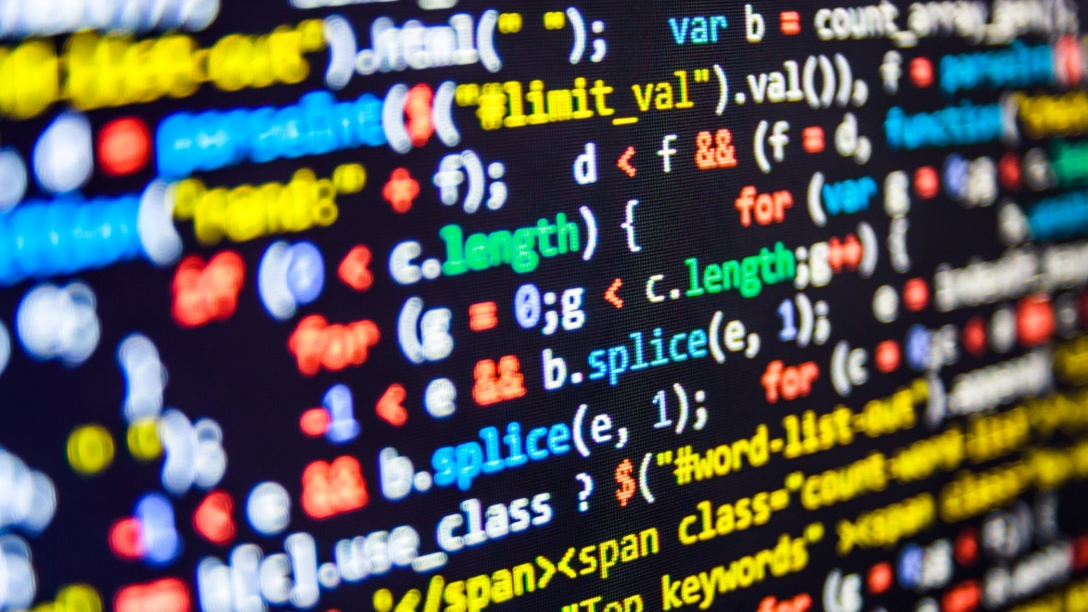

dvcoders
Week 8: Introduction to Node.js
Web Application Project
Nov 8

Slide 2
What is a server?
Servers send data to clients, usually webpages or RSS feed
After you enter a website URL, a server returns the webpage

Slide 3
What is Node.js?
A platform allowing you to write server-side code in JavaScript
Has a large collection of community made packages
Each package adds special functionality

Slide 4
Installing Node.js and npm
Node.js is the engine that allows your code to run
Node Package Manager for community modules
Navigate to npmjs.com
Scroll down to install both Node.js and npm
Install
Open Terminal on MacOS, Command Prompt on Windows
Type in the following. If a number pops up, you’re done!
node -v

Slide 5
Creating a Node.js project
Navigate to the folder you want your project to be in
In command line, change directory to the same folder with:
Then type in and press enter through setup for defaults
cd
cd <project_path>
npm init

Slide 6
Creating index.js
Create a new file called index.js
Type in the following and save
In command prompt, type in:
If it prints out Hello world!, you’re set!
console.log(‘Hello world!’);
node index

Slide 7
dvcoders
Week 8: Introduction to Node.js
Web Application Project
Nov 8

