Slide 1
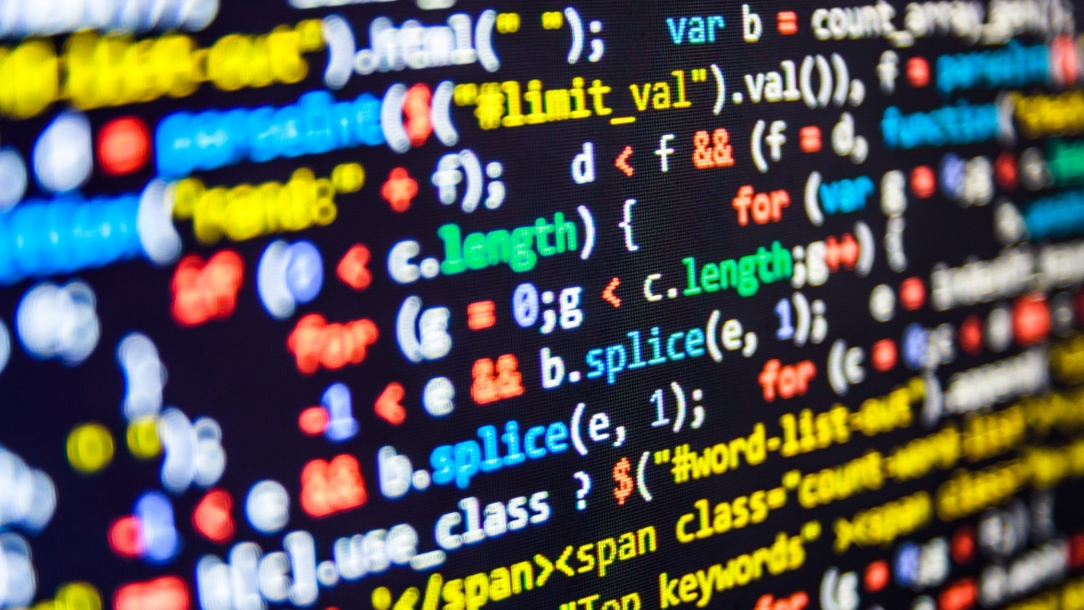

dvcoders
Week 8: Express
Web Application Project
Nov 22

Slide 2
Modules
Prewritten code you can import into your project
Adds functionality for your server
Similar to including libraries in C++
Express
Module which allows you to quickly set up a server
Widely used in industry

Slide 3
Installing Express
In command line, cd to your Node.js project directory
Run the following:
Downloads the Express package
The --save option lists Express as a dependency in package.json
If someone downloads your program and runs npm install, Express will be installed too
Open up package.json to check Express is there
npm install express --save

Slide 4
Running the server!
In the interest of time, we’ll download an example
Navigate to github.com/dvcoders/17fa-nodejs-project
Press Clone or Download > Download ZIP
Extract that folder
Navigate to that folder in command line
Run npm install
Run node app
Navigate to localhost:3000
Should show a page from our website project

Slide 5
dvcoders
Week 8: Express
Web Application Project
Nov 22

