Slide 1

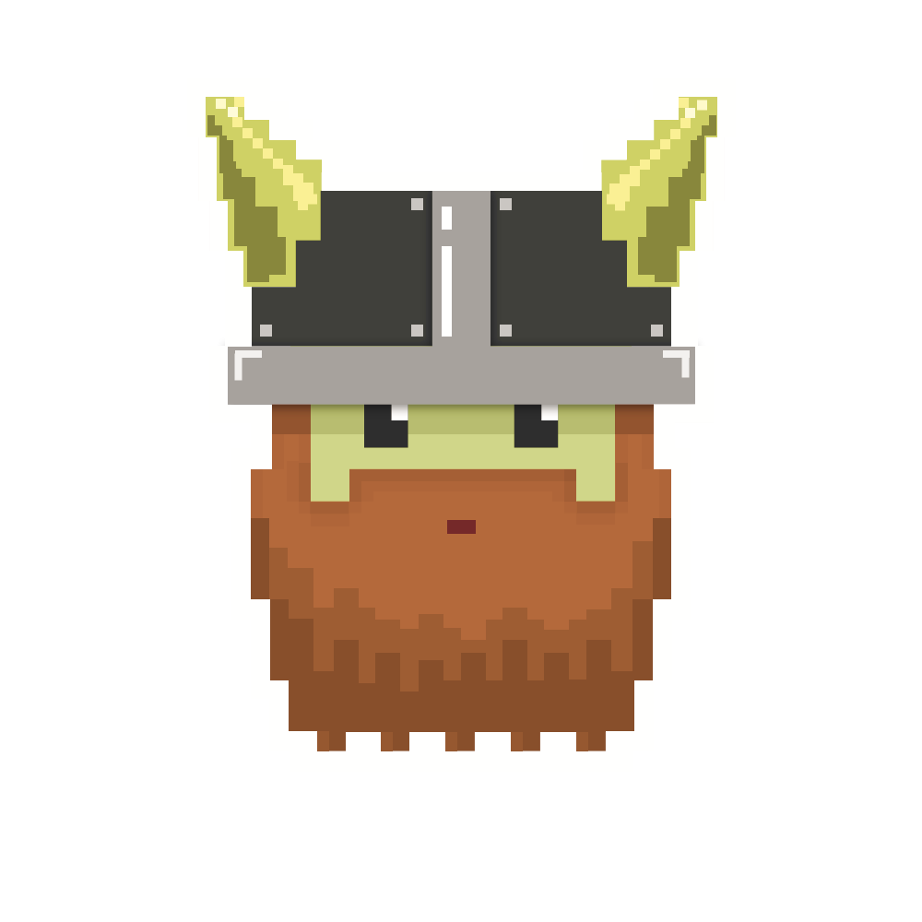
dvcoders
Week 6: Weapon
Phaser.io Video Game Project
Nov 1

Slide 2
Review
Movement using acceleration
Max speed
Friction

Slide 3
Weapon
Need to make bullet(s)
Teleport them to player
Move them until it collides

Slide 4
Weapon
gun = game.add.weapon(numberOfBullets, ‘image’);
Very similar to sprite creation
Notes:
Use if button pressed

Slide 5
Bullet attributes
How many bullets?
How fast?
At what rate?
How accurate?

Slide 6
Weapon attributes
1. gun.bulletKillType
(Phaser.Weapon.KILL_WORLD_BOUNDS)
2. gun.bulletSpeed
3. gun.fireRate
There are other attributes too!
Notes:
Pseudo code

Slide 7
So, how do I shoot this thing?
gun.fire();
But shoot from where?
Notes:
Pseudo code

Slide 8
Friction
gun.trackSprite(sprite, offsetX, offsetY);
gun.fireAngle = angle;
Detail explanation in drawings
(or notes below in ppt)
Notes:
Track sprite will make gun to automatically shoot from sprite object. But that will shoot from center of your character, not from the gun.
Adding offset can make small changes of where the bullet will fire from.
Fire angle will decide where the bullet will travel. This angle is in radian so keep that in mind.
If not sure, look up unit circle and its angles in radian.

Slide 9
Left or Right?
Q: How does “gun” know
whether player is facing left or right?
A: It doesn’t

Slide 10
Width
You can set sprite’s width to negative value
It will flip its image

Slide 11
dvcoders
Week 6: Weapon
Phaser.io Video Game Project
Nov 1

