Slide 1

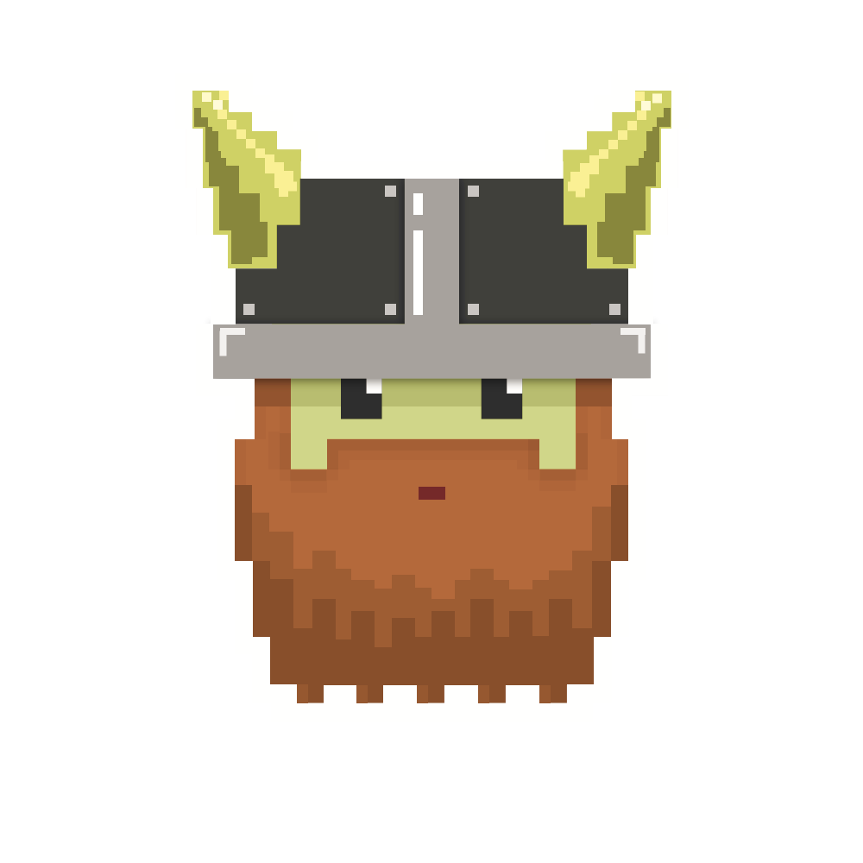
dvcoders
Week 9: Game Logic
Phaser.io Video Game Project
Nov 29

Slide 2
Yay!
We are basically done
Let’s polish this with minor part implementation

Slide 3
Display text
Use image file for text
-> looks nicer but harder
Use default text
-> easier to implement

Slide 4
Text
textVar = game.add.text(x, y, “”, { font: "30px Arial", fill: "#ff0044", align: "center" } );
You can also change fonts!
[“”] is where initial text goes in.
I set it to [nothing]. You can give it an initial text.

Slide 5
Deobjectify
player.kill();
enemies.killAll();
kill() : sprite (single object)
killAll(): group (many object)

Slide 6
Challenge
Challenge in github’s code

Slide 7
dvcoders
Week 9: Game Logic
Phaser.io Video Game Project
Nov 29

