Slide 1
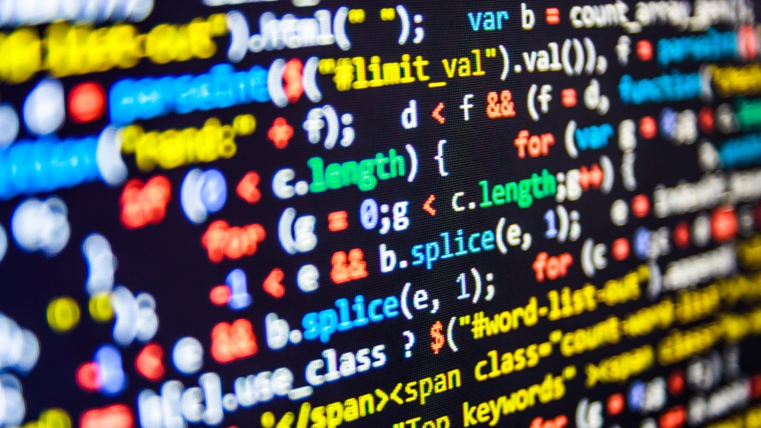

dvcoders
Week 7: Introduction to Bootstrap
Website Project
Nov 1

Slide 2
What is Bootstrap?
From getbootstrap.com:
Build responsive, mobile-first projects on the web with the world's most popular front-end component library.
“Responsive” means webpages adapt to screen size
The “front-end” is what the user sees
Library that quickly styles pages and adapts them to screen size
Extremely popular in industry

Slide 3
Installing Bootstrap
<link rel = "stylesheet"
href = "...bootstrap.min.css">
<link rel = "stylesheet"
href = "...bootstrap-theme.min.css">
<script src = "...bootstrap.min.js"></script>
Two new <link> and one new <script> elements in <head>
Recall that href and src elements can be downloaded too
This downloads CSS files Bootstrap already made
And a JavaScript file implementing them

Slide 4
Bootstrap’s table system
<div class = "container">
<div class = "row">
<div class = "col-md-6">Column 1</div>
<div class = "col-md-6">Column 2</div>
</div>
</div>
Implement table system with .container
Contain each .col inside a .row
Specify .col size with –md-6

Slide 5
Bootstrap’s table system
Each .row contains 12 columns
Specify how many of the 12 columns a <div> takes up
.col-md-6
.col-md-6
.col-md-4
.col-md-4
.col-md-4
.col-md-9
.col-md-3

Slide 6
.jumbotron
<div class = "jumbotron">
<div class = "row">
<div class = "col-md-12">
<!-- Text in background -->
</div>
</div>
</div>
Use .jumbotron class to a <div> for a gray background
Mainly used for page titles

Slide 7
.display-3
<h1 class = "display-3">Title</h2>
Use .display-3 for a very large font size
Usually used as the page title

Slide 8
dvcoders
Week 7: Introduction to Bootstrap
Website Project
Nov 1

