Slide 1
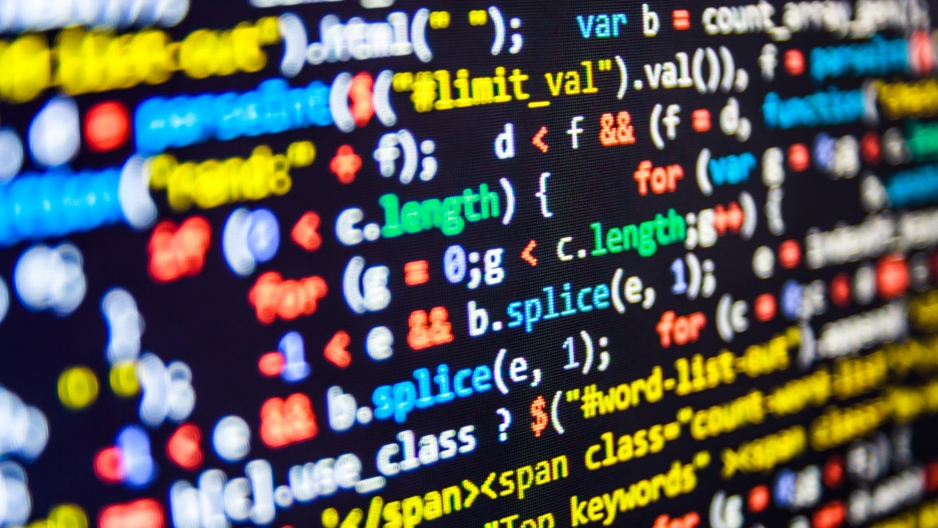

dvcoders
Week 1: Introduction to HTML
Website Project
Sep 20

Slide 2
What is a webpage?
A collection of text, images, videos and other media.
Think of it as a Word document

Slide 3
Webpage body
Everything that appears on the page
Think of it as everything you put in the Word document

Slide 4
<!DOCTYPE html> <!– Say this is HTML -->
<html> <!-- Wrap code with this tag -->
<body> <!-- What shows up on page -->
<p>Hello world!</p> <!–- Show this -->
</body> <!-- Close the body tag -->
</html> <!-- Do the same for the html tag -->

Slide 5
Tags
<p></p> <!-- Regular body text -->
<h1></h1> <!-- Header (large text) -->
<!-- h2, h3, ... h6, decreasing in size -->
Text goes in between the ><
Remember to close each one!

Slide 6
Webpage head
Data about the page
Nothing in here appears in the page
Think of it like a Word document’s file name and file type

Slide 7
<!DOCTYPE html>
<html>
<head> <!-- Data about webpage -->
<title>My Webpage</title>
</head> <!-- Close head tag -->
<body>
...

Slide 8
dvcoders
Week 1: Introduction to HTML
Website Project
Sep 20

