Slide 1
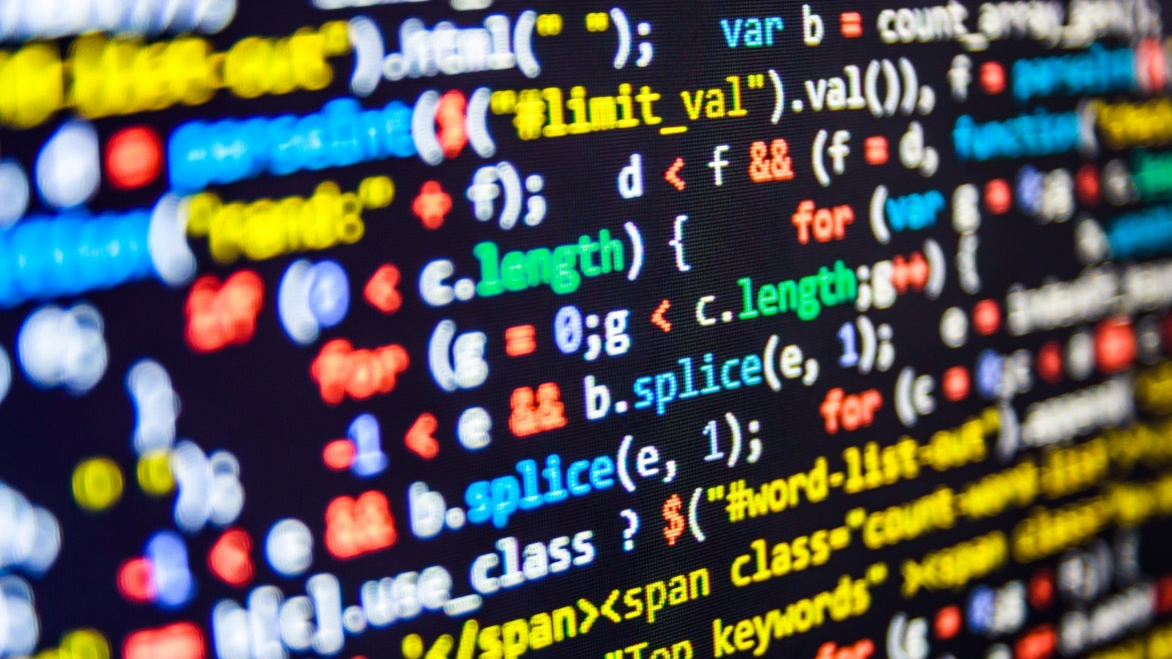
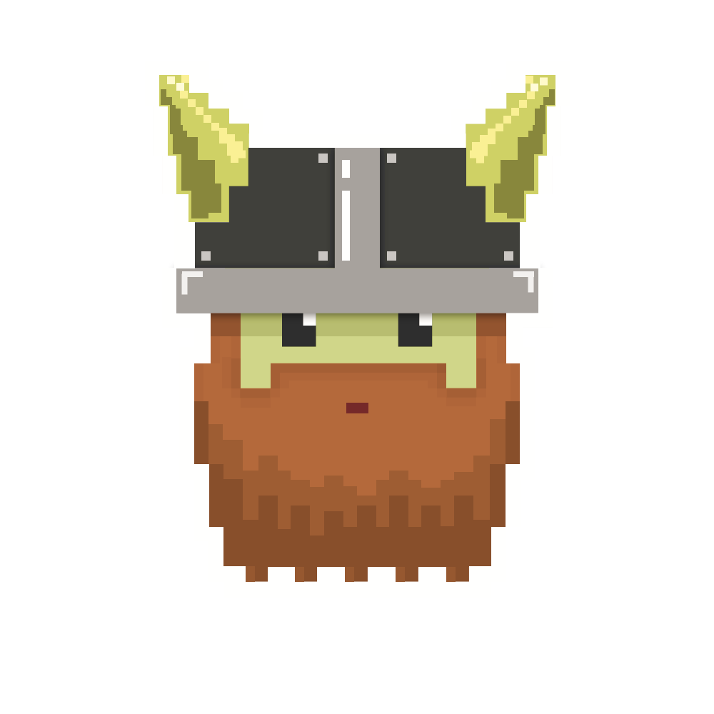
dvcoders
Week 4: Workshop Session
Website Project
Oct 10

Slide 2
Catch up guide
Navigate to github.com/dvcoders
Click on 17fa-video-game-project
Click the green Clone or download button
Click the Download ZIP button
Most recent code is in the 3.physics folder
Repeat for 17fa-website-project

Slide 3
Review of CSS properties
background: #FFFFFF;
color: #665;
font-family: Arial, sans-serif;
font-size: 16px;
margin: 0;
padding-left: 50px;
padding-right: 50px;
Navigate to w3schools.com/css for more!

Slide 4
Challenges!
Disable links in the navigation bar if user is already on the page (originally from week 3).
Navigate to color.adobe.com, pick a color scheme (or create your own!) and implement those colors into your website.
Recreate en.m.wikipedia.org/wiki/Hackathon from scratch. Try to replicate the colors and styling. Hint: Press F12 when on the page to bring up the Developer Tools.

Slide 5
dvcoders
Week 4: Workshop Session
Website Project
Oct 10

