Slide 1


dvcoders
Week 10: Night Mode Script
Website Project
Nov 22

Slide 2
Webpage scripting
<script
type = ”text/javascript”
src = “main.js”
</script>
Attaching functionality to your webpage
Need to link a JavaScript file to your webpage
The <script> tag should be at the end of the <body>
Need to wait before whole page loads to run the script

Slide 3
Testing your JavaScript file
Create a new main.js file in the same folder as your HTML
Test it is working by typing in:
Open up your webpage
Right click on your webpage, click Inspect Element
Or press F12
In the Console tab, you should see Hello world! printed
console.log(”Hello world!”);

Slide 4
Accessing document elements
Use one of the following:
document.getElementsById(”idName”);
document.getElementsByClassName(”className”);
document.getElementsByTagName(”tagName”);
Getting elements by class or tag returns array of all matches
Can save reference to element with following:
var myElem = document.getElementsById("myId");

Slide 5
Modifying element text and CSS
Change text with .innerText
Change CSS with .style.backgroundColor
myElem.innerText = "Hello World!";
myElem.style.backgroundColor = "Red";

Slide 6
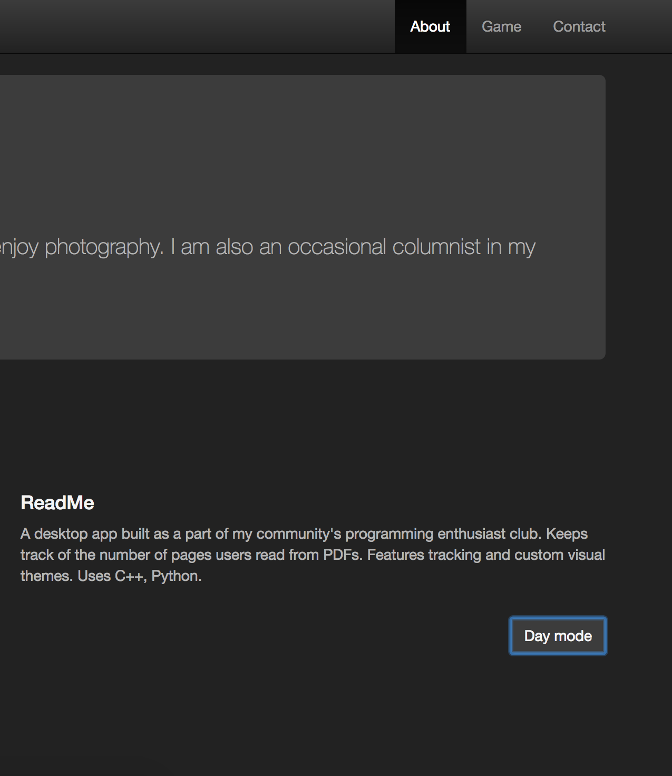
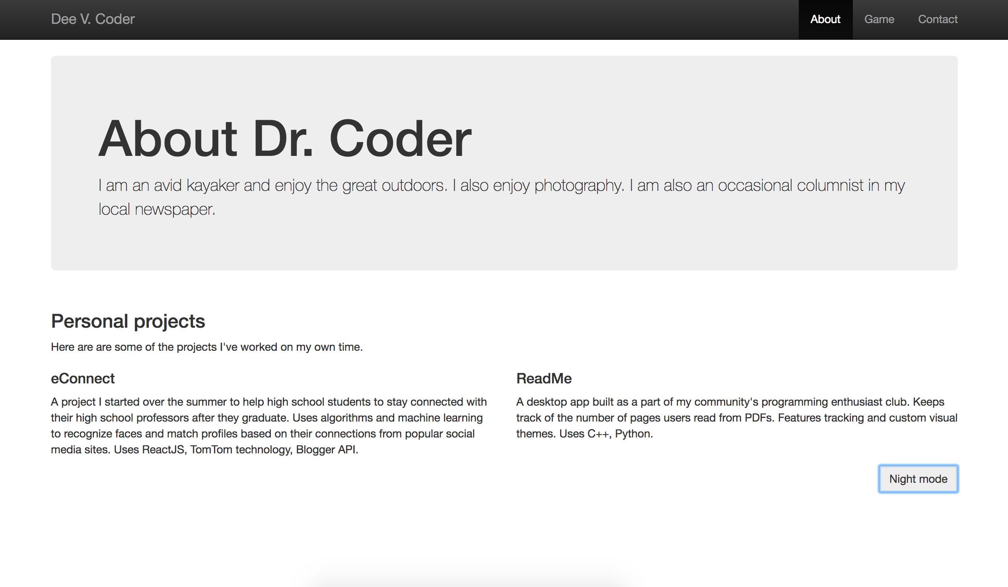
Night Mode script
Toggles night mode
Button inverts colors
Button text changes

Slide 7
Setup
Variables already given to you
nightModeOn Boolean to track if night mode on
dayColors A key-value pair of colors to use when night mode off
nightColors
headers, paragraphs Array of all headers and basic text elements
body, jumbotron Body element and array of all jumbotron elements
button Button element to click

Slide 8
Event listeners
We need to listen for events which trigger our program
Add “event listeners” which run code when something happens
Following already provided
When users “click” the button, call the toggle function
button.addEventListener("click", toggle);

Slide 9
Challenge: write the Night Mode script
Write code in toggle, nightMode and dayMode functions
In toggle, call nightMode or dayMode depending on the nightModeOn bool
In nightMode, change button text to “Day Mode” and change all colors to those in nightColors
In dayMode, change button text to “Night Mode” and change all colors to those in dayColors
Hint: Use a for loop to change paragraph and header colors

Slide 10
dvcoders
Week 10: Night Mode Script
Website Project
Nov 22

