Slide 1
An Investigation of Lesser-Known Programming Languages
David Colgan
Dr. Nurkkala advising
Taylor University

Slide 2
Programming is HARD

Slide 3
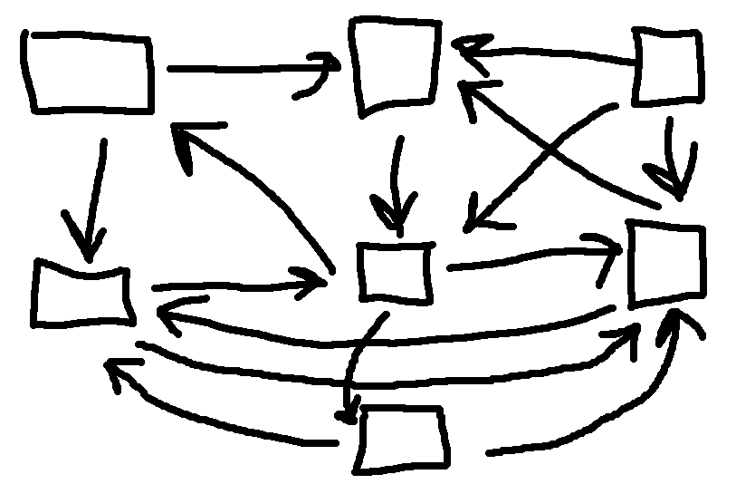
MM
Data
Q
RN
PO
Lamp
CDI

Slide 4
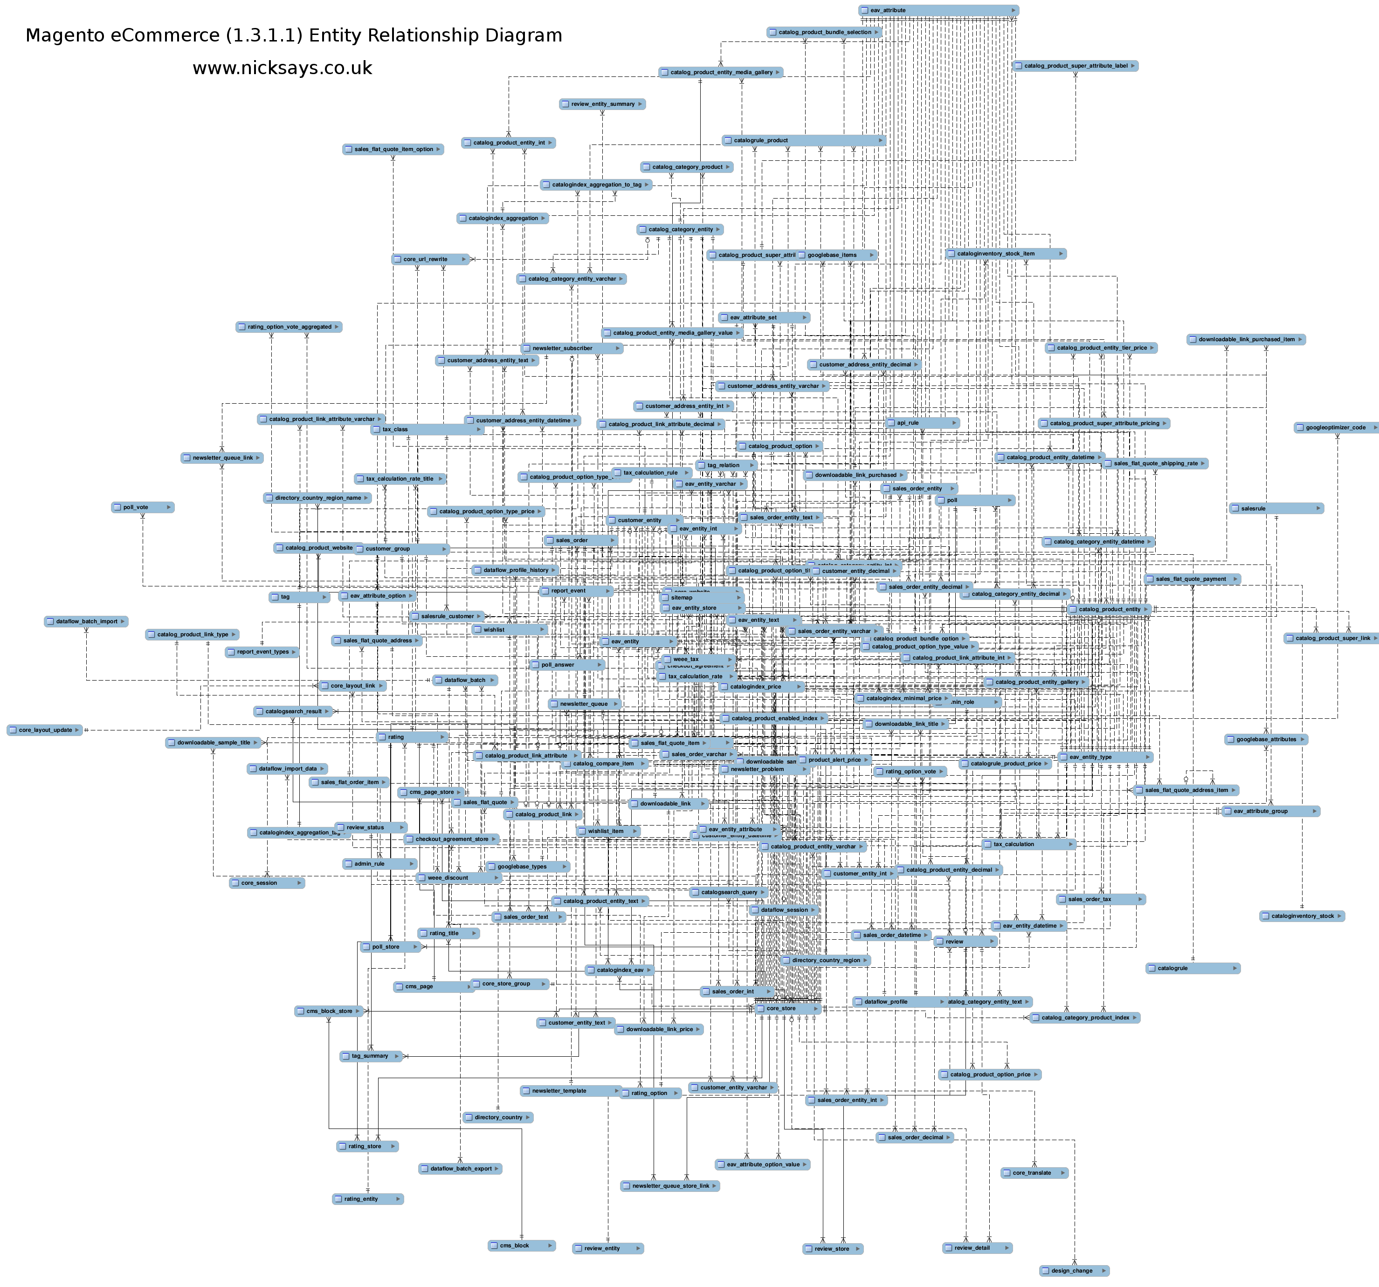

Slide 5


Slide 6
When Building A Huge Thing,

Slide 7
Why Not Use Power Tools?

Slide 8


Why Not Use Power Tools?
VS

Slide 9


Why Not Use Power Tools?
VS

Slide 10


Why Not Use Power Tools?
VS

Slide 11
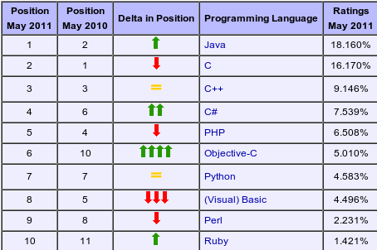
TIOBE Index

Slide 12
Assembly, C, C++, Java, PHP, Visual Basic, Python, Perl, Ruby, Lua, Common Lisp, Clojure, Scheme, Haskell, Erlang, Objective Caml, Factor, Actionscript, Javascript, Bash, Prolog, Smalltalk, J

Slide 13
What makes a language powerful?
Fewer bugs
Less to remember
Performance
Doing more in less code
Readable

Slide 14
Feature Comparisons

Slide 15
Program Comparisons

Slide 16
Meet the Languages:
C
Python
Clojure
Haskell
Factor

Slide 17
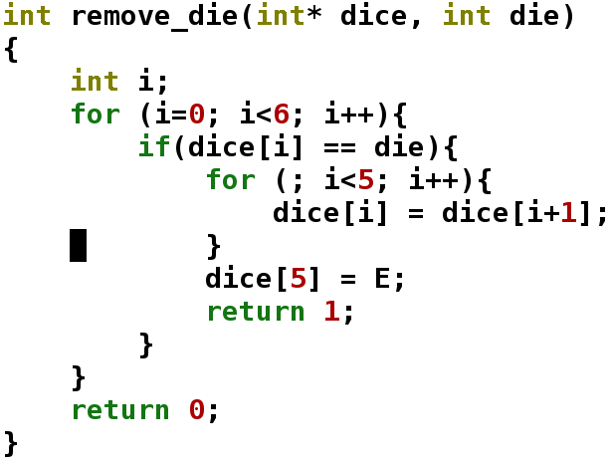
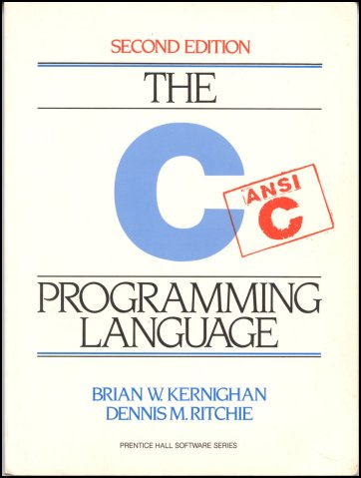
C – The Venerable Classic

Slide 18
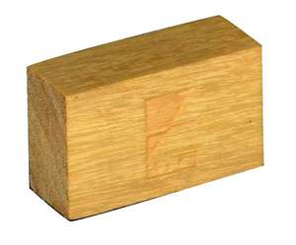

Slide 19

C is like

Slide 20

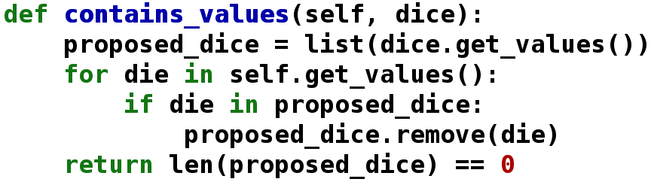
Python – A Fine Choice
"Python is a programming language that lets you work more quickly and integrate your systems more effectively.
You can learn to use Python and see almost immediate gains in productivity and lower maintenance costs."
-Python.org

Slide 21

Python is like

Slide 22
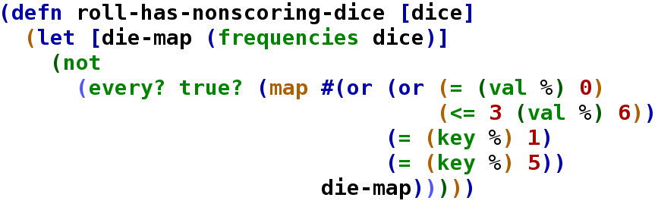

Clojure – The Next Big Thing?

Slide 23

Clojure is like

Slide 24

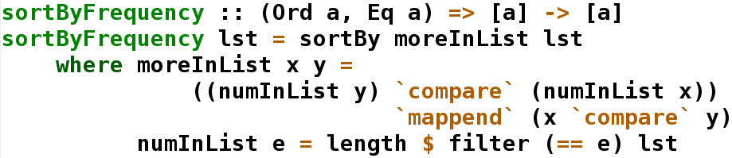
Haskell – The Zen of Programming?
"Haskell is an advanced purely-functional programming language. An open-source product of more than twenty years of cutting-edge research, it allows rapid development of robust, concise, correct software.
Haskell makes it easier to produce flexible, maintainable, high-quality software."
-Haskell.org

Slide 25
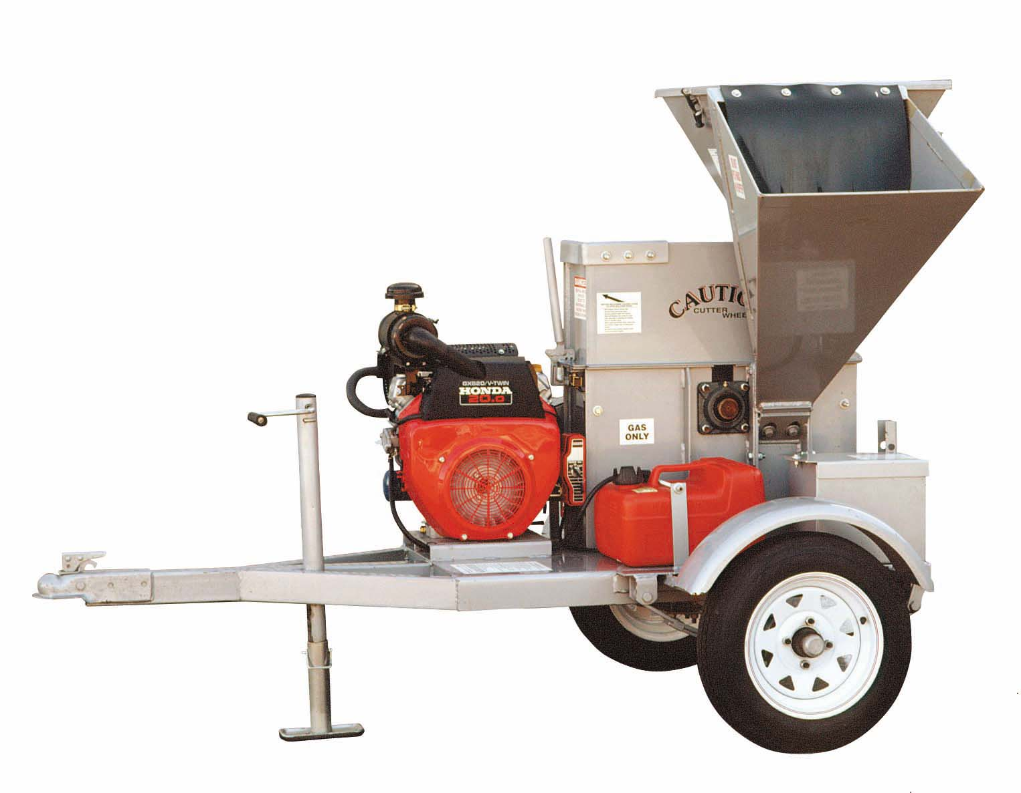
Haskell is like

Slide 26
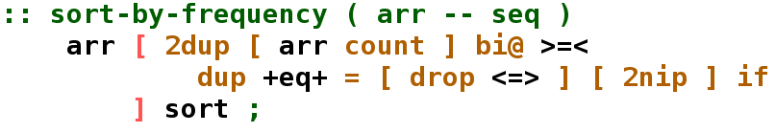

Factor – And now for something completely different

Slide 27

Factor is like

Slide 28
A Whirlwind Tour

Slide 29
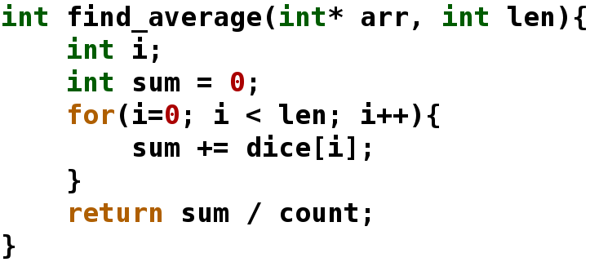
Imperative Average in C

Slide 30
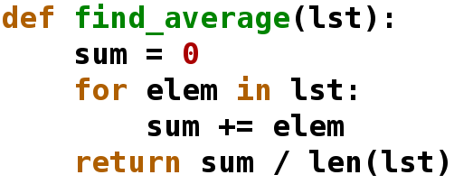
Higher Level Average in Python

Slide 31
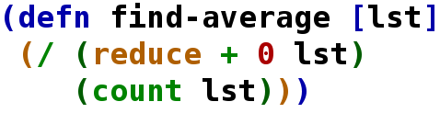
Functional Average in Clojure

Slide 32
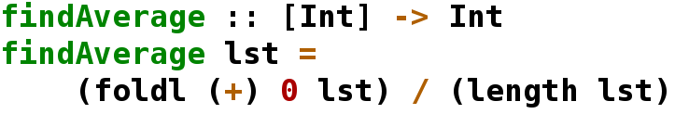
Purely Functional Average in Haskell

Slide 33

Concatenative Average in Factor

Slide 34
Comparisons with Farkle

Slide 35
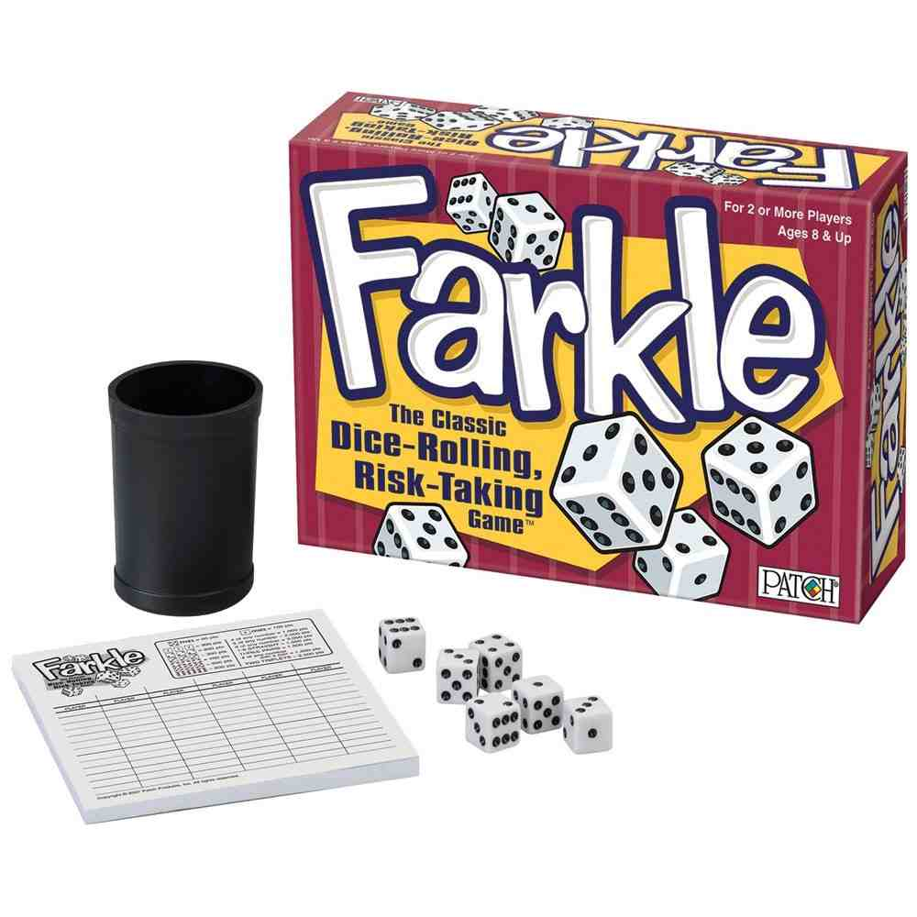
We need a program to write

Slide 36
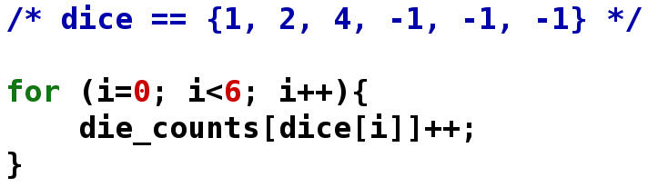
Fun with C:
Can you spot the bug?

Slide 37
Fun with Python:
Conciseness

Slide 38
Conciseness Equals
Fewer Points of Failure

Slide 39
For Loops on One Line!

Slide 40
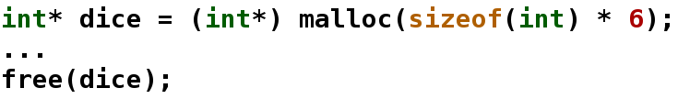

Memory Management
VS

Slide 41
Now For the Crazy Stuff

Slide 42
Clojure and Haskell's Crazy Idea
No Mutable Variables

Slide 43
Clojure and Haskell's Crazy Idea
No Mutable Variables?

Slide 44
Clojure and Haskell's Crazy Idea
No?
x+=4
i++

Slide 45


Slide 46
No for loops!
How will we ever do work?

Slide 47
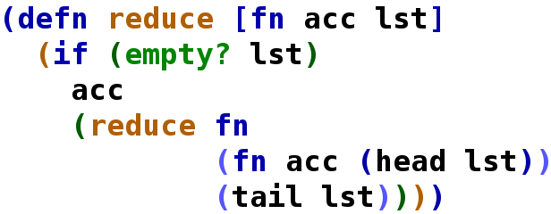
Recursion and
Higher Order Functions

Slide 48
Higher Order Functions?
(map fn list)
(reduce fn init list)
(filter pred list)
(sum lst)
(every? pred list)
(all? pred list)

Slide 49
Higher Order Example

Slide 50
Why Immutability?
Fewer bugs!
Shorter code!
Reduce duplication!
Referential transparency!
Faster performance!
(Almost) free parallelization!

Slide 51
Fun with Haskell:
Strict Type Safety
Clojure was mostly functional
Haskell is purely functional

Slide 52

Type System

Slide 53
What is a Monad?
A strategy for combining computations into more complex computations.

Slide 54
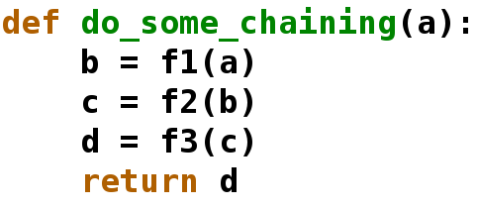
Monads!

Slide 55
Monads!

Slide 56
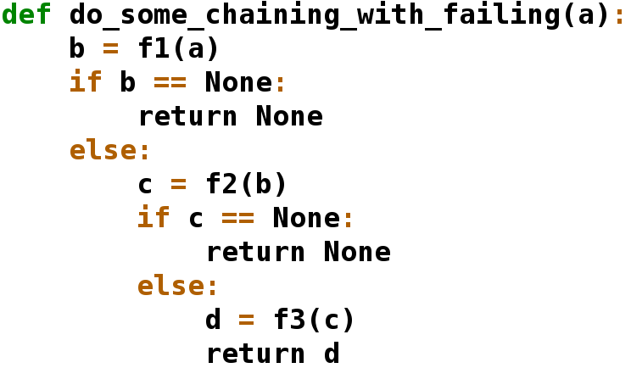
Monads 2

Slide 57
Monads 2

Slide 58
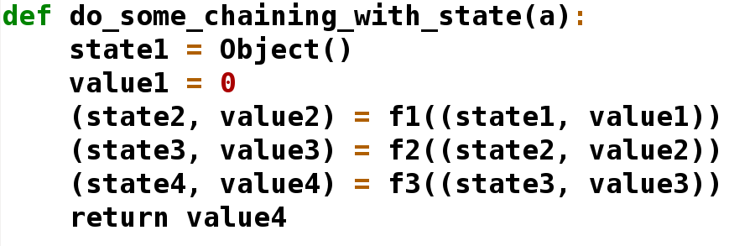
Monads 3

Slide 59
Monads 3

Slide 60
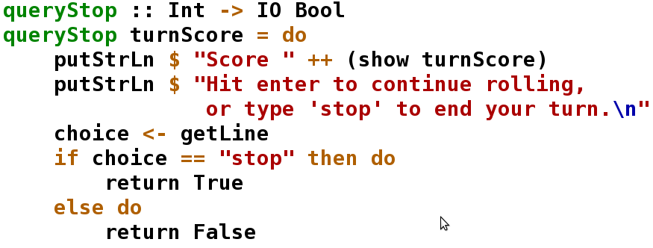
IO Monad

Slide 61
Fun with Factor:
Eliminate ALL Redundancy
I wish that was true, my program probably could have been better.
There is no extra syntax for calling functions, no variable declarations

Slide 62
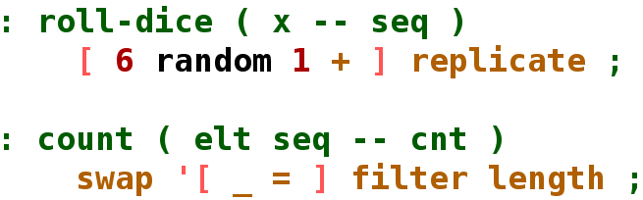
Very Short Words

Slide 63

The Languages Look Different!
Lisp has all the visual appeal of oatmeal with fingernail clippings mixed in.

Slide 64
The Languages Look Different!
Gives Lisp and Factor their regularity and macro abilities
Factor's postfix notation allows implicit parameters off the stack.

Slide 65
Program Analyses For:
Total Lines of Code
Total Tokens
Average Tokens
Per Line
Execution Time

Slide 66
Total Lines of Code

Slide 67
Total Tokens

Slide 68
Average Tokens Per Line

Slide 69
A Conclusion:
Please don't use C

Slide 70
Unless you have to have high performance.

Slide 71
Speed Tests

Slide 72
Fast enough is usually fast enough.

Slide 73
A Conclusion:
Learning new paradigms is hard

Slide 74
Programmer Reaction
C Python Clojure Haskell Factor

Slide 75

Programmer Reaction
C Python Clojure Haskell Factor

Slide 76

Programmer Reaction
C Python Clojure Haskell Factor

Slide 77

Programmer Reaction
C Python Clojure Haskell Factor

Slide 78

Programmer Reaction
C Python Clojure Haskell Factor

Slide 79

Programmer Reaction
C Python Clojure Haskell Factor

Slide 80
A Conclusion:
Further investigation is needed

Slide 81
Future Work
Measure speed of programming
Write more idiomatic code
Larger sample size
More languages!

Slide 82

So the next time you start a software project:
Use the best tool for the job!

Slide 83
So the next time you start a software project:
Use the most powerful language in the paradigms you know.

Slide 84
Unless you have lots of time
Then learn Clojure

Slide 85
Unless you have even more time
Then learn more about Haskell and Factor and let me know what you find.

Slide 86


Slide 87
Thanks to:
Dr. Nurkkala for being an excellent advisor and proofreader of my papers
My parents for birthing me
YOU, for coming

