Slide 1
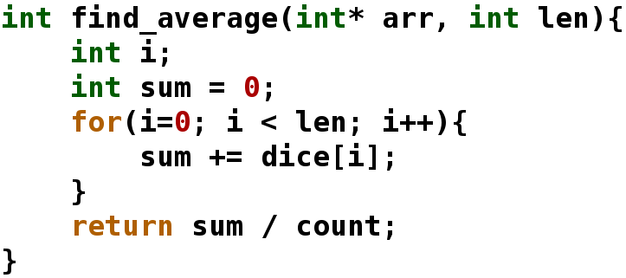
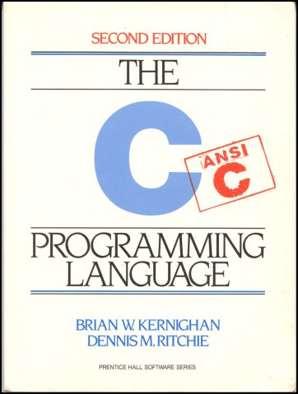
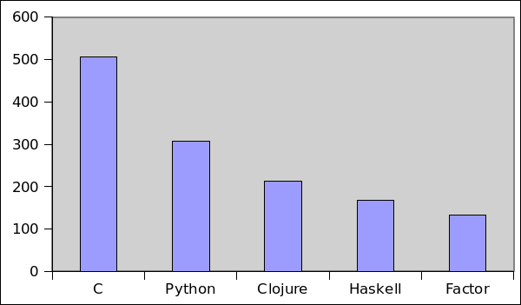
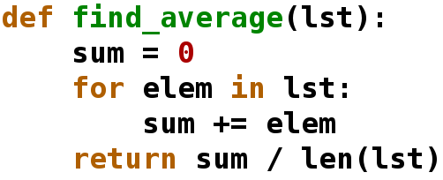

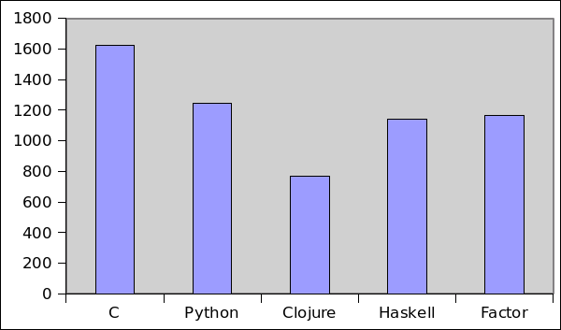
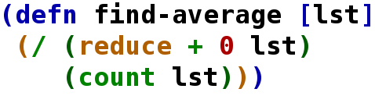

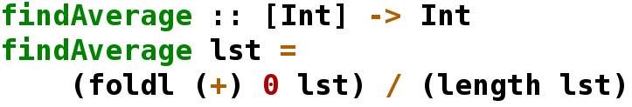

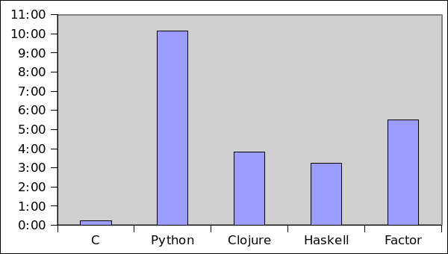

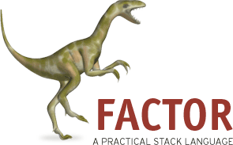
An Investigation of Lesser-Known Programming Languages
David Colgan
May 2011
Introduction
Most computer science majors and software developers have used Java and C. These two languages have consistently been among the most popular for general use. They are both established, well understood, and use the object-oriented or imperative paradigm.
Most of the other top languages are similar to Java and C. Languages like C#, PHP, Python, Perl, and Objective-C all use some combination of the procedural and object-oriented paradigms. But are procedural and object oriented languages the best computer science has to offer for creating reliable, high performing software on a budget?
A number of lesser-known languages, many influenced by the functional paradigm, claim increased programmer productivity, fewer bugs, and shorter programs.
A Survey of the Languages
As a demonstration of the syntax of the five languages, I wrote a simple function in each to find the average of a list of integers.
Program Comparisons
After writing the Farkle game in each of the five languages, I compared the programs by generating descriptive statistics on the source files and by running performance benchmarks. The functional languages have shorter programs but at the cost of performance. In many programs, trading execution speed for programmer speed is a worthwhile tradeoff.
Conclusions
This survey supports the theory that functional languages such as Clojure, Haskell, and Factor offer compelling reasons for using them over imperative and object-oriented languages like C and Python. Functional languages have many powerful constructs to reduce code size and prevent bugs, including lack of mutable state, laziness, macros, strong type systems, and more.
The program comparisons demonstrate that functional languages can reduce code size, sometimes in dramatic fashion. The Clojure code is half the size of the C code, and less code means fewer places for bugs to hide. The tradeoff is in performance, seeing that C performs several orders of magnitude faster than all the other languages.
I have found that learning new languages in paradigms I already know is easy. Learning new languages in paradigms I do not know is hard. Therefore when starting a new programming project, I recommend choosing the most powerful language available in a paradigm you know. If you only know imperative languages, use Python over C.
If you want to learn a new language, I recommend Clojure. Of the languages I surveyed, it has the highest gain in
expressive power for the least amount of new concepts to learn. I was very impressed by Clojure's low total token count. It is concise, but not so concise that it is unreadable (like Factor). It also is not so idealistic that it is hard to use (like Haskell).
C
The C code contains type declarations, named parameters, an explicit for loop, curly braces to delimit blocks, and manual array management.
Total Lines of Code
Python
The Python code is cleaner than the C version thanks to a lack of explicit types and whitespace for indentation. Its for/in loop abstracts looping over the elements of a list.
Research Goals
This project investigates languages that have the potential to be compelling alternatives to the common procedural and object-oriented languages used most often in today's commercial environments. I want to know if they live up to the hype generated by their communities.
In the two semesters of this project I investigated three lesser-known languages and two common languages as a comparison. The two common languages are C and Python, and the three lesser-known languages are Clojure, Haskell,
and Factor.
Figure 1. Counts exclude blank lines and comments.
Total Tokens
Clojure
The Clojure code eliminates the loop altogether by using the higher-order function reduce, an abstraction of loops that calculate a single value.
Future Work
If given more time, I would have liked to write the Farkle system in Java, Erlang, and J. Other interesting languages include Scala, F#, OCaml, Lua, and Groovy. The more languages in the comparison, the more useful and informative it will be.
One of the greatest flaws of my project is the fact that at I was the only one writing programs for comparison. As such, my sample size is one. I would love to enlist the skills of prominent community members in each of these languages and ask them to write the Farkle program. Because I was just learning some of these languages, my implementation may be much slower and longer than what a master would produce. I know that I did not make use of all the advanced features of every language.
Haskell
The Haskell code also uses higher-order functions but also adds explicit type checking for added safety.
Figure 2. A token is any whitespace-separated string of characters.
Methods
After studying them to be able to produce as idiomatic code as possible, I wrote a simulator of the dice game Farkle in each language. I also compared the languages feature-by-feature.
I first implemented the Farkle system in Python, the language I know best, to serve as a basis for comparison. I then rewrote the system in Clojure. Clojure is a language I have not had experience with, although I have used other Lisp dialects. Next, I wrote the system in Haskell, a purely functional language. I then took a respite and wrote the system in C, another language I know well, to give another standard of comparison. I finished out with an implementation in Factor, a relatively unknown stack-based language.
Having completed the system in all five of these languages, I ran performance tests by timing how long each language takes to have four simplistic AI players compete in 10,000 games.
Execution Time for 10,000 4-Player Farkle Games
Factor
The Factor code is written in the stack-based paradigm, eliminating the need for explicit function parameters by manipulating a global data stack. The Factor code has the fewest lines but is also the least readable.
Acknowledgments
I thank the amazing computer scientists who invented these languages, Dr. Nurkkala for advising me and doing a thorough job of paper proofreading, and my parents for birthing and raising me. Without any of these people, this project would not have been possible.
Figure 3. Benchmarked on a 1.66 Ghz netbook with 2 GB of RAM running Ubuntu 10.10.
Notes:
This poster template is from http://www.swarthmore.edu/NatSci/cpurrin1/posteradvice.htm. It is free, free, free for non-commercial use. But if you really like it, I’m always thrilled to get postcards from wherever you happen to be presenting your poster. Have fun. Sincerely, Colin Purrington, Department of Biology, Swarthmore College, Swarthmore, PA 19081, USA. Email: cpurrin1@swarthmore.edu

